Slide 1
E-Commerce Order Tracking and Management System
By
L.Aswini-192124096
A.Jashwini-192124192

Slide 2
Introduction
An E-Commerce Order Tracking and Management System enables businesses to track, manage, and process orders seamlessly from purchase to delivery. It provides real-time updates on order status, inventory levels, shipping details, and customer interactions..

Slide 3
Definition of E-Commerce Order Tracking
E-Commerce Order Tracking is the process of monitoring and managing the status of customer orders from placement to final delivery. It involves real-time tracking of order progress, including order confirmation, payment processing, packaging, dispatch, shipping, and delivery updates.
This system provides transparency to both businesses and customers by offering real-time notifications and estimated delivery timelines.

Slide 4
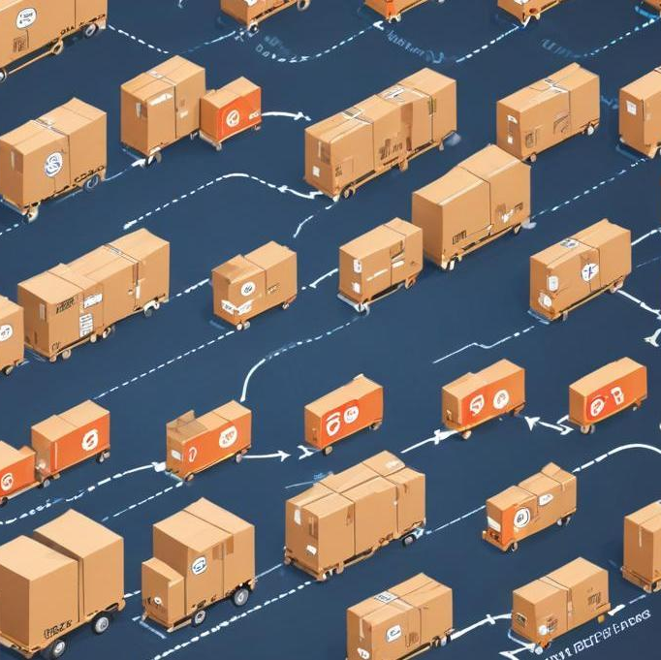
Importance of Order Management
Enhances Customer Satisfaction – Ensures accurate order fulfillment, real-time tracking, and timely deliveries.
Improves Inventory Control – Helps maintain stock levels, prevents overselling, and automates restocking alerts.
Streamlines Order Processing – Reduces manual errors, automates order confirmation, invoicing, and shipping.

Slide 5
Key Features of Order Tracking Systems
Provides live updates on order status from placement to delivery.
Sends alerts via SMS, email, or app notifications for order status changes.
Allows customers to track their orders with real-time location updates.
Supports orders from multiple platforms like websites, apps, and marketplaces

Slide 6
Technologies Used
A DBMS is essential for managing and storing order-related data efficiently.
A Data Warehouse is a centralized repository that consolidates data from multiple sources for analysis and reporting.
BI tools analyze stored data to generate reports, dashboards, and performance insights, enabling businesses to make data-driven decisions.

Slide 7
Challenges in E-Commerce Order Management
Difficulty in tracking stock levels, leading to overstocking or stockouts.
Manual errors or system failures can slow down order fulfillment.
Delays from suppliers, logistics issues, or unforeseen circumstances affect deliveries.

Slide 8
Hardware Requirements
Powerful processors (Intel Xeon/i7 or higher) with SSD storage for fast data retrieval.
High-speed internet, routers, and firewalls for secure and seamless data transmission.
Software requirements
MySQL, PostgreSQL, MongoDB, or Oracle for managing order data.
Power BI, Tableau, or Google Data Studio for analytics and reporting.

Slide 9
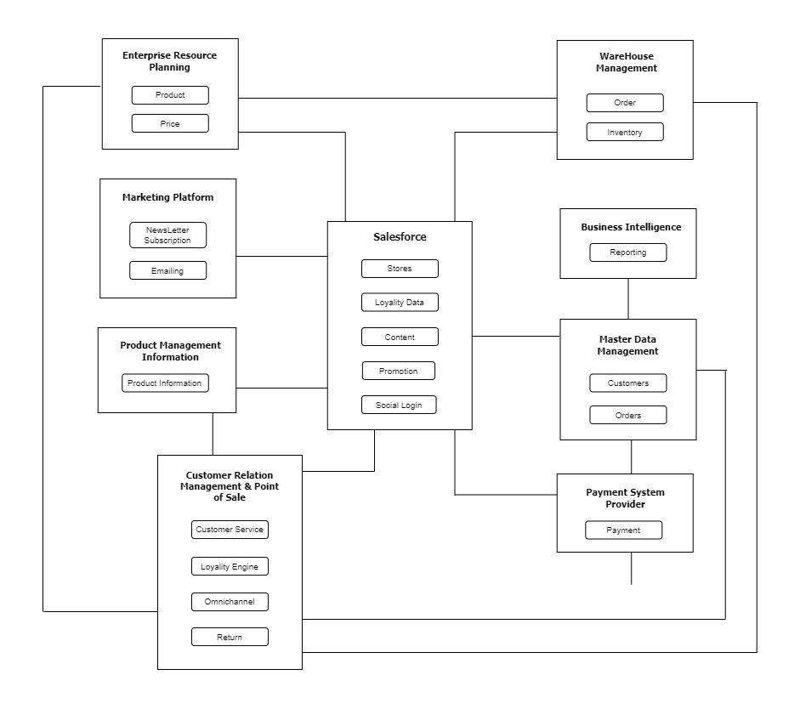
Architecture diagram

Slide 10
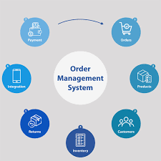
Implemention of E-Commerce Order Management System
Real-Time Inventory Management – Synchronizes stock levels across warehouses and sales platforms to prevent overselling.
Automated Order Routing – Directs orders to the nearest warehouse or fulfillment center for faster delivery.
Integration with Logistics & Shipping – Connects with third-party courier services (FedEx, UPS, DHL) for seamless shipping.

Slide 11
Outcomes of E-Commerce Order Management System
Reduces manual errors and ensures precise order processing.
Automates workflows, reducing processing time and delivery delays.
Uses encryption and verification processes to protect transactions.
Supports increasing order volumes without performance issues.

Slide 12

Future Trends in E-Commerce Order Management
AI-powered chatbots, predictive analytics, and smart order processing for improved efficiency.
Enhances transparency, security, and fraud prevention in order management.
Faster fulfillment using drones, autonomous vehicles, and local micro-warehouses.

Slide 13
Conclusion
An E-Commerce Order Tracking and Management System is essential for modern businesses to streamline operations, enhance customer satisfaction, and improve efficiency. By integrating advanced technologies such as AI, cloud computing, and automation, businesses can ensure real-time tracking, seamless order fulfillment.

Slide 14
THANK YOU

