Slide 1
Exploring Movie & TV Metadata with Excel, SQL, Python & Power BI
A data-driven exploration of entertainment trends
Jasika Nawreen Samantha

Slide 2
Project Objective
Analyze IMDb movie data to uncover trends, top performers, and patterns in genres, ratings, revenue, and director influence.
Tools Behind the Insights:
Excel | Excel provided a fast and intuitive way to clean and explore the structure of the dataset.
SQL | SQL enabled efficient querying, restructuring, and summarizing the large metadata for analysis.
Python | Python allowed for in-depth exploration, pattern recognition, and custom visuals beyond Excel or SQL.
Power BI | Power BI brought the analysis to life with dynamic visuals and an interactive narrative.
Source: Kaggle | Entertainment | Internship
Key columns:
movie | genre | runtime | certificate | rating | votes | director

Slide 3

What Was Our Goal?
Analyze metadata from IMDB-listed movies and shows.
Discover patterns in genres, rating and directors.
Visualize audience response and industry trends
Build an insightful dashboard for storytelling and decision making

Slide 4
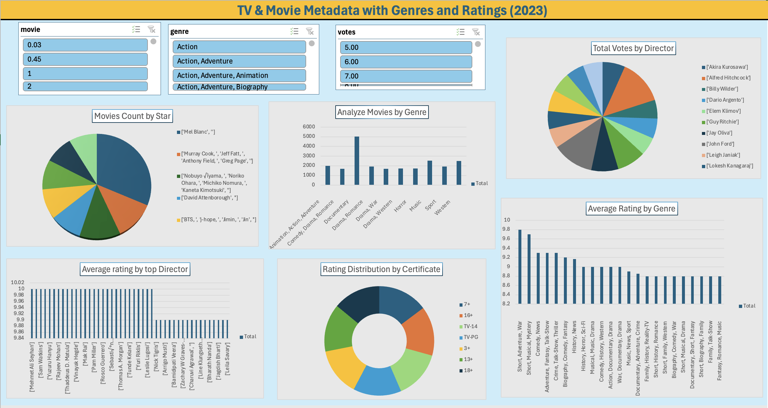
Visual Insights with Excel

Slide 5
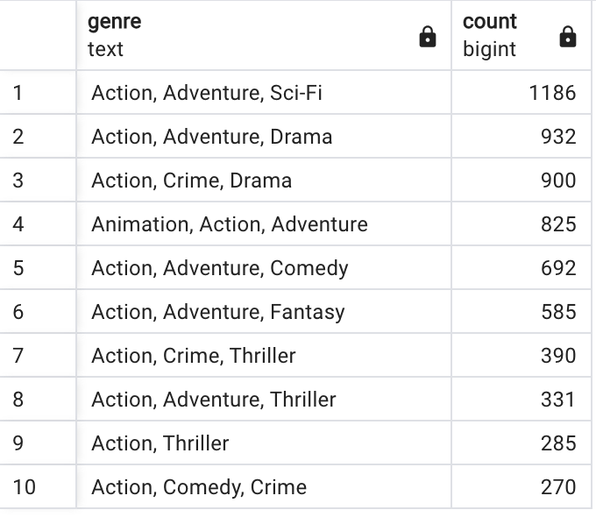
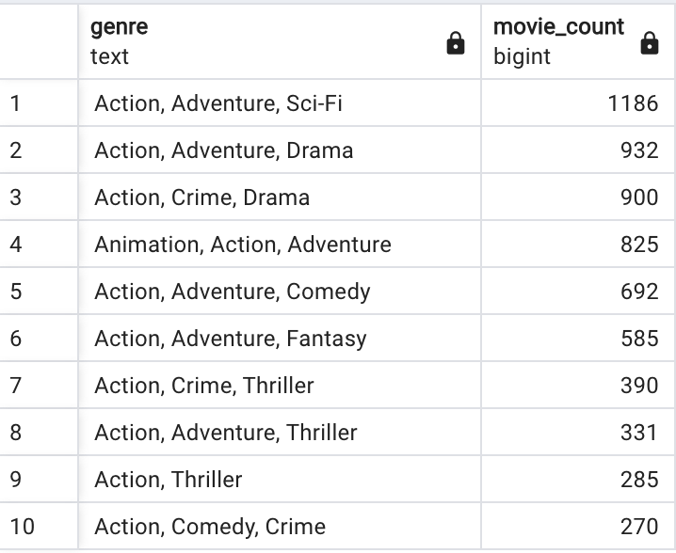
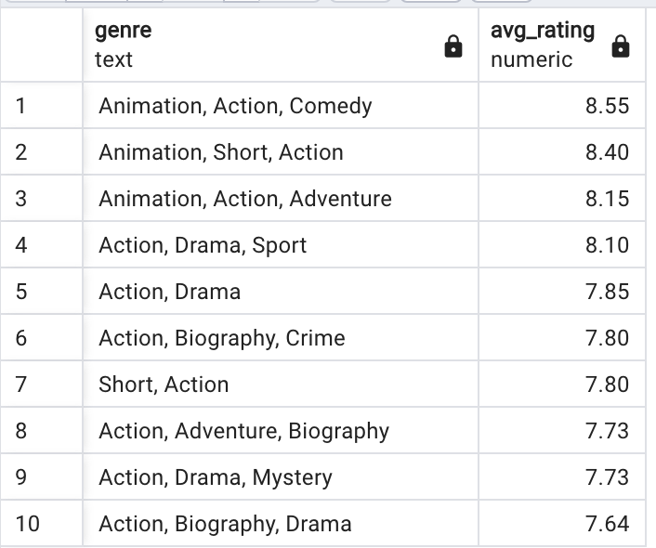
Structured Insights with SQL
Genre Distribution
Most Common Movie Genres
Average Rating by Genre

Slide 6
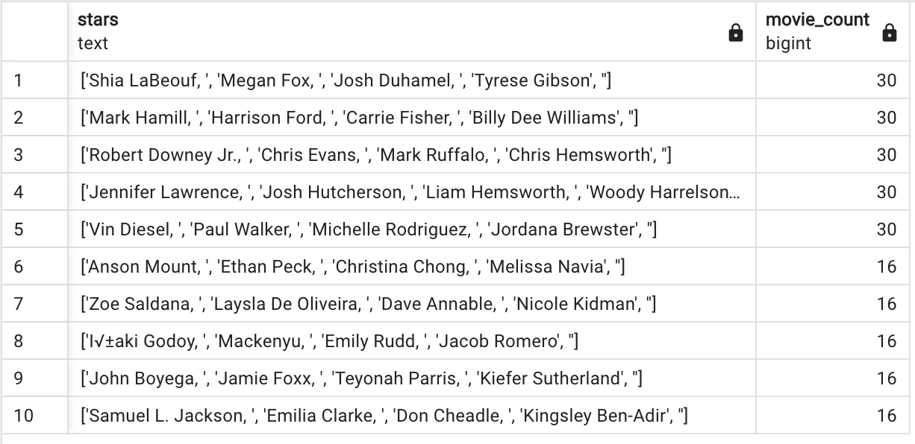
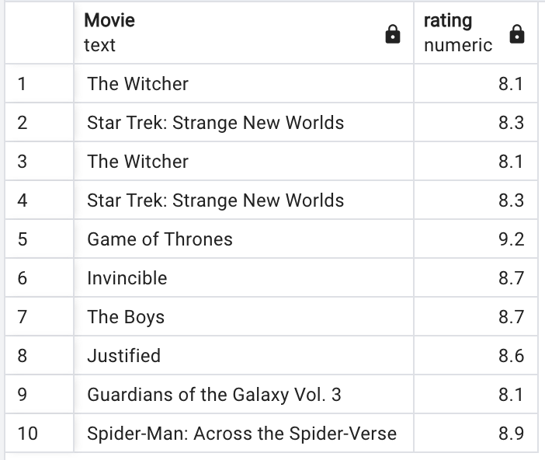
Power Players of the Screen
Star-wise Movie Count
Top rated movies

Slide 7
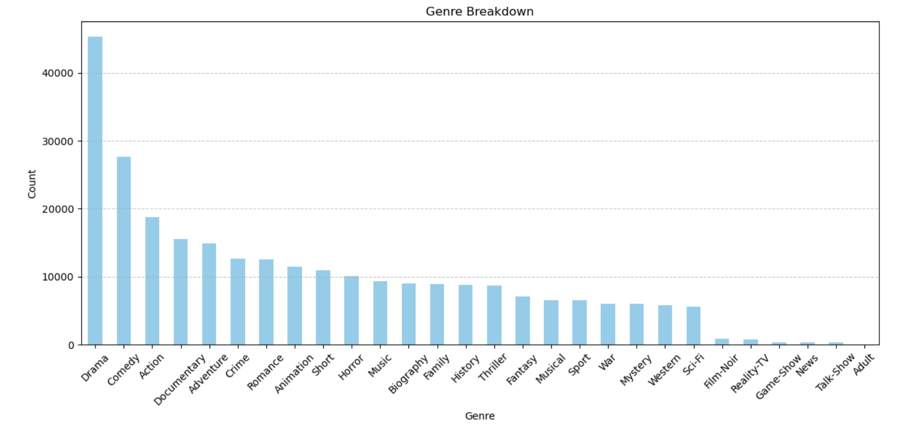
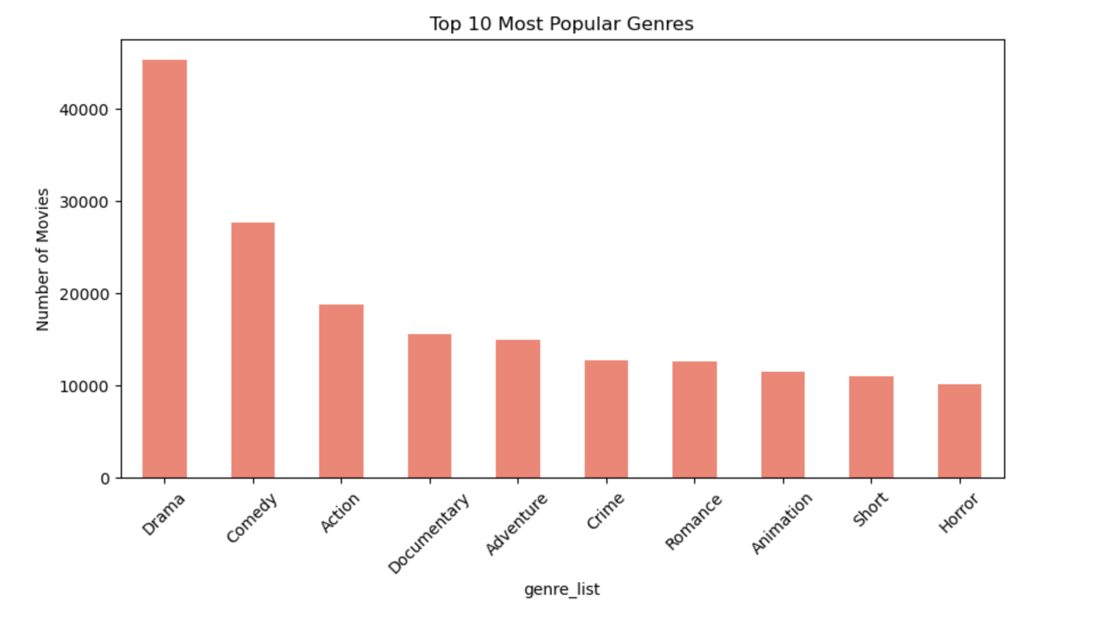
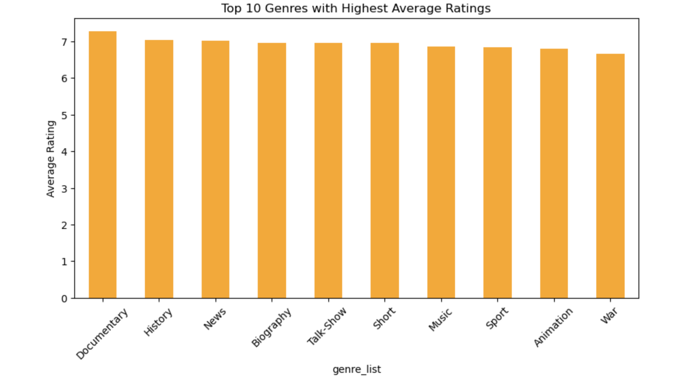
Digging Deeper with Python
Genre Breakdown
Top 10 Most Popular Genres
Average Rating by Genre

Slide 8
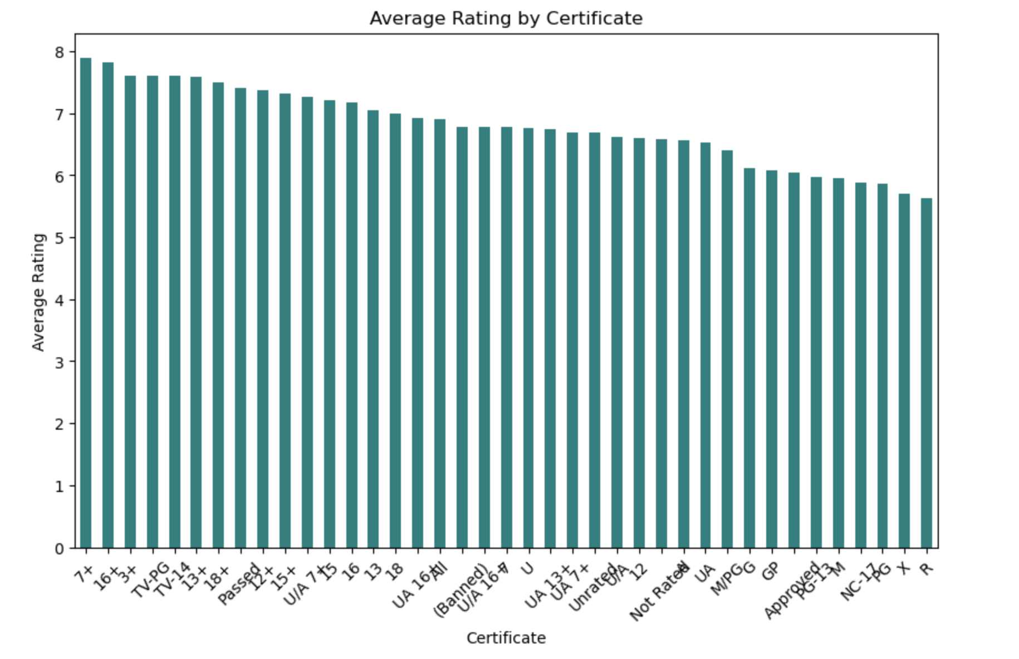
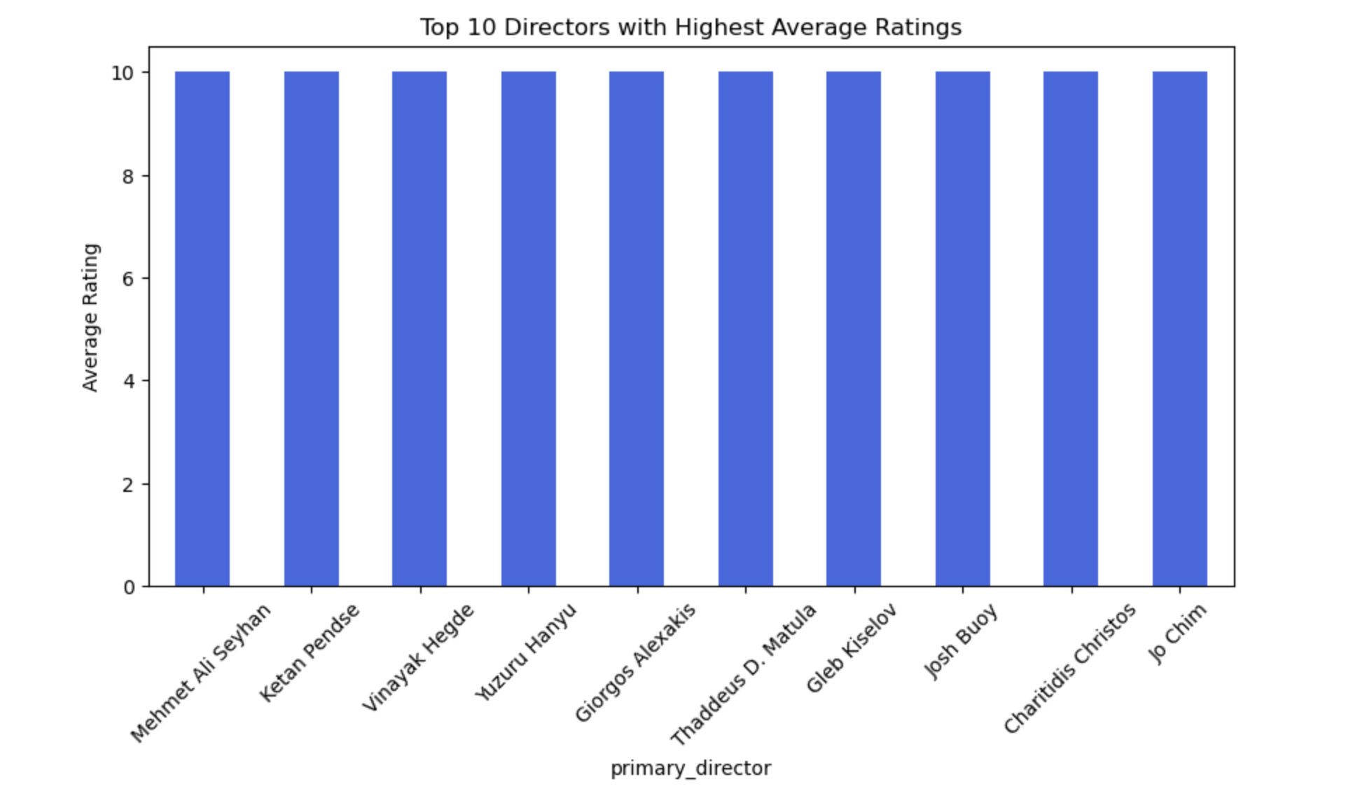
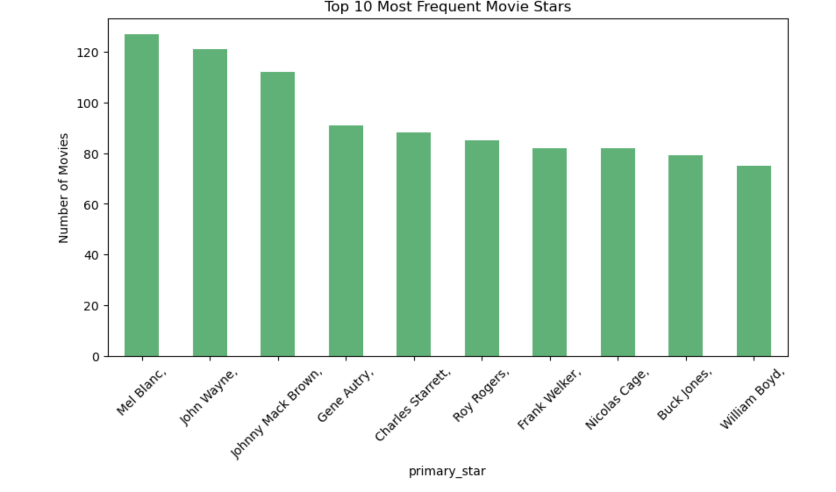
Patterns in Ratings, Directors & Star Power
Movies by Certification and Average Rating
Trend of Popular Directors by Ratings
Which Stars Appear Most Often?

Slide 9

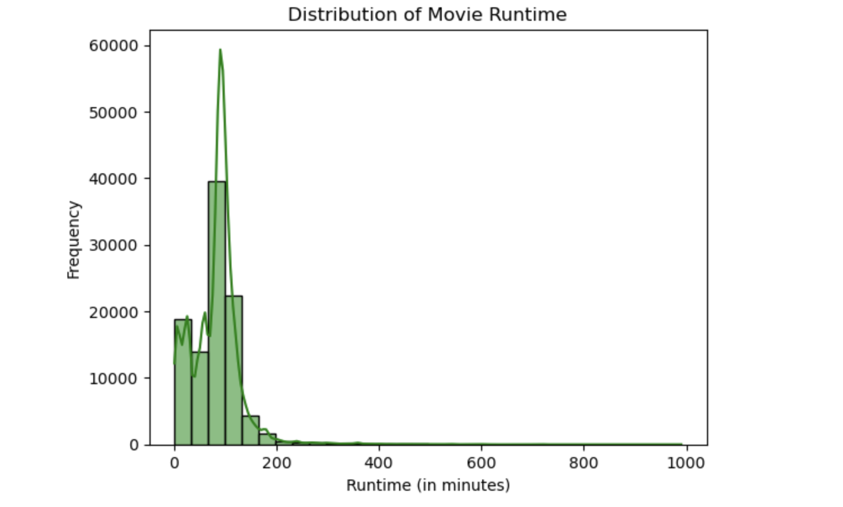
Movies with High Runtime
Many movies are around 90 to 120 minutes long, which means most movies are made to fit this time range.

Slide 10
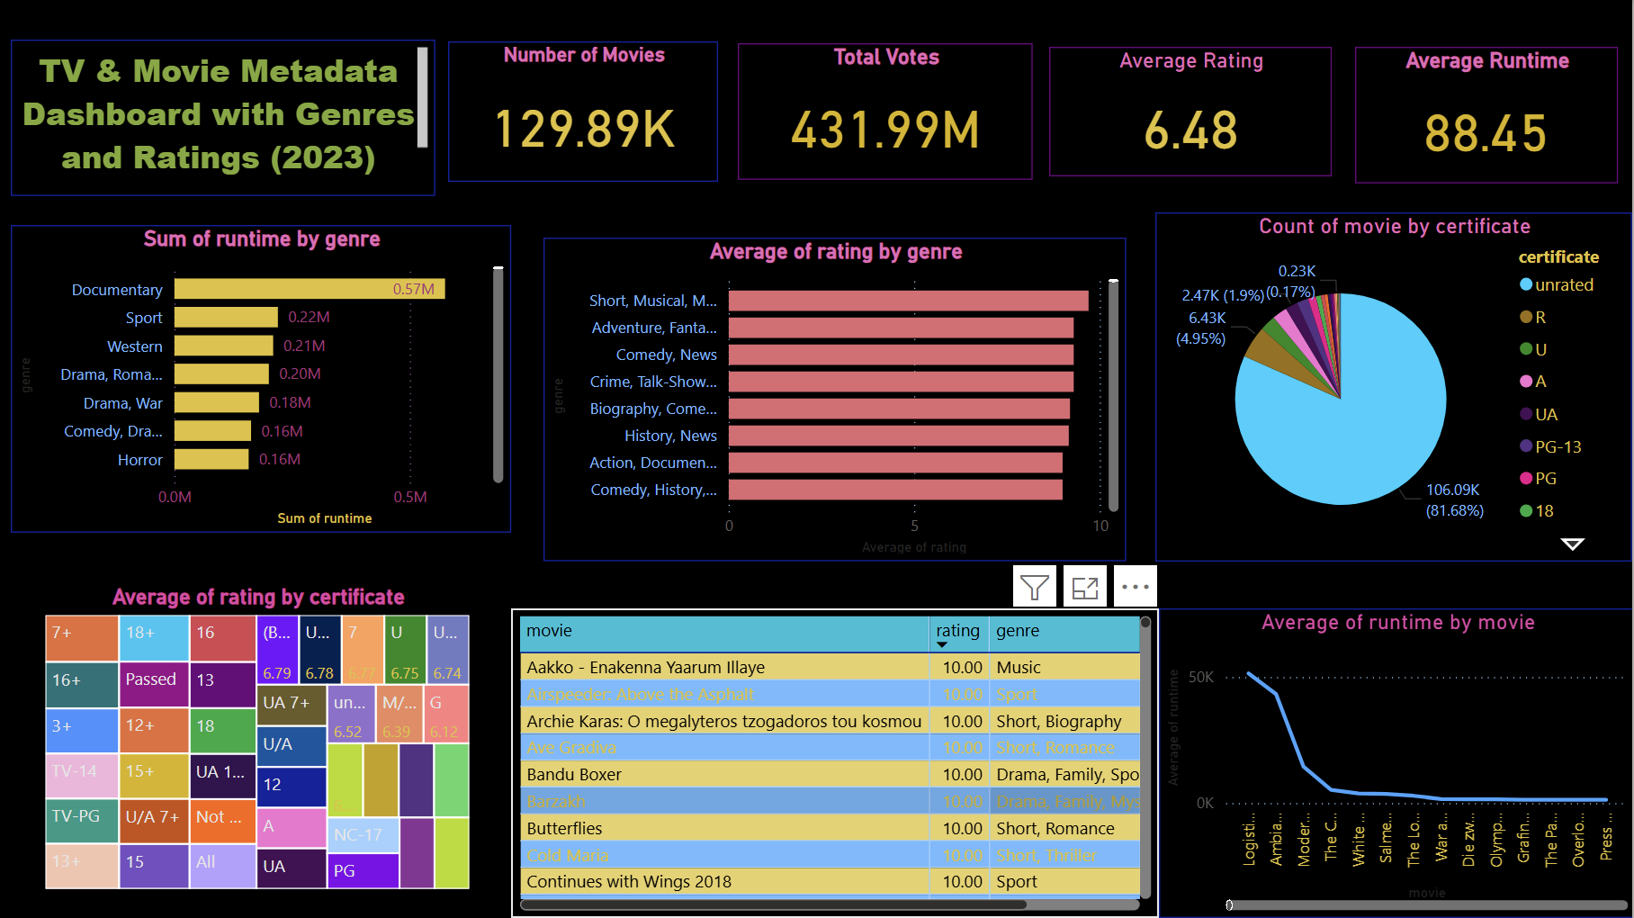
Built an interactive dashboard to present all key insights visually.

Slide 11

Conclusion
Metadata analysis reveals viewer preferences, genre dominance and director impact.
Valuable for producers, platforms and marketing teams for better content strategy.
This stack (Excel →SQL → Python → Power BI) delivers both technical depth and visual clarity.

Slide 12

A picture is worth a thousand words

Slide 13
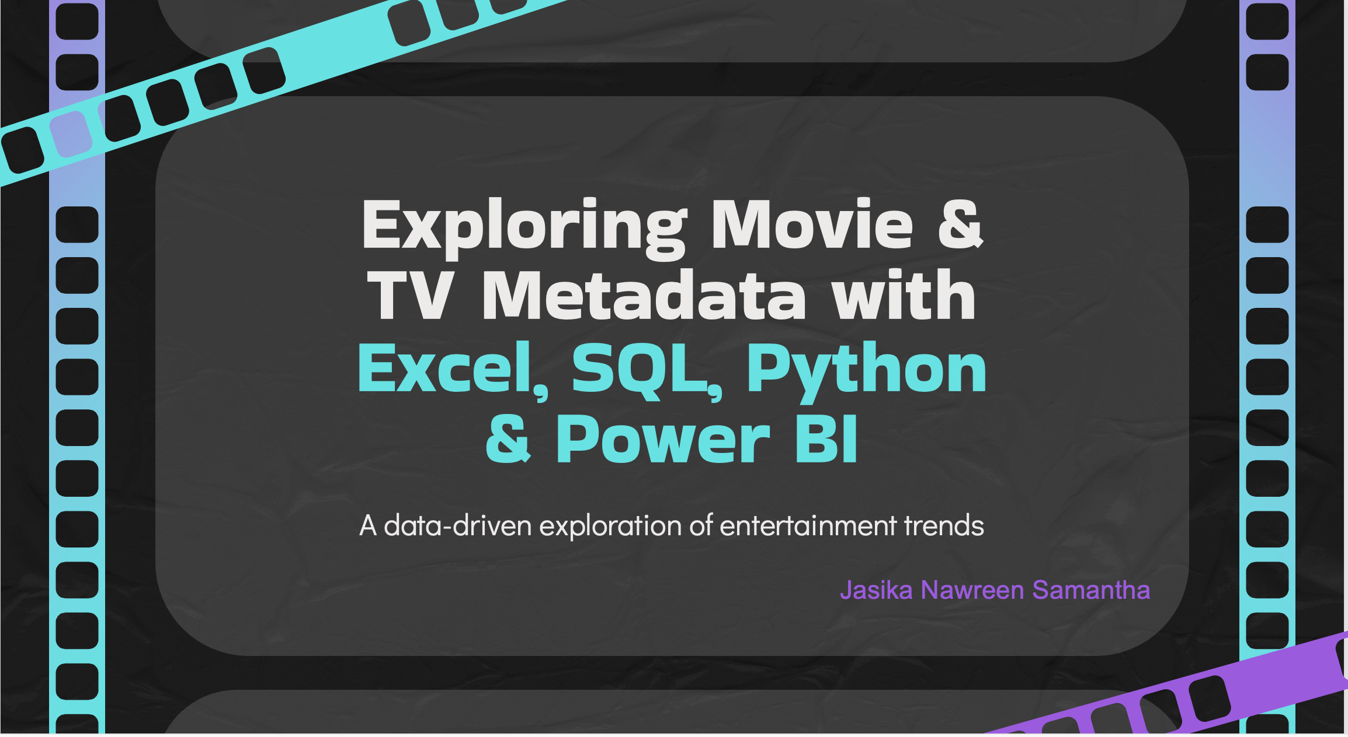
Thank You

