Slide 1
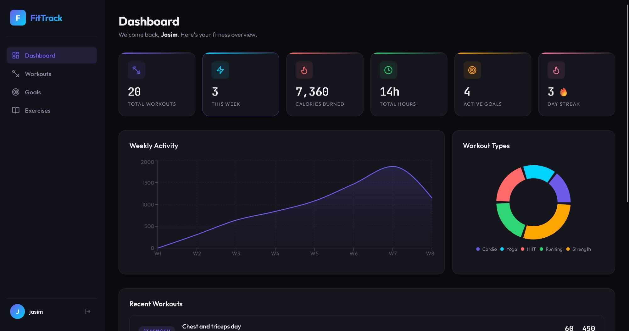
FitTrack
Applying DevOps Practices to a
Full-Stack Fitness Application
Presented by Jasim
DevOps Practices Module | March 2026
React 18
Flask API
PostgreSQL
Docker
GitHub Actions
Railway + Vercel
fittrack-delta-brown.vercel.app | github.com/Jasim2032/fittrack-

Slide 2
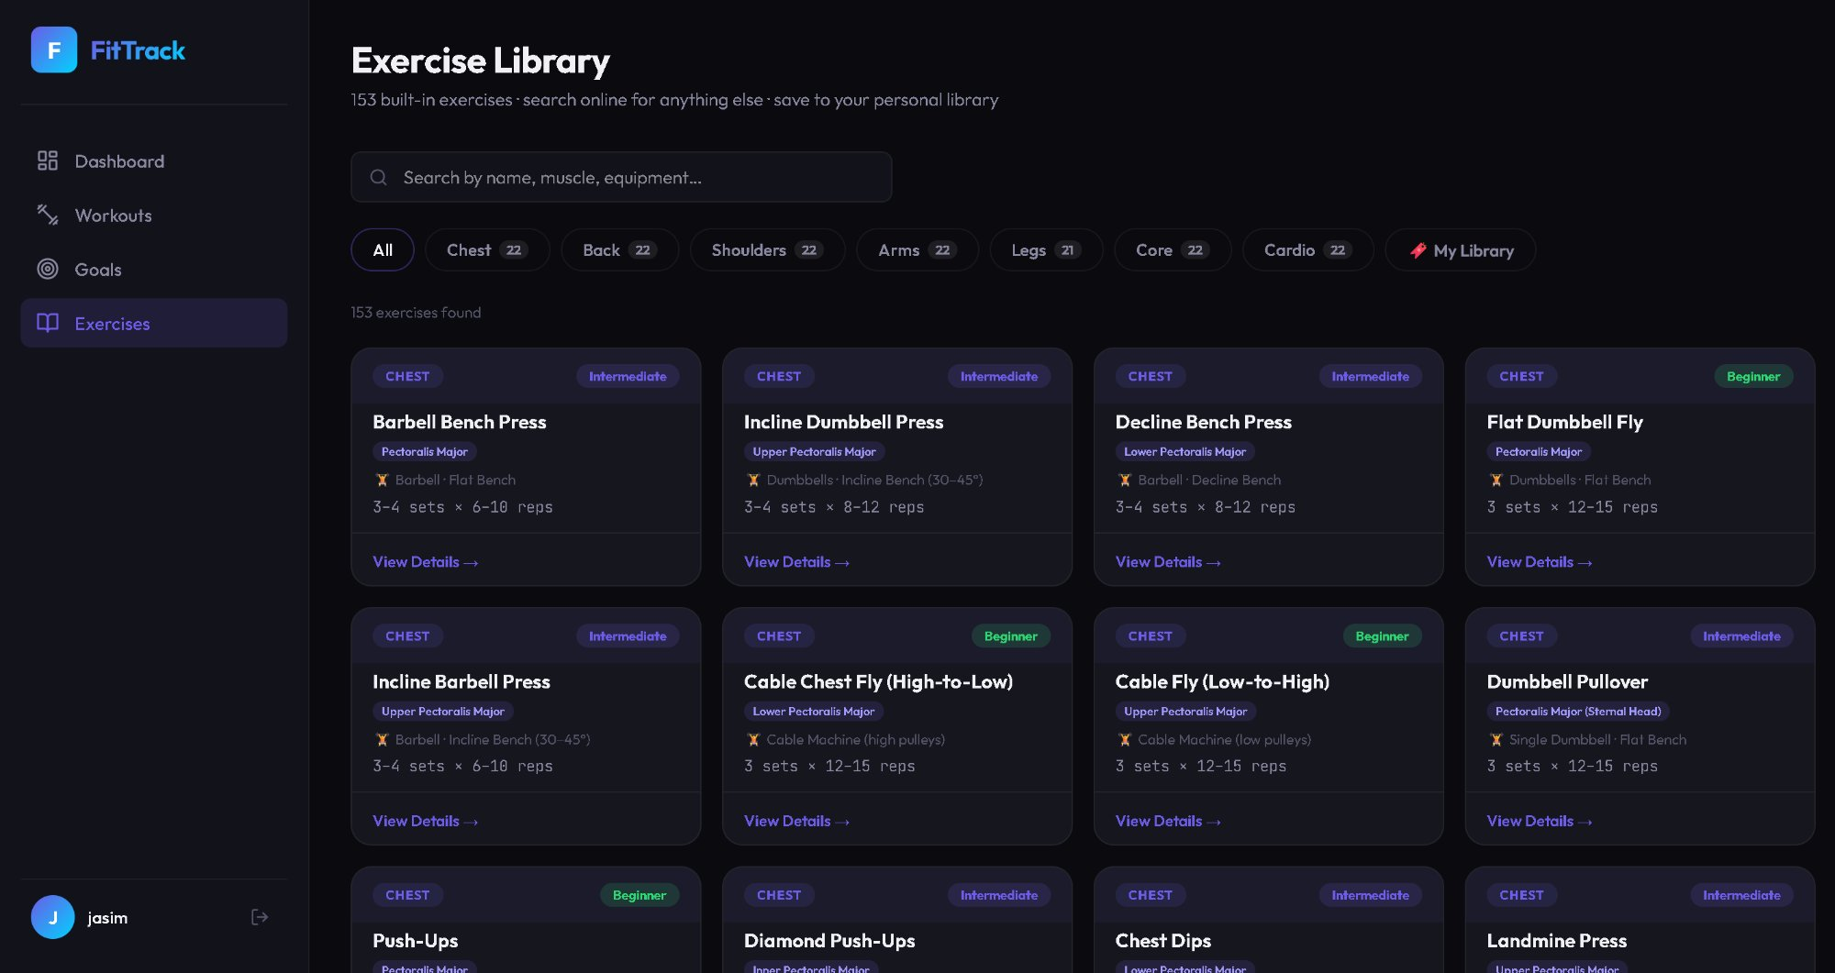
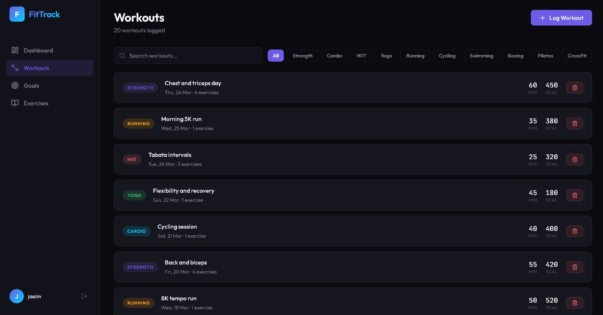
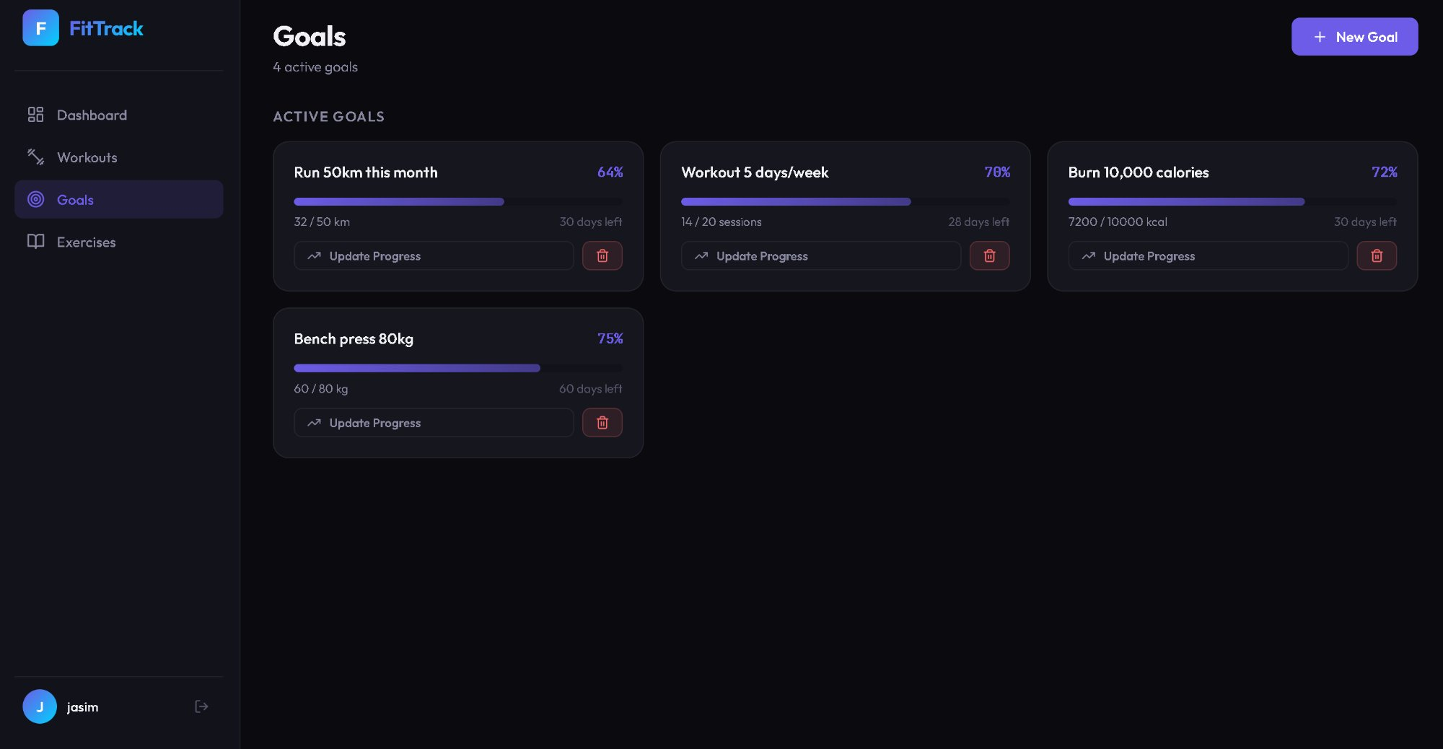
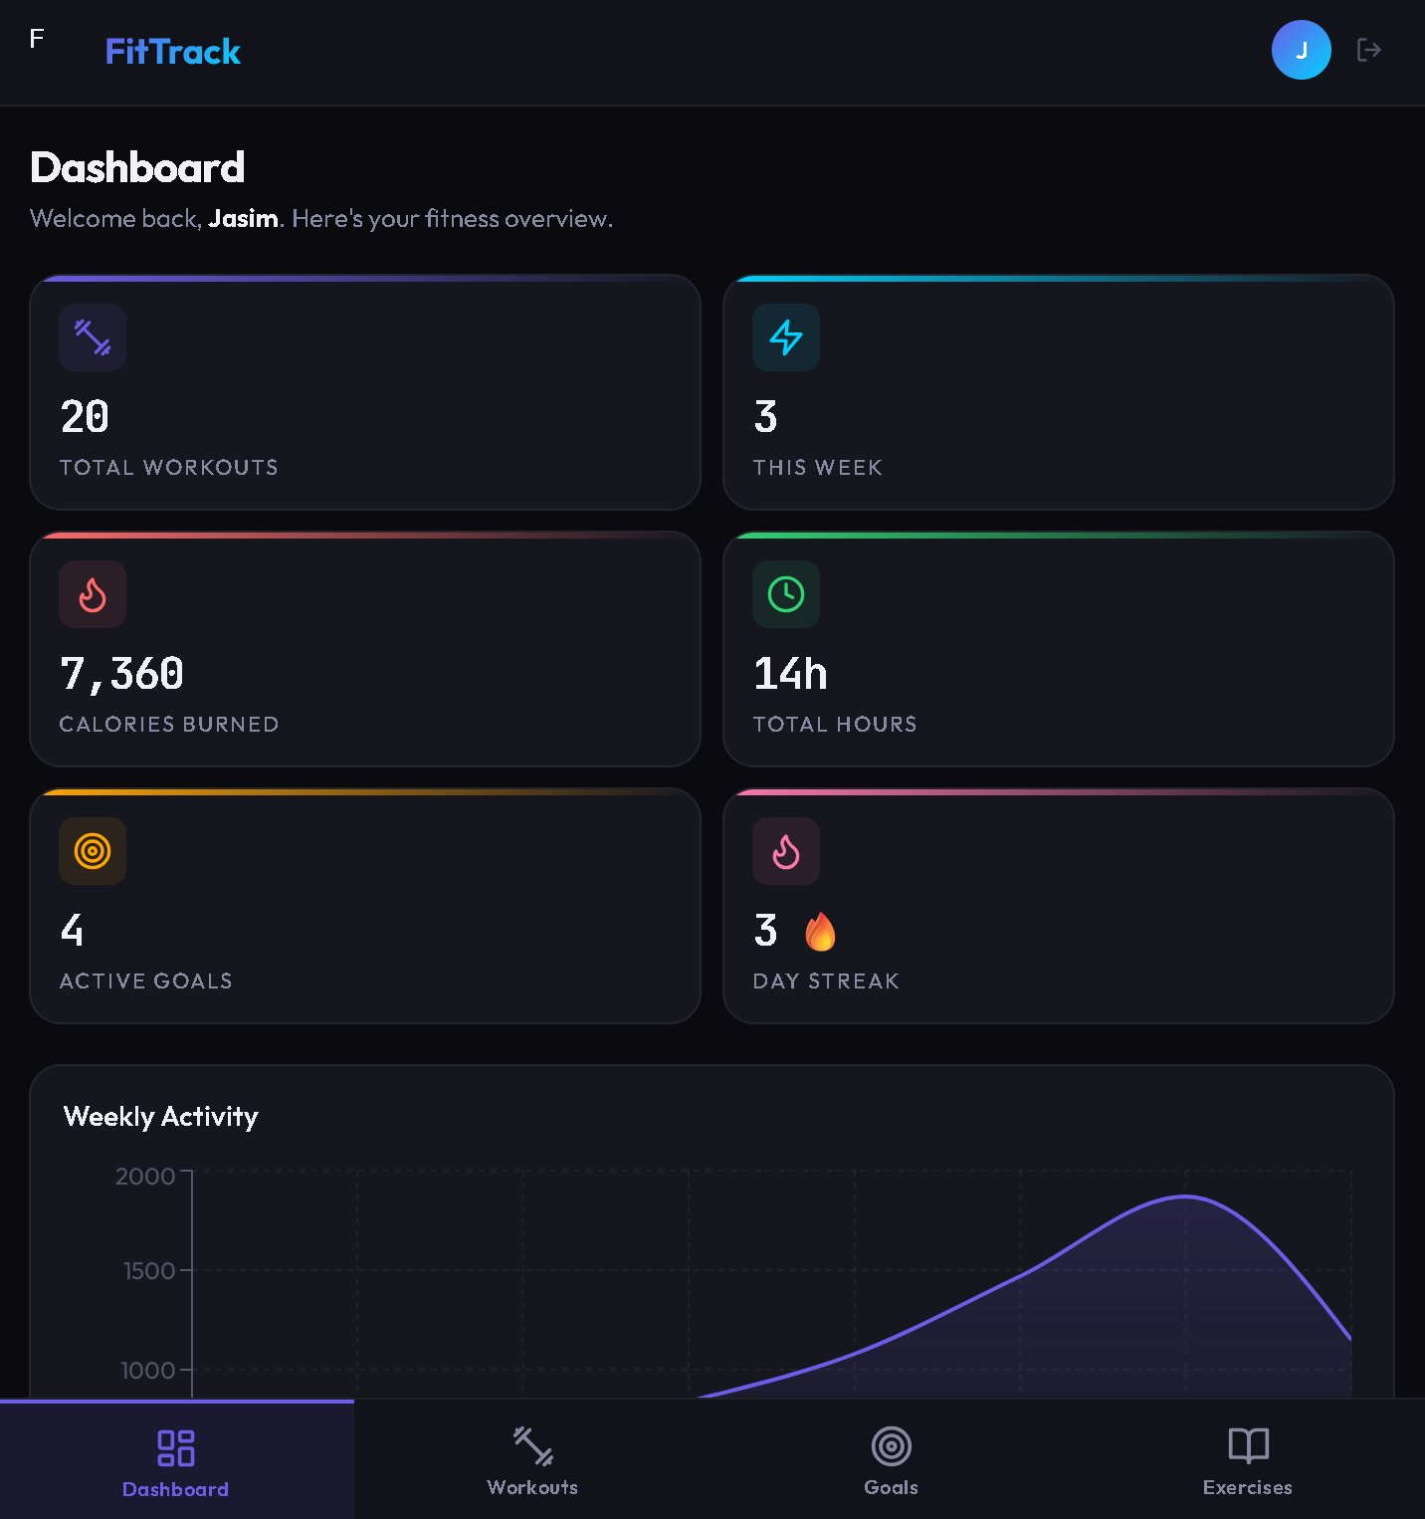
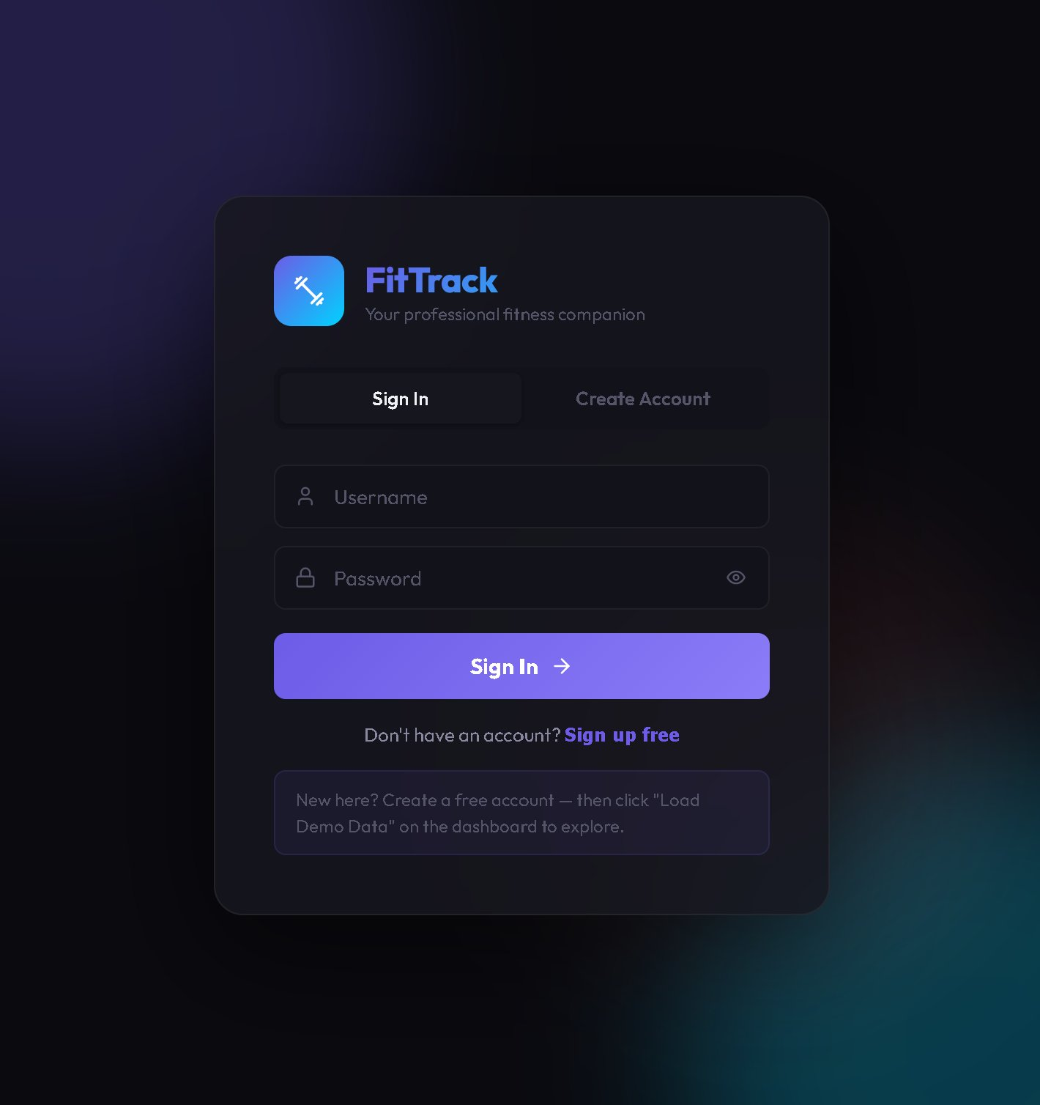
The Application
React 18 + Flask + PostgreSQL | 153 exercises | JWT auth | Mobile responsive

Slide 3
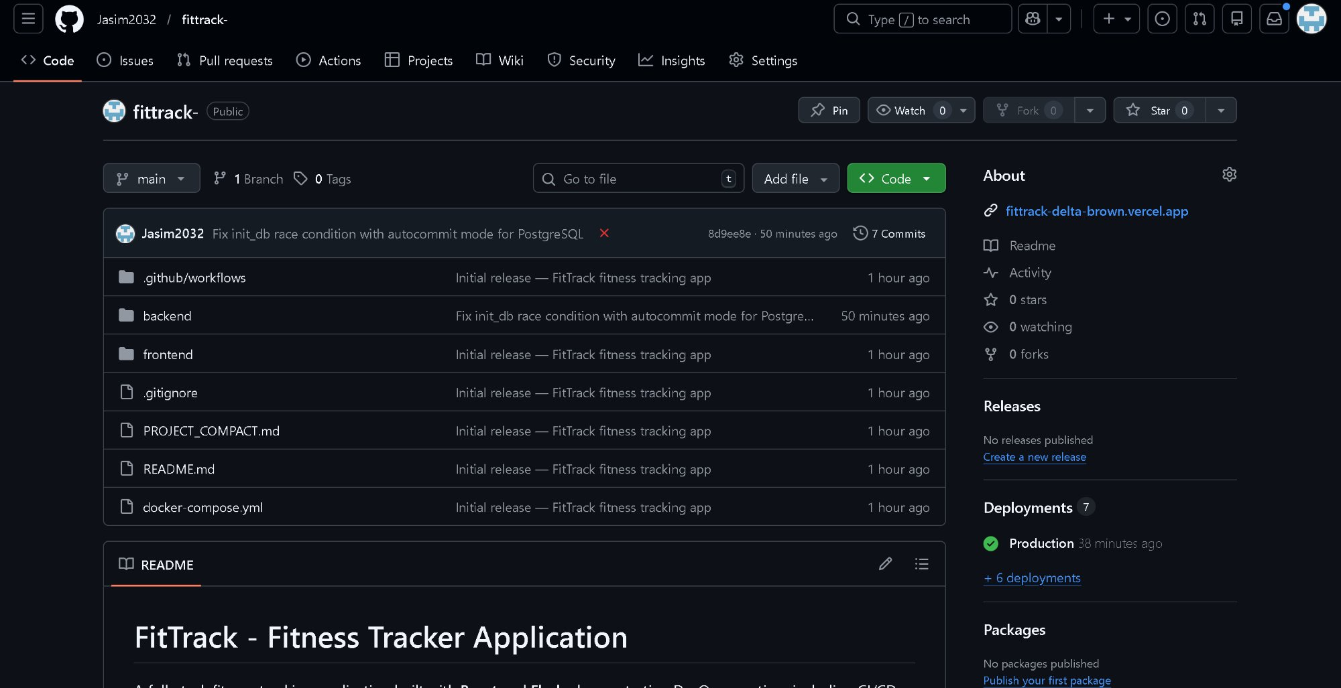
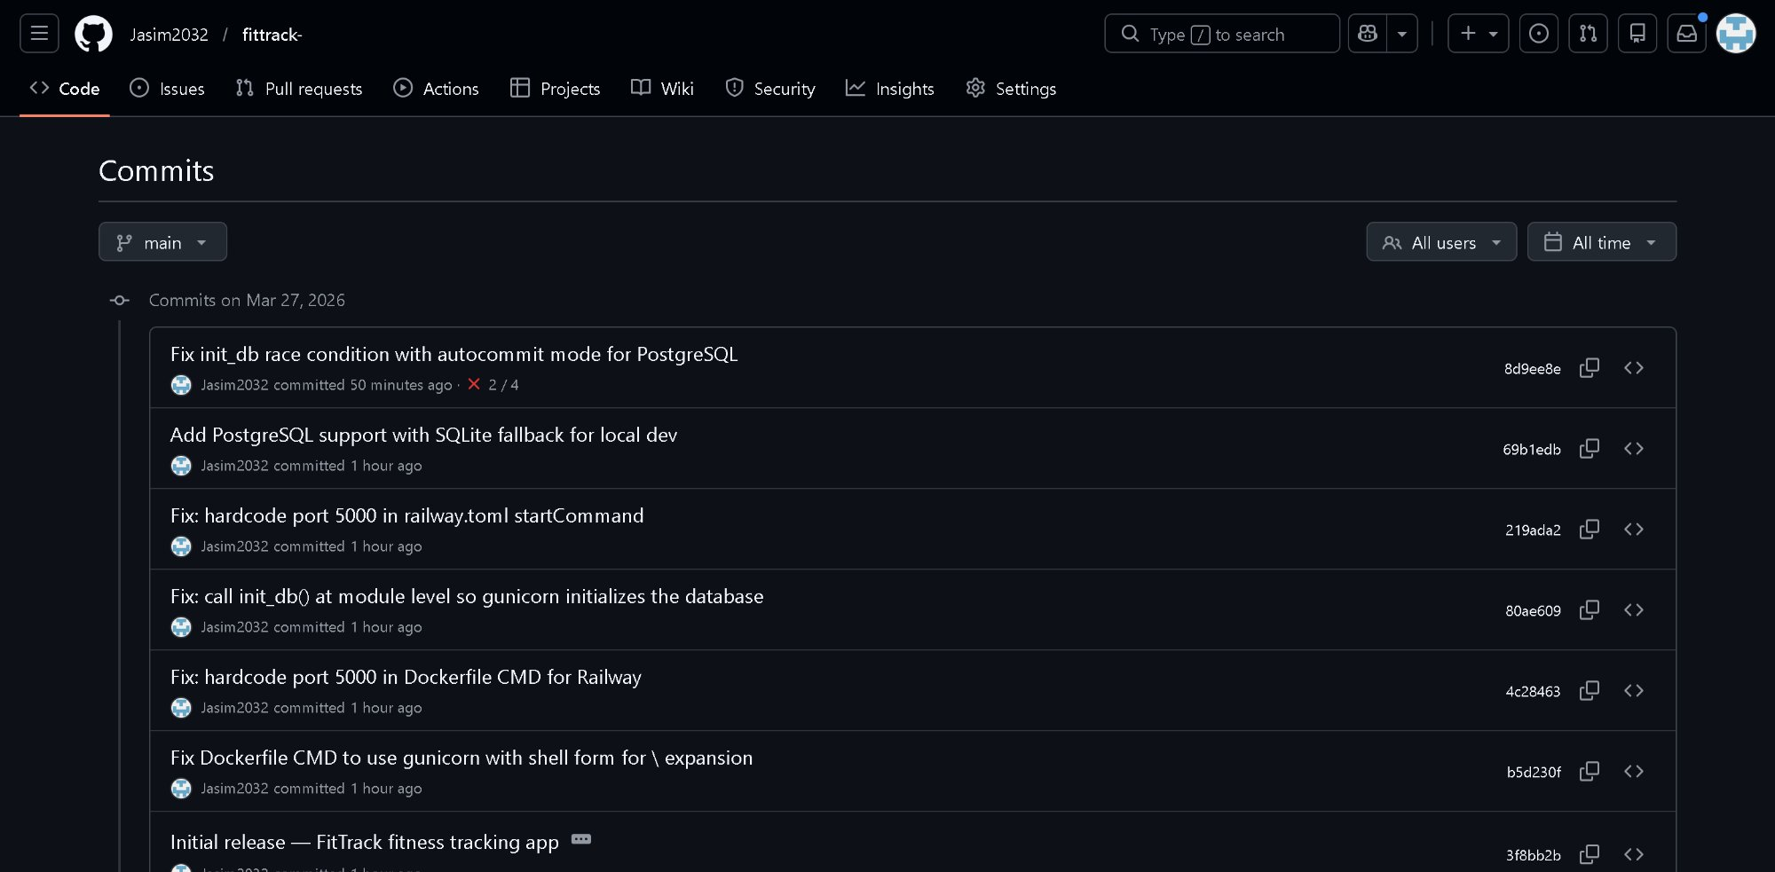
PROBLEM 1
No Version Control
In the early stages of the project, the team had no
structured way to track code changes. Members were
sharing files through USB drives and messaging apps.
This caused files to be overwritten, work to be lost,
and constant confusion about which version was latest.
SOLUTION
Git + GitHub
We adopted Git as our distributed version control
system and GitHub as the remote repository. Every
single change is now tracked with meaningful commit
messages like 'Add PostgreSQL support with SQLite
fallback for local dev'. The repository shows a clean
structure with backend/, frontend/, docker-compose.yml
and .gitignore — all under Jasim2032's account with
7+ commits providing full traceability of the entire
development history of the project.
Impact: Full change history, easy rollbacks, team collaboration without conflicts

Slide 4
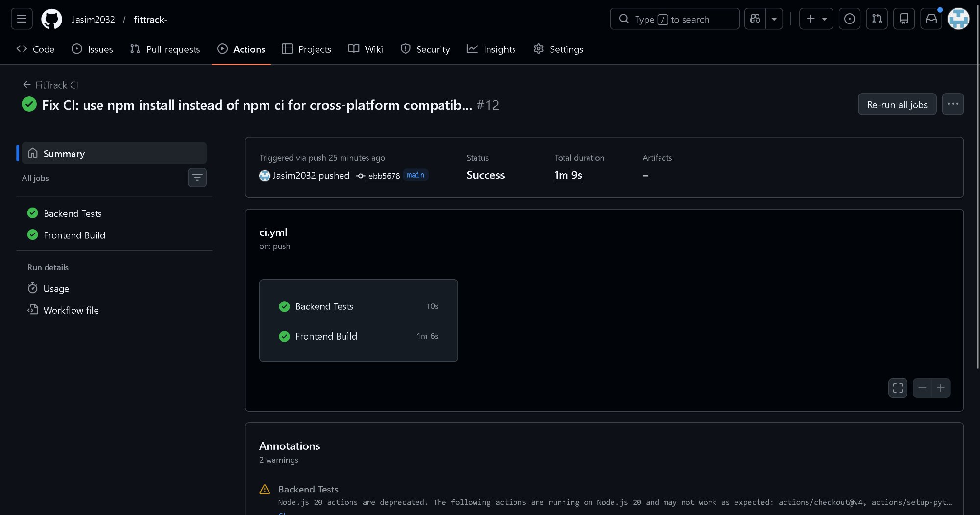
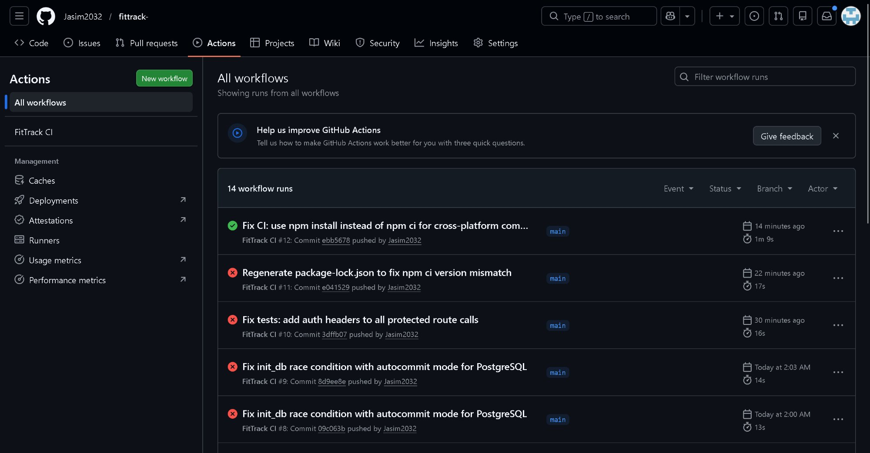
PROBLEM 2
Manual Testing
Before implementing CI/CD, every code change had
to be tested manually by the developer. There was no
automated feedback loop — developers would push
code without running tests, leading to broken builds
and bugs reaching the live application. Debugging
these issues consumed valuable development time.
SOLUTION
GitHub Actions CI/CD
We created a CI/CD pipeline using GitHub Actions
(.github/workflows/ci.yml) that triggers automatically
on every push to the main branch. The pipeline runs
two jobs in parallel:
Backend Tests - runs pytest on the Flask API
endpoints (completes in ~10 seconds)
Frontend Build - verifies the React application
compiles without errors (completes in ~1 minute)
Developers get immediate visual feedback - green
checkmarks mean all tests passed, a red X means
something broke and needs fixing before merging.

Slide 5
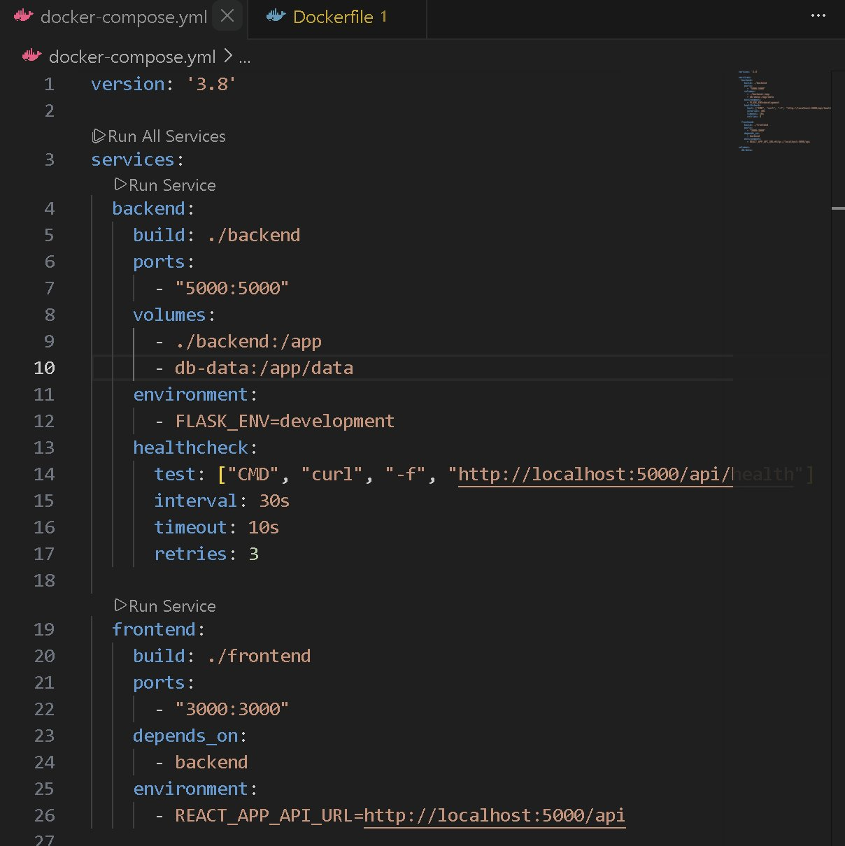
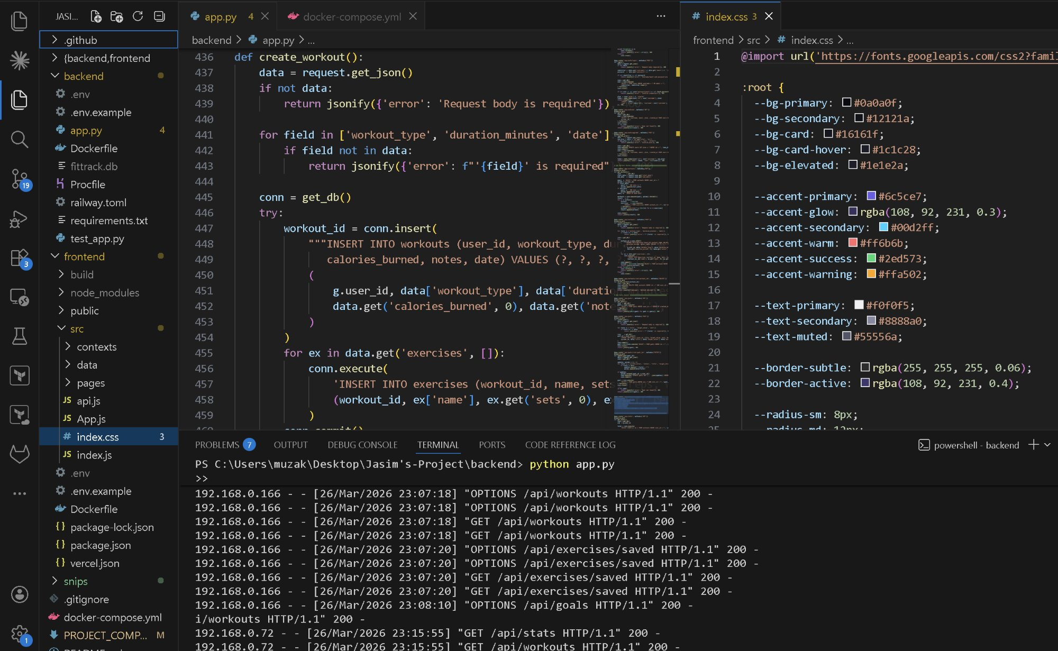
PROBLEM 3
"Works on My Machine"
One of the most common issues in software teams is
environment inconsistency. Code that works perfectly
on one developer's laptop fails on another's because
of different Python versions, missing npm packages,
or conflicting system-level configurations. This
problem wasted hours of debugging time in our team.
SOLUTION
Docker Containerisation
We containerised both services using Docker. The
backend uses a python:3.11-slim base image and the
frontend uses node:18-alpine. Docker Compose
orchestrates both containers together, defining:
Port mappings (5000 for API, 3000 for frontend)
Volume mounts for persistent data
Environment variables for configuration
Health checks for reliability monitoring
Any team member can run 'docker compose up --build'
and get an identical, production-like environment
regardless of their host operating system.

Slide 6
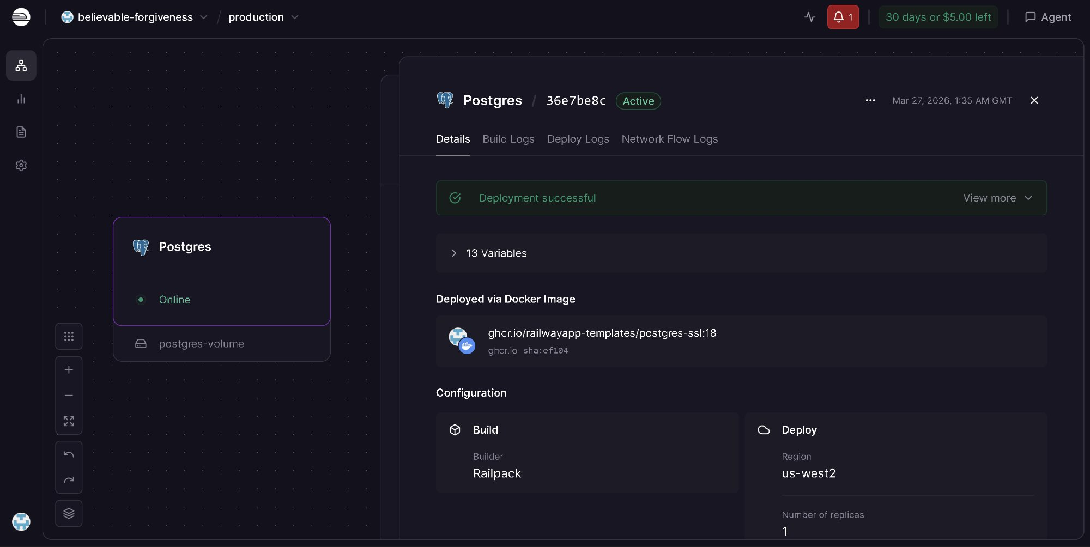
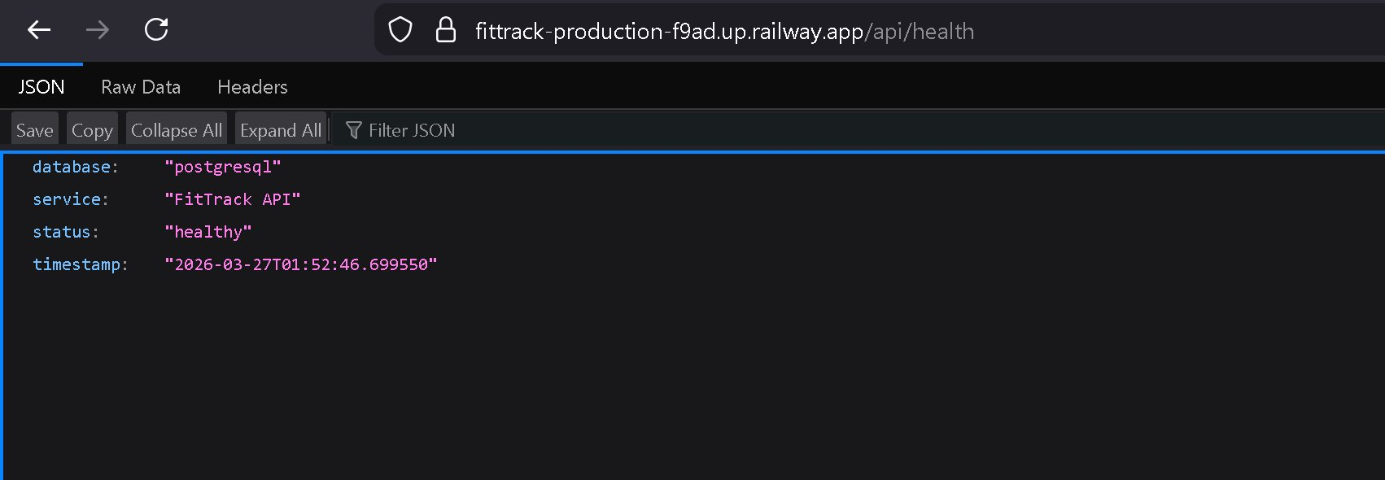
PROBLEM 4
Data Loss on Restart
The application initially used SQLite a file-based
database stored inside the container. Every time the
production server restarted or the container was
rebuilt during deployment, the entire database was
permanently wiped. All user accounts, workout logs,
goals, and saved exercises were lost. This is
completely unacceptable for any production app.
SOLUTION
Railway PostgreSQL
We migrated from SQLite to Railway's managed
PostgreSQL service. The backend code was refactored
to support both databases, it automatically detects
the DATABASE_URL environment variable and connects
to PostgreSQL in production, while falling back to
SQLite for local development convenience.
The PostgreSQL database runs as a completely separate
service from the application container, meaning data
persists through restarts, redeployments, and scaling
events. The /api/health endpoint confirms the active
database: "database": "postgresql".

Slide 7
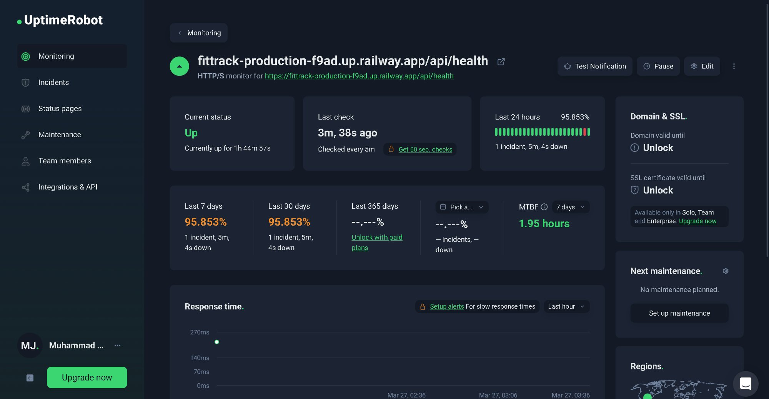
PROBLEM 5
No Downtime Visibility
SOLUTION
Without monitoring, the team had no way of knowing when the application
went down. Users would report issues hours later. No data on uptime or response times.
UptimeRobot + /api/health pings every 5 min, emails on downtime, tracks response times

Slide 8
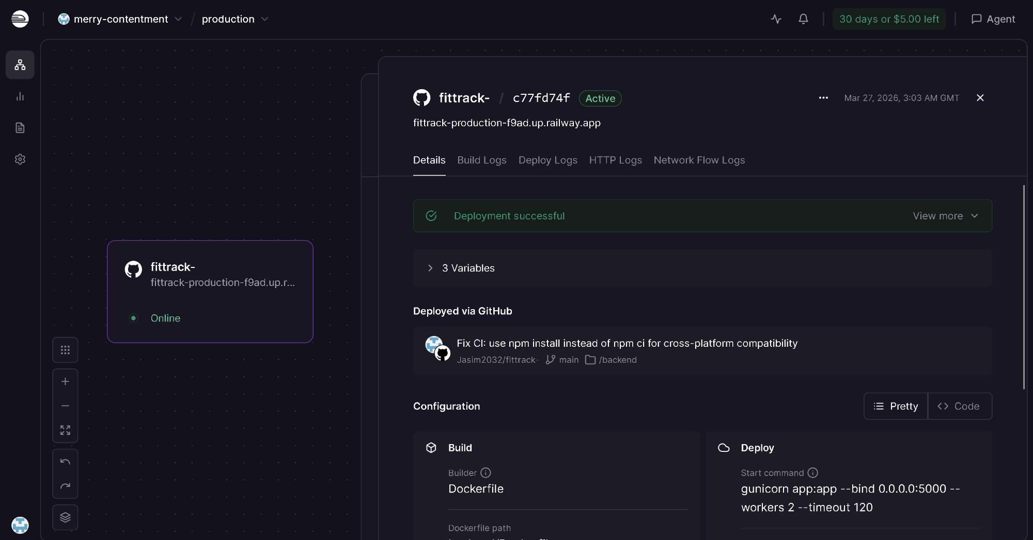
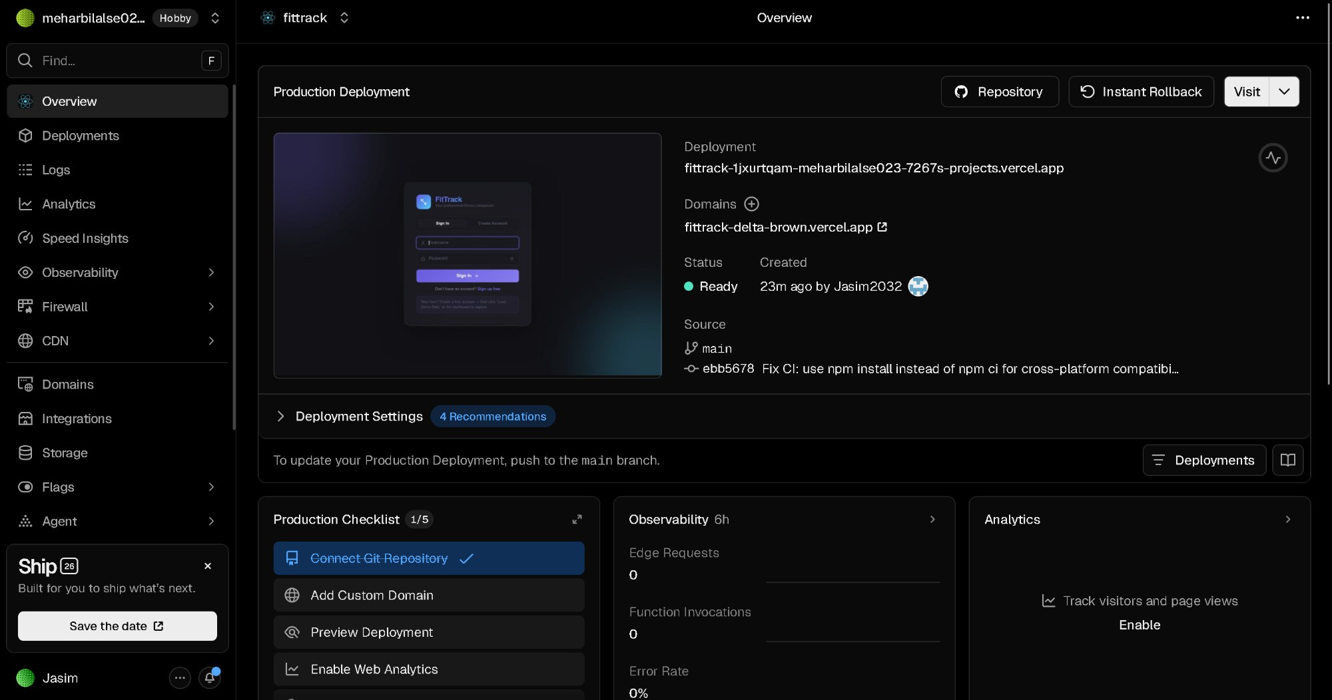
Cloud Deployment Architecture
BACKEND — Railway
FRONTEND — Vercel
Flask API served via gunicorn with 2 workers
PostgreSQL database as a separate managed service
Auto-deploys from GitHub on every push to main
Environment variables: SECRET_KEY, DATABASE_URL
Dockerfile-based builds using python:3.11-slim
React production build served as static files via CDN
Connected to GitHub for automatic deployments
REACT_APP_API_URL points to the Railway backend
Live at: fittrack-delta-brown.vercel.app

Slide 9
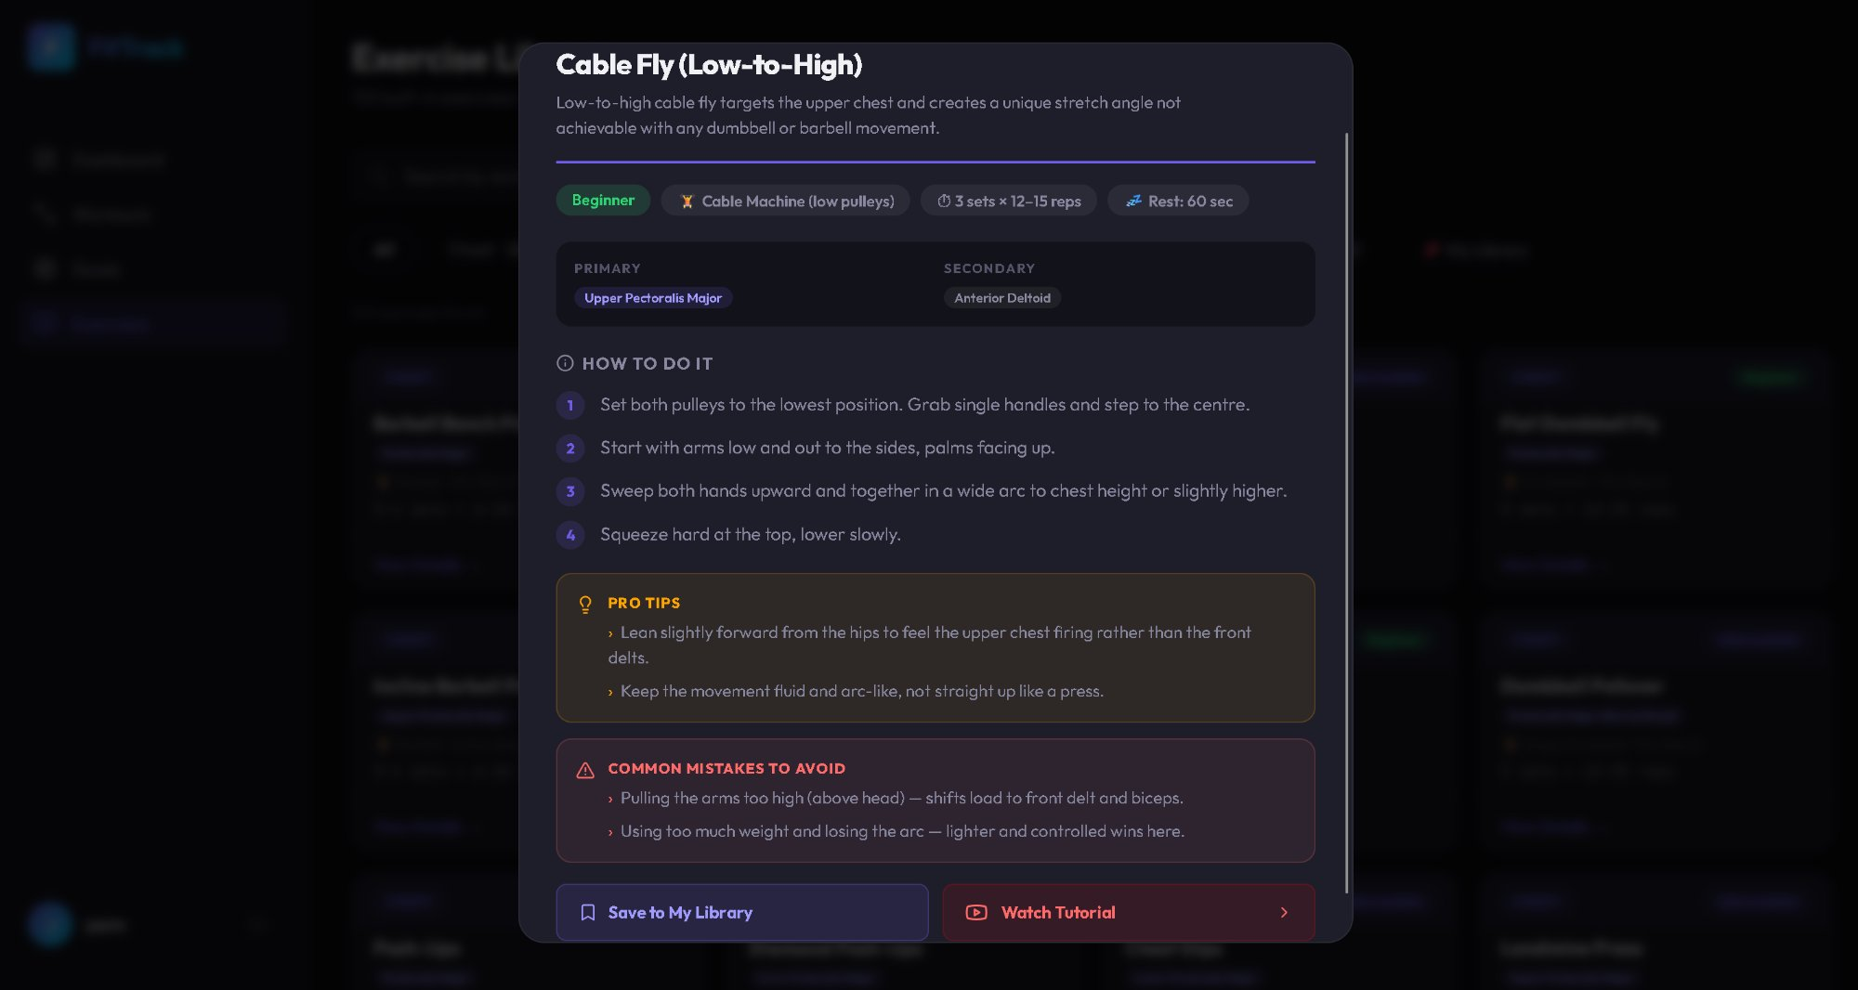
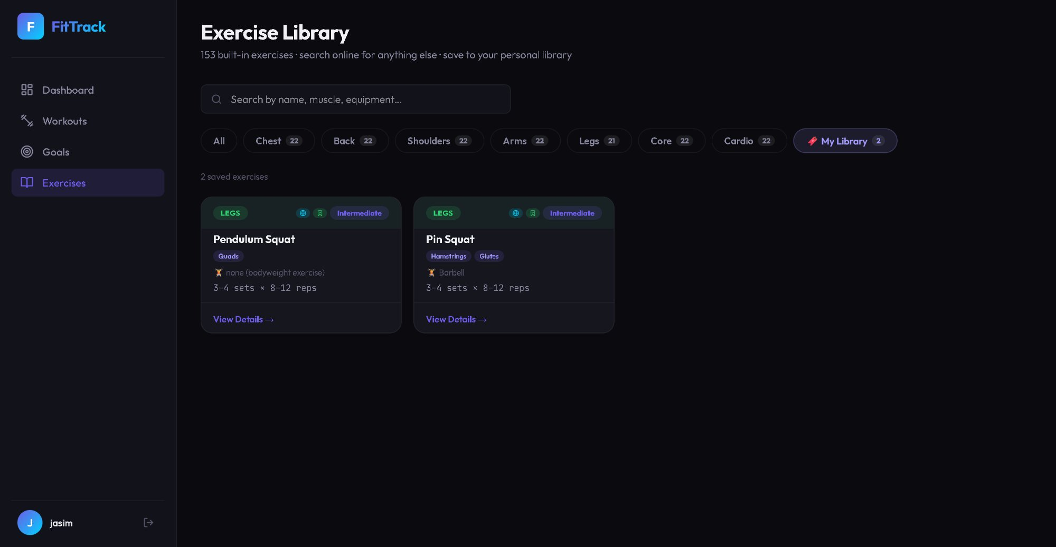
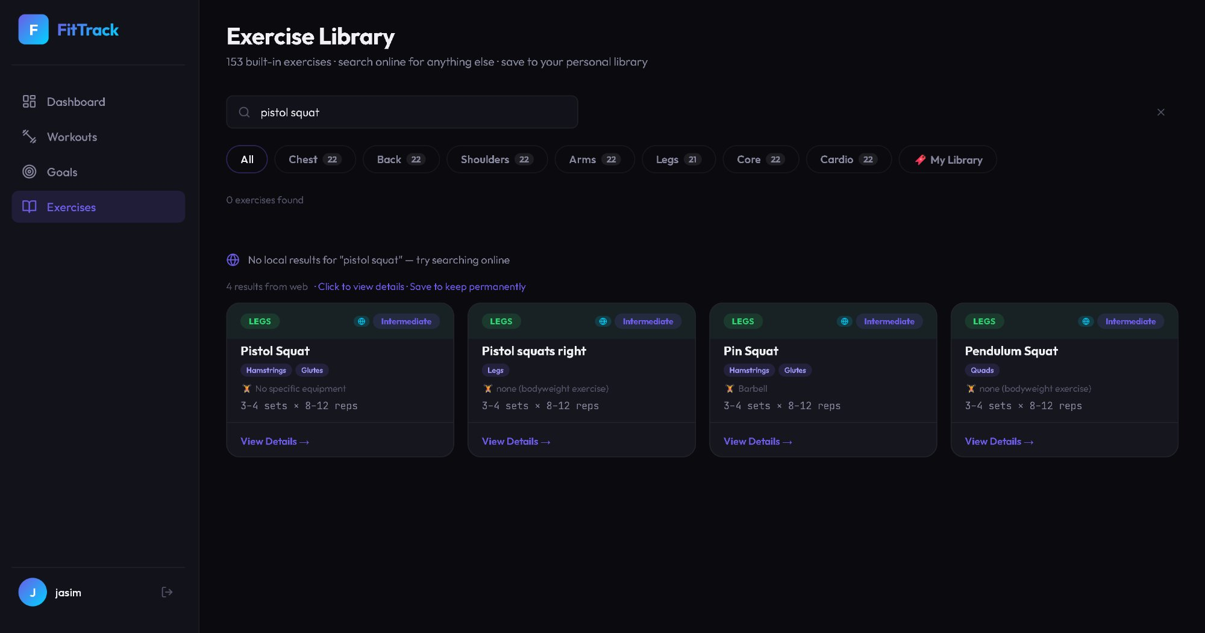
DevOps Practices — Complete Summary
# | Problem Identified | DevOps Practice | Tool Used | Evidence / Impact
1 | No version control — files shared via USB | Version Control | Git + GitHub | 7+ commits, clean repo, full history
2 | Manual testing — bugs reach production | CI/CD Pipeline | GitHub Actions | Auto pytest + build on every push
3 | Environment inconsistency across team | Containerisation | Docker + Compose | One command = identical environment
4 | Data wiped on every container restart | Managed Database | Railway PostgreSQL | Persistent storage, separate from app
5 | No visibility when application goes down | Monitoring | UptimeRobot + /api/health | 5-min checks, email alerts, 95.8% uptime

Slide 10
What I Learned
1
DevOps is a culture of automation and continuous improvement — not just tools
2
CI/CD pipelines catch bugs before they reach production, saving hours of debugging
3
Docker eliminates environment-specific bugs by standardising the runtime
4
Managed databases solve the data persistence problem in cloud environments
5
Monitoring provides visibility — you cannot fix what you cannot see
Thank You — Questions?
Live demo available
Live App: fittrack-delta-brown.vercel.app
GitHub: github.com/Jasim2032/fittrack-
Health: fittrack-production-f9ad.up.railway.app/api/health

