Slide 1
CAR POOLING (A Sar-Sabz Initiative)
Project For, Software Engineering (CS 360)
By,
Muhammad Wajahat (14100128)
Hasan Abbas (14100059) Luqman Ghani (14100180) Usman Zaheer (14100222)

Slide 2
The Team
Muhammad Wajahat – Project Manager, Programmer, Designer
Hasan Abbas – Project Planner, Documentation Manager
Luqman Ghani – Extreme Coder
Usman Zaheer – Synchronizer & Stabilizer

Slide 3
Introduction
Why need car-pooling? - A green initiative by Sar-Sabz LUMS - To encourage sharing resources within our community
Who can use this app?
- Anyone who is a part of the LUMS community
What this project hopes to accomplish? - Awareness to share and conserve resources - To encourage going green! - Highlight and promote a new initiative for public use

Slide 4
Developmental Models Used:-
Waterfall Model with Feedback loops: - Defined checkpoints to achieve at each stage - Made sure code and logic in order before moving onto next stage.
2. Agile Methodologies: - Release planning - Testing - Pair Programming - Refactoring

Slide 5
Tools & Technologies Used:-
Technologies:-
PHP
Oracle
JavaScript
J-Query
CSS
Tools:-
SQL-developer
Notepad++
Firebug
GitHub

Slide 6
TimeLine
Task Name | Duration | Start | Finish | Predecessors | Resource Names
Product Statement | 3 days | Wed 2/20/13 | Fri 2/22/13 |  | Wajahat,Usman,Luqman
Conduct Questionare | 2 days | Mon 2/25/13 | Tue 2/26/13 | 1 | Hasan
User Input/ System Output identification | 2 days | Wed 2/27/13 | Thu 2/28/13 |  | Wajahat,Luqman,Usman,Hasan
Review with Course Staff | 1 day | Wed 2/27/13 | Wed 2/27/13 |  | Wajahat,Luqman,Usman,Hasan
Product Statement Defined | 0 days | Thu 2/28/13 | Thu 2/28/13 | 4
Identify the functional specifications | 4 days | Thu 2/28/13 | Tue 3/5/13 | 4 | Hasan
Team meeting with Course Staff | 1 day | Wed 3/6/13 | Wed 3/6/13 | 6 | Wajahat,Luqman,Usman,Hasan
Functional Specifications defined | 0 days | Thu 3/7/13 | Thu 3/7/13
Cost Estimation | 5 days | Mon 3/11/13 | Fri 3/15/13 |  | Usman,Wajahat
Model Specification | 2 days | Fri 3/22/13 | Mon 3/25/13 |  | Wajahat
Team meeting with Course Staff | 1 day | Wed 3/27/13 | Wed 3/27/13 |  | Wajahat,Luqman,Usman,Hasan
Estimation Done | 1 day | Thu 3/28/13 | Thu 3/28/13 | 11
Identify Classes | 2 days | Tue 3/26/13 | Wed 3/27/13 |  | Wajahat,Usman
State, Class and Sequence Diagrams | 10 days | Wed 3/27/13 | Tue 4/9/13 |  | Wajahat,Luqman,Usman,Hasan
ER Diagram and Normalization | 2 days | Tue 4/2/13 | Wed 4/3/13 |  | Usman
Pick or design a webpage template | 1 day | Mon 4/8/13 | Mon 4/8/13 |  | Wajahat
Software Design Completed | 0 days | Wed 4/3/13 | Wed 4/3/13 | 15
Setting up the DB | 4 days | Mon 4/1/13 | Thu 4/4/13 |  | Usman,Luqman
Login form | 1 day | Tue 4/2/13 | Tue 4/2/13 |  | Luqman
Advertise Lift | 1 day | Tue 4/2/13 | Tue 4/2/13 |  | Wajahat,Luqman

Slide 7
Timeline Contd . . .
Recurring Trip form | 2 days | Wed 4/3/13 | Thu 4/4/13 | 20 | Hasan,Usman
User Profile form | 2 days | Thu 4/4/13 | Fri 4/5/13 | 17 | Wajahat
Apply For lift | 2 days | Thu 4/4/13 | Fri 4/5/13 |  | Luqman,Hasan
Cancel Lift | 2 days | Fri 4/5/13 | Mon 4/8/13 |  | Wajahat,Hasan
Check Rating | 1 day | Fri 4/5/13 | Fri 4/5/13 |  | Usman
Check My Lifts | 3 days | Fri 4/5/13 | Tue 4/9/13 |  | Usman
Update Personal Info | 2 days | Mon 4/8/13 | Tue 4/9/13 |  | Wajahat
Search Lift | 5 days | Sat 4/6/13 | Thu 4/11/13 |  | Hasan,Usman
Rate your Partner | 2 days | Tue 4/9/13 | Wed 4/10/13 |  | Usman
Modify Trip Specs | 3 days | Mon 4/8/13 | Wed 4/10/13 |  | Luqman,Hasan
Confirm Lift | 3 days | Wed 4/10/13 | Fri 4/12/13 |  | Luqman
Code Implemented | 0 days | Mon 4/15/13 | Mon 4/15/13 |  | Wajahat,Luqman,Usman,Hasan
Make Test cases | 2 days | Fri 4/12/13 | Mon 4/15/13 |  | Wajahat,Luqman,Usman,Hasan
Run test cases and Debug | 3 days | Tue 4/16/13 | Thu 4/18/13 | 33 | Wajahat,Usman,Hasan
Implement any added functionality | 3 days | Mon 4/15/13 | Wed 4/17/13 | 32 | Luqman
Remove any bugs, finish the design and code | 10 days | Tue 4/16/13 | Mon 4/29/13 |  | Wajahat,Luqman,Usman,Hasan

Slide 8
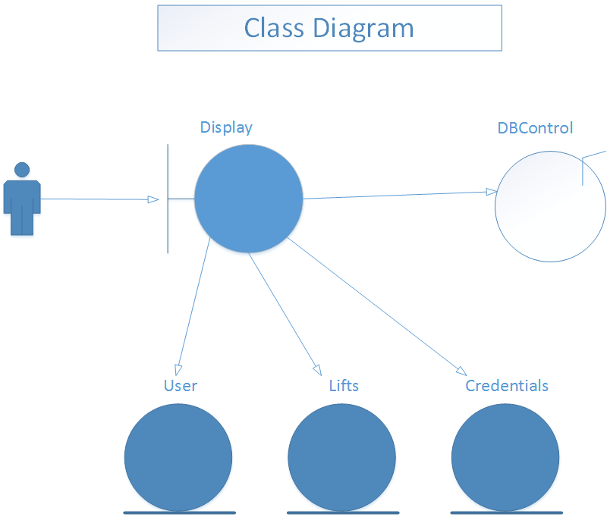

Slide 9
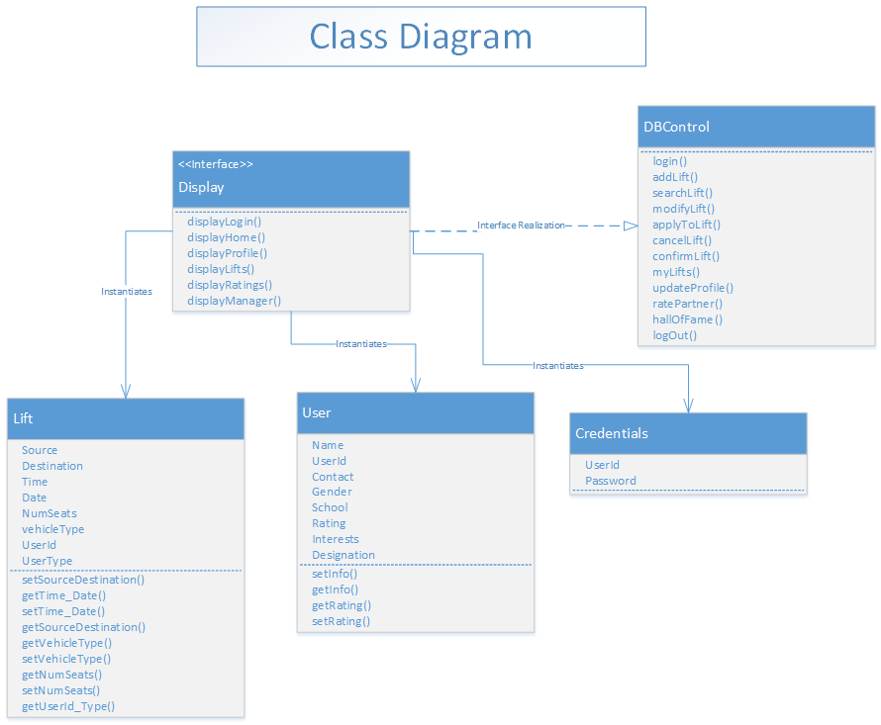

Slide 10
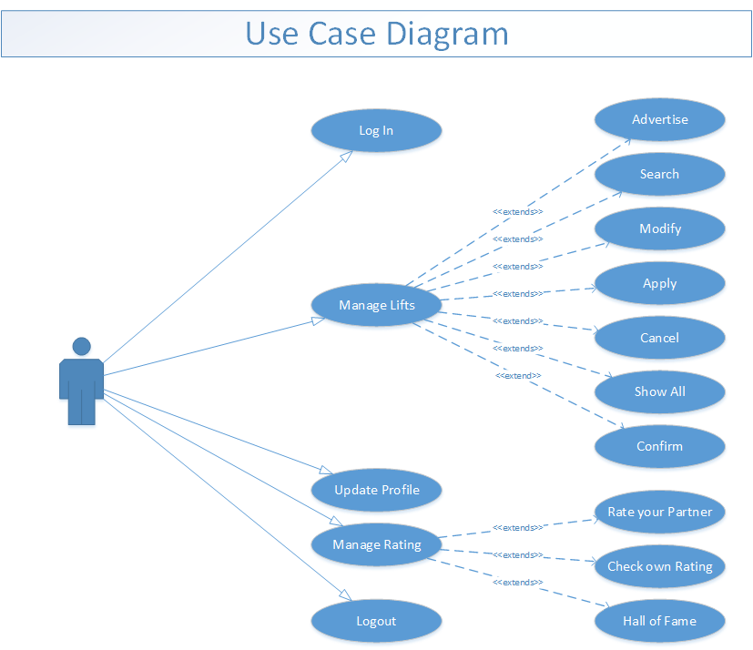

Slide 11
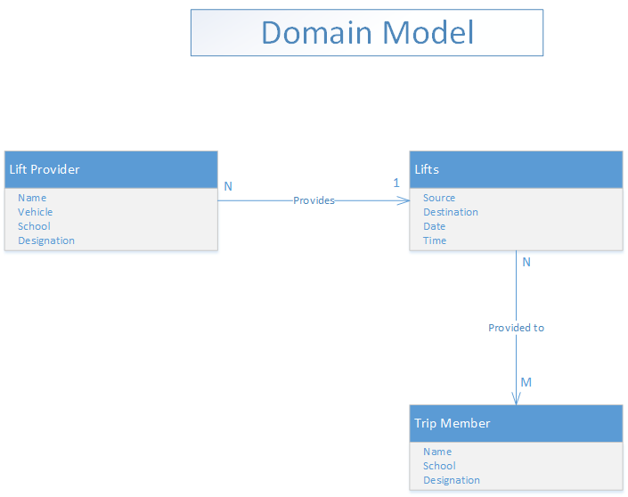

Slide 12
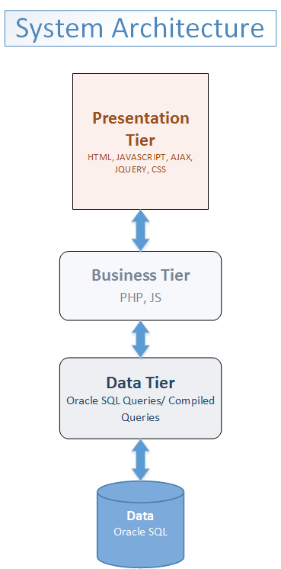

Slide 13
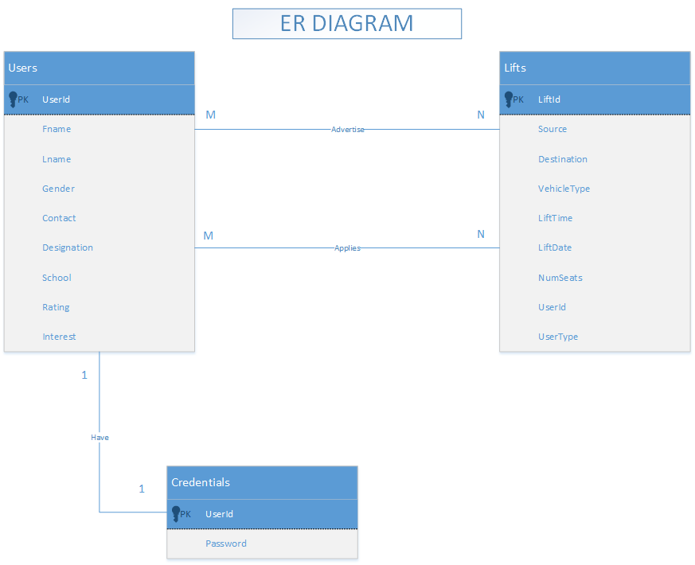

Slide 14
DEMO

Slide 15
So what makes this project special. . .?
Ease of use – click as you go !
Google Map API implemented to aid trip planning
A fun experience overall
Its green . . . Made to bring a change !!

Slide 16
Thank You ☺

