Slide 1
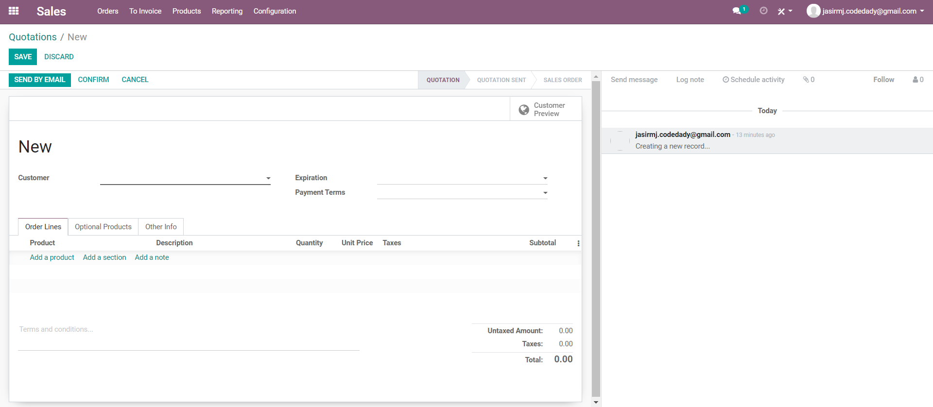
New Quotation

Slide 2
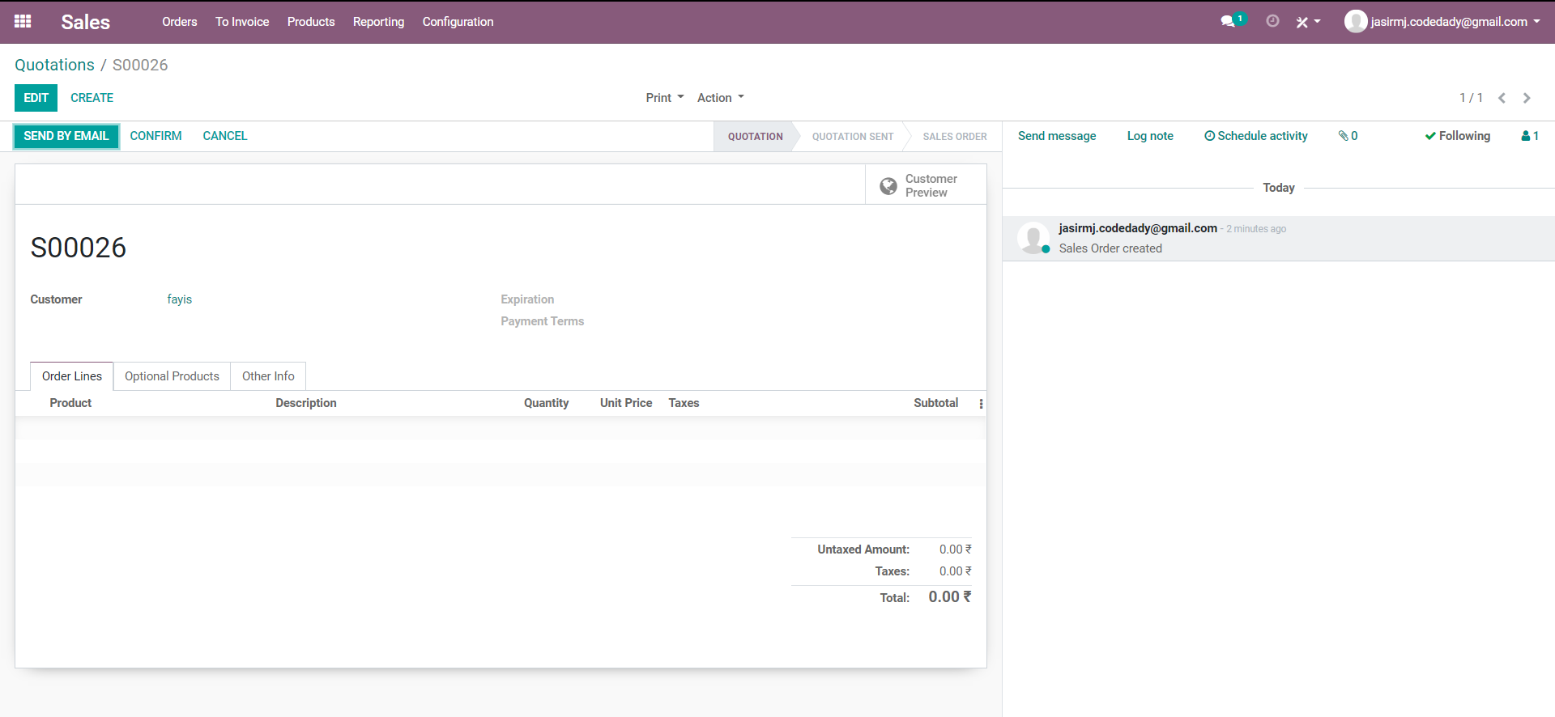
Saved Quotation

Slide 4

New Sales Order

Slide 5
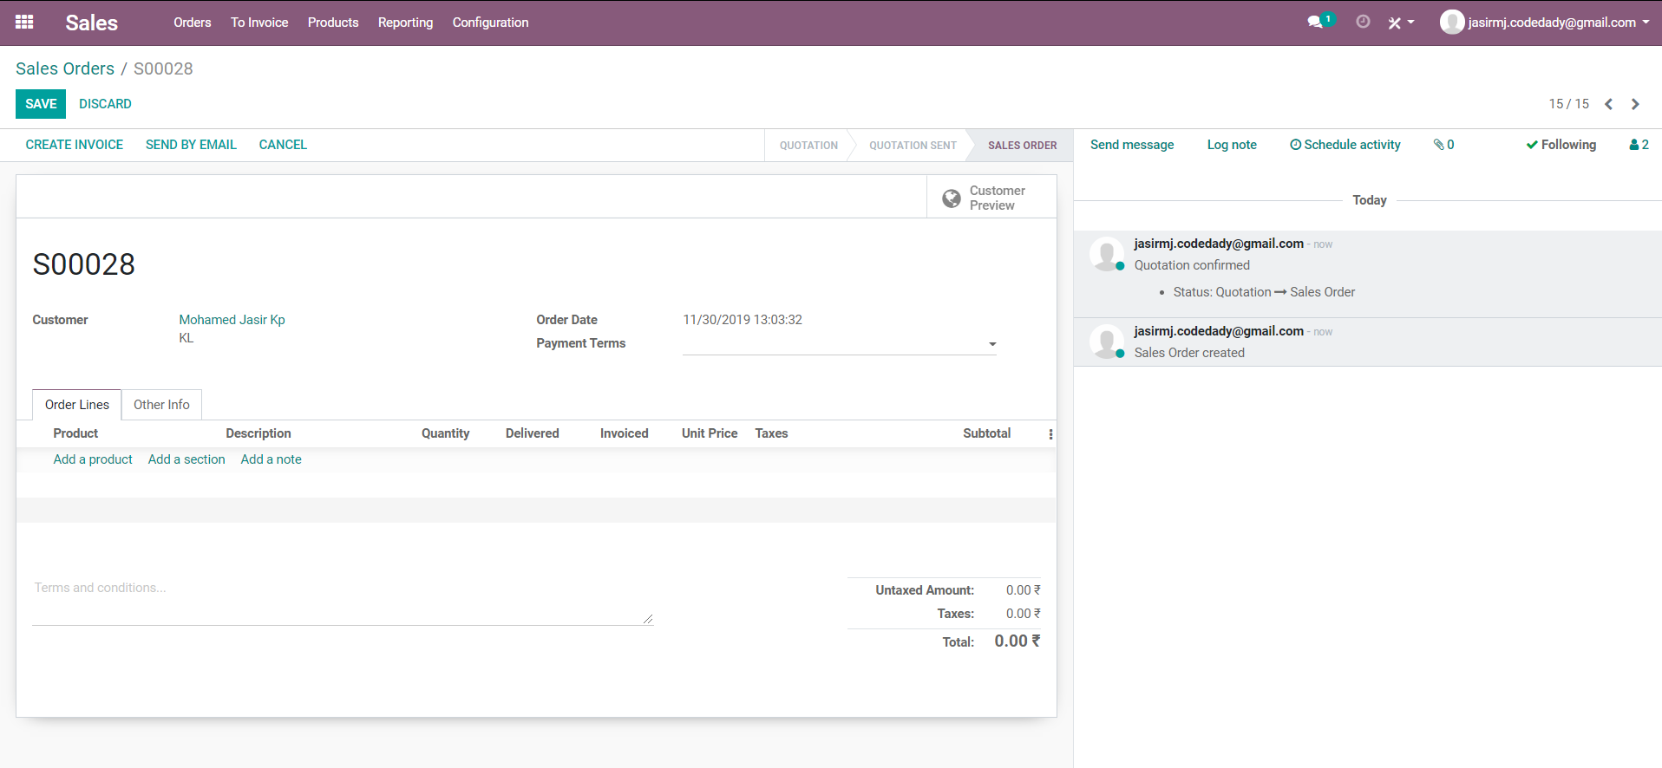
Sale order confirm

Slide 6
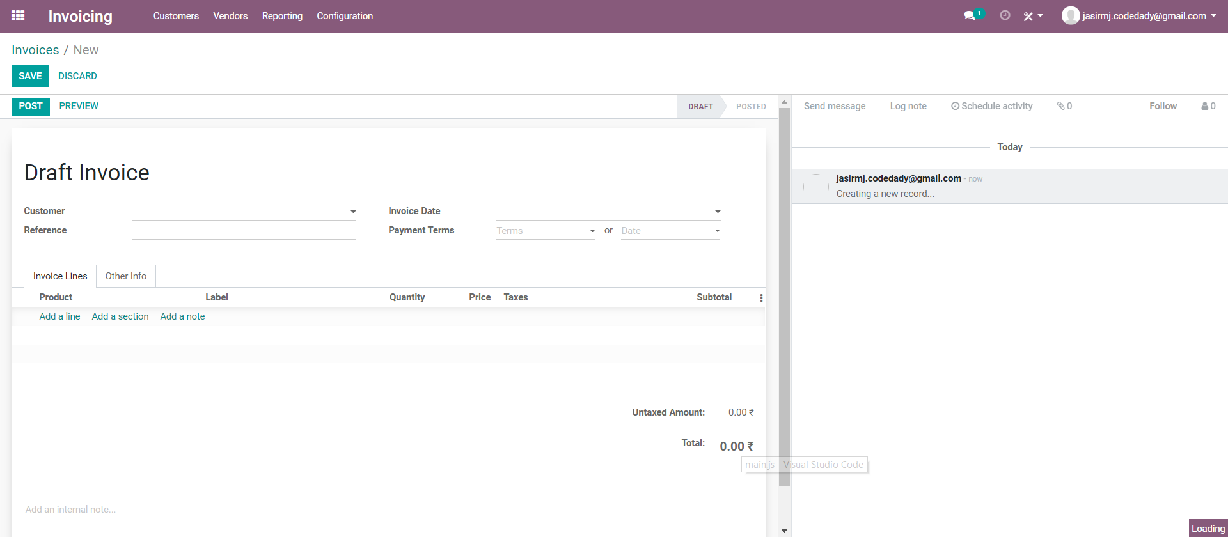
New Invoice

