Slide 1
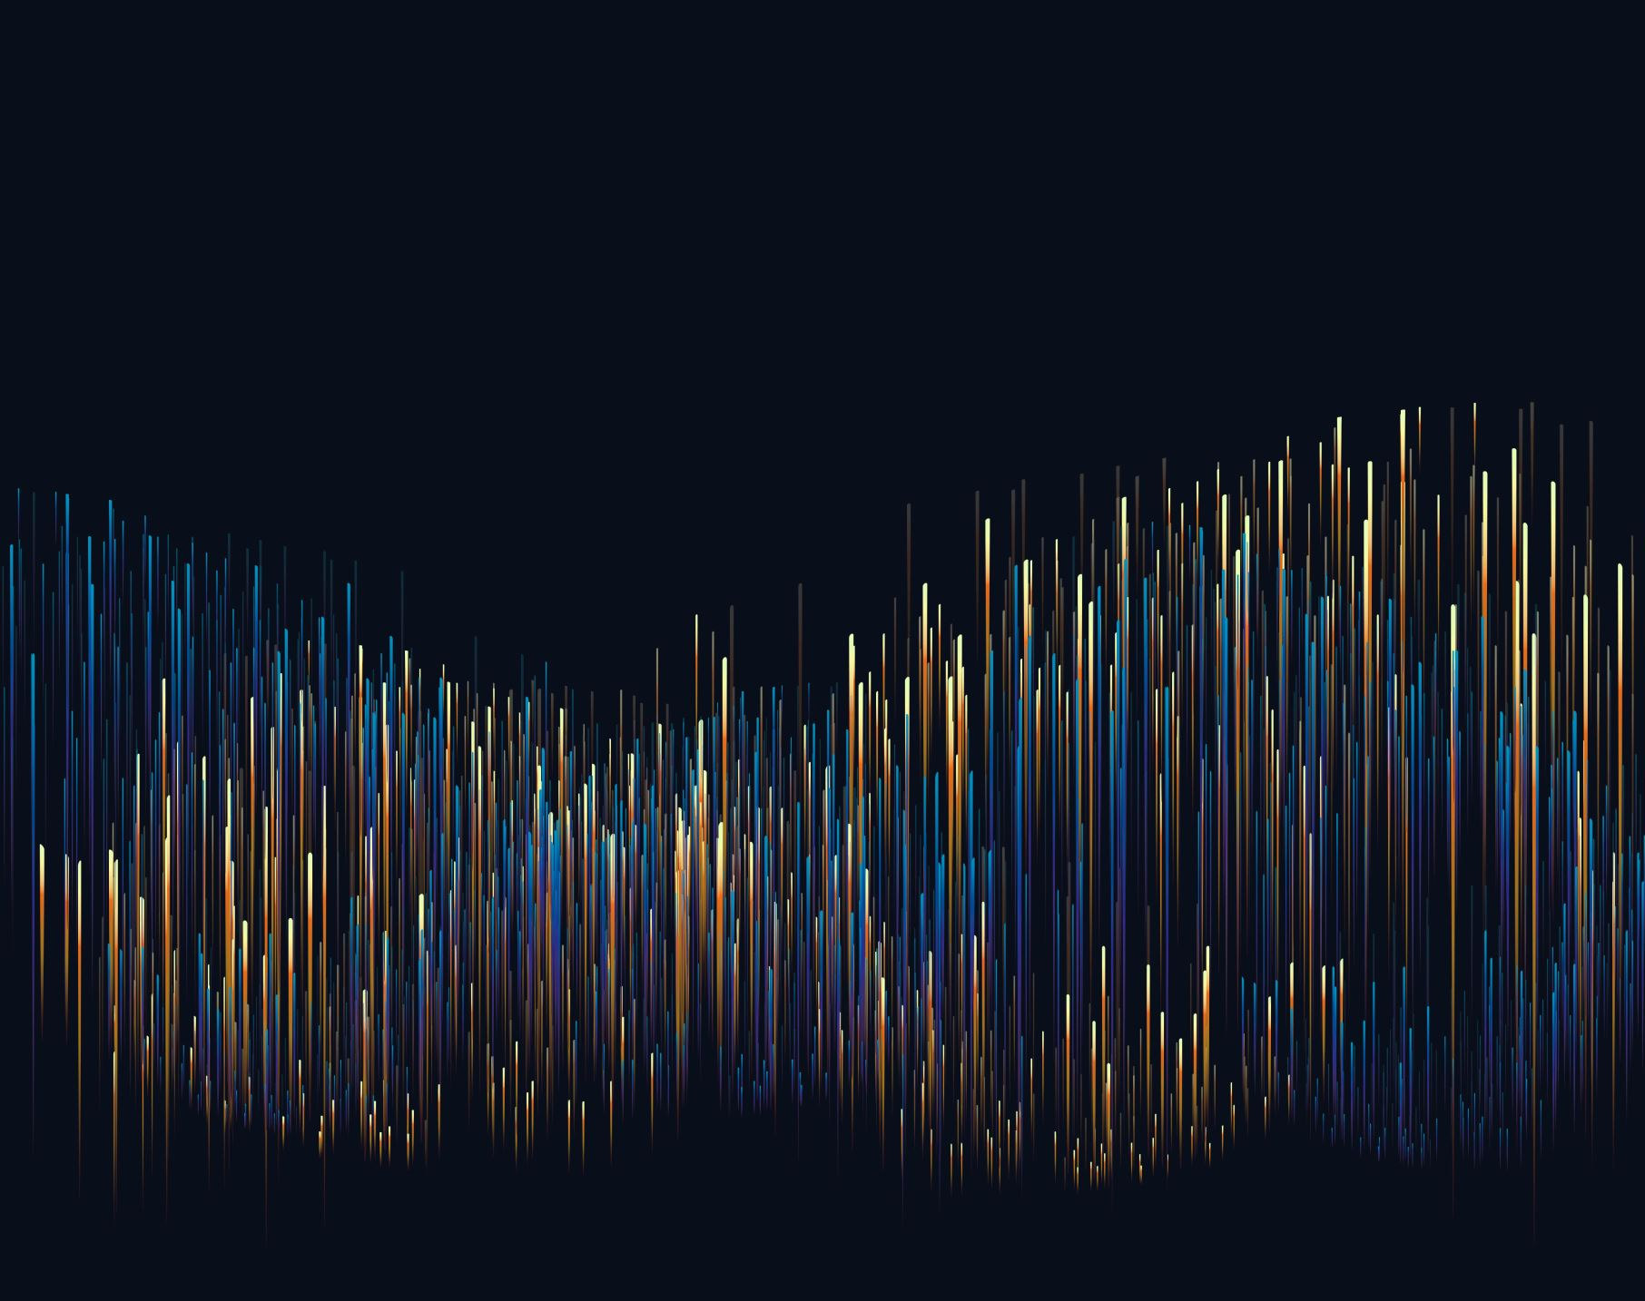
TIIA
A Python based project

Slide 2
TIIA
Environment

Slide 3
Django
Model – DB table View – Business logic Template – UI screen

Slide 4
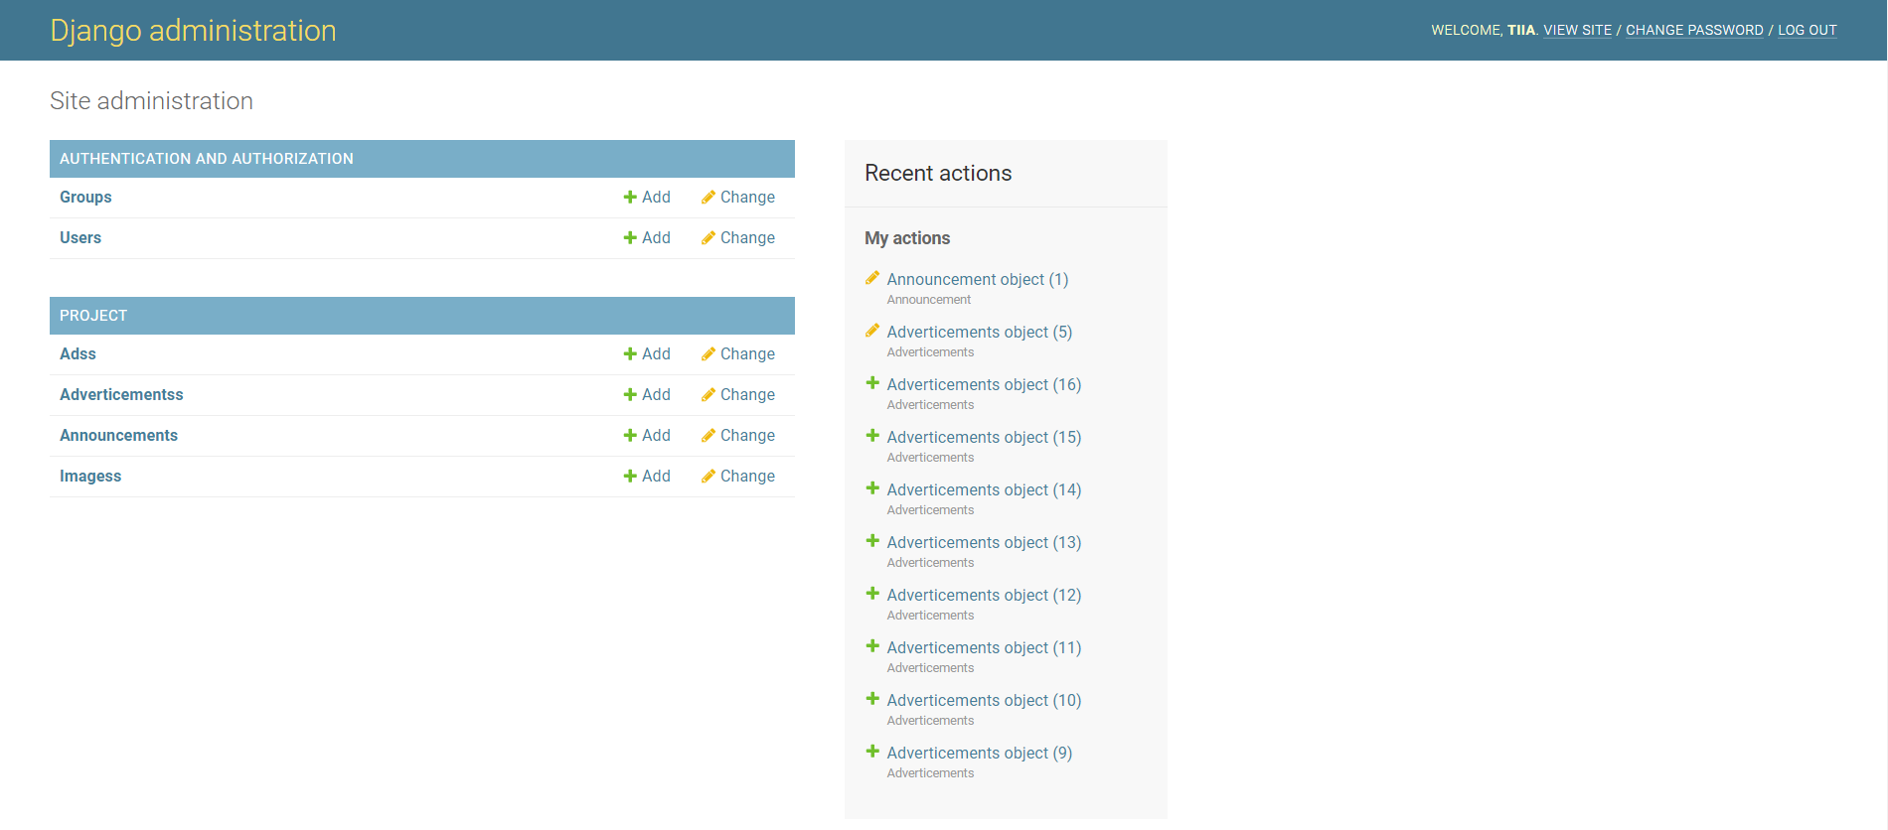
Admin Panel

Slide 5
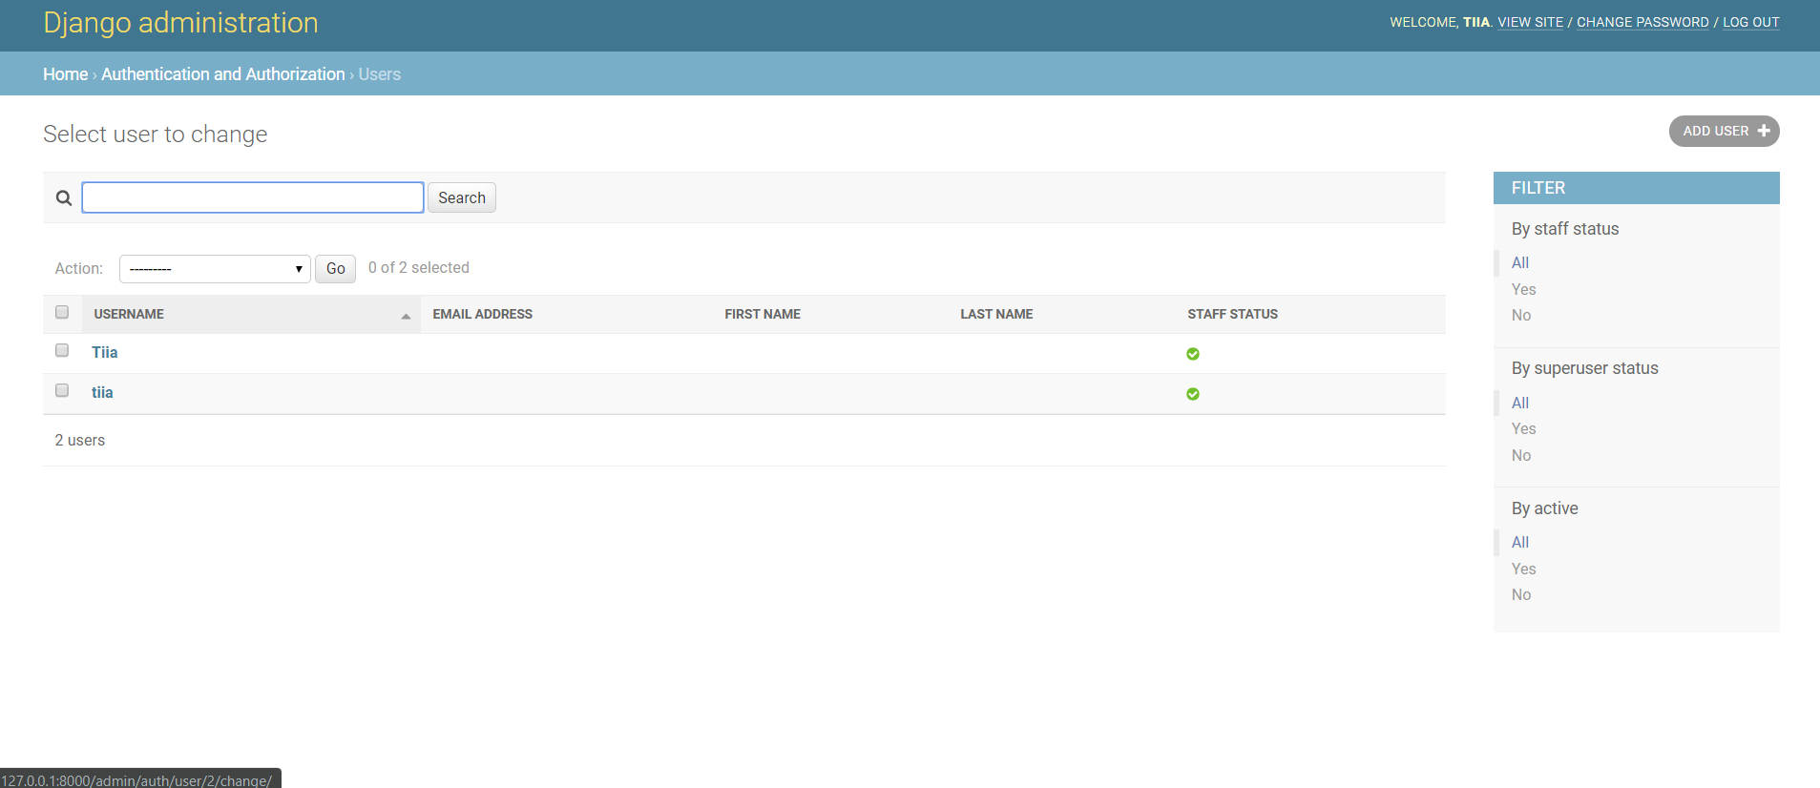
Admin Panel / Users

Slide 6
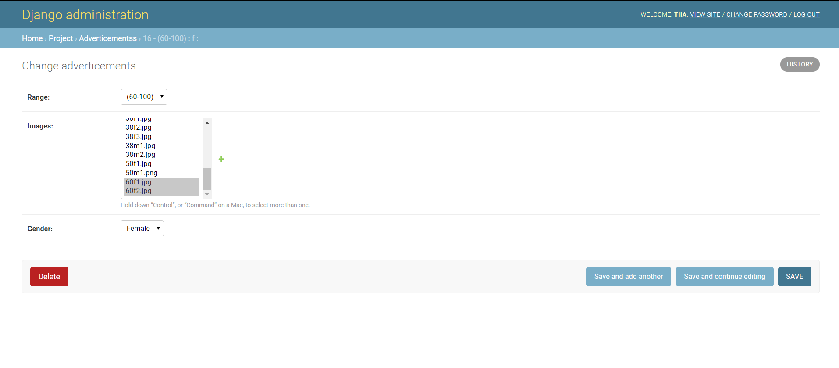
Admin Panel / Adverticements

Slide 7
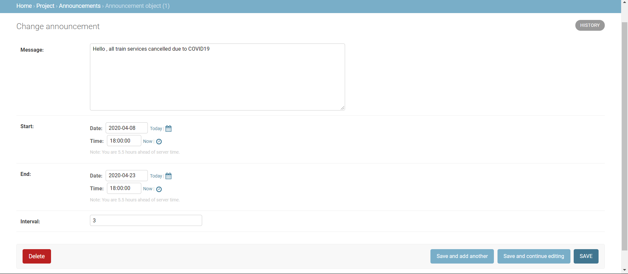
Admin Panel / Announcement

Slide 8
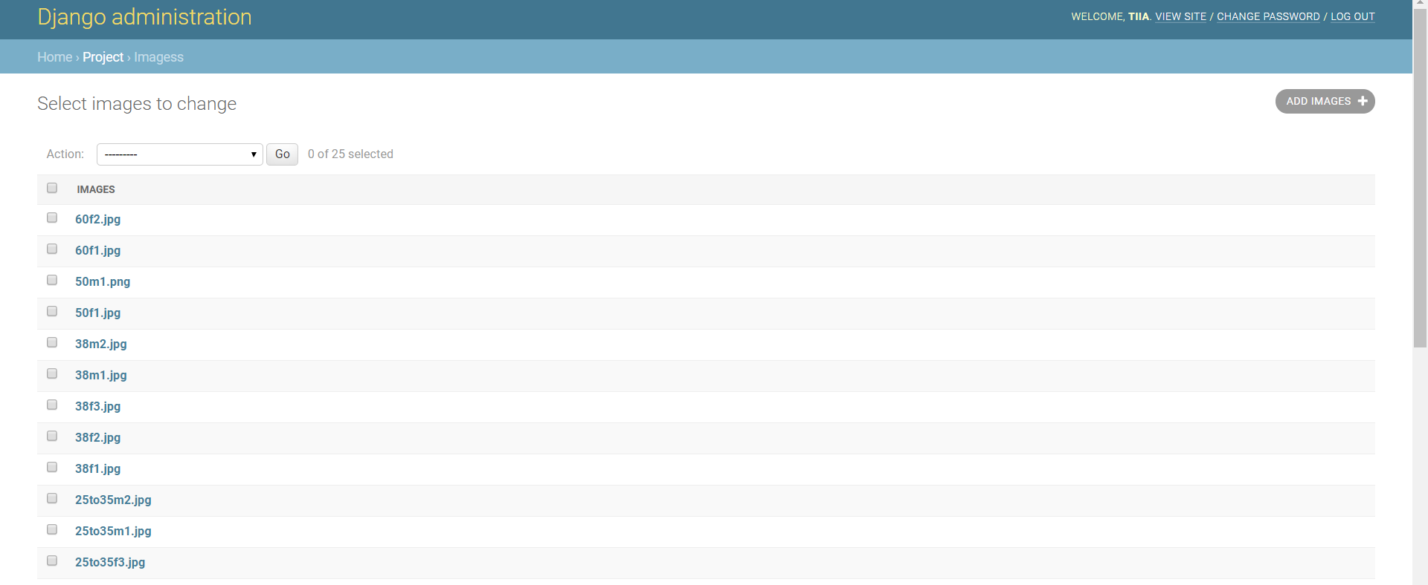
Admin Panel / Images

Slide 9
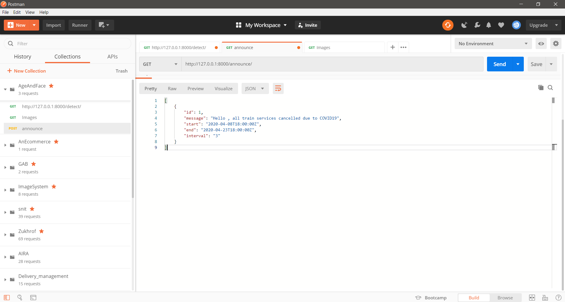
Postman

Slide 10
Postman

Slide 11
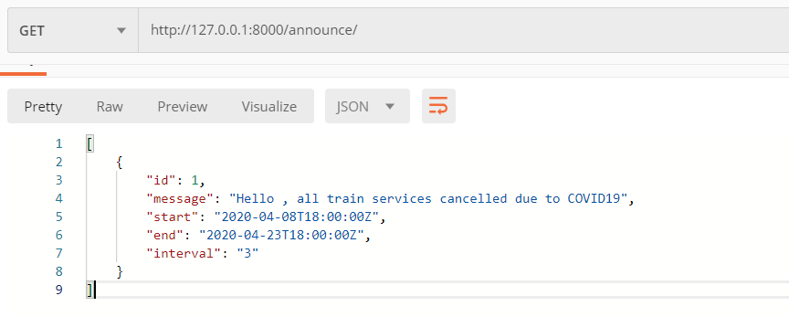
Postman/ Announce -GET

Slide 12
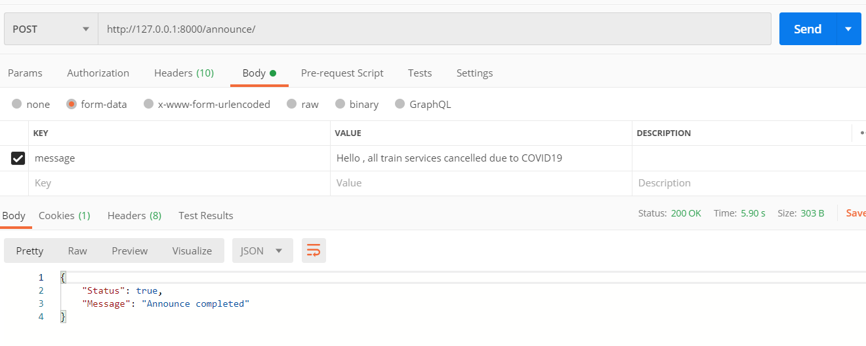
Postman/ Announce -POST

Slide 13
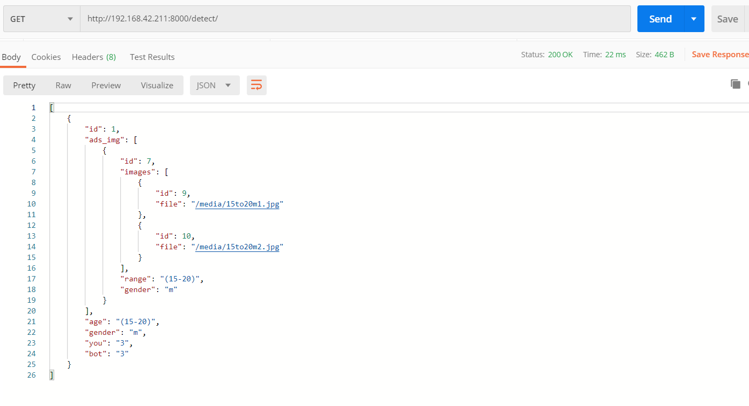
Postman/ detect -GET

Slide 14
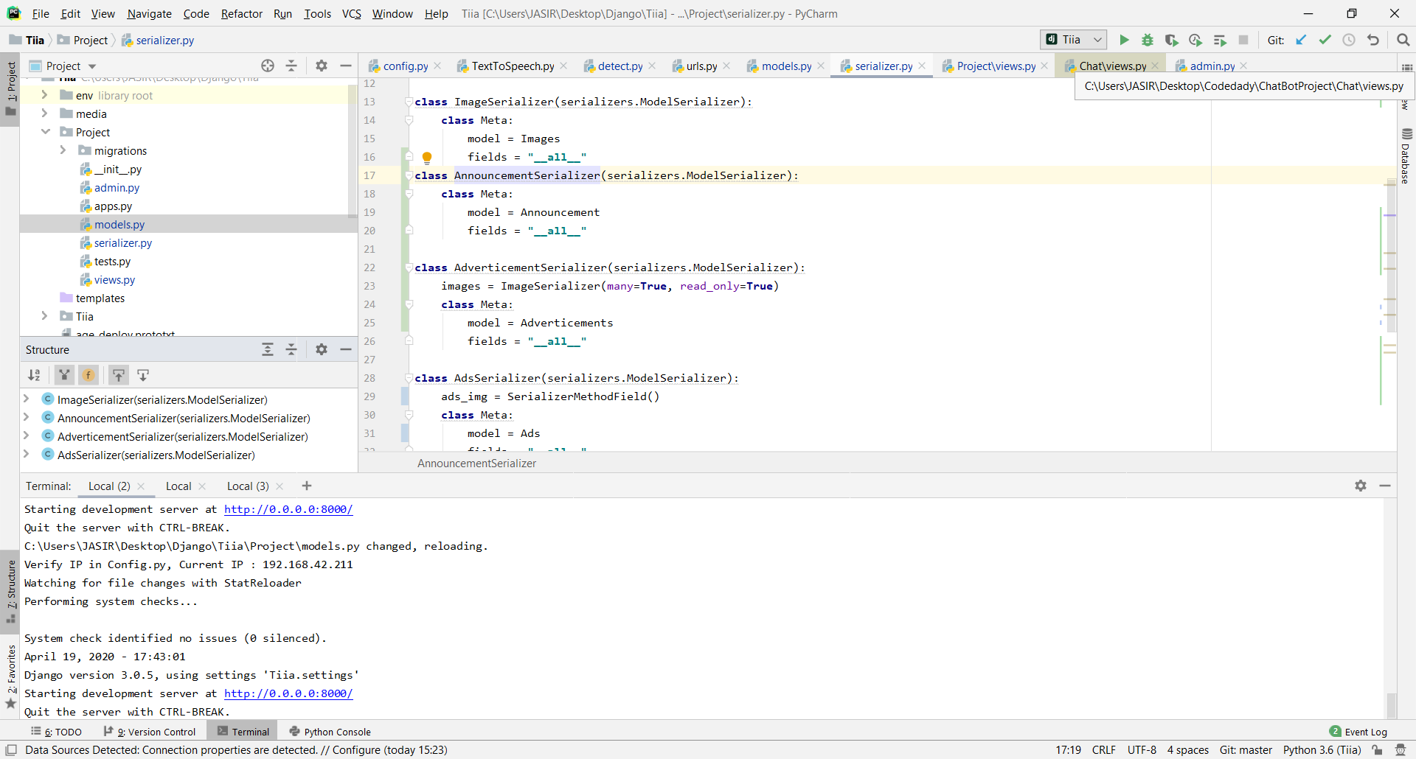
Pycharm IDE

Slide 15
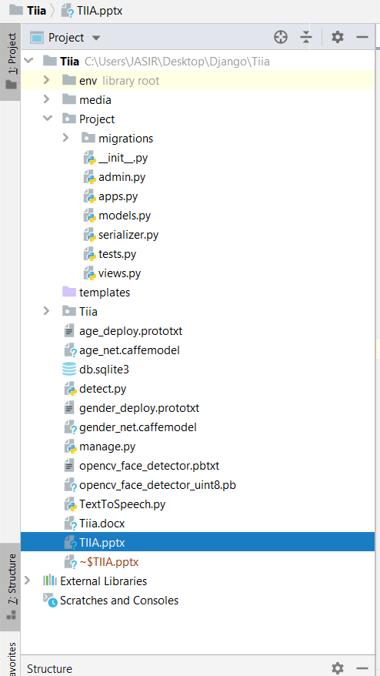
Pycharm IDE

Slide 16
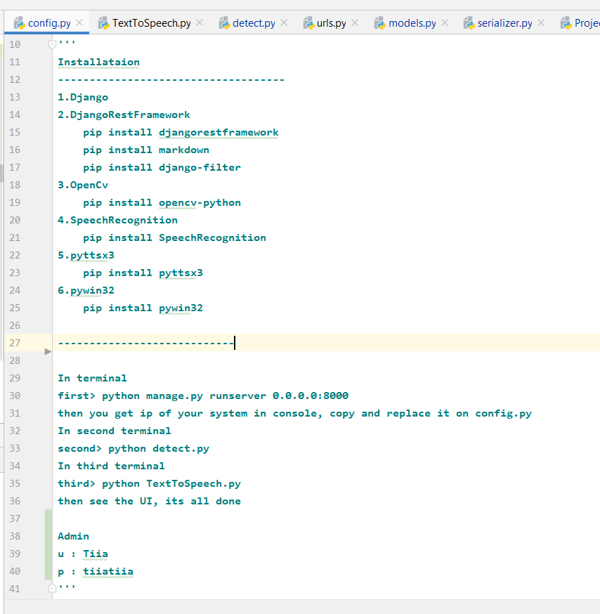
Working

Slide 17
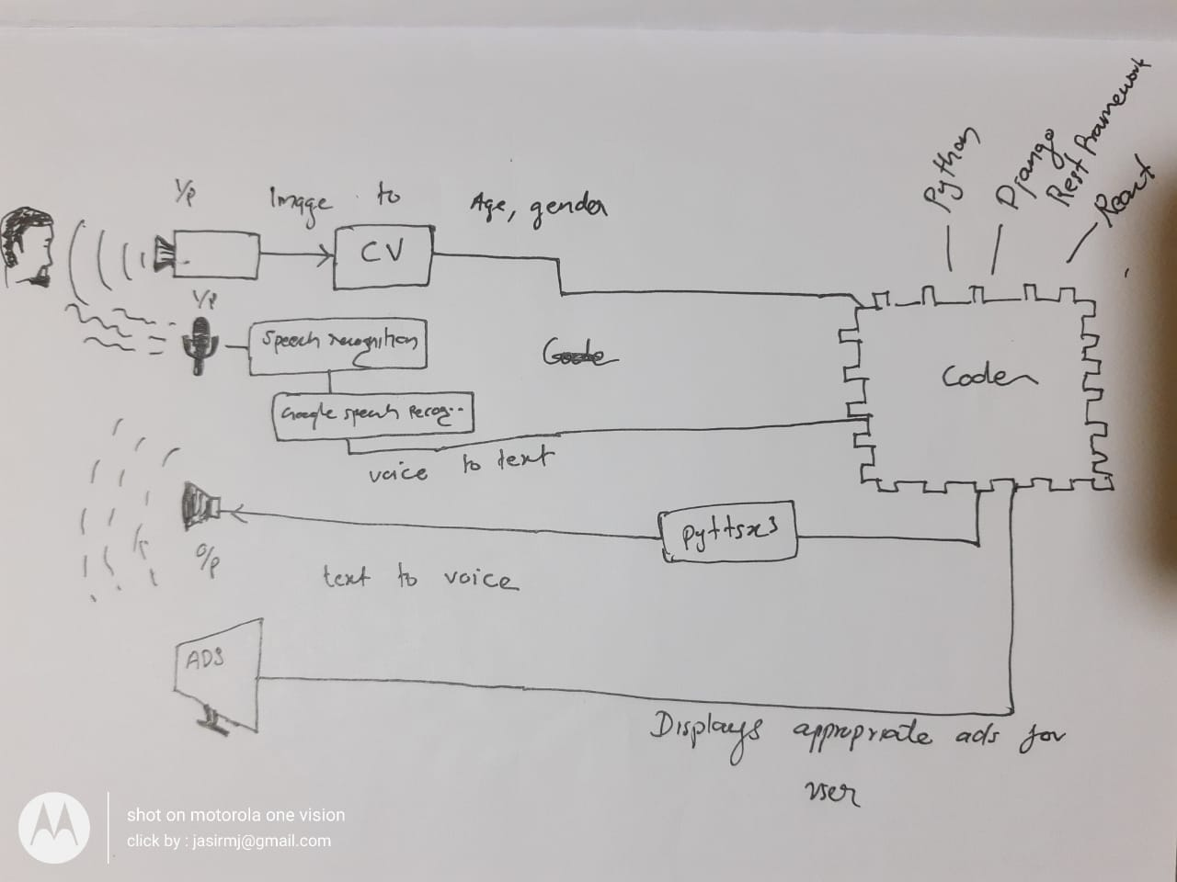
Working

