Slide 1

Customer Behavior Analysis Report
Condensed insights from Jupyter analysis & dashboard.

Slide 2

Objective
Understand customers
Demographics, purchases, subscriptions, seasons, payments
Enable decisions
Support data-driven strategy and targeting

Slide 3

Methodology
01
02
1. Data Collection
2. Cleaning & Transformation
Transactions, demographics, payments, ratings
Handle missing values, standardize categories, compute aggregates
03
3. EDA & Dashboard
Charts: bar, donut, pie, area, treemap. KPI selection

Slide 4
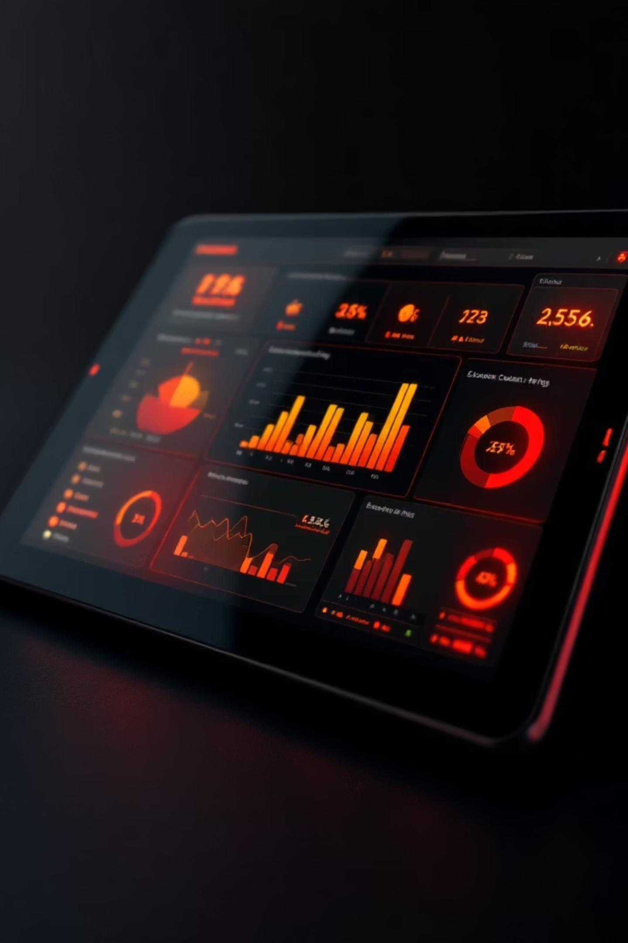
Dashboard — Key KPIs
4K
3.75
Total Customers
Average Rating
$233K
Total Sales

Slide 5

Sales by Category
Clothing
$104K — highest
Accessories
$74K
Footwear
$36K
Outerwear
$19K

Slide 6
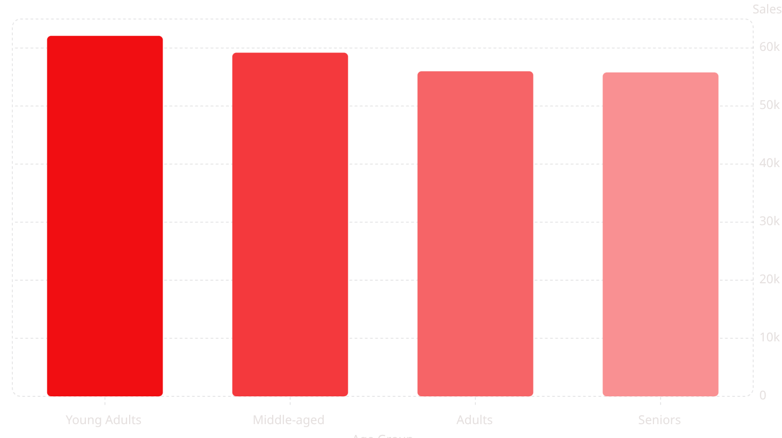
Revenue by Age Group
Young Adults highest at 62.1K

Slide 7

Subscription Impact
Non-subscribers
2.85K — more purchases
Subscribers
1.05K

Slide 8



Gender & Payment Insights
Male
Female
Payments
$158K — higher value
$75K
Credit Card, Cash, PayPal ≈ $40K each; Debit $39K; Venmo & Bank Transfer $37K

Slide 9
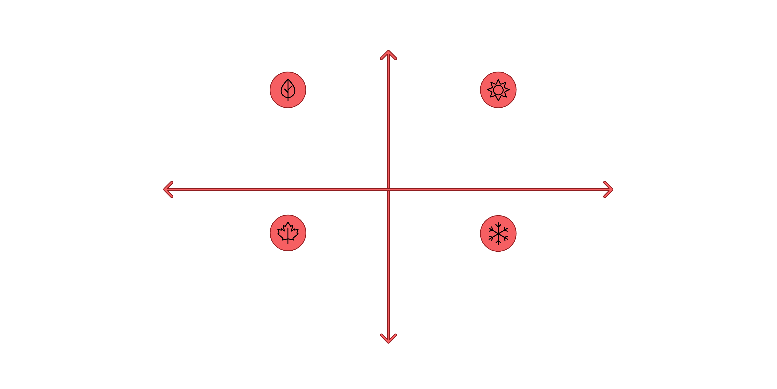

Seasonal Trends
High Seasonal Demand
Spring — Moderate variation, rising demand
Summer — High variation, peak purchases
Low Variation
High Variation
Fall — Moderate-low variation, steady decline
Winter — Low variation, stable baseline
Low Seasonal Demand
Purchasing varies by season — use seasonal filters to target peaks.

Slide 10







Recommendations
1. Focus Categories
2. Target Young Adults
3. Boost Subscriptions
4. Gender Strategy
Prioritize Clothing & Accessories
Personalized offers
Improve benefits to convert non-subscribers
Loyalty for male segment; increase female-targeted campaigns
5. Payment Promotions
6. Seasonal Promotions
Encourage debit & online transfers
Use seasonal campaigns to maximize peaks
Insights align with dashboard metrics and analysis.

