Slide 1
Project Presentation of CO-OP Project at Industry (Module-2) (22CS421)
On
Evaluating Observability Tools in Modern Distributed Backends
Jasjeet Kaur Saini
2210990442
Supervised By
Dr. Preeti Saini
Department of Computer Science and Engineering,
Chitkara University, Punjab

Slide 2
Introduction – Monolith vs Microservice
A monolithic application keeps all features in one codebase and one deployment. It is easy to start with, but scaling is inefficient because the whole app must be copied even when only one part is busy. A failure in one module can affect the entire system.
Microservices split the application into small, independent services such as User, Order, and Payment. Each service can be deployed and scaled on its own, which improves fault isolation. The trade-off is complexity: one user action may cross several services over the network, so problems are harder to trace. Modern backends in e-commerce, banking, and cloud platforms rely on this model, which makes good observability essential.
2

Slide 3
Problem Statement
Distributed backends are difficult to monitor with traditional approaches that focus only on CPU, memory, and uptime. In a checkout flow, a single request may pass through an API gateway, user service, order service, and payment service. Failures are often subtle—a slow payment service, extra network delay, high traffic, or CPU and memory pressure—and they do not always show up as a clear error on one dashboard.
Logs alone are hard to correlate across services. Metrics may show that latency increased but not which service caused it. Teams need to detect problems quickly (mean time to detection, MTTD) and recover faster (mean time to recovery, MTTR). This project evaluates observability tools—Prometheus, Grafana, Jaeger, OpenTelemetry, and Datadog—on a realistic microservices testbed under controlled failure scenarios.
3

Slide 4
Observability and its pillars
Observability is the ability to understand what is happening inside a system by looking at the data it produces, without guessing or redeploying code for every new question.
It rests on three complementary pillars-
Logs are detailed records of events (errors, warnings, request details). They answer what happened at a point in time but can be hard to connect across many services.
Metrics are numeric measurements over time (latency, error rate, throughput, CPU). They are ideal for dashboards, trends, and alerts when values cross a threshold.
Traces follow one request end to end across services and show where time was spent (gateway → user → order → payment). Traces are especially valuable in microservices, where a single user action crosses several hops.
4

Slide 5
Observability Tools
OpenTelemetry provides a standard way to collect traces and metrics from all services, so instrumentation is consistent across the stack.
Prometheus is a pull-based metrics system that stores time-series data such as latency, errors, and resource use, and it supports alerting rules.
Grafana offers dashboards and charts to visualize Prometheus metrics and Jaeger traces in one place.
Jaeger supports distributed tracing by showing the full path of a request and highlighting which service was slow.
Datadog is an optional commercial platform that combines metrics, traces, logs, and automated alerts in a single interface.
Together, these tools represent the three pillars of observability: metrics, traces, and logs.
5

Slide 6
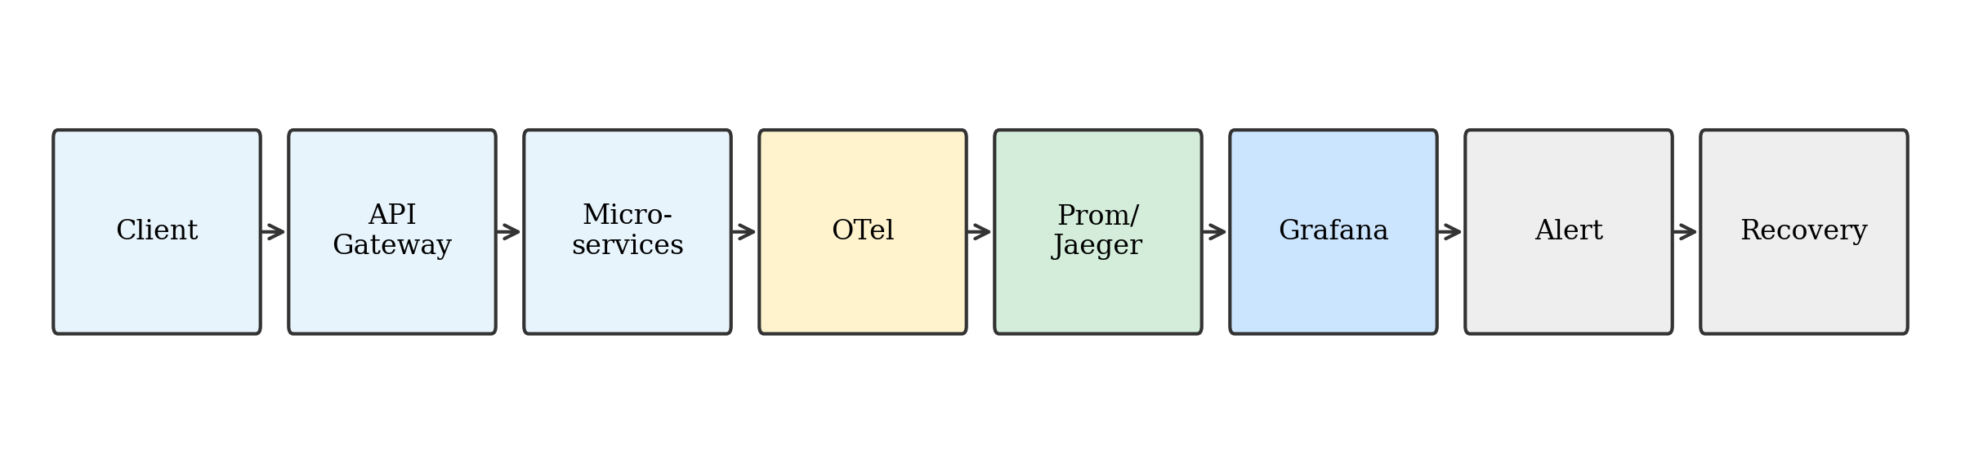
Architecture
All services send telemetry to an OpenTelemetry Collector, which forwards metrics to Prometheus and traces to Jaeger. Grafana queries both backends for visualization. Optionally, data can also be sent to Datadog for comparison with a unified commercial stack.
6

Slide 7
Failure Scenarios
Experiments use six scenarios to test the system under known conditions.
S0 is the healthy baseline with no injected fault.
S1 applies high load using k6, from about 500 to 2000 requests per second, to study performance under stress.
S2 injects a 300 ms delay in the payment service to simulate a slow dependency.
S3 adds network delay on calls from order to payment to model transport-level slowness.
S4 and S5 use LitmusChaos on Kubernetes to create CPU and memory pressure.
For each scenario we measure end-to-end latency (mean and percentiles), how quickly problems are detected (MTTD), and how quickly they are resolved (MTTR), comparing runs with full observability against manual debugging without integrated traces and dashboards.
7

Slide 8
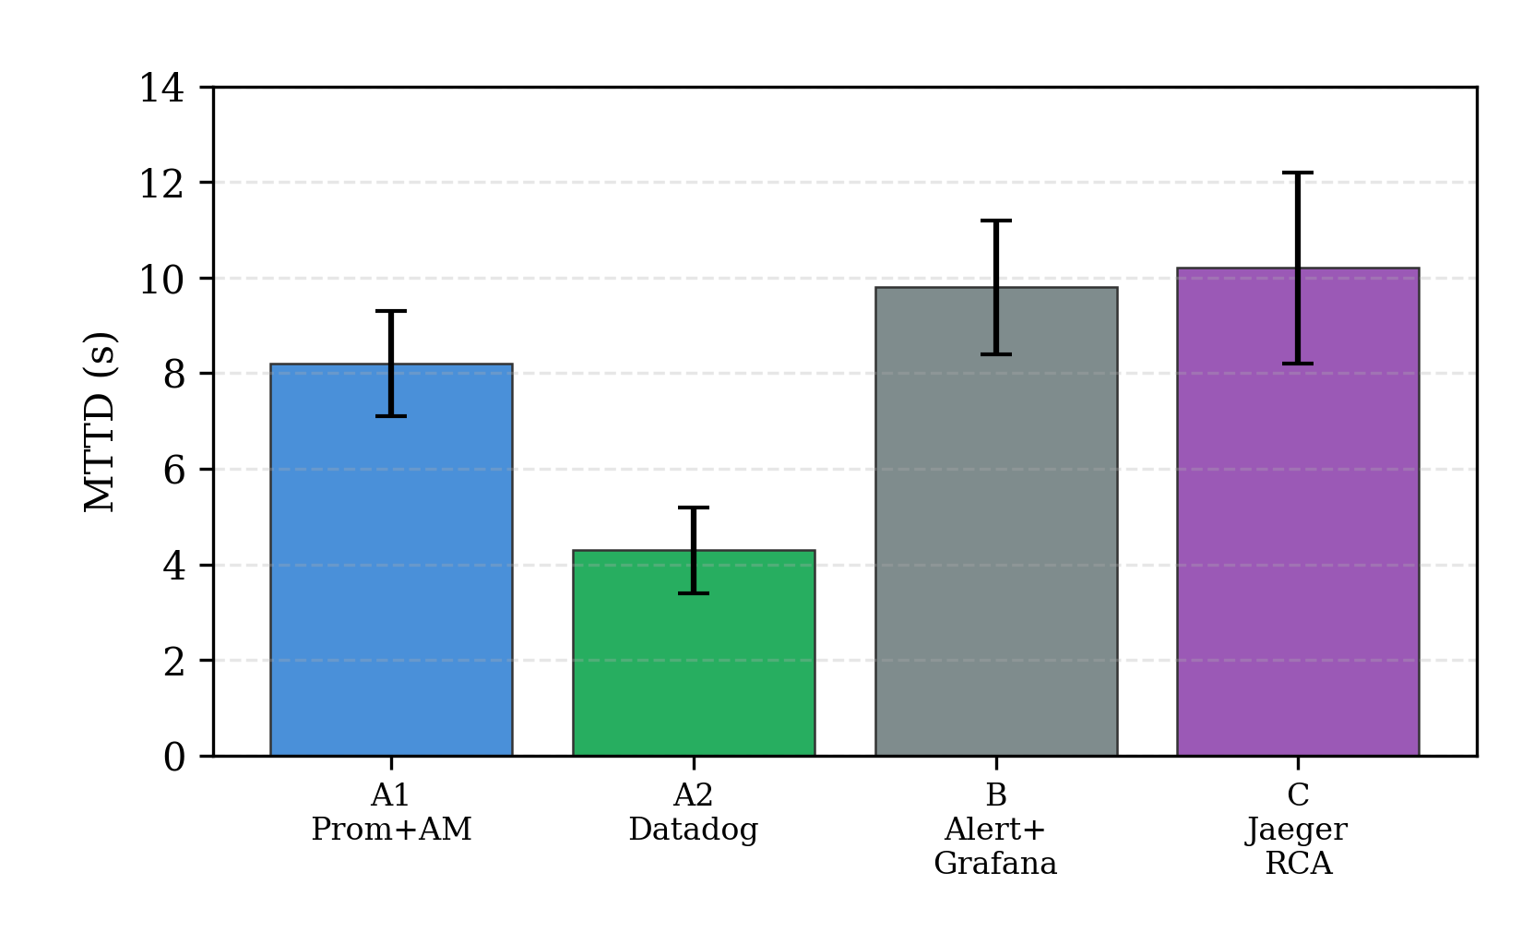
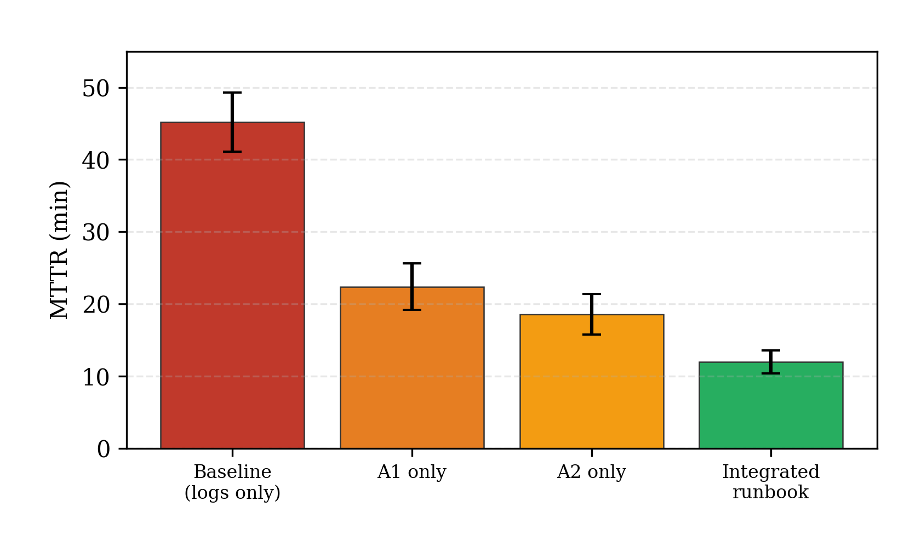
MTTD and MTTR metrics
8

Slide 9
Conclusion
The study shows that latency rises with load even when no fault is injected, which reflects normal queueing under stress. When faults are injected, integrated logs, metrics, and traces help locate the cause faster—for example, identifying the payment service as the bottleneck during payment delay.
In our lab runs, observability-guided recovery reduced mean recovery time from about 45 minutes to about 12 minutes, a large improvement over manual log searching.
No single tool provides complete visibility. A practical approach is to use OpenTelemetry for instrumentation and Prometheus, Grafana, and Jaeger for open-source observability, with Datadog as an option when unified alerting and correlation are required.
Future work can include larger production-like tests, detailed cost and overhead analysis, and automated anomaly detection.
9

Slide 10
Thank You
10

