Slide 1
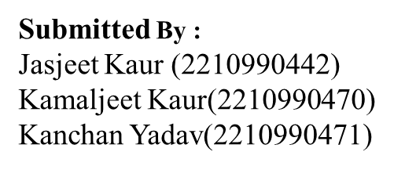
Online Payment Fraud Detection
Using Machine Learning
Supervised by: Ms. Shagun Sharma

Slide 2
Table of Contents
Introduction
Objective
Problem Statement
Solution Statement
Dataset Overview
Technical Details
Project Highlights
Conclusion
References

Slide 3
Introduction
Online payment fraud is a significant concern in today's digital world, as the convenience of online transactions brings with it the risk of fraudulent activities.
Detecting and preventing such fraud is crucial for maintaining trust and security in online payments.

Slide 4
Objective
Our project aims to tackle this issue by utilizing machine learning techniques. By using machine learning, we seek to develop effective tools that can automatically identify online payment fraud.
By doing so, we strive to enhance the safety and reliability of online transactions for all users.

Slide 5
Problem statement
As we move towards future, online payments are becoming increasingly popular, offering convenience and solving the hassle of carrying cash. However, this trend also brings along the risk of fraudulent activities.
Online payment fraud is a growing concern, undermining trust and security in digital transactions. Fraudulent activities can lead to financial losses and compromise personal information.
Detecting and preventing online payment fraud is essential to ensure the safety and reliability of digital transactions for all users.

Slide 6
Solution statement
We're using machine learning techniques to tackle this problem head-on.
By analyzing patterns in online transactions, our tools can quickly spot suspicious activity and stop fraudsters in their tracks.
This not only safeguards users but also ensures a safer and more secure online shopping experience for everyone.

Slide 7
Dataset Overview
Our dataset comprises various columns, each serving a unique purpose in understanding online payment transactions.
These columns include:
step: Represents the unit of time.
type: Indicates the type of transaction conducted.
amount: Denotes the total transaction amount.
nameOrig: Refers to the account initiating the transaction.
oldbalanceOrg: Displays the sender's account balance before the transaction.
newbalanceOrg: Shows the sender's account balance after the transaction.
nameDest": Represents the receiving account.

Slide 8
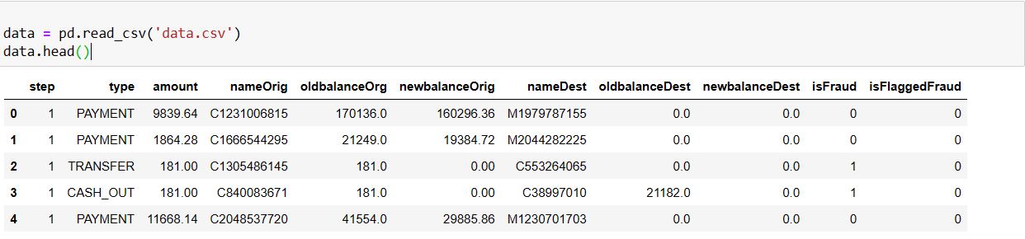
Dataset Overview
oldbalanceDest: Indicates the recipient's account balance before the transaction.
newbalanceDest: Illustrates the recipient's account balance after the transaction.
isFraud: Binary value (0 or 1) indicating fraudulent or non-fraudulent transactions.
Here are some sample records from the dataset:

Slide 9
Technical Details
Numpy: Provide support for large, multi-dimentional arrays along with collection of mathematical function to operate on these array efficiently.
Pandas: library for data manipulation & series provides function to read and work data.
Data visualization:
Matplotlib: for creating static, interactive visualisation with ease.
Seaborn: it is a library based on Matplotlib that provides a high-level interface for creating attractive statistical graphics.

Slide 10
Technical Details
Sklearn: Scikit-learn is a versatile machine learning library in Python that offers simple and efficient tools for data mining and analysis.
Roc_auc_score: evaluates the performance of binary classification models based on the area under the Receiver Operating Characteristic (ROC) curve.
LogisticRegression: Logistic Regression is a linear classification algorithm used for binary and multiclass classification tasks.

Slide 11
Technical Details
3. SVC: It finds the hyperplane that best separates classes by maximizing the margin between them.
4. RandomForestClassifier: It builds multiple decision trees during training and outputs the mode of the classes for classification tasks.
5. Confusion_matrix: A confusion matrix tabulates the counts of true positive, true negative, false positive, and false negative predictions for evaluating classification models.
6. Classification_report: The classification report provides precision, recall, F1-score, and support for each class, summarizing the performance of a classification model.

Slide 12
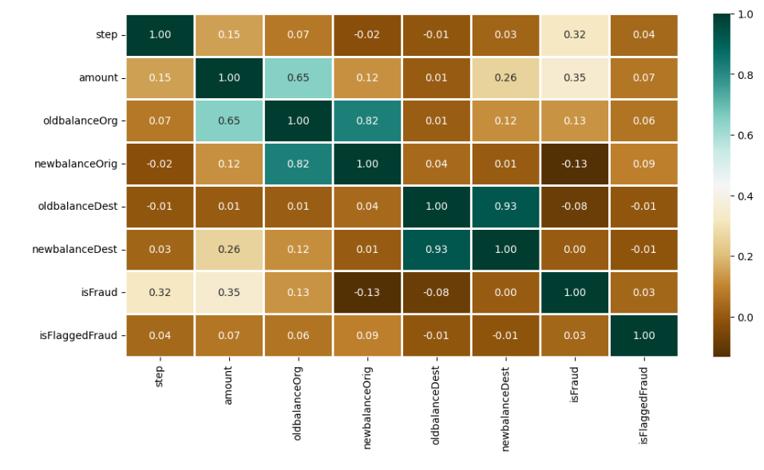
Project Highlights
This heatmap is showing corelations of various varibales.

Slide 13
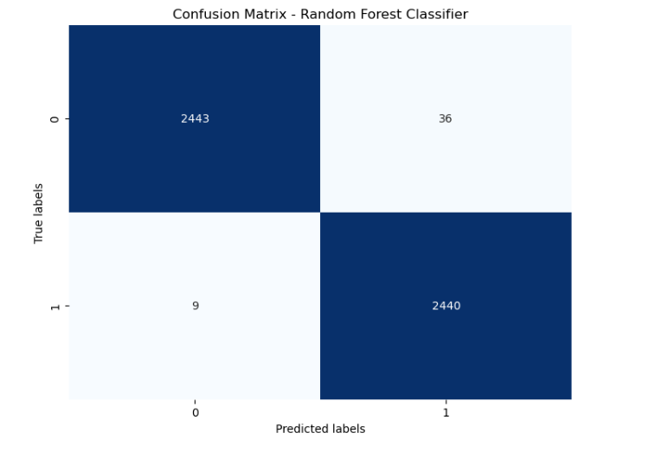
Project Highlights

Slide 14
Conclusion
In conclusion, our project endeavors to combat the prevalent issue of online payment fraud through the application of machine learning techniques.
By harnessing the power of machine learning, we aim to create robust tools capable of autonomously detecting and preventing fraudulent activities in online transactions.
Our efforts are directed towards enhancing the safety and reliability of online transactions for all users. By leveraging advanced algorithms and data-driven approaches, we aspire to contribute to a more secure digital environment, fostering trust and confidence in online payment systems.
Through continuous innovation and collaboration, we remain committed to safeguarding the integrity of online transactions and ensuring a seamless experience for users worldwide.

Slide 15
References/Links used
Geeks for Geeks: https://www.geeksforgeeks.org
kaggle :https://www.kaggle.com/datasets/rupakroy/online-payments-fraud-detection-dataset

Slide 16


