Slide 1
AIML Project
Finance Tracker
Submitted By :
Jasjeet Kaur (2210990442)
Submitted To :
Mr. Tushar

Slide 2
Table of content
Introduction
Problem Statement
Technical Details
Key Features
Project Highlights
References/Links used

Slide 3
Introduction
Take Control of Your Finances with Finance Tracker!
This user-friendly application, built with Python's Tkinter module and enhanced with the customtkinter library for a sleek design, empowers you to manage your income and expenses effortlessly.

Slide 4
Problem Statement
Many personal finance management applications suffer from clunky and confusing interfaces. This lack of visual appeal can significantly discourage users from consistently tracking their income and expenses, which is a crucial step towards achieving financial goals. Inconsistent tracking makes it difficult to understand spending habits and identify areas for improvement, creating a significant roadblock on the path to financial well-being.

Slide 5
Solution Statement
This Python finance tracker application, built with a custom Tkinter interface, offers a user-friendly and visually appealing solution. The intuitive interface allows users to effortlessly add income and expenses, while a dynamic pie chart brings financial data to life, empowering users to make informed decisions.

Slide 6
Technical Details
Tkinter: The application uses Tkinter, Python's built-in GUI library, for the interface.
customtkinter: The application enhances the interface with customtkinter, a library that provides more appealing widgets and themes.
Matplotlib: The application uses Matplotlib to create the pie chart.

Slide 7
Key Features
Intuitive User Interface: The application utilizes customtkinter to provide a visually appealing and user-friendly interface that is easy to navigate.
Effortless Transaction Tracking: Users can seamlessly record both income and expense transactions by specifying the category and amount.
Comprehensive Transaction History: The application maintains a detailed record of all income and expense transactions. Users can easily access this history to review their spending habits and identify areas for potential improvement.
Interactive Pie Chart Visualization: A dynamic pie chart visually represents the user's income and expenses.
Data Validation and Error Handling: The application incorporates error handling mechanisms to ensure data integrity.

Slide 8

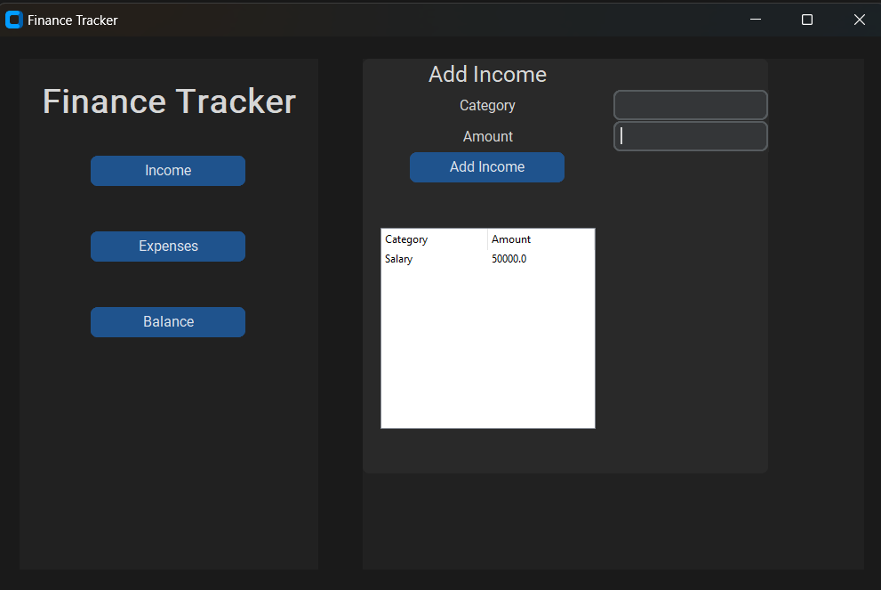
Here are few Project snapshots for preview:

Slide 9



Slide 10
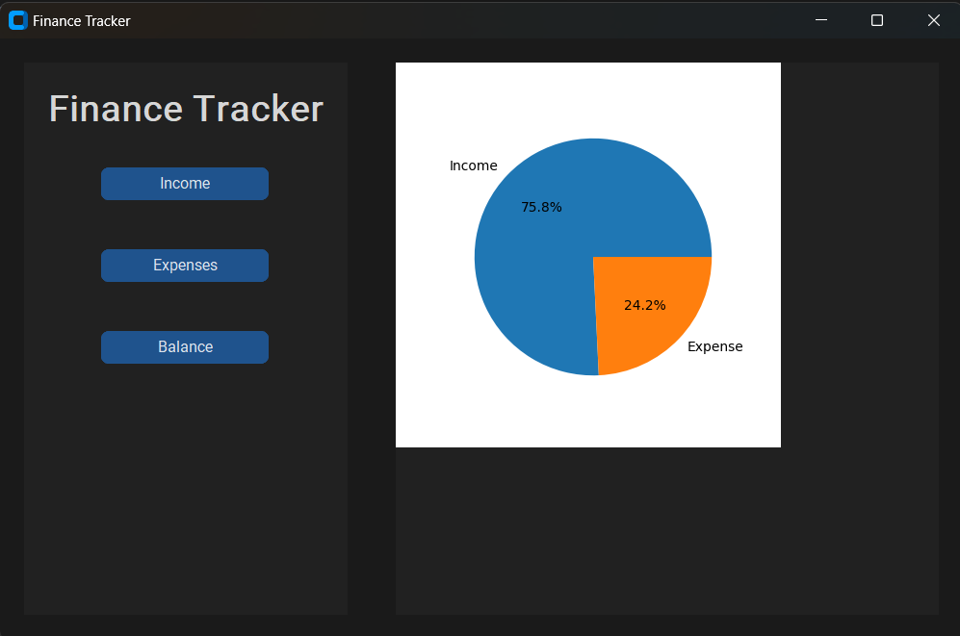
Project Highlights

Slide 11
References/Links used
customtkinter repository- https://github.com/TomSchimansky/CustomTkinter
Matplotlib documentation - https://matplotlib.org/
Tkinter Tutorial- Pinterest - https://realpython.com/tutorials/gui/

Slide 12


