Slide 1

1
Interactive Data Visualization Using
Python
Department of Mechanical, Industrial & Aerospace Engineering
INSTRUCTOR
Presented By-
Jasjit Singh
40171474
Adrit Sulce

Slide 2
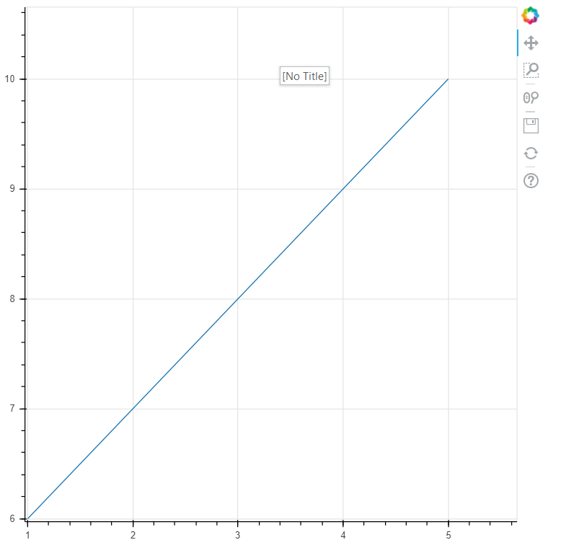
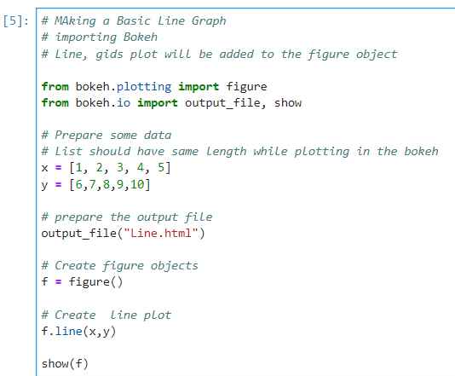
2
A) Plotting of the Line Graph
Using Bokeh Library
Documentation - https://docs.bokeh.org/en/latest/

Slide 3
3

