Slide 1

1
Interactive Data Visualization Using
Python
Department of Mechanical, Industrial & Aerospace Engineering
INSTRUCTOR
Presented By-
Jasjit Singh
40171474
Adrit Sulce

Slide 2
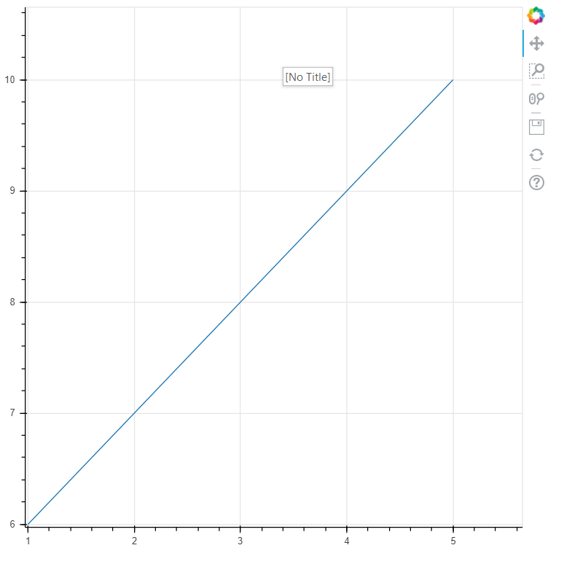
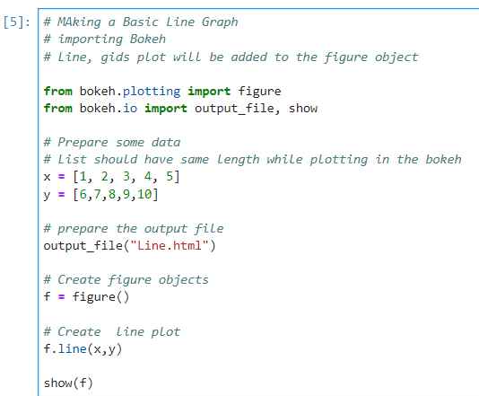
2
A) Plotting of the Line Graph
Using Bokeh Library
Documentation - https://docs.bokeh.org/en/latest/

Slide 3
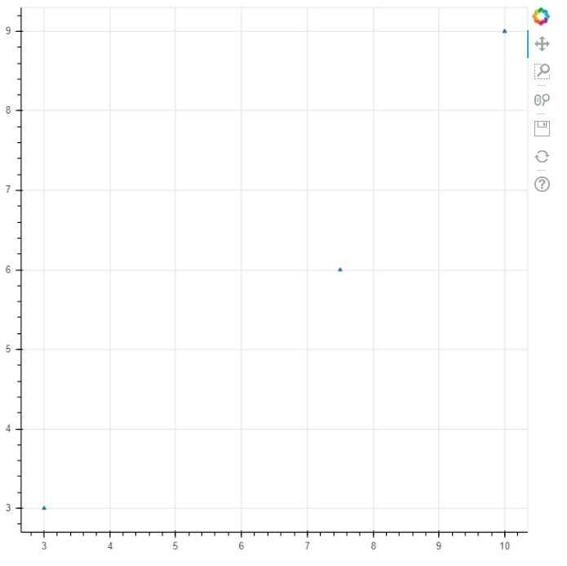
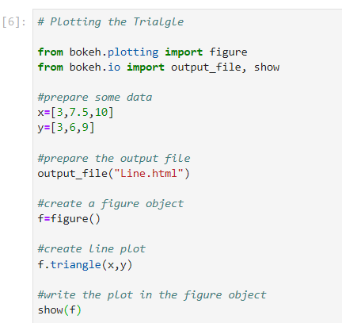
3
B) Plotting the Triangle

Slide 4
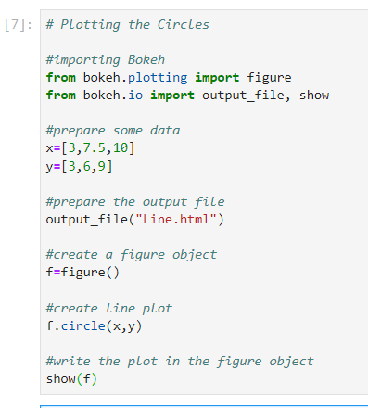
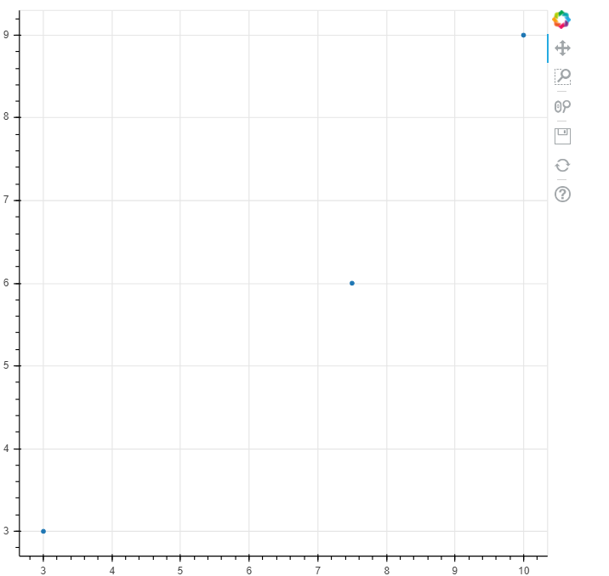
4
C) Plotting the Circles

Slide 5
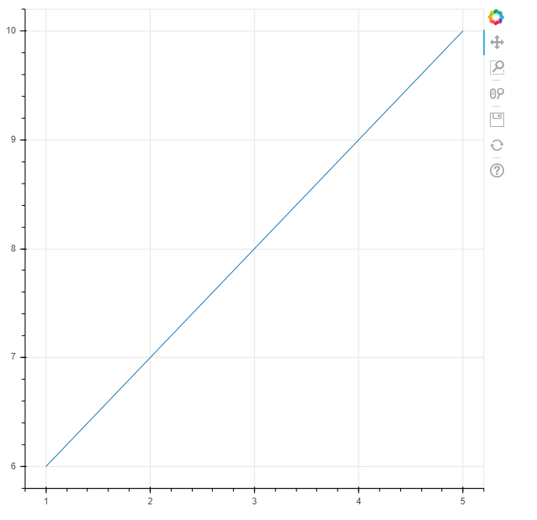
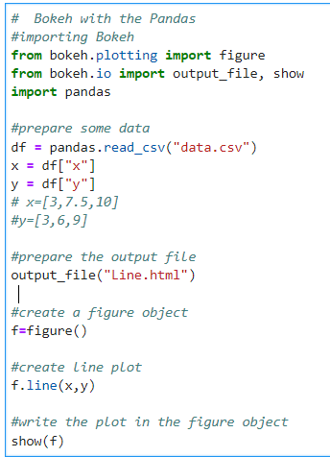
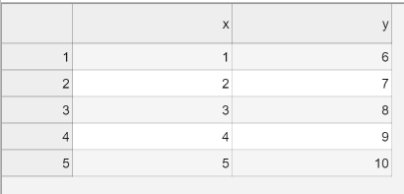
5
D) Using Bokeh with Pandas
# Importing Data From the CSV file :-
Resources - https://docs.bokeh.org/en/latest/
https://pandas.pydata.org/docs/
Csv file data

Slide 6
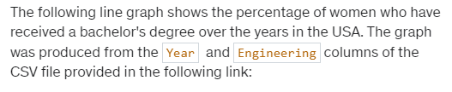
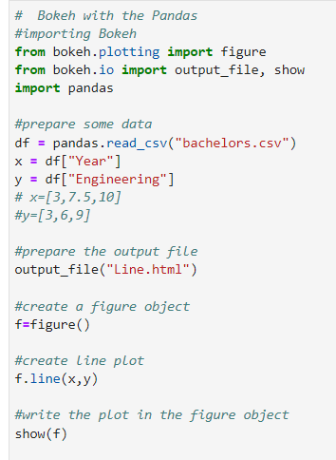
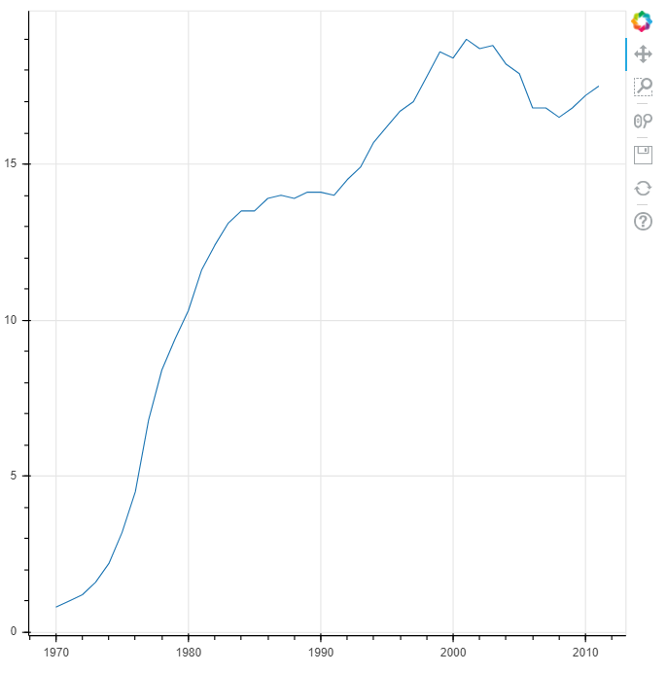
6
E) Plot the Data ufrom CSV using the Bokeh
Csv File - https://pythonizing.github.io/data/bachelors.csv

Slide 7
6
E) Plot the Data from CSV using the Bokeh
In the next lecture, you will learn how to load Excel files in Python with pandas. For this, you need pandas (which you have already installed) and also two other dependencies that pandas needs for opening Excel files. You can install them with pip:
Command for Installation within Jupyter Notebook -:
! pip3.9 install openpyxl (needed to load Excel .xlsx files)
! pip3.9 install xlrd (needed to load Excel old .xls files)

