Slide 1
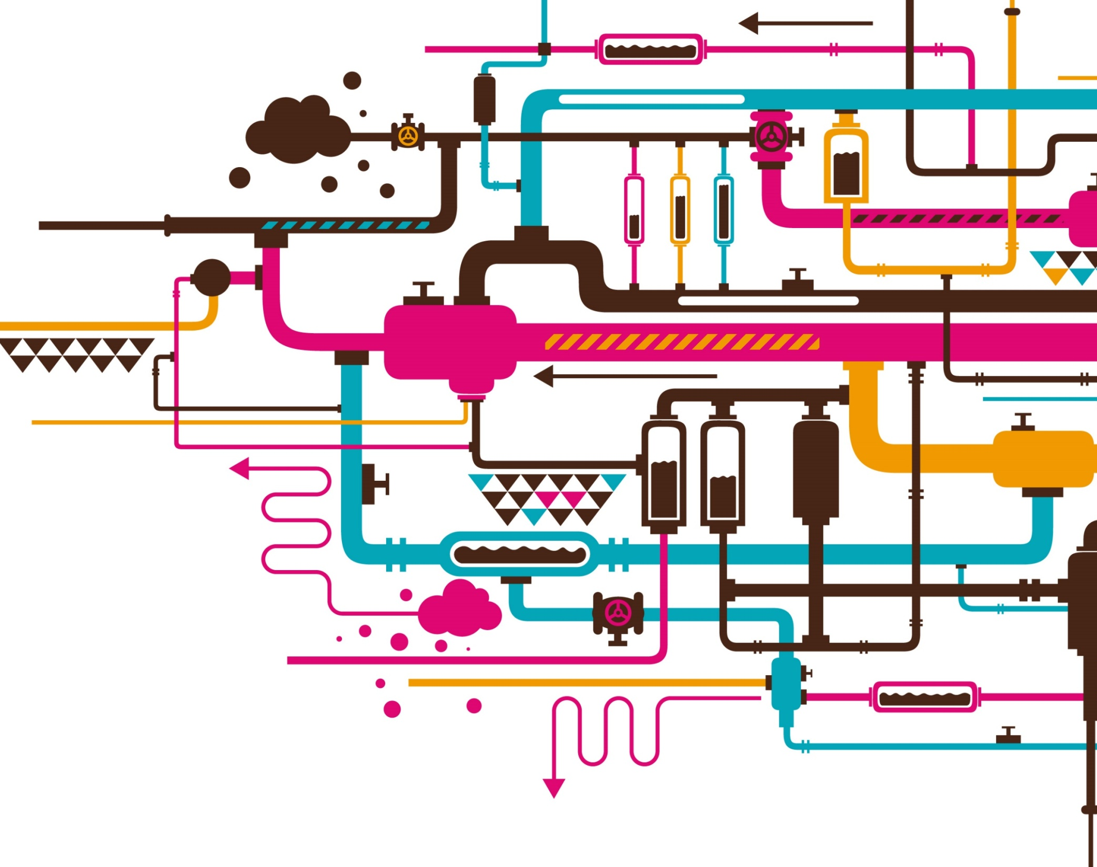
“DevSecOps: Automated CI/CD Pipeline”
Jasjit Singh Rudra

Slide 2
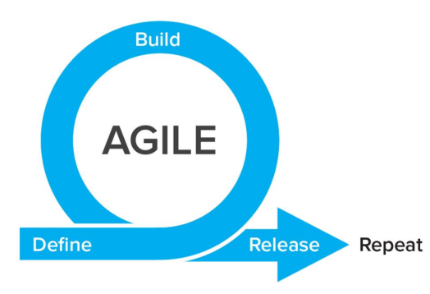
Agile
“We practice improvement through work, work through improvement, one sprint at a time!”
Agile is a time-bound, iterative approach to software delivery that builds software incrementally from the start of the project, instead of trying to deliver all at once.
Highest priority is to satisfy the customer through early and continuous delivery of valuable software.
It welcomes changing requirements, even late in development.
Deliver working software frequently, from a couple of weeks to a couple of months, with a preference to the shortest timescale.
Deployment of software is quicker and thus helps in increasing the trust of the customer.
Can better adapt to rapidly changing requirements and respond faster.
Helps in getting immediate feedback which can be used to improve the software in the next increment.

Slide 3
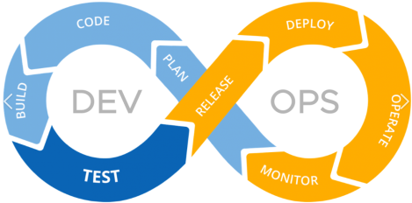
DevOps
DevOps is the combination of two words, one is Development and other is Operations.
It is a culture to promote the development and operation process collectively.
It allows a single team to handle the entire application lifecycle, from development to testing, deployment, and operations.
DevOps helps you to reduce the disconnection between software developers, quality assurance (QA) engineers, and system administrators.

Slide 4

CI/CD
CI/CD stands for Continuous Integration and Continuous Delivery
It is about how an Integrated code on a shared repository is used to release software to production multiple times a day with the help of automation.
Jenkins is a tool that is used for automation, and it is an open-source server that allows all the developers to build, test and deploy software.
By using Jenkins, we can make a continuous integration of projects(jobs) or end-to-endpoint automation.

Slide 5
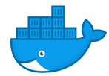
Containerization
Containerization is OS-based virtualization which creates multiple virtual units in the user space, known as Containers.
Containers share the same host kernel but are isolated from each other through private namespaces and resource control mechanisms at the OS level.
Docker is the containerization platform which is used to package your application and all its dependencies together in the form of containers so to make sure that your application works seamlessly in any environment which can be development or test or production.
It is a tool designed to make it easier to create, deploy, run applications by using containers.

Slide 6
Our Project
WebApp
A fitness tracking system that takes inputs entered by users suggests them an exercise plan and calculates their Body Mass Index. It contains an interactive UI and following pages:-
Welcome Page: The first page of the website.
Home Page: Page to take inputs and suggest exercise plans.
Contact Us: Registers queries entered by user.
About Us: Informative page about the website.

Slide 7
Our Project
Centralized Repository
It is where our code is stored and webhooks get triggered whenever any change is pushed by developers (either through their IDEs or from Github itself.

Slide 8
Our Project
CI/CD (Jenkins)
A maven project is configured on our Jenkins server, hosted on Amazon EC2 that runs maven commands- clean install package to build our war file from code being pushed onto git repository.

Slide 9
Our Project
Containerizing and Hosting (Docker)
Docker has been used to containerize our Java war.
Docker runs on a docker host which is installed on an Amazon EC2 server. This the server which finally hosts our website for everyone on the internet to use.

Slide 10
Screenshots

Slide 11
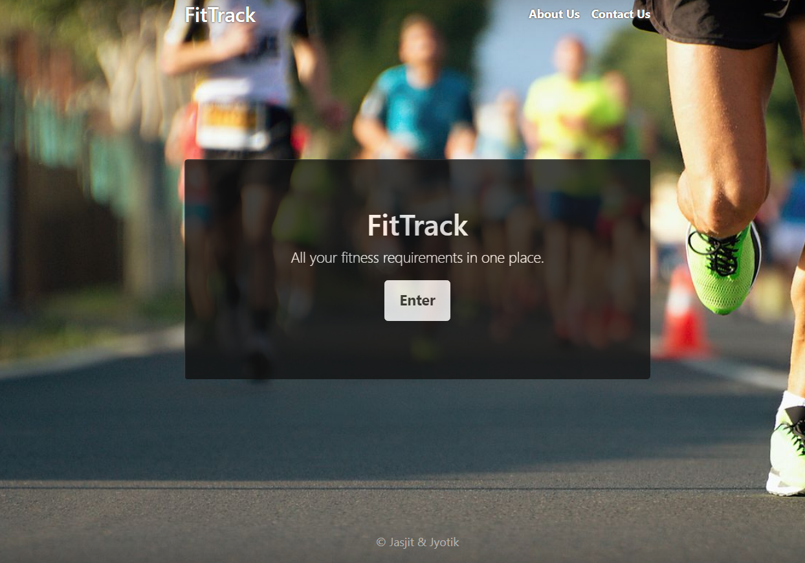
Home Page

Slide 12
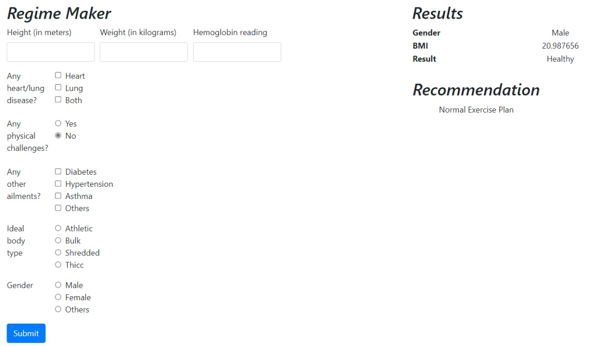
Main Page: Calculates BMI and Recommends Exercise Plan

Slide 13
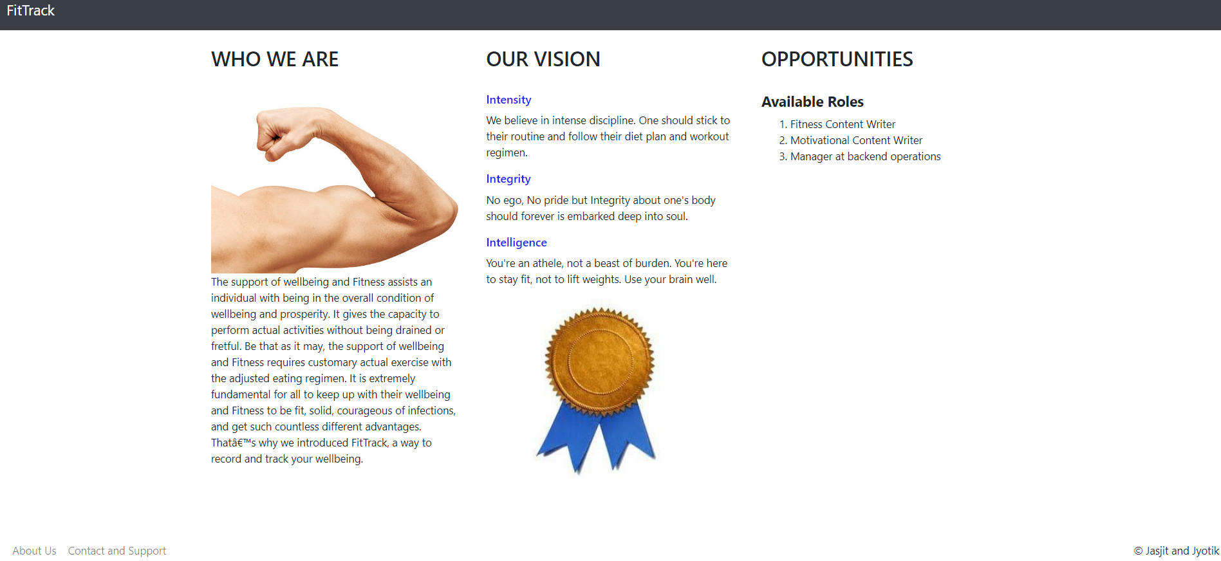
About us Page

Slide 14
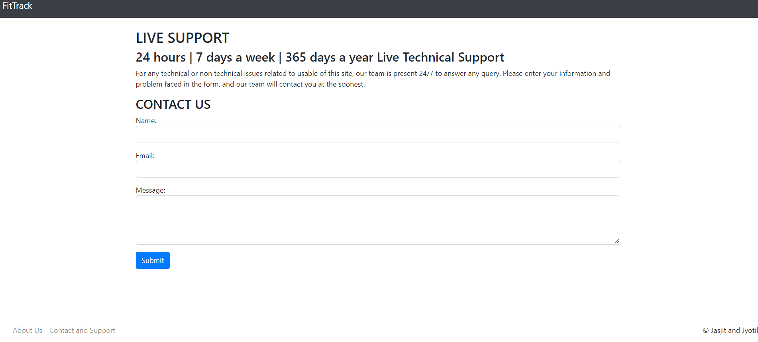
Contact Us Page

Slide 15
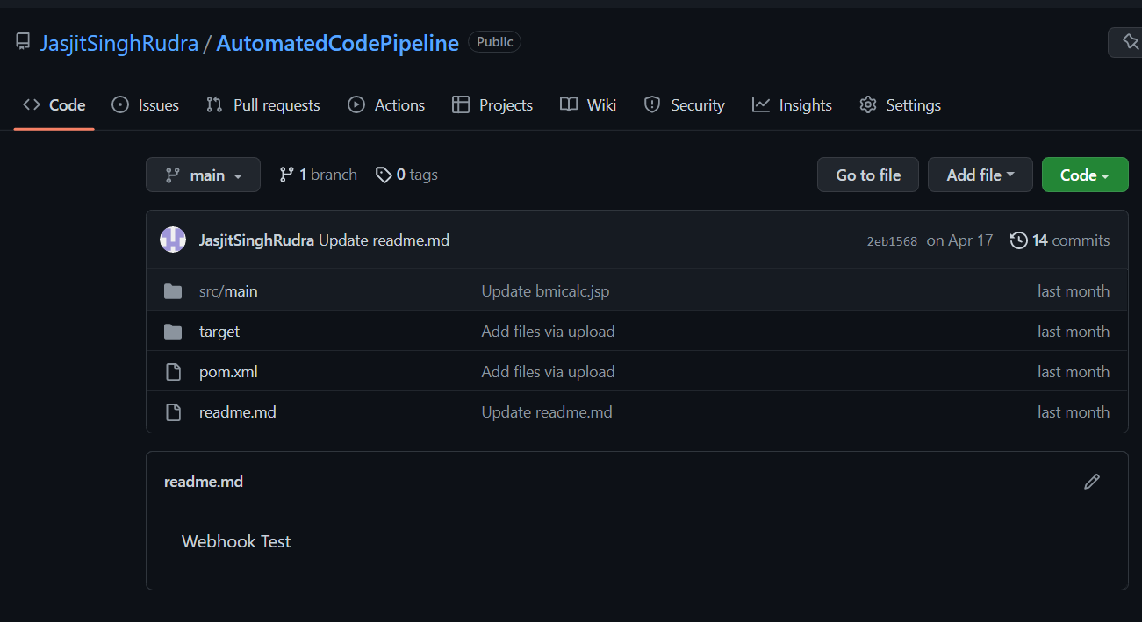
VCS Repository

Slide 16
Jenkins Server

Slide 17
Docker Server

Slide 18

Any Questions?

