Slide 1
CEOL
A social media platform for artists and people in the music community where they can share their ideas, jam together, form bands and learn more about the local gigs and events going on so they can grow and in-turn the community grows.

Slide 2
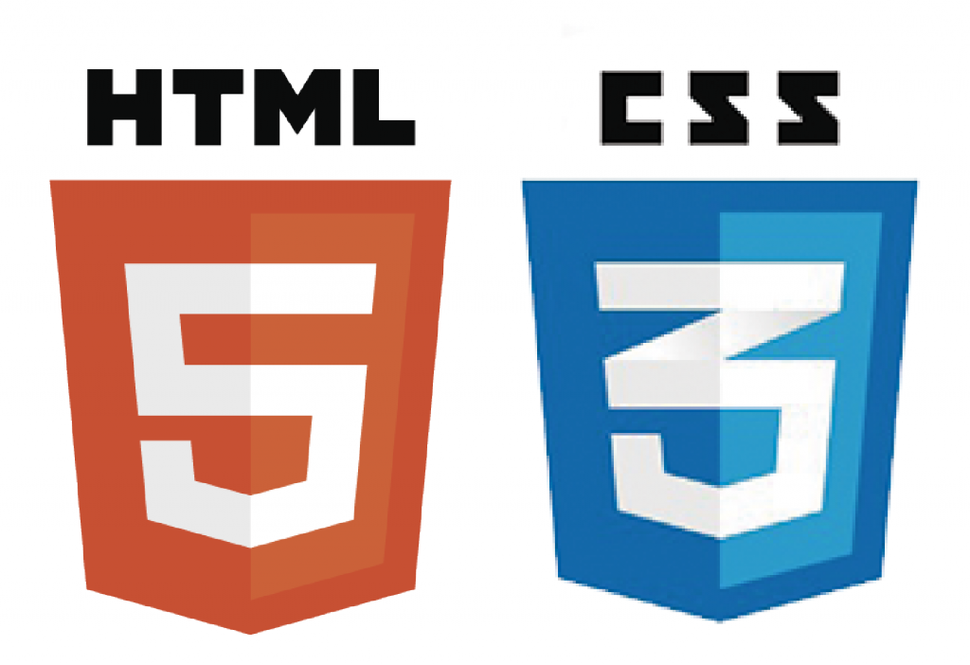



Technologies used:
PHP is used to make scripts
To connect the SQL backend with the
Website.
Html and CSS for making the barebone structure of website. It’s the skeleton framework of the website design
Bootstrap is used as an secondary framework for applying modular components in the website.
SQL is used for database backend.

Slide 3
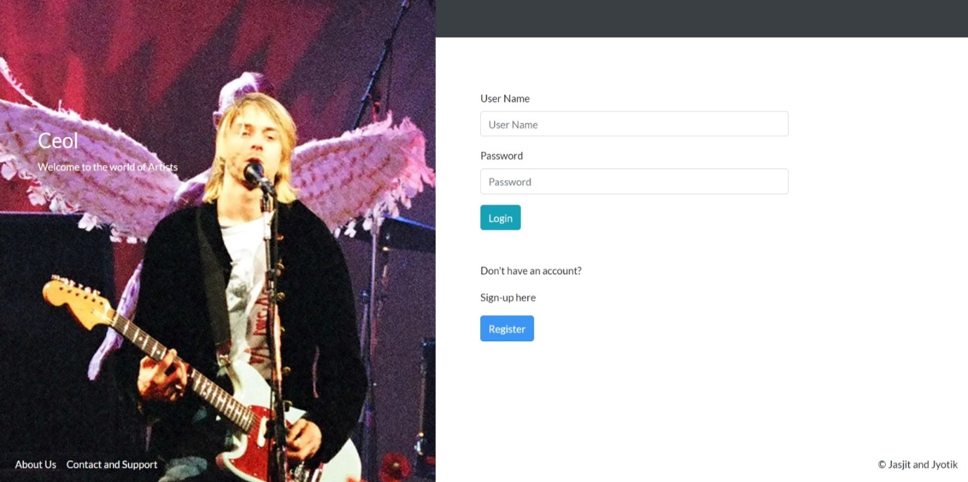
Ceol: Ceol-home
Login page:
You add your user-name and password and you are good to go.
If you don’t have an account you can click on Register to get yourself registered.

Slide 4
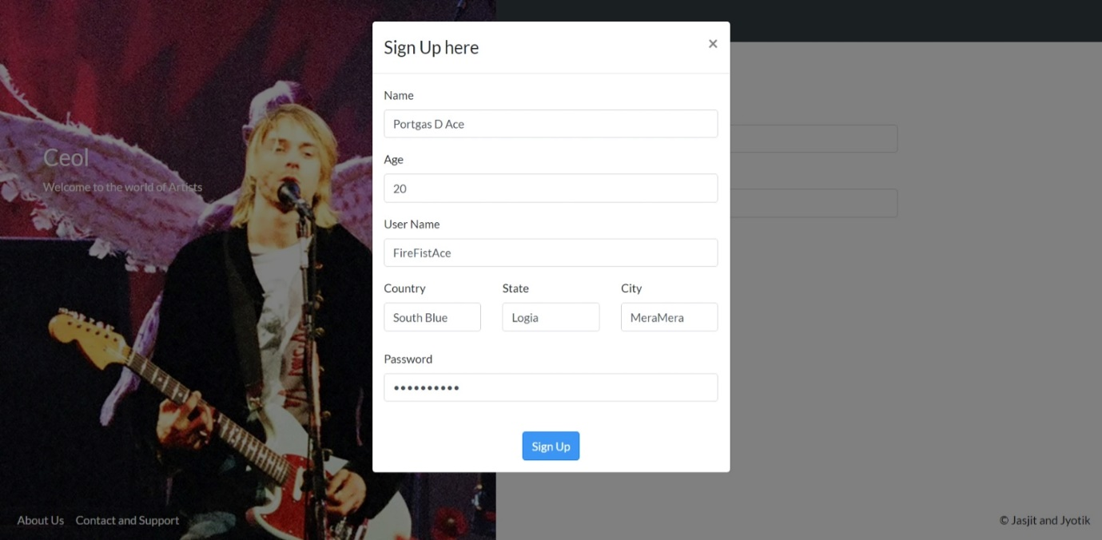
Sign-Up page
The Sign-up is a modal form which opens on the login page itself.
You have to fill in your basic details and the details are sent to the database to get you registered.

Slide 5
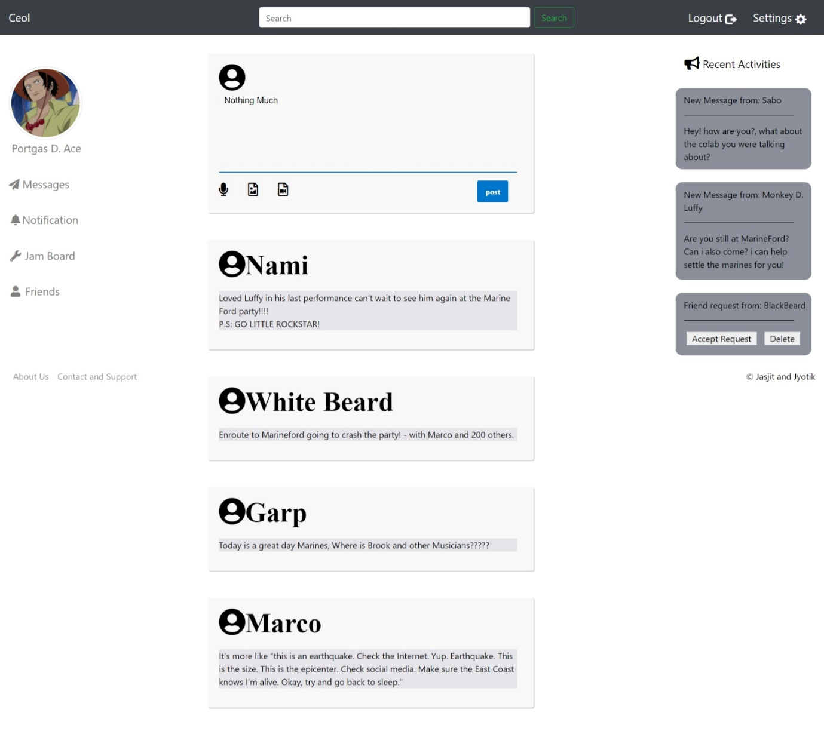
Home-Page
Left panel is for displaying various website controls.
Right panel:
Displays the new messages you got and the various friend Requests you get.
As the name suggests its for Recent Activities in the virtual world of the website.
The middle panel displays the new post area and the posts made by friends and people who you follow.

Slide 6
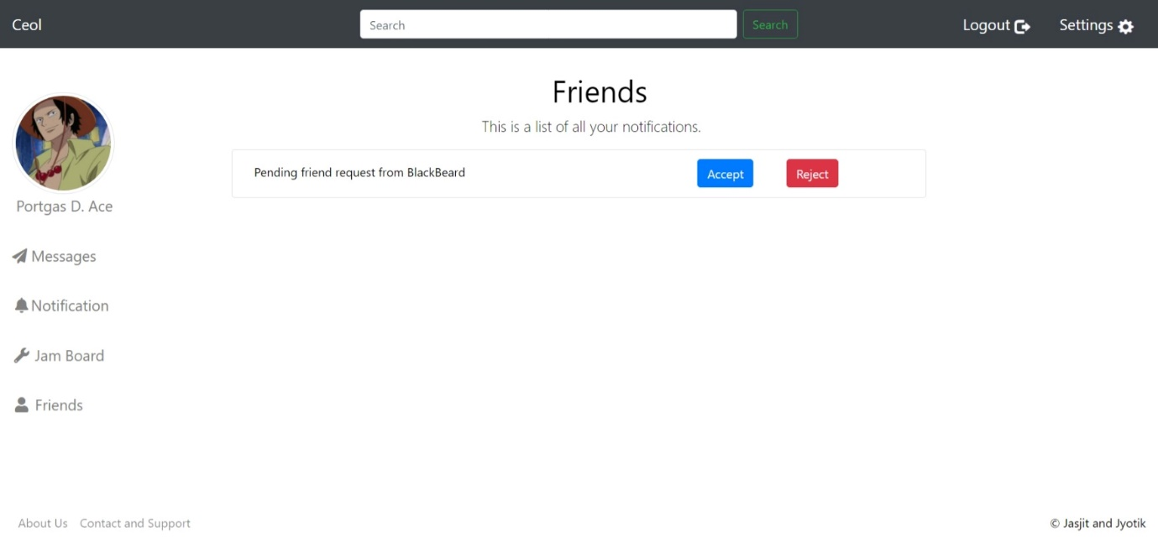
Notifications Page:

Slide 7
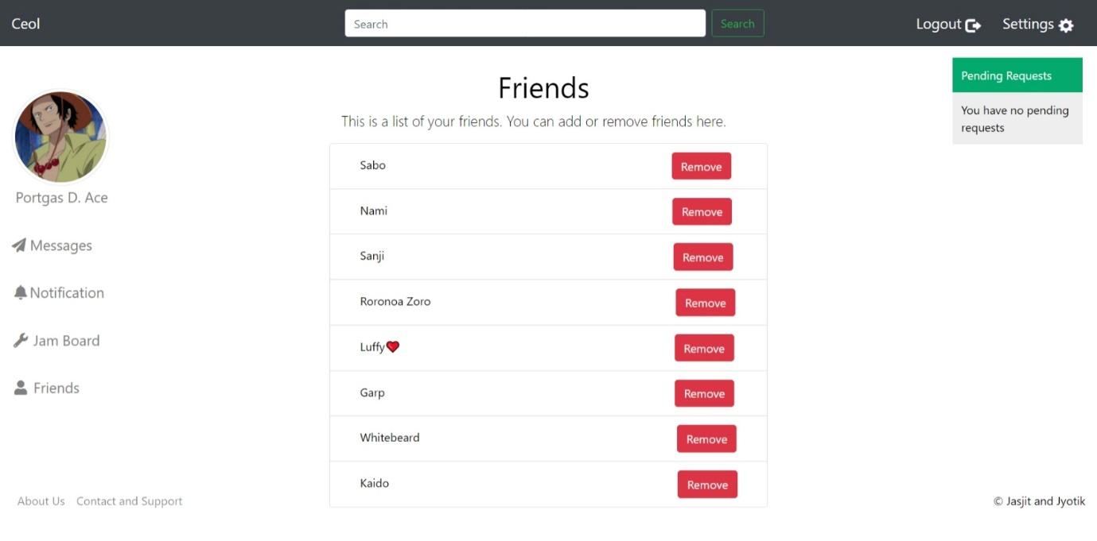
Friends Page:

Slide 8
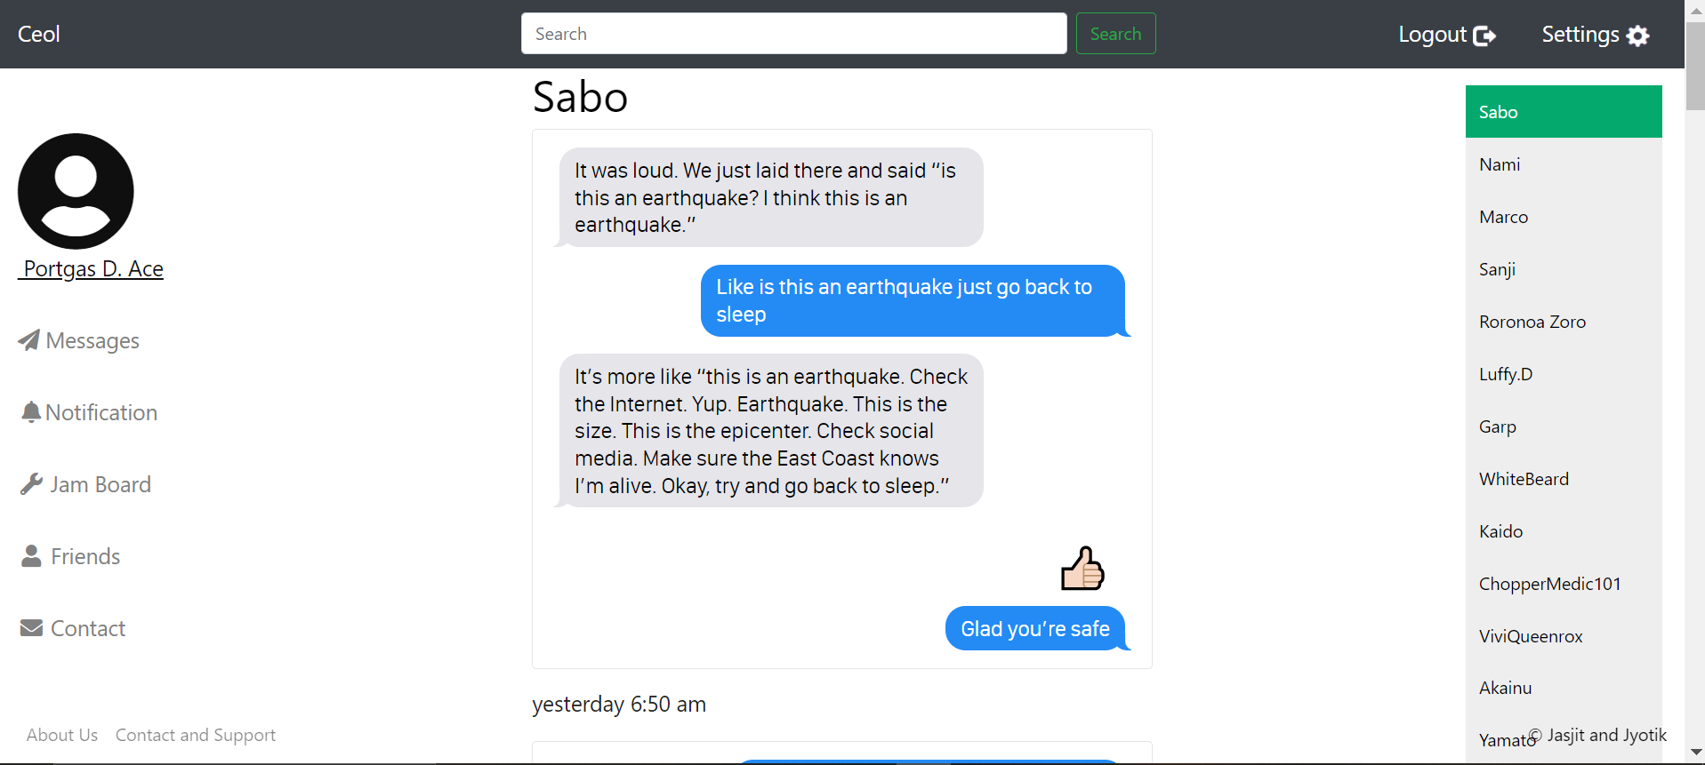
Messages:
Right Panel:
Shows your Friend list and the person you are currently connected to is highlighted in Green Color.

Slide 9
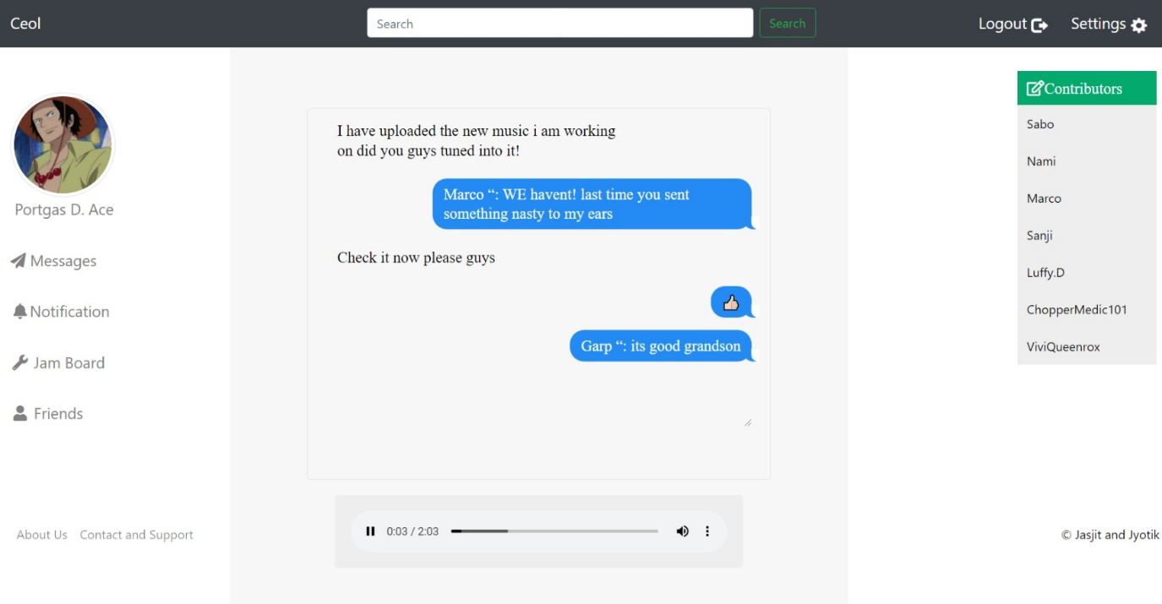
Jam-Board:
Jam board:
It’s the place where you(artist) can connect with your friends and share your ideas in the format of music files and videos. Pictures and text also.
Right Panel: shows the people who are the contributors to the Jamboard.

Slide 10
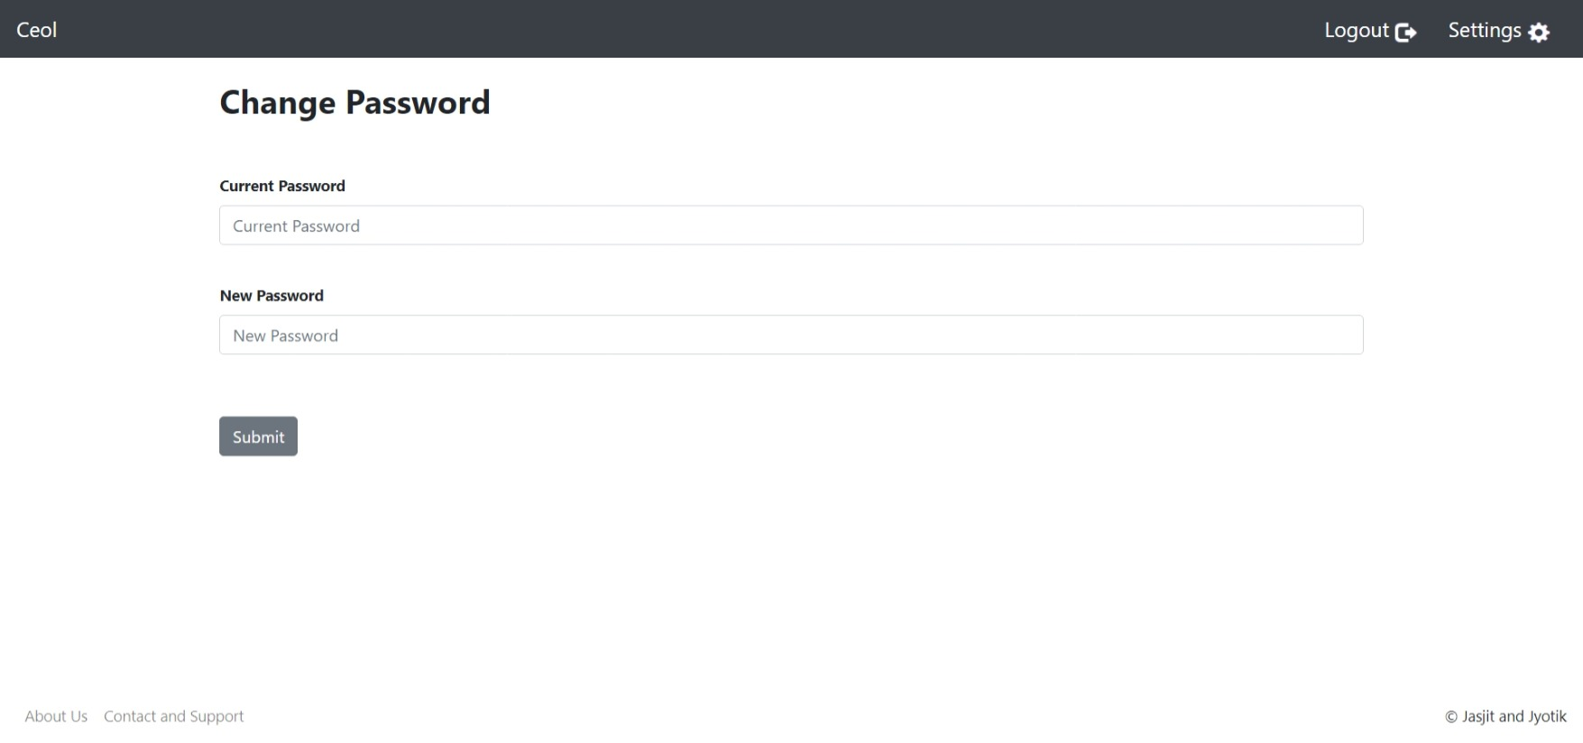
Settings Page:

Slide 11
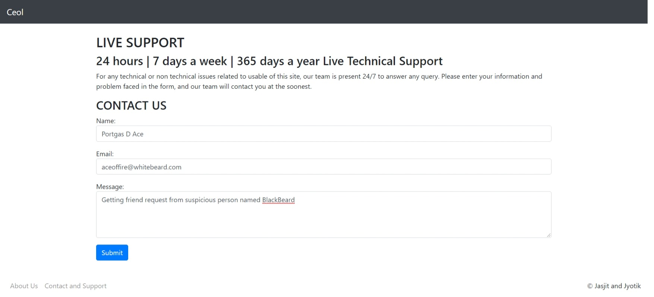
Contact us/Queries page:

Slide 12
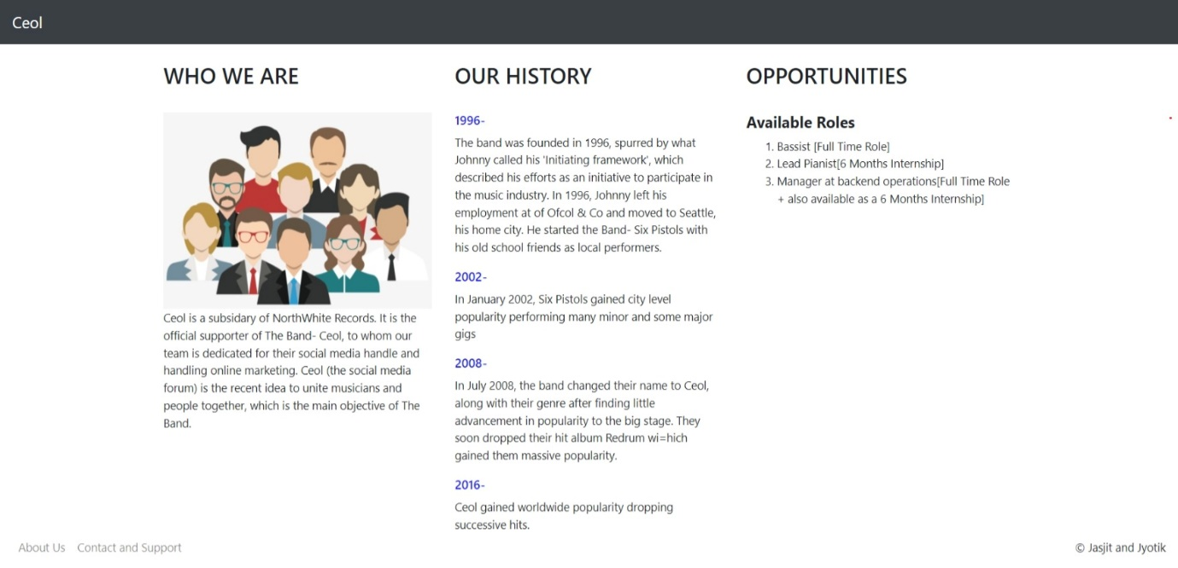
About-Us :

Slide 13
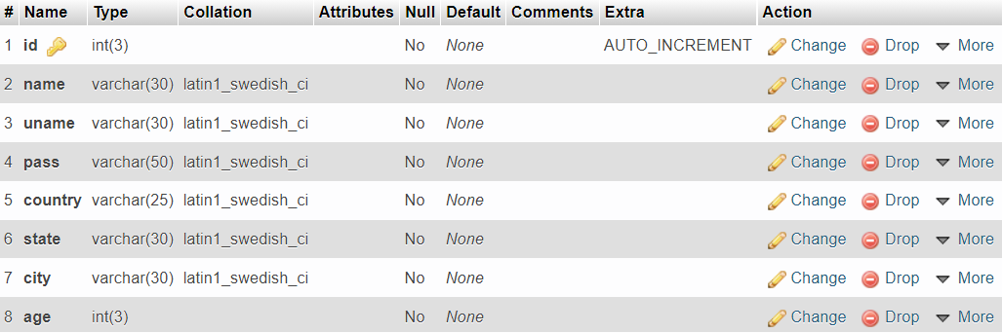
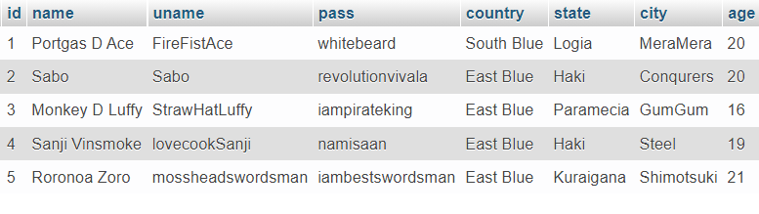
Database-Tables-Example:
User Table (Content- top 5 entries)

