Slide 1
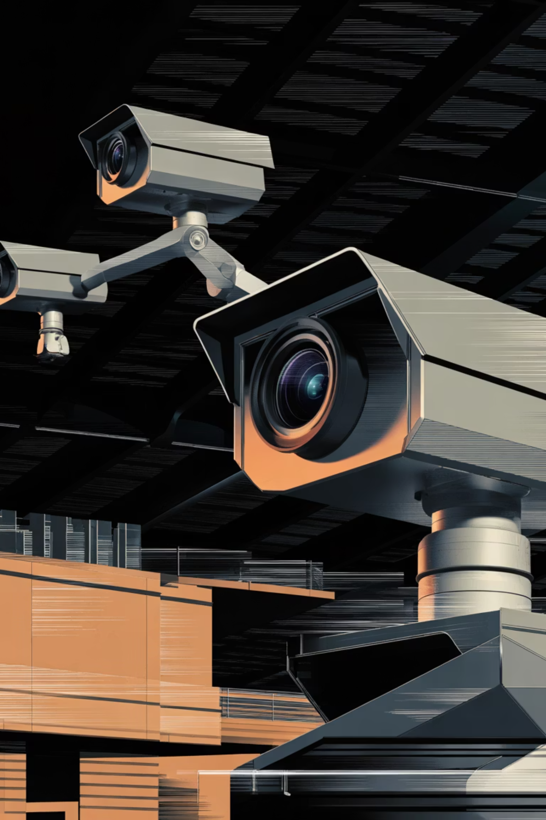

Real-Time Processing using MPI, OpenMP and CUDA
Hybrid Parallel Processing for High-Speed Video Analytics
Presented By: Subham Kumar, Jasjot Singh, Aditya Singh
Guide: Dr. Saif Nalband
Department of Computer Science and Engineering
Thapar Institute of Engineering and Technology

Slide 2
Why This Project?
Input Video
The Problem
1080p surveillance footage with 3921 total frames spanning approximately 60 seconds of continuous recording
Processing high-resolution video sequentially creates bottlenecks that severely impact real-time performance
Sequential Processing Issues
High latency in frame processing
Low frames per second (FPS)
Frequent frame drops
Poor real-time performance
Applications like surveillance systems require fast preprocessing pipelines before object detection algorithms can analyze content effectively.

Slide 3

Objective & Real-World Applications
Project Objective
Build a real-time video preprocessing pipeline leveraging three parallel computing paradigms working in concert:
MPI
OpenMP
CUDA
Distributed parallelism across multiple processes
Shared memory parallelism on CPU cores
GPU-accelerated parallel computing
Real-World Use Cases
Smart Traffic Monitoring
CCTV Surveillance
Autonomous Systems
Real-time vehicle detection and traffic flow analysis
Enhanced video quality for security applications
Preprocessing pipeline for self-driving vehicles
Goal: Deliver faster and cleaner video frames optimized for real-time analytics and AI detection systems

Slide 4





Proposed 4-Stage Processing Pipeline
The pipeline processes each frame through sequential stages designed to enhance video quality before AI detection systems analyze content:
Motion Blur Detection
Identify and flag frames with motion artifacts
Gaussian Blur
Noise reduction and image smoothing
Background Subtraction
Isolate foreground objects from static background
Sobel Edge Detection
Extract edge features for object recognition
FPS Overlay
Add performance metrics to output

Slide 5
Hybrid Parallel Architecture
How Parallelization Works
MPI
OpenMP
CUDA
Splits frames into horizontal strips distributed across multiple processes for parallel processing
Enables parallel CPU execution for blur detection algorithms using shared memory threads
GPU handles Gaussian Blur, Background Subtraction, and Sobel Edge Detection simultaneously
Hardware & Software Stack
GPU: NVIDIA GTX 1650
CUDA: Version 11.5
OpenCV: Version 4.5.4
OpenMPI: On WSL2
OS: Windows Subsystem for Linux
Compiler: NVCC with OpenMP support

Slide 6

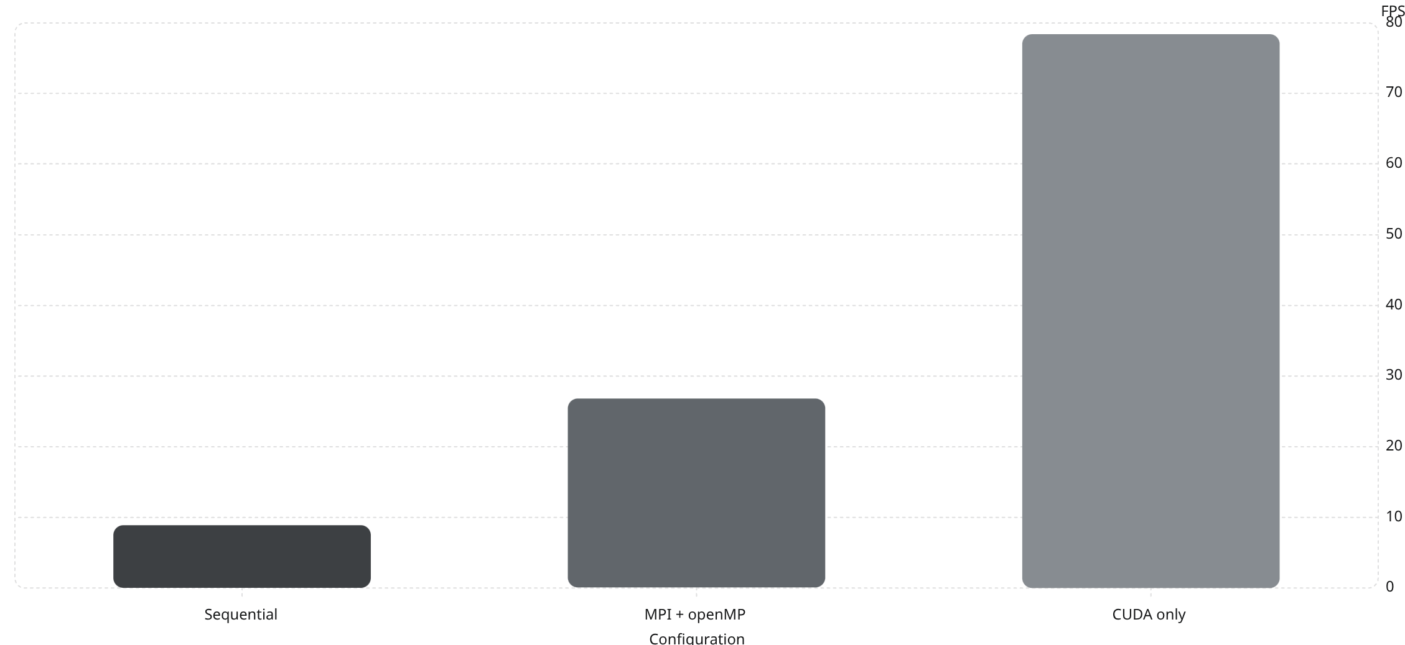
Performance Results
The hybrid parallel approach delivered substantial performance improvements compared to sequential processing:
FPS
3.02×
8.82×
MPI + OpenMP Speedup
CUDA Speedup
Triple the performance of sequential execution
Nearly 9× faster than sequential processing
Key Result: CUDA-only implementation achieved the best performance, processing 78.42 frames per second—enabling real-time 1080p video analytics

Slide 7


Challenges Faced & Key Learnings
Major Technical Challenges
MPI + CUDA Setup Conflict
Initial attempts to combine MPI and CUDA failed due to WSL2 limitations
Solution: Implemented CUDA-enabled WSL2 configuration with proper driver support
CUDA Compilation with MPI
Compilation errors when mixing MPI and CUDA code in single source files
Solution: Separated CUDA kernel files (.cu) from MPI-OpenMP code, using proper linking
Too Many MPI Processes
Using np=8 processes actually reduced performance compared to np=4
Root Cause: Communication overhead exceeded parallelization benefits
Key Learning
More parallelism does not always mean better performance. Efficient workload distribution, proper load balancing, and understanding communication overhead are critical factors that often outweigh the benefits of additional parallelization.

Slide 8
Conclusion
Project Achievements
The hybrid MPI + OpenMP + CUDA pipeline successfully demonstrated the feasibility of real-time 1080p video processing for surveillance applications:
Reduced execution time significantly
Improved FPS drastically
Enabled practical surveillance use
Nearly 9× speedup enables real-time analytics on high-resolution video
From 8.89 FPS sequential to 78.42 FPS with CUDA acceleration
Proven framework for CCTV monitoring and vehicle detection systems
Best Result
78.42 FPS
CUDA-only configuration delivered optimal performance for real-time 1080p video analytics
Thank You
Questions?

