Slide 1
Illegal Parking Detection Project
Using AI based approach to detect illegal parking of vehicles (Cars) from an image.

Slide 2
Problems
With the high percentage of vehicle ownership in the India, parking has become a conflicting and confusing situation for the people.
Cars are parked everywhere in a reckless manner around us which has become the root cause of all the major traffic jams.
With the growing number of vehicles, this problem of illegal parking is increasing day by day.
Even if the cars are parked illegally there are no measurements taken in order to curb it. Not much people are fined and therefore keeps on parking illegally.
People don’t know about the rules that whether to park a car at a particular location or not and in turn park anywhere they like causing traffic jams and even accidents in some cases.

Slide 3
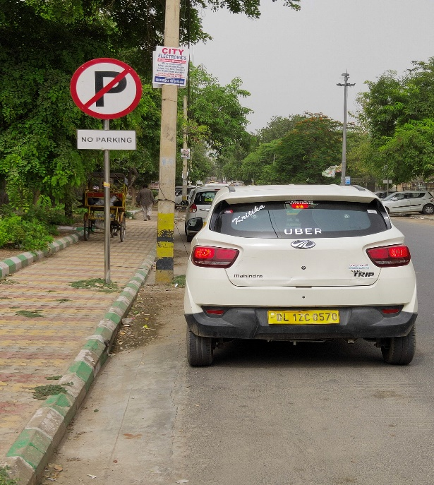
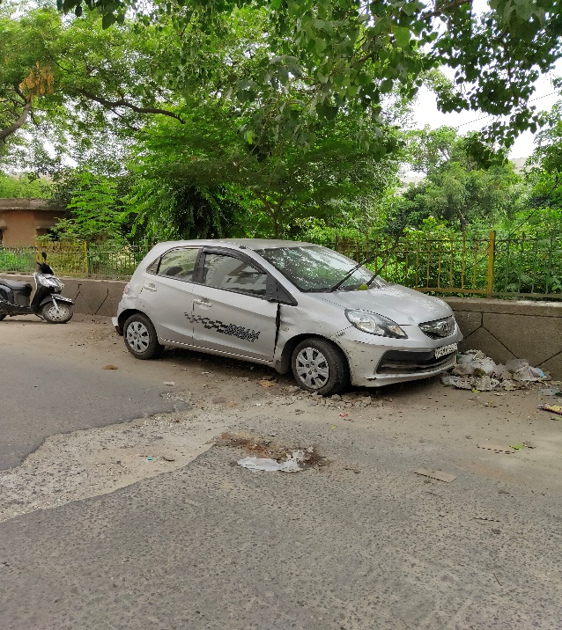
Illegal parking images

Slide 4
Idea behind the project
The main idea behind this project is to handle this growing problem of illegal parking using Artificial Intelligence.
We’ve tried applying modern Deep Learning approach in order to tell whether the parked car is legal or illegal.
Our model will classify the cars from the images clicked by the users into two different categories that is, legally and illegally parked cars using deep learning.

Slide 5
Dataset Used
Collecting data was one of the most challenging and time consuming part of this project.
We’ve tried to collect data from all the different locations including narrow roads, markets, highways, colonies, societies etc.
Data that we’ve collected is of all the different cars parked legally and illegally in the above mentioned scenarios and also from the parking areas.
It was the most challenging and difficult part of this project as to check what type of images and cars are legal or illegal.
We’ve first collected the images and then have applied image augmentations in order to increase the number of images in the dataset which are later used to train the Deep Learning model

Slide 6
Our Project
Using AI based approach to detect illegal parking of vehicles (Cars) from an image
Our model will receive an image of parked car through the user of the app , then our model will try to predict the status of parking based on the background details (Traffic Signs , Crowded (market) area, Open field, Traffic , On road , number of side cars etc. ).
Our model will do the prediction for each car that is present in the image.

Slide 7
Model Architecture
It consists of a feature extractor that is a pretrained model VGG16 , which is trained on image-net dataset (consist of million of images).
It is consist of 16 layers , but here we did not included the fully connected layers to extract features.
The extracted features and then passed through a Dense model or Linear SVC model.
The Dense model consist of 5 layers or the Linear SVC is a Support Vector Classifier.

Slide 8
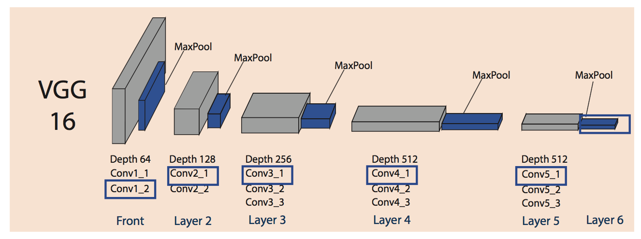
VGG16 Architecture

Slide 9
Brief about VGG
VGG is a Convolutional Neural Network (CNN) architecture that secured first and second positions in the localization and classification tasks respectively in ImageNet challenge 2014.
All the CNNs have more or less similar architecture, stack of convolution and pooling layers at start and ending with fully connected and soft-max layers.
The main contribution of VGG is to show that classification/localization accuracy can be improved by increasing the depth of CNN in spite of using small receptive fields in the layers.

Slide 10
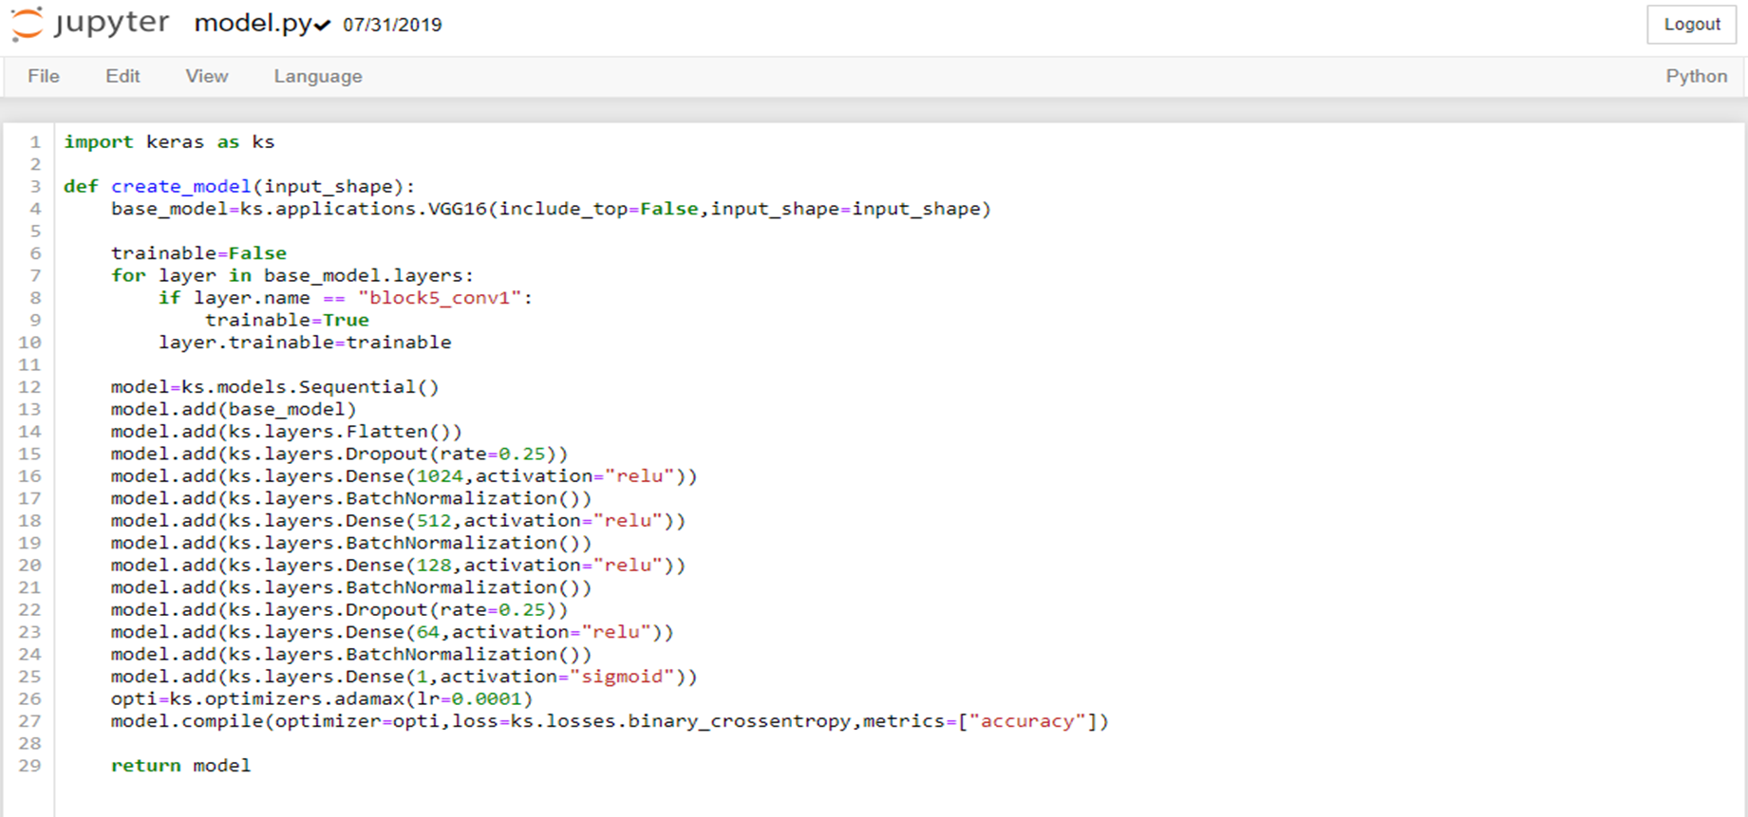
CNN Model

Slide 11
Model predicitons

Slide 12
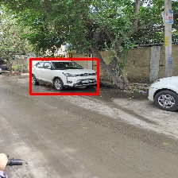
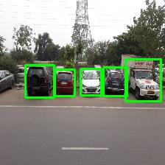

Slide 13
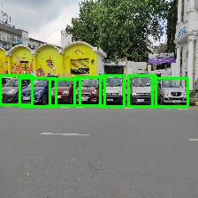
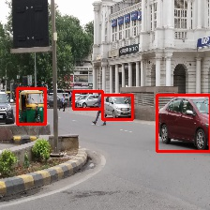

Slide 14
Wrong Detections

Slide 15
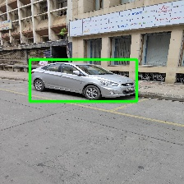
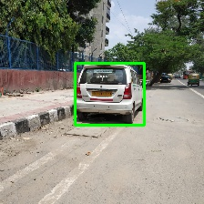

Slide 16
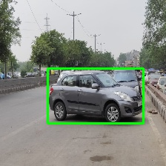
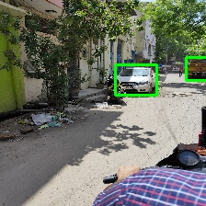

Slide 17
Benefits
This will be beneficial for not just the traffic police but also the common people to check and report an illegally parked car in order to fine the owner for the reckless parking.
It is a cost effective way of categorizing whether the car should be fined or not.
It requires only the image of the parked car in order to classify it as legal or illegal which makes it robust and easily manageable.
It will create a sense of awareness and responsibility among the citizens in order to park their cars properly and also for the government to make more and more legal parking spots.

