Slide 1
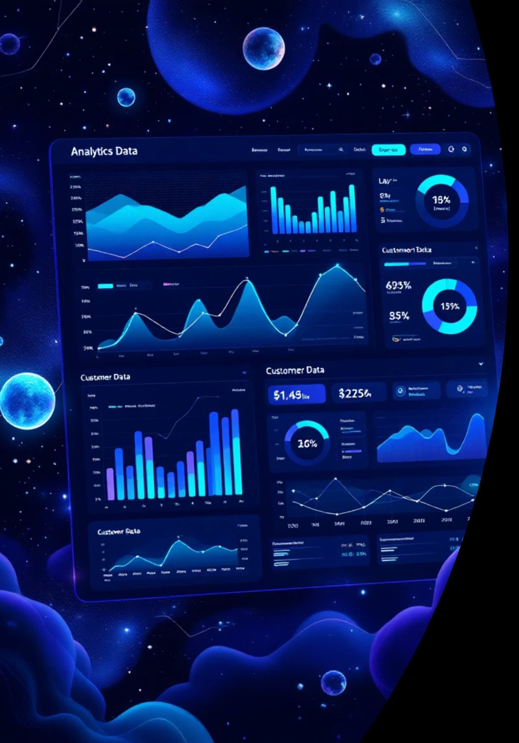
Customer Churn Analysis & Prediction: Turning Data into Retention Strategy
Harness the power of predictive analytics to identify at-risk customers before they leave. Transform raw data into actionable retention strategies that protect your revenue and strengthen customer relationships.

Slide 2
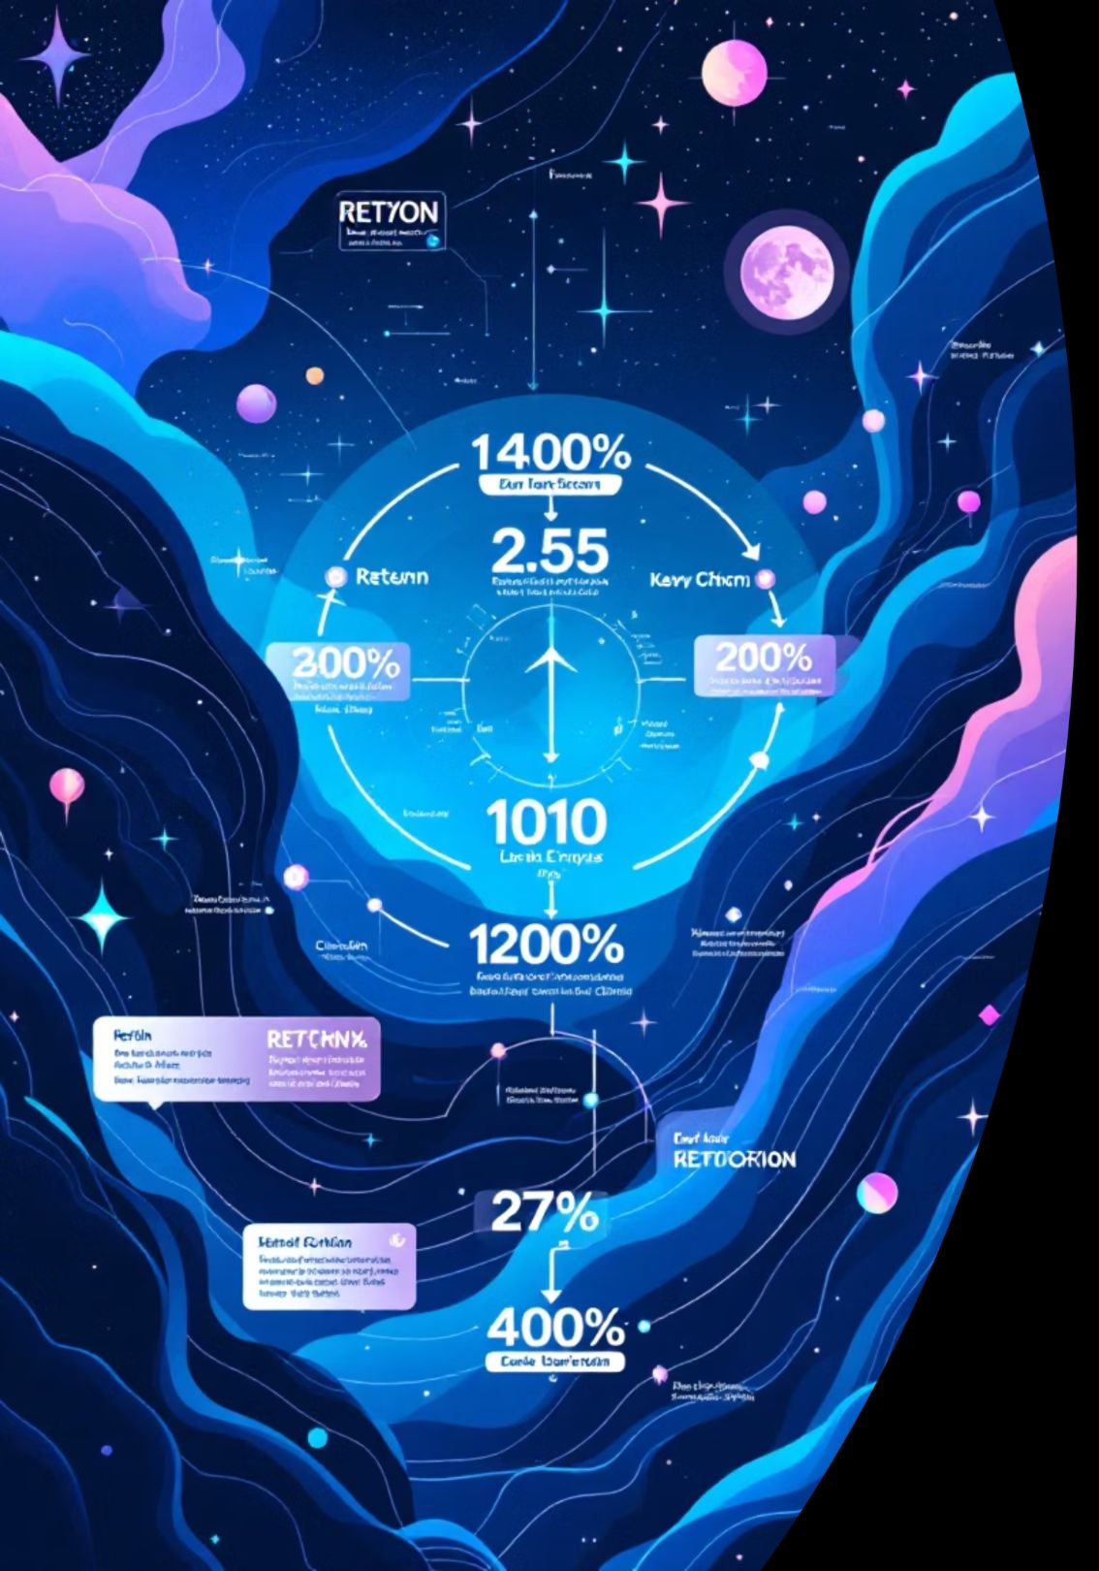
Understanding Customer Churn: What It Means for Your Business Bottom Line
What is Customer Churn?
Types of Churn
Customer churn refers to the percentage of customers who discontinue using your product or service during a specific time period. It's a critical metric that directly impacts revenue, growth trajectory, and long-term business sustainability.
Voluntary Churn: Customers actively choose to leave due to dissatisfaction, better alternatives, or changing needs
Involuntary Churn: Loss occurs due to payment failures, expired cards, or technical issues
Understanding churn patterns helps organisations anticipate revenue loss, identify service gaps, and implement targeted interventions to retain valuable customers.
Passive Churn: Gradual disengagement where customers reduce usage before eventually leaving

Slide 3
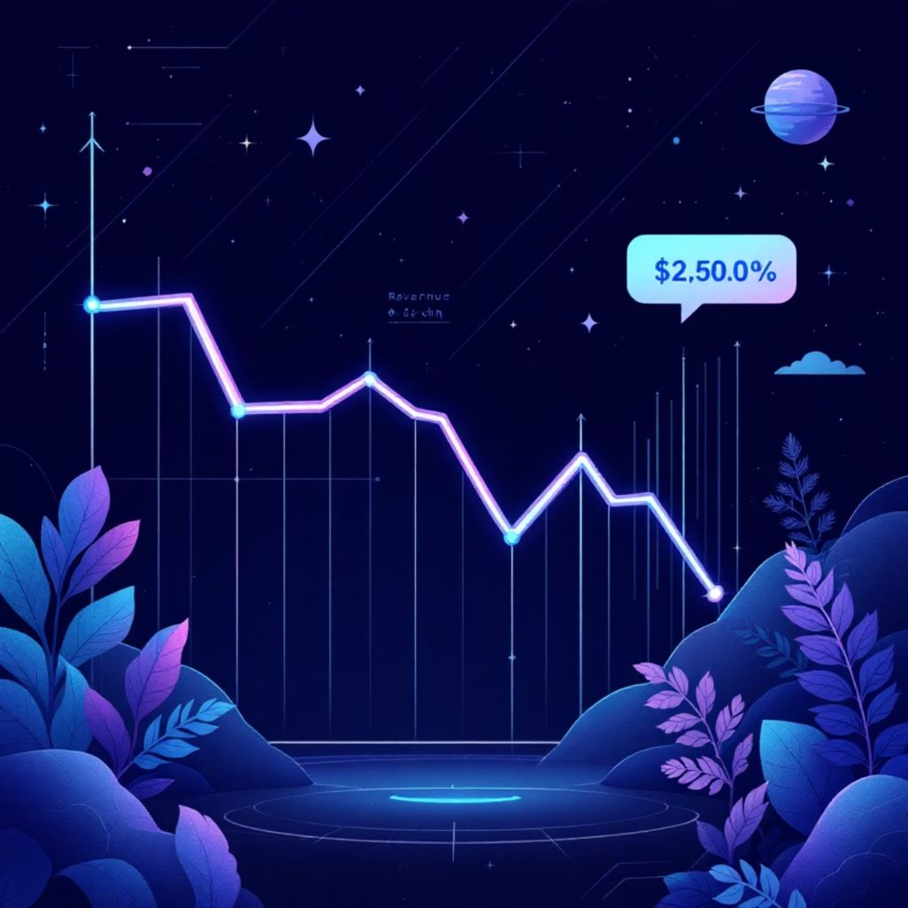
The Cost of Losing Customers: Why Retention Beats Acquisition Every Time
5X
25%
67%
Higher Acquisition Cost
Profit Increase Potential
Repeat Purchase Likelihood
Acquiring a new customer costs five times more than retaining an existing one
Just a 5% increase in customer retention can boost profits by 25% to 95%
Existing customers are 67% more likely to make repeat purchases than new prospects
The Hidden Costs of Churn
Lost lifetime customer value and recurring revenue streams
Wasted marketing and acquisition investments
Decreased referral opportunities and brand advocacy
Negative word-of-mouth that impacts future acquisition
Reduced competitive advantage in the marketplace

Slide 4
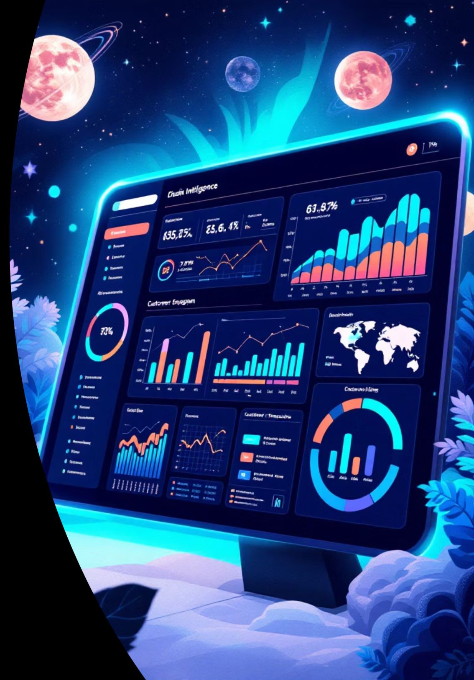





Key Churn Indicators: Identifying Warning Signs in Customer Behaviour Patterns
Usage Decline
Significant decrease in product usage frequency, login rates, or feature adoption over time
Support Tickets
Spike in complaints, unresolved issues, or negative sentiment in customer interactions
Payment Issues
Failed transactions, downgraded plans, or delayed payment patterns indicating disengagement
Communication Gaps
Reduced email open rates, ignored notifications, or opt-outs from marketing communications
Successful churn prediction requires monitoring multiple behavioural signals simultaneously. By combining these indicators with demographic and transactional data, organisations can create comprehensive risk profiles that enable proactive intervention before customers decide to leave.

Slide 5

Data Collection Strategy: Building Your Customer Intelligence Framework
01
02
Identify Data Sources
Define Key Metrics
Map all customer touchpoints including CRM systems, transaction databases, website analytics, mobile apps, customer support platforms, and social media interactions
Establish critical variables such as customer lifetime value, engagement scores, purchase frequency, contract duration, and satisfaction ratings
03
04
Ensure Data Quality
Create Data Pipeline
Implement validation rules, handle missing values, remove duplicates, and standardise formats across all data sources
Build automated systems for continuous data collection, cleaning, transformation, and storage in a centralised analytics platform
Essential Data Categories
Demographic information
Behavioural patterns
Transaction history
Engagement metrics
Customer feedback

Slide 6
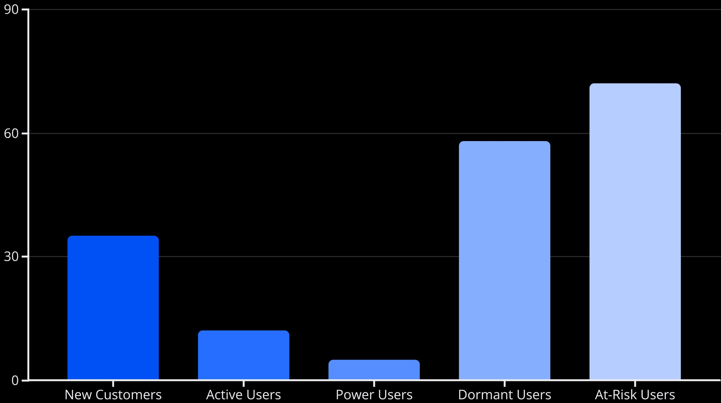
Exploratory Data Analysis: Uncovering Hidden Patterns in Customer Journey
Univariate Analysis
Correlation Discovery
Segmentation Insights
Examine individual variables to understand distributions, central tendencies, and outliers in customer attributes
Identify relationships between variables to understand which factors most strongly influence churn decisions
Group customers based on shared characteristics to reveal distinct behaviour patterns and risk profiles

Slide 7
Machine Learning Models for Churn Prediction: From Logistic Regression to Random Forest
Logistic Regression
Random Forest
XG Boost
Simple yet powerful baseline model that predicts churn probability using linear combinations of features. Offers excellent interpretability and fast training times.
Ensemble method combining multiple decision trees for superior accuracy. Handles non-linear relationships and feature interactions effectively.
Advanced ensemble technique that sequentially builds models to correct previous errors. Often achieves highest prediction accuracy for churn scenarios.
Model selection depends on your specific requirements: logistic regression for interpretability, random forest for balanced performance, or gradient boosting for maximum accuracy. Consider experimenting with multiple approaches and comparing results.

Slide 8




Model Performance Evaluation: Measuring Success with Precision, Recall and F1-Score
Understanding Key Metrics
Precision measures the accuracy of positive predictions—what percentage of customers flagged as churners actually churned. High precision minimises wasted retention efforts.
Recall measures how many actual churners were successfully identified. High recall ensures you don't miss at-risk customers.
F1-Score provides a balanced metric combining precision and recall, especially valuable when dealing with imbalanced datasets.
87%
82%
84%
Model Precision
Model Recall
F1-Score
87 out of 100 predicted churners actually left
Successfully identified 82% of all churning customers
Balanced performance across both metrics
Beyond these metrics, consider business context: the cost of false positives (wasted retention spending) versus false negatives (lost customers). Adjust classification thresholds to align model outputs with your organisation's strategic priorities and budget constraints.

Slide 9


Implementing Predictive Insights: Proactive Retention Campaigns That Actually Work
Personalised Outreach
Incentive Programmes
Contact at-risk customers with tailored messages addressing their specific pain points, usage patterns, and preferences
Offer targeted discounts, exclusive features, or loyalty rewards to high-value customers showing churn indicators
Product Improvements
Proactive Support
Use churn insights to prioritise feature development and address common friction points in the customer journey
Reach out to struggling customers before they contact support, offering assistance and demonstrating value
Campaign Best Practises
Segment interventions based on churn probability and customer value
Test multiple retention strategies and measure effectiveness
Time outreach strategically during critical decision windows
Combine automated triggers with human touchpoints
Continuously refine approaches based on campaign results

Slide 10




Next Steps: Building a Sustainable Churn Prevention System for Long-term Growth
Deploy Models
Establish Foundation
Implement initial prediction models in production, integrate with existing CRM systems, and automate risk scoring
Build robust data infrastructure, define success metrics, and secure stakeholder buy-in across customer-facing teams
Scale & Optimise
Test & Learn
Expand successful interventions, refine models with new data, and build organisational capabilities for ongoing improvement
Run controlled experiments comparing retention strategies, measure ROI, and iterate based on performance data
"Successful churn prevention isn't a one-time project—it's an ongoing commitment to understanding your customers, anticipating their needs, and continuously delivering value that keeps them engaged and loyal."
Start your churn prevention journey today by identifying your highest-risk customers, implementing targeted retention campaigns, and building the analytics capabilities that will drive sustainable growth for years to come.

