Slide 1
AeroDSL
QR572
AI202
A compiler for
aircraft traffic scenarios.
Review 2 | Design & Architecture
SG811
Compiler Design (BCSE307L)
BA117
Kaustav Goel
Jaskaran Singh
24BCE0426
24BCE0466

Slide 2
Index.
SECTION
SLIDE
SECTION
SLIDE
01
Introduction
3
07
Front end
12
The problem from Review 1, and our answer
Lexer, parser, symbol table
02
Architecture
4
08
Middle end
13
The whole compiler, top to bottom
Three-address code and the control-flow graph
03
The language
5
09
Optimiser
14
A scenario, written as a program
Seven passes, run to a fixed point
04
Grammar and parse tree
6–7
10
Design decisions
15
The language in EBNF; one line, parsed
Four choices, and what they cost
05
One line through the compiler
8–10
11
Implementation status
16
Front end, middle end, what comes out
Every stage, its files and its size
06
Inside the code
11
Files and the core data structures

Slide 3
We asked a question.
Then we built the compiler.
THE PROBLEM STATEMENT, FROM REVIEW 1
Express
How can a domain-specific language make aircraft traffic scenarios easier to express and analyse, while preserving predictable generation into an existing scenario format?
A language: named values, loops, procedures, assert.
Analyse
A checker: mistakes reported before anything runs.
Generate
A compiler: BlueSky’s .scn format, the same every time.

Slide 4
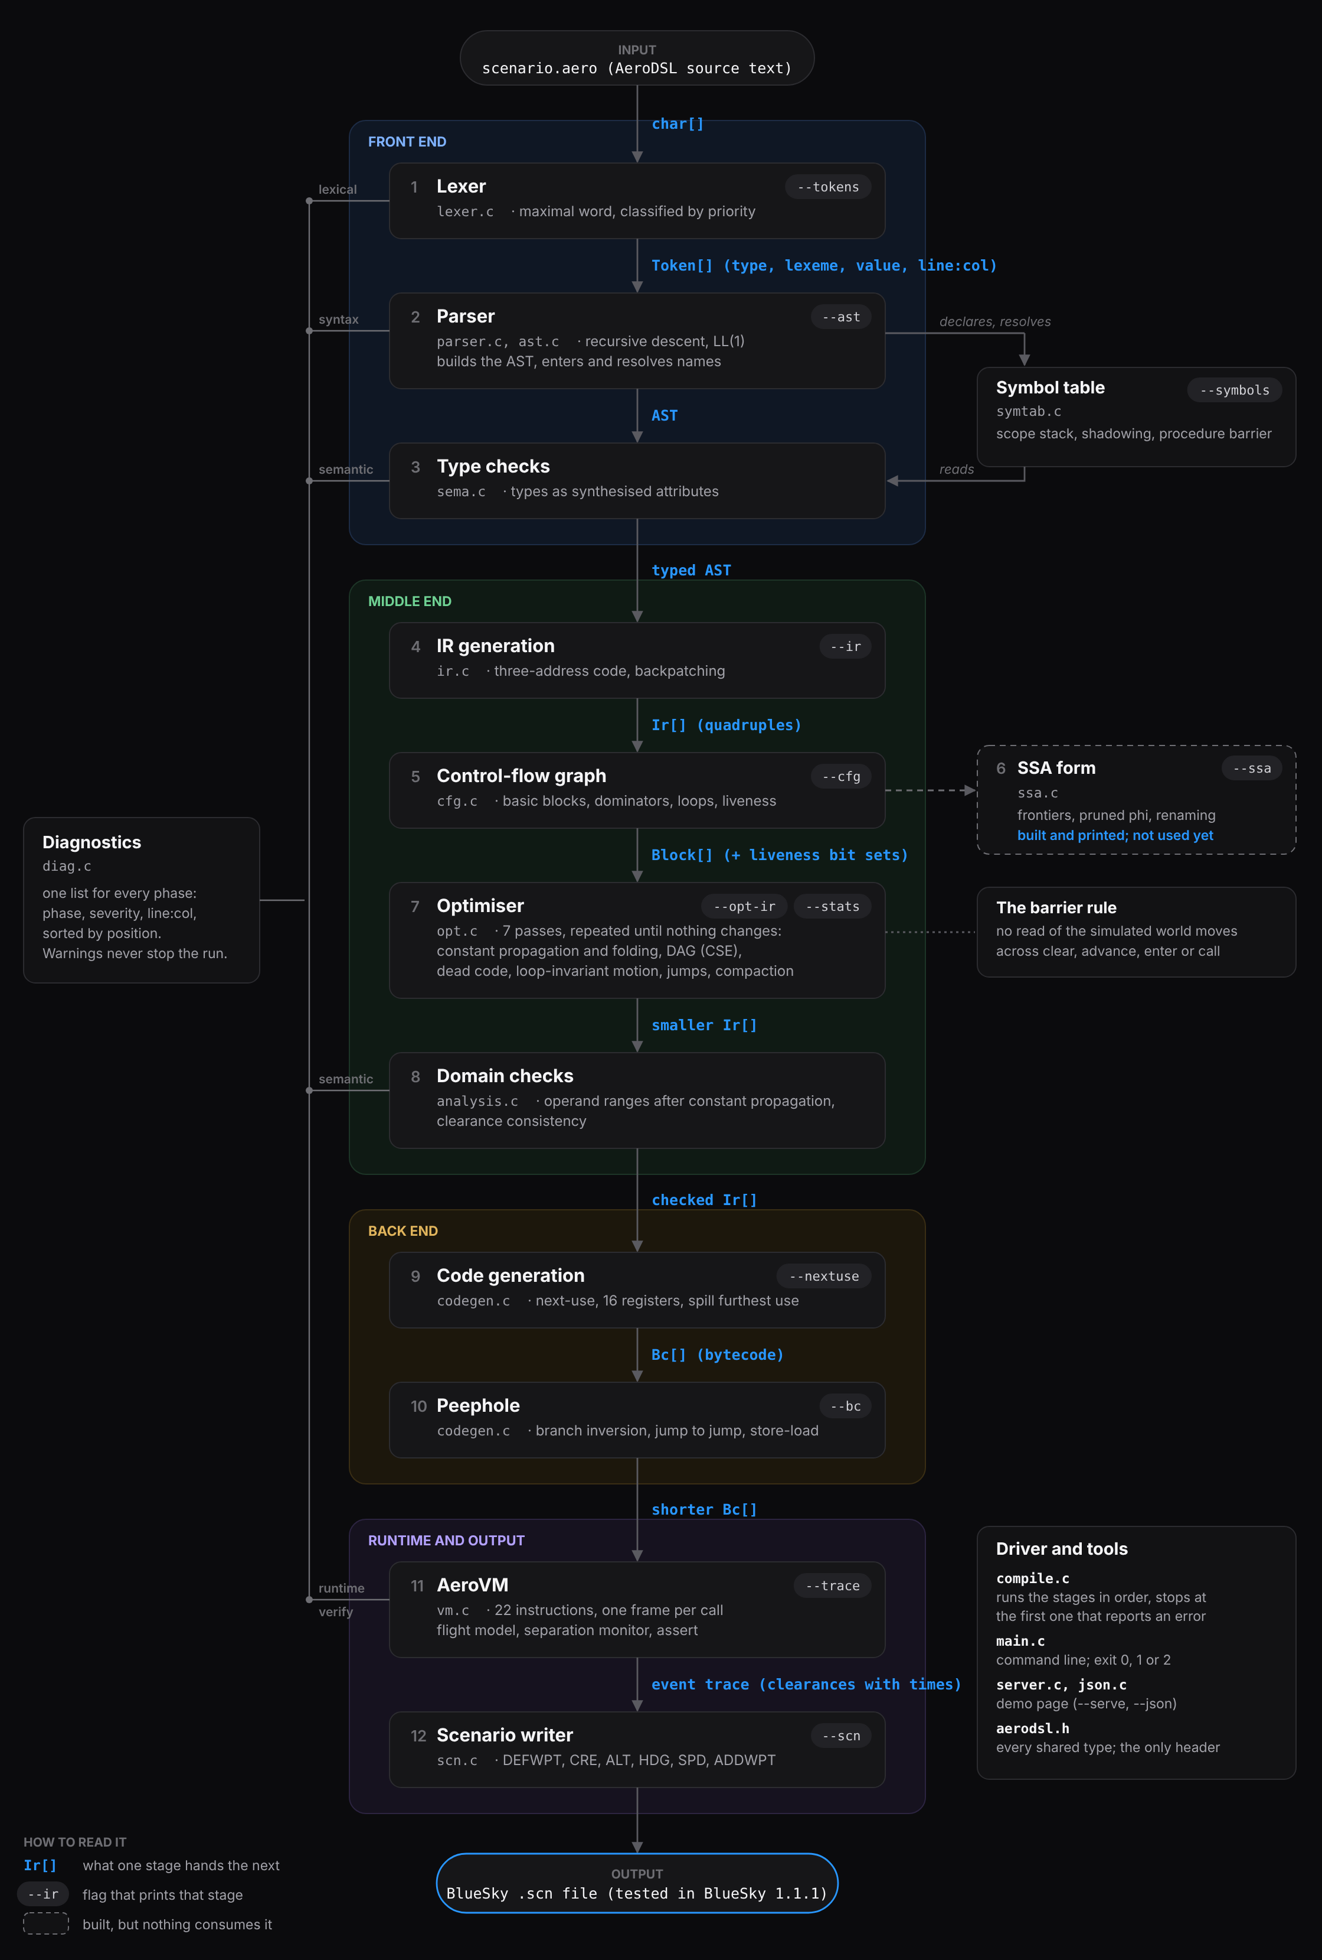
The whole compiler,
connected.
Twelve stages, four parts
Front end, middle end, back end and runtime, in 20 C files and one header.
Each arrow is a data structure
Token[], AST, Ir[] quadruples, Block[], Bc[], the event trace: what one stage hands the next.
Most stages can be printed
--tokens --ast --ir --cfg --ssa --opt-ir --bc --trace --scn
Shared by every stage
The symbol table, one diagnostics list, and compile.c, which stops at the first phase that reports an error.

Slide 5
A scenario, written as a program.
Example 5: climb, wait until the aircraft passes FL300, then turn.
AERODSL · EXAMPLES/05_LOOP.AERO
fix
a named waypoint
scenario "Wait for level, then turn"
fix VOMAN 12.95 77.67
flight AI202 type A320 enter VOMAN alt FL240 hdg 090 spd 280KT
clear AI202 climb FL320
let waited = 0
while AI202.alt < FL300 do
advance 10
waited = waited + 10
end
print "reached FL300 after ", waited, " seconds"
clear AI202 heading 270
advance 120
assert AI202.alt >= FL300, "the aircraft should have passed FL300"
flight
an aircraft entering, with its starting state
clear
an instruction: climb, descend, heading, speed, direct
advance
let simulated time pass
let while if
named values, and reacting to the situation
proc call
reusable procedures (example 3)
assert
the scenario’s purpose, checked when it runs
The loop becomes 00:03:20.00>HDG AI202,270

Slide 6
The grammar, on one slide.
Written in EBNF, and LL(1): each rule is one function in src/parser.c.
EXPRESSIONS: ONE LEVEL, ONE FUNCTION
lowest
PROGRAMS AND STATEMENTS · DOCS/SPEC.MD §4
or
parse_expr
program ::= "scenario" STRING item*
item ::= fix_decl | flight_decl | proc_decl | stmt
fix_decl ::= "fix" CALLSIGN coord coord
flight_decl ::= "flight" CALLSIGN ["type" CALLSIGN] "enter" CALLSIGN
"alt" expr "hdg" expr "spd" expr
proc_decl ::= "proc" IDENT "(" [param {"," param}] ")" block "end"
stmt ::= "let" IDENT "=" expr
| IDENT "=" expr
| "clear" expr clear_op expr
| "advance" expr
| "if" expr "then" block ["else" block] "end"
| "while" expr "do" block "end"
| "assert" expr ["," STRING]
| "call" IDENT "(" [expr {"," expr}] ")"
| "print" print_arg {"," print_arg} | "return"
clear_op ::= "climb" | "descend" | "heading" | "speed" | "direct"
and
parse_and
not
parse_not
< <= > >= == !=
parse_rel, one only
+ -
parse_add
* / %
parse_mul
-x (unary)
parse_unary
.alt .hdg …
parse_postfix
42 FL320 x ( )
parse_primary
binds tightest
TOKENS, AS REGULAR EXPRESSIONS
FLEVEL FL[0-9]{3} SPEED [0-9]{1,3}KT
NUMBER [0-9]+(\.[0-9]+)? IDENT [a-z][a-z0-9_]*
CALLSIGN [A-Z][A-Z0-9]*

Slide 7
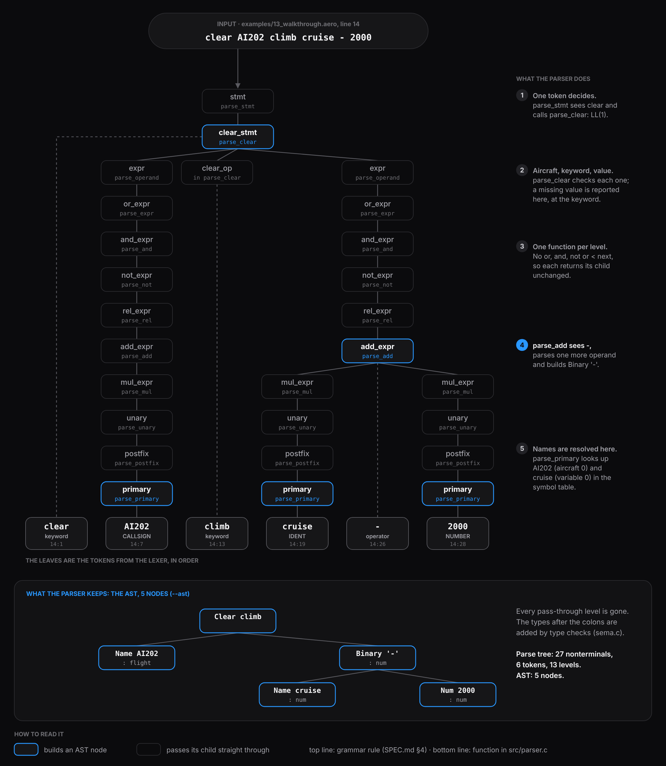
The parse tree
of one line.
Thirteen levels for one line
Every precedence level is a grammar rule, so the name AI202 passes through ten of them.
One function per rule
Each box is a call in src/parser.c, from parse_stmt down to parse_primary. One token of lookahead picks each one.
Only five nodes are kept
A level with no operator next returns its child unchanged, so the parser builds the AST directly.
Names resolved on the way
parse_primary looks up AI202 and cruise in the symbol table as it reaches them.

Slide 8
Follow one line: the front end.
examples/13_walkthrough.aero, line 14 (Review 1, slide 5): clear AI202 climb cruise - 2000
Tokens
Tree
Checks
TAC
Optimised
Bytecode
VM
.scn
1 LEXER: WORDS INTO TOKENS
2 PARSER: TOKENS INTO A TREE
3 Checker
14:1 clear clear
14:7 CALLSIGN AI202
14:13 climb climb
14:19 IDENT cruise
14:26 - -
14:28 NUMBER 2000 value 2000
Clear climb
Name AI202
Binary '-'
Name cruise
Num 2000
AI202 is declared, and is a flight
cruise is declared, and is a num
climb needs a number of feet: num
The tree still says “cruise minus 2000”. A flat scenario file could only ever hold the answer. Any failure here stops with a line:column message, and no output.

Slide 9
Follow one line: the middle end.
The tree becomes three-address code: one operation per instruction. Then the optimiser simplifies it.
Tokens
Tree
Checks
TAC
Optimised
Bytecode
VM
.scn
THREE-ADDRESS CODE (--IR)
AFTER THE OPTIMISER (--OPT-IR)
0 cruise = 32000
1 param 24000
2 param 90
3 param 280
4 enter AI202
5 advance 120
6 t1 = cruise - 2000
7 clear AI202, climb, t1
8 advance 80
9 clear AI202, heading, 120
10 return
0 param 24000
1 param 90
2 param 280
3 enter AI202
4 advance 120
5 clear AI202, climb, 30000
6 advance 80
7 clear AI202, heading, 120
8 return
cruise is 32000 and never changes, so cruise - 2000 becomes 30000, and both cruise and t1 disappear. The optimiser’s own report: 1 constant folded, 2 operands replaced by propagated constants, 2 dead instructions removed.

Slide 10
Follow one line: what comes out.
AeroVM runs the bytecode and records each clearance with its time; scn.c writes them out.
Tokens
Tree
Checks
TAC
Optimised
Bytecode
VM
.scn
WHAT THE AUTHOR WROTE
WHAT BLUESKY GETS (.SCN)
advance 120
clear AI202 climb cruise - 2000
advance 80
clear AI202 heading 120
00:02:00.00>ALT AI202,FL300
00:03:20.00>HDG AI202,120
The author wrote “cruise minus 2000, two minutes in”. The compiler worked out FL300 and 00:02:00.

Slide 11
Inside the code.
C11 with no libraries: one shared header, a small driver, and plain structs.
aerodsl.h
Every shared type and every phase’s entry point. The only header.
ONE TOKEN · AERODSL.H, COMMENTS SHORTENED
compile.c
The driver: runs the stages in order and stops at the first error.
typedef struct {
TokenType type;
Str text; /* the lexeme: a view into the source */
double num; /* value of NUMBER, FLEVEL, SPEED */
int line, col;
} Token;
diag.c
One list of messages: phase, severity, line and column.
util.c
Str (a view into the source, never copied), IntList, BitSet.
ONE QUADRUPLE · AERODSL.H, COMMENTS SHORTENED
main.c server.c json.c
The command line, and the server and JSON for the demo page.
typedef struct {
IrOp op; /* t = a op b, goto, clear ... */
BinOp bop; /* which operator, for arithmetic */
int aux; /* field, built-in or clearance kind */
Arg dst, a, b; /* result, arg1, arg2 */
int line, col; /* source position, for late errors */
} Ir;
tests/test_all.c
336 checks across every phase, run by make test.

Slide 12
Hand-written, and traceable.
No Lex and no Yacc: every phase is our own code, so every step can be traced.
Lexer src/lexer.c
THE SYMBOL TABLE’S STACK, WHILE PARSING A PROCEDURE
#
name
kind
seen from inside arrival
Reads a whole word, then classifies it: keyword, FLEVEL, SPEED, NUMBER, IDENT, CALLSIGN, in that order. FL320 becomes 32000 ft here.
5
from_level
parameter
visible: its own scope
4
f
parameter
visible: its own scope
Parser src/parser.c
barrier = 4: below it, only aircraft, waypoints and procedures resolve
Recursive descent, LL(1), one function per rule. It enters each declaration in the symbol table and resolves every name as it parses.
3
arrival
procedure
visible: global kind
2
cruise
variable
hidden: main’s variable
1
AI202
aircraft
visible: global kind
Semantic analysis src/sema.c
0
VOMAN
waypoint
visible: global kind
One walk over the tree. Each expression’s type is a synthesised attribute; a failed one becomes error, so one mistake gives one message.
examples/17_scope.aero: inside arrival, clear f climb cruise gives
11:17: semantic error: 'cruise' is not declared; a procedure
can only use its own parameters and globally declared
aircraft, waypoints and procedures

Slide 13
Flat code, then a map of it.
CONTROL-FLOW GRAPH OF EXAMPLE 5 (--CFG)
SHORT-CIRCUIT AND · EXAMPLE 4 (--IR)
B0 start: enter, climb
if hsep(AI202, BA117) < 15 and vsep(AI202, BA117) < 2000
10 t0 = hsep(AI202, BA117)
11 t1 = t0 < 15
12 if t1 goto L0
13 goto L2
14 L0:
15 t2 = vsep(AI202, BA117)
16 t3 = t2 < 2000
17 if t3 goto L1
18 goto L2
19 L1:
20 print "too close: turning AI202 away"
...
24 L2:
B1 test: alt < FL300
B3 advance 10
B2 leave the loop
back edge: the loop
B4 print, turn, assert
Backpatching: when a jump is emitted its target is not known yet. It goes on a true-list or false-list and is filled in once the target exists.
Also computed: dominators, natural loops and liveness. SSA form is built and printed too, but the optimiser does not use it yet.

Slide 14
Seven passes, run until nothing changes.
1
Constant propagation
replace a variable by its known value
WHAT EXAMPLE 6 REPORTS (--STATS)
2
Constant folding
work out constant expressions now
optimisation summary
constants folded 5
operands replaced by propagated constants 11
common subexpressions eliminated 2
copies propagated 6
algebraic simplifications 1
dead instructions removed 15
instructions hoisted out of loops 3
jumps threaded or removed 6
unreachable blocks removed 2
peephole rewrites 4
3
DAG of each block
common subexpressions, copies, identities
4
Dead-code elimination
remove results nobody reads
5
Loop-invariant code motion
move unchanging work out of loops
6
Jump threading
jumps to jumps, unreachable blocks
7
Compaction
renumber what is left
61 three-address instructions before the optimiser, 37 after.
Then compare-and-branch fusion, and a peephole pass on the bytecode: branch inversion, jumps to the next line, jumps to jumps.
./aerodsl --ir --opt-ir --stats examples/06_optimise.aero

Slide 15
Four decisions, and what they cost.
Decision
Why
What it costs
Hand-written lexer and parser
Every step can be traced and explained, and errors read as plain English.
More code to write and test than a generator would need.
Our own VM, not LLVM
The “machine” has to fly aircraft and check separation, not just compute.
No native-code speed, which a scenario does not need.
Resolve loops by simulating
The output must be a flat file, so every loop and if is decided before it is written.
Times are only as good as our flight model: in BlueSky, one turn comes about 1,060 ft early.
Range checks after constant propagation
Catches heading 450 even when it hides in a variable.
Values known only while running are checked by the VM instead.

Slide 16
Every stage is built.
Where each stage lives in the code, its size, and the flag that prints its output.
STAGE · SOURCE FILES
LINES · PRINT IT WITH
STAGE · SOURCE FILES
LINES · PRINT IT WITH
Lexer
296
Domain checks
286
lexer.c
--tokens
analysis.c
error messages
Parser and symbol table
1,344
Code generation, peephole
739
parser.c ast.c symtab.c
--ast --symbols
codegen.c
--nextuse --bc
Type checks
482
AeroVM
826
sema.c
--ast
vm.c
--trace
IR generation
639
Scenario writer
104
ir.c
--ir
scn.c
--scn
Control-flow graph
490
Driver and shared code
1,468
cfg.c
--cfg
aerodsl.h compile.c diag.c …
--phases
SSA
435
Demo page server
520
ssa.c
--ssa (printed only)
server.c json.c
--serve
Optimiser, seven passes
885
8,514 lines of C11 in 20 C files and one header, with no libraries. Every stage runs end to end; SSA is the one part built and printed but not yet used by the optimiser.
opt.c
--opt-ir --stats

Slide 17
Thank you.
Questions welcome.
github.com/Jaskaran-Singh-ops/AeroDSL

