Slide 1
AeroDSL
QR572
AI202
A compiler for
aircraft traffic scenarios.
Review 3 | Implementation & Results
SG811
Compiler Design (BCSE307L)
BA117
Kaustav Goel
Jaskaran Singh
24BCE0426
24BCE0466

Slide 2
Index.
SECTION
SLIDE
SECTION
SLIDE
01
Abstract
3
07
Testing
13
The project in one paragraph
336 checks, differential test, fuzzing
02
Introduction
4
08
Live demo
14
The problem, and our answer
The compiler, phase by phase
03
Architecture diagram
5
09
GitHub repository
15
The whole compiler, connected
The link, and what is in it
04
Sample code
6
10
Steps to run
16
A scenario, written as a program
Windows, macOS, Linux, from source
05
Sample output
7
11
Limits and future work
17
Example 5, compiled and run
What it does not do, yet
06
Results: AeroDSL vs BlueSky
8–12
12
References
18
Written both ways, edited, scored, replayed
What we built on

Slide 3
Abstract.
Air-traffic-control simulators such as BlueSky read training scenarios as flat lists of timestamped commands. Authors write them by hand: every time is worked out manually, nothing is checked before the file runs, and one small edit can move many lines. AeroDSL is a domain-specific language in which a scenario is a program, with named values, procedures, loops, conditionals and assertions, and a compiler, written in C11 with no libraries, that translates it into BlueSky’s .scn format. The compiler has twelve stages: a hand-written lexer, a recursive-descent LL(1) parser, scoped symbol tables and type checking, three-address code, a control-flow graph with SSA form, seven optimisation passes, domain range checks, register allocation and bytecode generation, a peephole pass, and a virtual machine that simulates the scenario to fix every timestamp. On a three-arrival scenario the author works out no numbers by hand, against 13 in the hand-written file, and four typical mistakes are reported before anything runs. All 336 automated checks pass, and the generated files run in BlueSky 1.1.1.
KEYWORDS
Domain-specific language · compiler design · recursive-descent parsing · three-address code · code optimisation · air-traffic-control simulation · BlueSky

Slide 4
We asked a question.
Then we built the compiler.
THE PROBLEM STATEMENT, FROM REVIEW 1
Express
How can a domain-specific language make aircraft traffic scenarios easier to express and analyse, while preserving predictable generation into an existing scenario format?
A language: named values, loops, procedures, assert.
Analyse
A checker: mistakes reported before anything runs.
Generate
A compiler: BlueSky’s .scn format, the same every time.

Slide 5
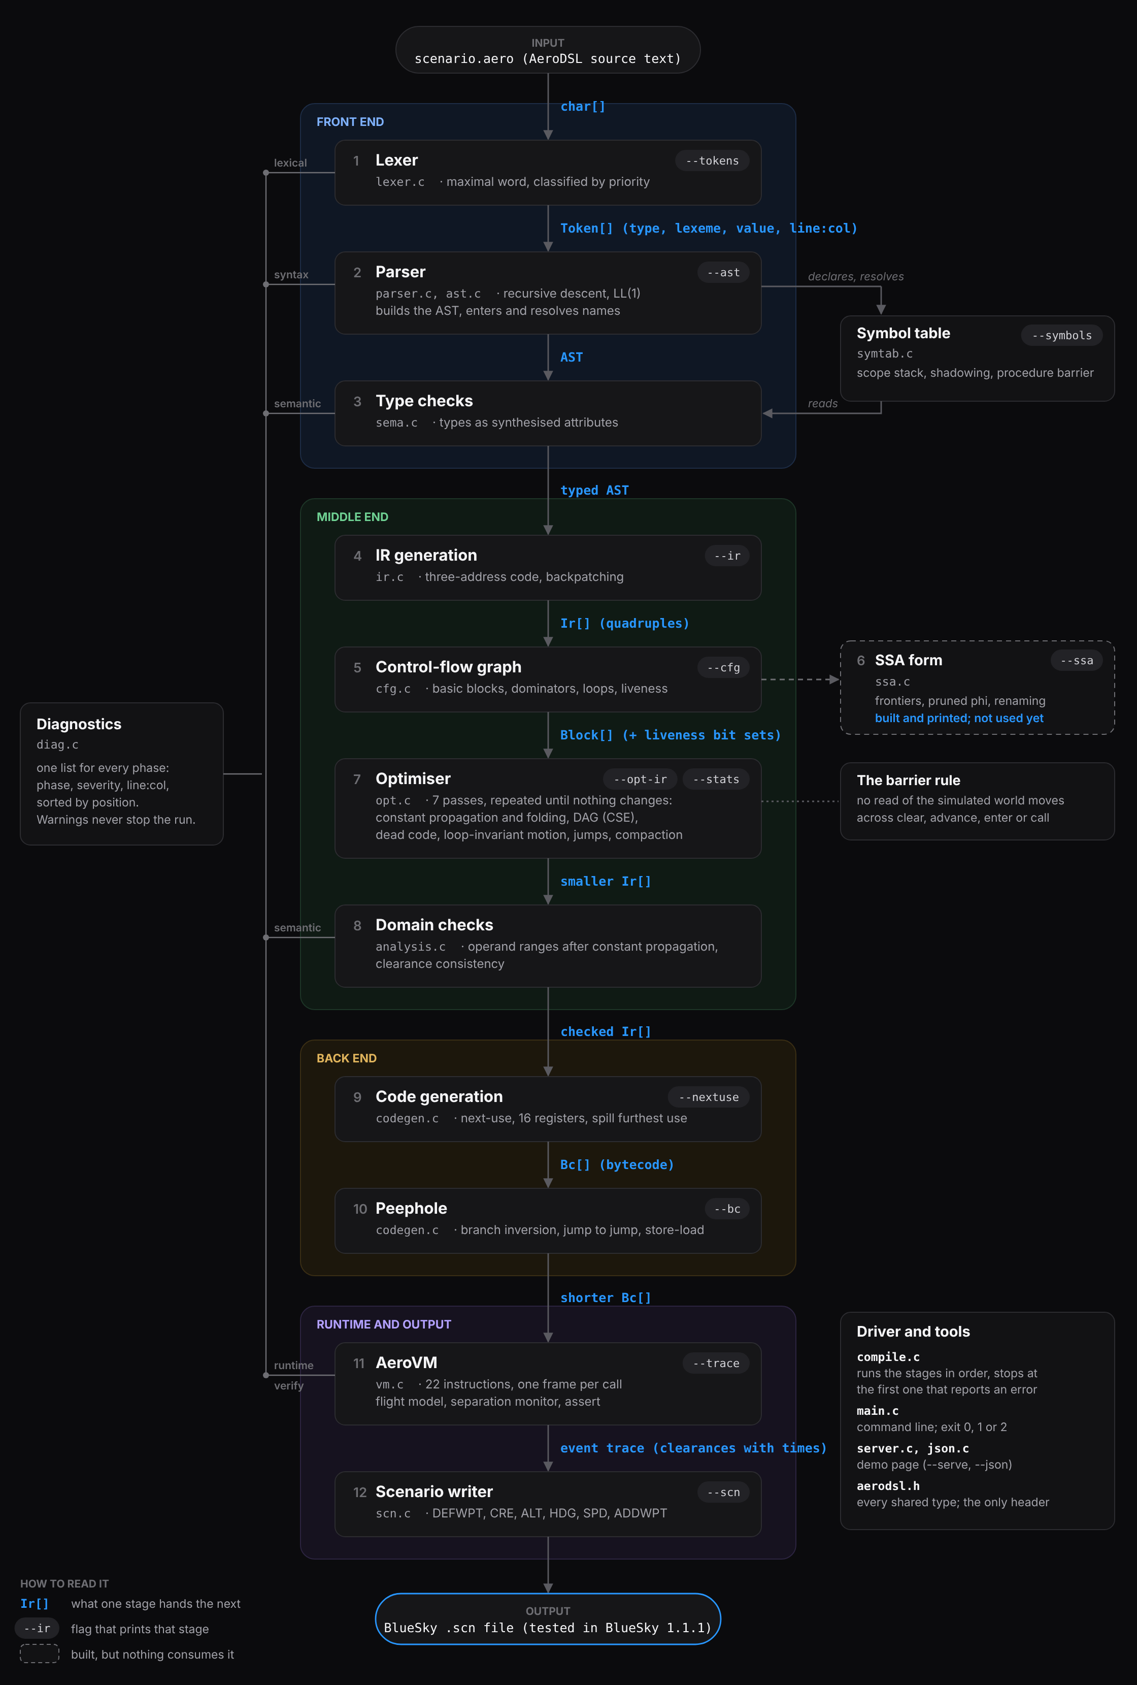
The whole compiler,
connected.
Twelve stages, four parts
Front end, middle end, back end and runtime, in 20 C files and one header.
Each arrow is a data structure
Token[], AST, Ir[] quadruples, Block[], Bc[], the event trace: what one stage hands the next.
Most stages can be printed
--tokens --ast --ir --cfg --ssa --opt-ir --bc --trace --scn
Shared by every stage
The symbol table, one diagnostics list, and compile.c, which stops at the first phase that reports an error.

Slide 6
A scenario, written as a program.
Example 5: climb, wait until the aircraft passes FL300, then turn.
AERODSL · EXAMPLES/05_LOOP.AERO
fix
a named waypoint
scenario "Wait for level, then turn"
fix VOMAN 12.95 77.67
flight AI202 type A320 enter VOMAN alt FL240 hdg 090 spd 280KT
clear AI202 climb FL320
let waited = 0
while AI202.alt < FL300 do
advance 10
waited = waited + 10
end
print "reached FL300 after ", waited, " seconds"
clear AI202 heading 270
advance 120
assert AI202.alt >= FL300, "the aircraft should have passed FL300"
flight
an aircraft entering, with its starting state
clear
an instruction: climb, descend, heading, speed, direct
advance
let simulated time pass
let while if
named values, and reacting to the situation
proc call
reusable procedures (example 3)
assert
the scenario’s purpose, checked when it runs
The loop becomes 00:03:20.00>HDG AI202,270

Slide 7
Sample output.
Example 5 from the previous slide, compiled and run.
TERMINAL · WHAT HAPPENED, SECOND BY SECOND
THE SCENARIO FILE BLUESKY READS
$ aerodsl --trace examples/05_loop.aero
simulation trace (5 events, 320 s of simulated time, 271 instructions)
00:00:00 AI202 enters the airspace
00:00:00 AI202 cleared climb 32000 ft
00:03:20 print: reached FL300 after 200 seconds
00:03:20 AI202 cleared heading 270 deg
00:05:20 assertion held: the aircraft should have passed FL300
final state
AI202 alt 32000 ft hdg 270 spd 280 kt at 12.9005 77.8549
separation standard applied: 5 NM horizontally and 1000 ft vertically
losses of separation: 0
assertions: 1 checked, 0 failed
$ aerodsl examples/05_loop.aero > loop.scn
# Scenario generated by the AeroDSL compiler
# Source scenario: "Wait for level, then turn"
# …
00:00:00.00>DEFWPT VOMAN,12.950000,77.670000
00:00:00.00>CRE AI202,A320,12.950000,77.670000,
90,FL240,280
00:00:00.00>ALT AI202,FL320
00:03:20.00>HDG AI202,270
The while loop on the previous slide became one timestamp, 00:03:20, worked out by simulating the climb. The scenario file’s ten header comment lines are shortened to three here, and its long CRE line is wrapped; everything else is exactly what the compiler prints.

Slide 8
One scenario, written both ways.
Three arrivals on one profile: direct to a fix, descend 8,000 ft, slow to 250 kt, then descend to FL100.
BLUESKY .SCN · WRITTEN BY HAND
AERODSL · EXAMPLES/03_PROCEDURES.AERO
00:00:00.00>ADDWPT AI202,VOMAN
00:00:00.00>ALT AI202,FL200
00:02:00.00>SPD AI202,250
00:04:00.00>ALT AI202,FL100
00:07:00.00>ADDWPT BA117,TELEM
00:07:00.00>ALT BA117,FL220
00:09:00.00>SPD BA117,250
00:11:00.00>ALT BA117,FL100
00:14:00.00>ADDWPT QF009,VOMAN
00:14:00.00>ALT QF009,FL240
00:16:00.00>SPD QF009,250
00:18:00.00>ALT QF009,FL100
+ 5 DEFWPT and 3 CRE lines
proc arrival(flight f, num from_level, fix entry)
clear f direct entry
clear f descend from_level - 8000
advance 120
clear f speed 250KT
advance 120
clear f descend FL100
advance 180
end
call arrival(AI202, FL280, VOMAN)
call arrival(BA117, FL300, TELEM)
call arrival(QF009, FL320, VOMAN)
13 numbers worked out by hand: 10 times and 3 levels (in blue). The file does not say how any of them was found.
None worked out by hand: the compiler derives all 13 from the four blue phrases.

Slide 9
Now change one number.
The instructor wants the first hold to last 3 minutes instead of 2.
BLUESKY .SCN · RETIME BY HAND
AERODSL · EDIT ONE LINE
00:02:00.00 00:03:00.00>SPD AI202,250
00:04:00.00 00:05:00.00>ALT AI202,FL100
00:07:00.00 00:08:00.00>ADDWPT BA117,TELEM
00:07:00.00 00:08:00.00>ALT BA117,FL220
00:09:00.00 00:11:00.00>SPD BA117,250
00:11:00.00 00:13:00.00>ALT BA117,FL100
00:14:00.00 00:16:00.00>ADDWPT QF009,VOMAN
00:14:00.00 00:16:00.00>ALT QF009,FL240
00:16:00.00 00:19:00.00>SPD QF009,250
00:18:00.00 00:21:00.00>ALT QF009,FL100
proc arrival(...)
clear f direct entry
clear f descend from_level - 8000
advance 120
advance 180
clear f speed 250KT
...
Recompile, and all ten times move.
10 lines to retime by hand, out of 12.
1 line to edit.

Slide 10
Now make a mistake.
The mistake
BlueSky 1.1.1, when the file is replayed
AeroDSL, before any file exists
HDG AI202,450
Accepted without a message, and flown as heading 090.
11:1: semantic error: the operand of 'heading' must be between 0 and 360 deg, found 450
a heading that does not exist
SPD AI202,40
Accepted without a message. The A320 slows to its limit, about 130 kt, and stays there.
12:1: semantic error: the operand of 'speed' must be between 60 and 600 kt, found 40
a speed no airliner flies
ALT AI220,FL300
Reported only when that line runs: “Aircraft with callsign AI220 not found”.
14:7: semantic error: 'AI220' is not declared
a typo in the callsign
ALT AI202,FL320
ALT AI202,FL280
Both accepted. The second silently replaces the first.
17:1: semantic warning: AI202 was cleared 'climb' at line 16 and 'descend' here with no 'advance' between them: the two contradict each other
two clearances at the same time
BlueSky: bluesky/four_mistakes.scn, replayed in BlueSky 1.1.1, headless. AeroDSL: examples/16_four_mistakes.aero. The undeclared AI220 stops the first compile; fix it, and the next compile reports the other three.

Slide 11
The same scenario, scored.
BlueSky file, by hand
AeroDSL
Lines the author writes
20
24
Not shorter. What changes is what the lines say.
Numbers worked out by hand
13
0
Lines to edit when the first hold changes
10
1
Of four mistakes, reported before it runs
0
4
BlueSky reports one of them, during the replay.
Runs in BlueSky
Yes
Yes
The compiled file loads and runs with no error messages.

Slide 12
It runs in BlueSky. The timing drifts.
Runs without errors
Our generated files for examples 3 and 5 load and run in BlueSky 1.1.1 with no error messages.
But the 3:20 turn comes early
Our model climbs at 1,800 ft/min; BlueSky’s A320 at about 1,500. At 3:20 it is at 28,939 ft, about 1,060 ft below FL300, which it reaches at about 4:02.
BlueSky already has the fix
AI202 ATALT FL300 HDG AI202 270 turns at FL300 whatever the climb rate. We tested it. Next step: compile altitude waits into ATALT, not a fixed time.
Altitude of AI202 in example 5 (feet), against time. The turn is issued at 3:20.

Slide 13
How we know it works.
336
unit and integration checks in 60 groups, all passing
18
scenarios run with and without the optimiser: identical behaviour
3,000
random and mutated inputs under AddressSanitizer: 0 crashes
255
runs comparing the Windows and Linux builds: identical output (Windows under Wine)
34
checks that each example and command-line option behaves as documented
Three-address instructions per example, before and after the optimiser. The examples were written to be clear, so most have little to remove; the optimiser demo drops from 61 to 37.

Slide 14
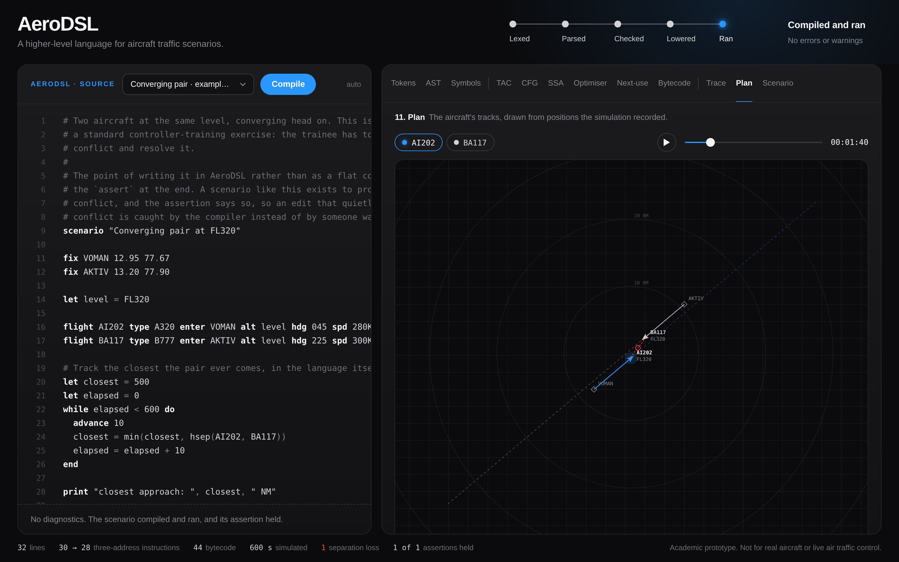
The compiler, live.
How far it got
Five stages across the top. The one that failed turns red.
The source
Coloured like the slides. Error lines are marked, and a click on a message jumps to it.
Every phase
Twelve views from tokens to the scenario file, including this plan view: press play, or drag the time.
Run it yourself
Windows: double-click run-demo.bat
macOS, Linux: ./run-demo.sh

Slide 15
The code is on GitHub.
Everything in these slides can be rerun from it.
REPOSITORY
WHAT IS IN IT
github.com/Jaskaran-Singh-ops/AeroDSL
AeroDSL/
├─ src/ the compiler: 20 C files, one header
├─ examples/ 17 programs, 7 written to fail
├─ tests/ 336 checks, and the fuzzer
├─ bin/ ready-to-run programs, 5 systems
├─ ui/ the demo page
├─ bluesky/ the BlueSky comparison files
├─ docs/ spec, architecture, viva, slides
├─ slides/ Review 1, 2 and 3 decks
├─ tools/ release and slide checks
└─ README.md how to run it
CLONE IT
git clone https://github.com/Jaskaran-Singh-ops/AeroDSL.git
OR WITHOUT GIT
On the repository page: Code, then Download ZIP. The ready-to-run programs for Windows, macOS and Linux are inside.

Slide 16
Run it yourself.
The same steps as the README. Pick the column for your computer.
Windows
macOS and Linux
From source
Nothing to install
Nothing to install
Any system with a C compiler and make
1
Download the ZIP from GitHub and unzip it
1
git clone https://github.com/Jaskaran-Singh-ops/AeroDSL.git
1
make
builds ./aerodsl
2
Open Command Prompt in the folder
2
cd AeroDSL
2
make test
336 checks and every example
3
bin/macos-arm64/aerodsl examples/05_loop.aero
3
aerodsl examples\05_loop.aero
Intel Mac: macos-x64. Linux: linux-x64
3
./aerodsl examples/05_loop.aero
the scenario file
the scenario file
4
Double-click run-demo.bat
4
./run-demo.sh
4
make ui
the demo page
the demo page
the demo page on port 8080
README.md has the same steps, the first-run warnings for Windows SmartScreen and macOS, and every command-line option.

Slide 17
What it does not do, yet.
LIMITS
NEXT, IN ORDER
Times come from our simplified flight model, not BlueSky’s
1
Compile altitude waits into ATALT
so BlueSky turns at FL300, whatever the climb rate
Tested in BlueSky 1.1.1 only, headless, on our examples
2
Measure with scenario authors
SSA is built and printed, but not used by the optimiser
time to make an edit, mistakes caught
No verifier checks bytecode before it runs
3
Use SSA in the optimiser
sparse constant propagation, cleaner passes
No study with real scenario authors
4
Add a bytecode verifier
An academic prototype: not for operational air traffic control
jump targets and registers checked before running

Slide 18
References.
USED FOR
[1]
A. V. Aho, M. S. Lam, R. Sethi and J. D. Ullman
Backpatching, the DAG, next-use, register allocation
Compilers: Principles, Techniques, and Tools, 2nd ed. Pearson Education, 2007.
[2]
R. Cytron, J. Ferrante, B. K. Rosen, M. N. Wegman and F. K. Zadeck
Dominance frontiers and phi placement for SSA
“Efficiently computing static single assignment form and the control dependence graph,” ACM TOPLAS, vol. 13, no. 4, pp. 451–490, 1991.
[3]
J. Hoekstra and J. Ellerbroek
The simulator the compiler targets
“BlueSky ATC simulator project: an open data and open source approach,” 7th Int. Conf. on Research in Air Transportation (ICRAT), 2016.
[4]
TU Delft CNS/ATM
The .scn line format and the CRE arguments
BlueSky wiki, “Scenario files.” github.com/TUDelft-CNS-ATM/bluesky/wiki/Scenario-files
[5]
S. Jafer, J. Updegrove and B. Chhaya
Prior work on scenario languages
“Towards a common air traffic control simulation scenario development,” EPS Madrid 2017, SciTePress, pp. 52–70, 2017.
[6]
D. S. W. Gould, G. De Ath, B. Carvell and N. Pepper
Scenario authoring as a bottleneck
“AirTrafficGen: Configurable air traffic scenario generation with large language models,” arXiv:2508.02269, 2025.

Slide 19
Thank you.
Questions welcome.
github.com/Jaskaran-Singh-ops/AeroDSL

