Slide 1
Sentimental Extraction
Using ML based approach to extract the sentiment out of a Tweet/Review/Feedback .

Slide 2
Problem Statement
With the large amount of feedback available across different products on online platforms let it be Playstore ,Wikipedia ,Google . Sentimental Analysis of these feedback are possible now with the upcoming NLP classification techniques but the extraction of these sentimental words is still a tough task.

Slide 3
Idea behind the project
Currently this system is done manually if needed , skilled labourers are used to extract the important portion out of the text to store it efficiently .
There are also some ML techniques which are currently being used like extracting good / bad words out of a sentence using a window around the words to capture the context of the sentiment .Although the ML solutions are proved to be not as accurate as Deep Learning solutions but are a good option.
The above solutions are not accurate and/or cheap to provide an efficient way to store the data .
I have used a Deep Learning Model to solve the problem.

Slide 4
Key points
Using an AI based approach to extract the sentimental part out of a sentence.
Our model will receive a chunk of text form the website feedback , then our model will try to extract the sentimental portion out of the sentence using the context of the sentence hence understanding the sarcasm as well.
Our model will be trained the Tweet Sentimental Extraction dataset as provided by the Kaggle Challenge.
We’ll be trying to use a State of the Art Model Called Roberta.

Slide 5
Approach
Data : Dataset is the part of the ongoing(then) competition Sentimental Extraction on Kaggle.
EDA: Understanding the dataset.
Pre Processing: Converting text into a input form for the model.
Fine tuning: Training the pre-trained model on our dataset for few epochs only.
Prediction: Testing our model on the Test dataset.

Slide 6
DATA
The Dataset consists of two parts, one a training data and other is the testing dataset on which the model will be evaluated by the Kaggle Submission in the backend.
The Training Dataset consists of three columns as (Tweet ID, Tweet, Extraction, Sentiment) .Tweet ID is a number assigned to the Tweets for easy manageability ,Tweet is the text chunk which users have tweeted .Extraction is the selected sentimental portion out of a text .Sentiment is the nature of the tweet.
In Testing data the Extraction column is missing.
Total training data is (27481,4) , that is 27481 data points for training are available for the model .
and testing will be done on (3534,3) data points which will be evaluated with Jaccard Score in the kaggle backend

Slide 7
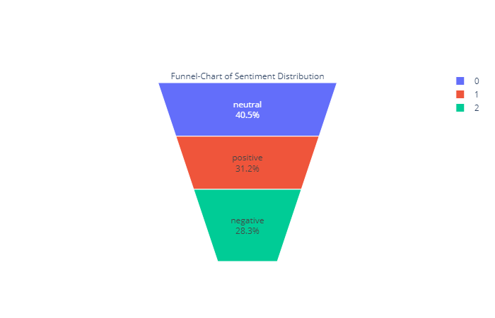
DATA EXTRACTION CODE
EDA

Slide 8
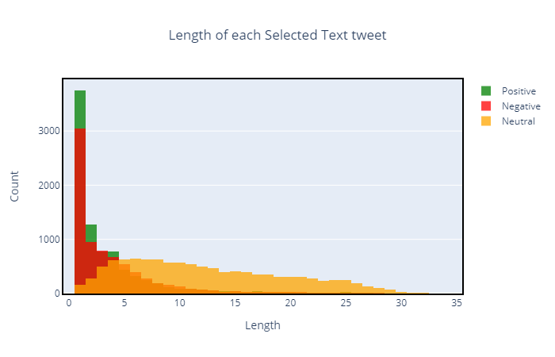
Observations
Average length of word in selected text is around 7 which seems bit high. This says we need to predict more words per tweet
Most of positive and negative tweets have selected text length less than 5.This is good significance as we can add exclude conditions for predicting words.
Neutral sentiments are distributed across all lengths.

Slide 9
Metric
Jaccard Score
The metric in this competition is the word level Jaccard score
A Python implementation based on the links above, and matched with the output of the C# implementation on the back end, is provided below.
def jaccard(str1, str2):
a = set(str1.lower().split())
b = set(str2.lower().split())
c = a.intersection(b)
return float(len(c)) / (len(a) + len(b) - len(c))
The formula for the overall metric, then, is:
score=∑^{n}_{i=1} jaccard(gt_{i},dt_{i})
where:
n=number of documents
jaccard=the function provided above
gti.=the ith ground truth
dti=the ith prediction

Slide 10
Model
A robustly optimized method for pretraining natural language processing (NLP) systems that improves on Bidirectional Encoder Representations from Transformers, or BERT, the self-supervised method released by Google in 2018.
BERT is a revolutionary technique that achieved state-of-the-art results on a range of NLP tasks while relying on unannotated text drawn from the web, as opposed to a language corpus that’s been labeled specifically for a given task. The technique has since become popular both as an NLP research baseline and as a final task architecture.
RoBERTa, produces state-of-the-art results on the widely used NLP benchmark, General Language Understanding Evaluation (GLUE).

Slide 11
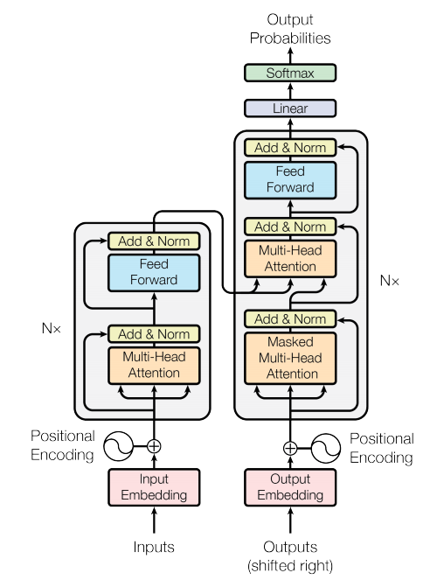
Architecture

Slide 12
Predicting Model
It consists of a feature extractor that is a pretrained model Roberta .
Roberta base is a 12-layer, 768-hidden, 12-heads, 125M parameters deep learning Transformer model .
A head is attached to the base model so that it can predict the starting and the ending of the extracted text .
the model predicts a 2 vector of words length one for starting and other for ending .

Slide 13
Pre-processing
Tokenization : byte-level Byte-Pair-Encoding.
This tokenizer has been trained to treat spaces like parts of the tokens (a bit like sentencepiece) so a word will be encoded differently whether it is at the beginning of the sentence (without space) or not.
It returns input_ids ,attention_mask ,token_type_ids.

Slide 14
Fine-Tuning
Fine Tuning : The process of training a pre-trained model on a downstream task is called fine tuning .
here we are using Roberta model which is pretrained on huge text data in a unsupervised way (masked language model).
To fine tune it to the extraction task a head is added to the base model and the weights are adjusted during the training .
It took 2 epochs of the training data to achieve a good accuracy of 70.5% .

Slide 15
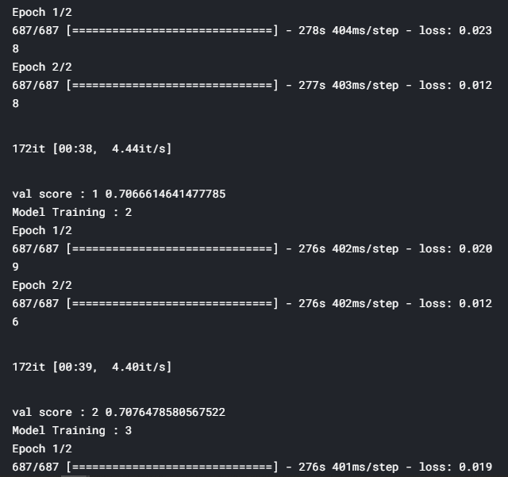
Training Snap

Slide 16
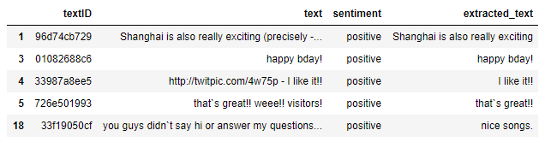
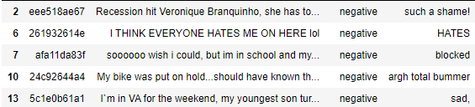
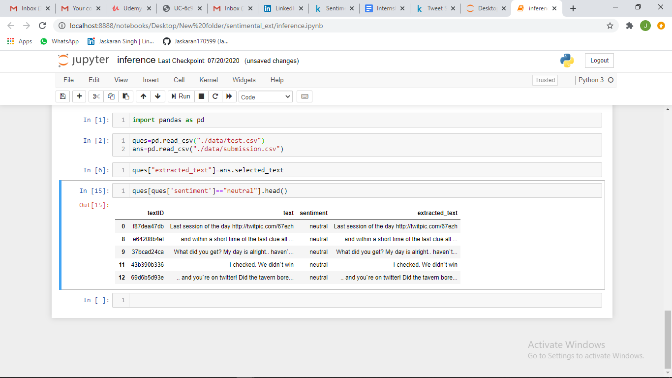
Predictions
For a new Youtube video

Slide 17
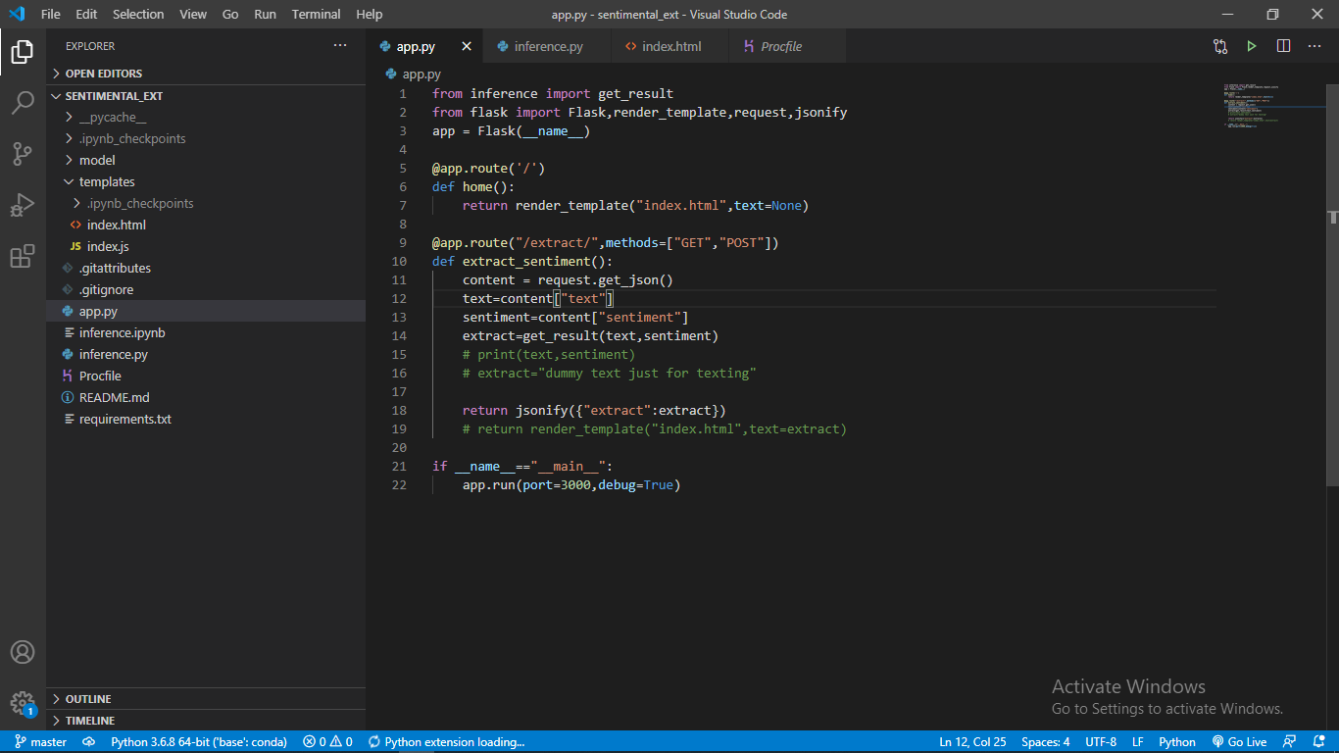
API

Slide 18
Result
The Kaggle challenge is over now and I have got a 70.8 Jaccard score which makes my rank around 1468 using 5-Folds Roberta on the test dataset out of 2227.
The winning score is 73.6 which consists of more than 30 models and a character wise approach .
The model is served on a flask API and can be integrated to a website.

Slide 19
FUTURE SCOPE
For future scope after training certain things are to be learnt to implement few features. For implementing on a large scale skills like big data , kubernetes , cloud computing services like AWS / GCP are needed .
Before actually implementing features, knowledge is to be gained to implement these features accurately so that they are effectively accommodated with the existing application without causing any issue and will increase the features of this application. With prior knowledge , this procedure is easily done rather than directly implementing these features into the application which can lead to various issues.
The response time of the model should be less in order to have a good api so pruning or other methods should be explored.

