Slide 1


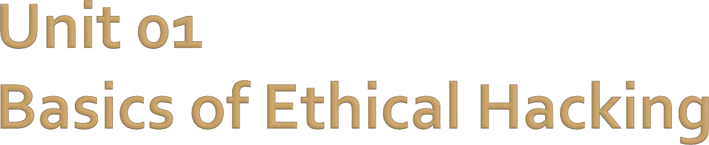
Computer and Application Security
Baljeet S. Bilkhu, BASc., MScIS bbilkhu@conestogac.on.ca

Slide 2
Course Outline Section 1.0 – Basics of Ethical Hacking
1.1 Explain the need for computer security.
1.2 Explain the ethical and professional aspects of security testing.
1.3 Explain the high-level framework of security through confidentiality, integrity and availability.

Slide 3
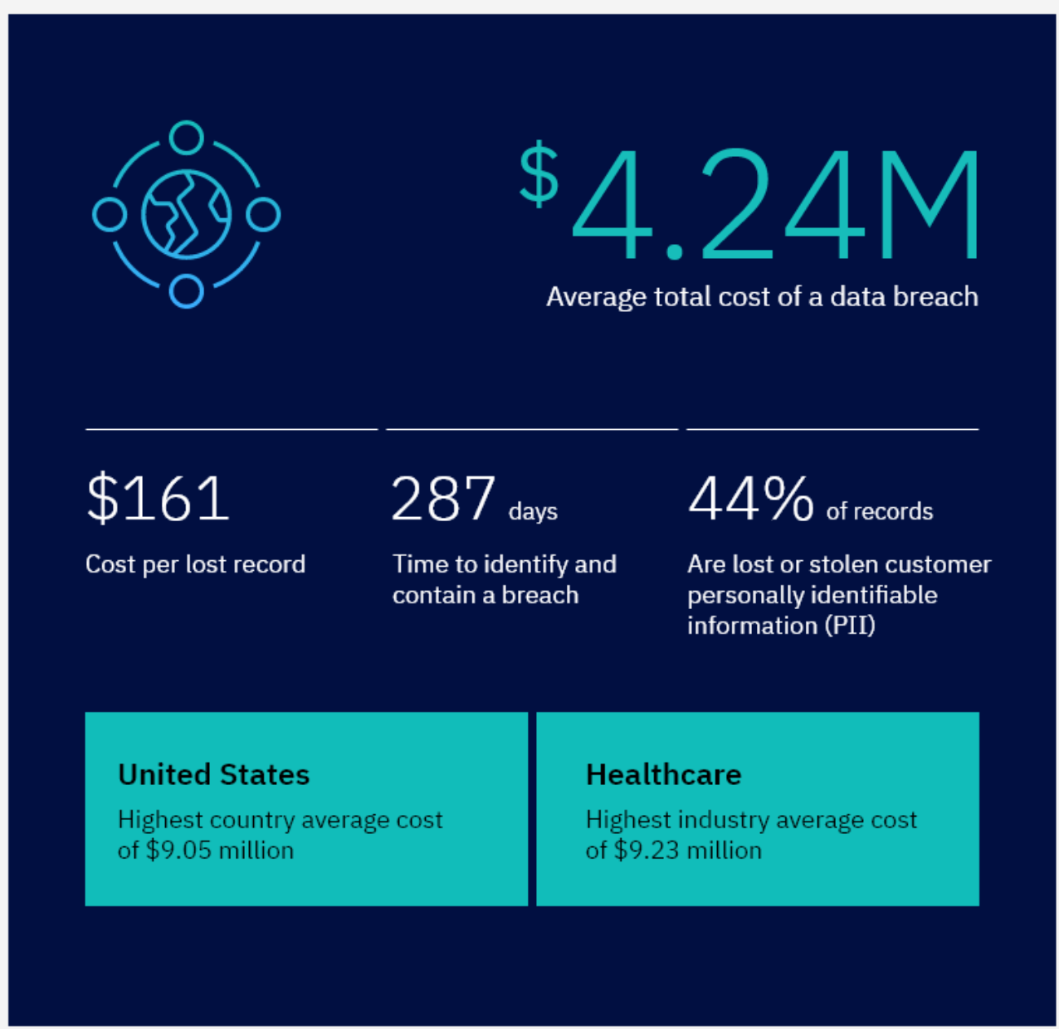
Some Statistics From IBM (2021)…
Notes:
Cost of a Data Breach Report 2021 (ibm.com)

Slide 4
Data Breaches
According to NASDAQ, there were over 1100 data breaches on US businesses in 2020
This number had risen to about 1300 by September of 2021.
A goal of this course is to help prepare you as mobile system developers on how to better protect your applications and the underlying systems.

Slide 5
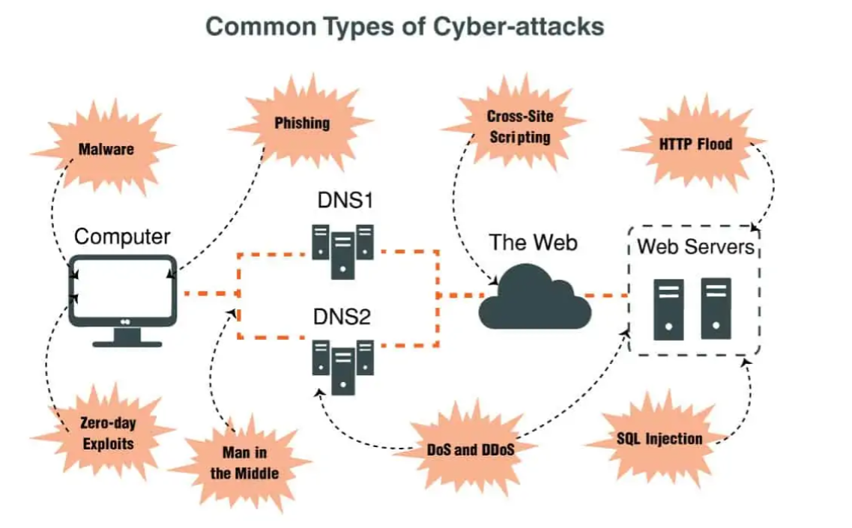
Common Types of Cyber-Attacks
How to Protect Against Cyber Attacks in 2021 & Best Tools (pcwdld.com)

Slide 6
Today’s Threat Landscape
Today's threat landscape is complex and continues to evolve alongside new advancements in technology.
Current cyber threats pose a risk to businesses, governments, health care institutions and even individuals.
For instance, Malware is becoming more aggressive. We are experiencing everything from network-based ransomware worms, to malware that can wipe out entire systems. Malicious actors are even designing sophisticated malware that is polymorphic in nature and alludes detection. This behavior makes it even more difficult to combat malware, because the signatures are constantly changing.

Slide 7
Today’s Threat Landscape (cont…)
With the advent and incorporation of IoT (Internet of Things) devices, such devices not having the same security built into them as other devices can be more susceptible to attacks.
Cloud security – as more and more organizations employ cloud computing for their hosting and deployments, they still need to ensure that security is being focused on.
Due to work from home arrangements, security needs to be considered to ensure that remote employees are not making them and their organizations susceptible to attacks.

Slide 8
Ensuring the security of computing resources
Ensuring
Working towards the goal
It is an unending process
Resources
Hardware, software, data, network

Slide 9
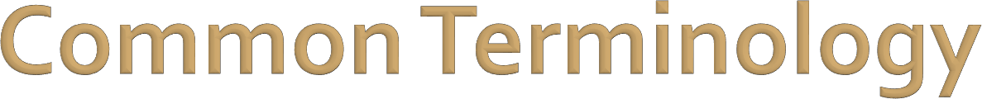

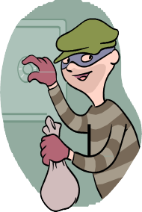
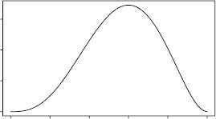
Vulnerability
A weakness in the system
Bug, glitch
Exploit
A known method of taking advantage of a vulnerability
Threat
The likelihood of an exploit being used to compromise the security of a system

Slide 10

Security is a very complex, detailed and difficult topic
Many concepts fall under "security"
There is no one solution
Instead, we have principles

Slide 11

"Security is a process, not a product."
It is not available on the shelf
Continual effort
Set of processes
Defined set of approved steps
Set of policies
Behavioural rules

Slide 12
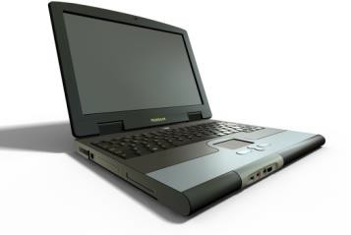
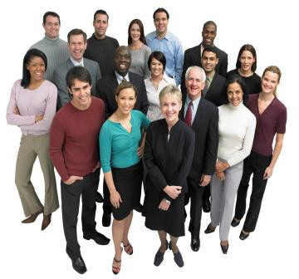
Computer Security is not limited to computers
Technology
Hardware and software
People
Insiders and outsiders
Legitimate and illegitimate
Environment
Rooms, buildings, proximity

Slide 13
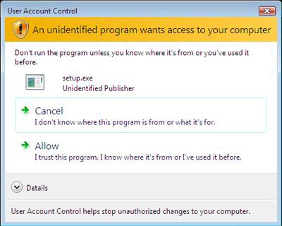
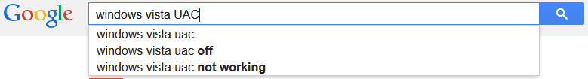
Security and convenience are inversely proportional
People want security, but they don’t want to see it working
Must find a balance
E.g. Windows Vista UAC

Slide 14
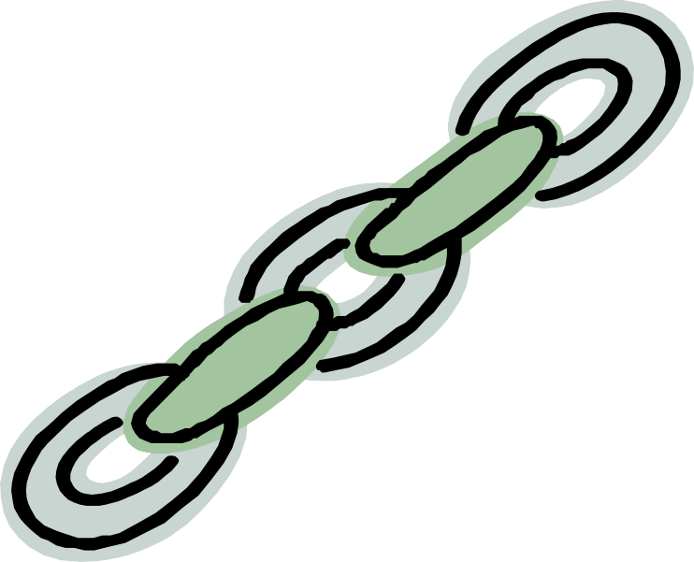
Security is only as strong as the weakest link
All aspects must be treated equally
Technology, people, environment
Must remain current

Slide 15
Multiple layers of defence
Routers, firewalls, etc.
Multifactor authentication
Backup power, UPS

Slide 16
Focus on the most likely threats
It is impossible to solve every problem
Solve the most likely first, then work on others
Dependant on the domain
Size of business
Type of business
Competition
Location
Etc.

Slide 17

Obscurity helps security
Keeping a low profile online helps
Not always possible
Popular becomes a target
Don’t need to encourage

Slide 18
Software processes
Cryptography, encryption, authentication, authorization, auditing, privacy protection, etc.
Physical processes
Locks, cameras, IDs, etc.
Many others processes
Documentation, policies, reporting system, etc.

Slide 19

The term “hacker” originated in the 1960’s at MIT and wasn’t associated with any malice – but has since been associated with negativity
"Hacking" and "hacker" can be used both positively and negatively
Someone who circumvents computer security to access information
Someone who uses their resourcefulness to solve problems. "Hack around with."

Slide 20
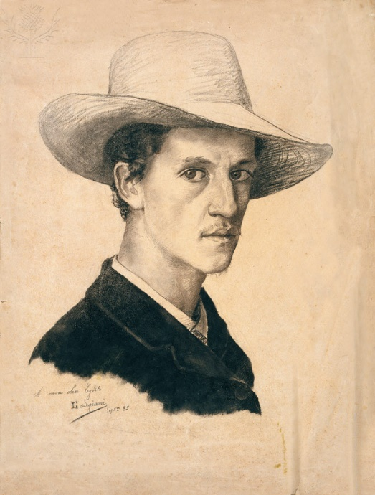
Ethical Hacking
Also known as White-Hat Hacking
Very important aspect of any security plan
Provides a framework to test systems from a security point 0f view
Goal is to identify and then address the vulnerabilities
Image Source: Self-portrait Created by Eduardo Gordigiani. [Fine Art]. Retrieved from Encyclopædia Britannica ImageQuest. https://quest-eb-com.conestoga.idm.oclc.org/search/135_856000/1/135_856000/cite

Slide 21
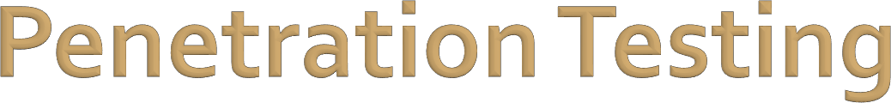
An authorized (legal) attempt to find and exploit computer systems for the purpose of making the system more secure
Find the problem before someone else does
Pen Testing
PT
Hacking
Ethical Hacking
White Hat Hacking

Slide 22

Computing has entered all aspects of our lives
Great convenience, great risk
The more something is needed, the more it should be protected
Computer security is the responsibility of everyone
Not just the network administrator, for example

Slide 23
Loss of hardware
Loss of software
Loss of disruption of service
Loss of information
Loss of money

Slide 24
Ethics

Slide 25
Ethics (or the study of human well-being) in and of itself can be based on a set of values
Concerns for the well-being of humans
Values are generally based from two perspectives:
The well-being of others
No suffering being caused
Autonomy / Freedom
Equality
The well-being of ourselves
Character
Trust

Slide 26
Many common ethical issues arise for security professionals
Are given rights and privileges that allow them to access large amounts of protected information
E.g. Network admin, given access to usernames and passwords or what happens when an employee leaves the company and the data needs to be retrieved / repurposed for another employee? Going beyond the scope of a security / penetration test for a client and finding some “other” information.
Laws and guidelines can be put in place to dictate when and why
access should be used
Ultimately the decision is left to the professional

Slide 27
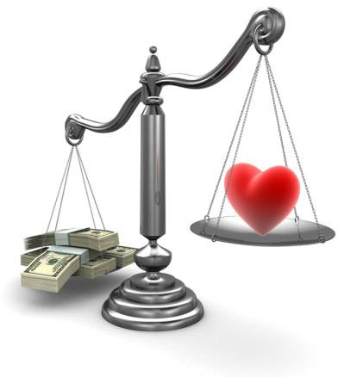
What you learn and how you learn it
Email, web site monitoring, key loggers, screen captures
All can be used to find security policy breaches
But should they be?
Who decides when it is worth it?
Consistency is required

Slide 28

Learn trade secrets and leave a company
Work for multiple companies
Discover your employer is breaking the law
Employee termination, recovery of assets

Slide 29
Convince your client they need additional, expensive security
Client wishes to remove important security features to save money
Allowing nefarious individuals (such as terrorists, etc…) to have stronger encryption than authorities?

Slide 30
There is no one or easy answer to any of these questions
Can be guided by precedent, law, organization
But ultimately, it is up to the person and their personal ethics to decide
Should always be aware of the potential and real harm of your actions

Slide 31
Confidentiality, Integrity and Availability

Slide 32
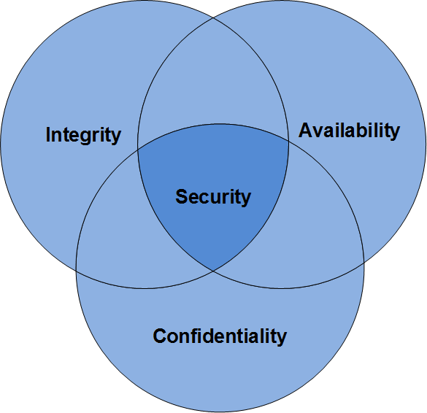
A widely used benchmark for evaluating the security of information systems
Meant to guide policies for information security within an organization

Slide 33
Protect sensitive information by ensuring that our data and systems are kept:
Private
Unchanged
Available

Slide 34
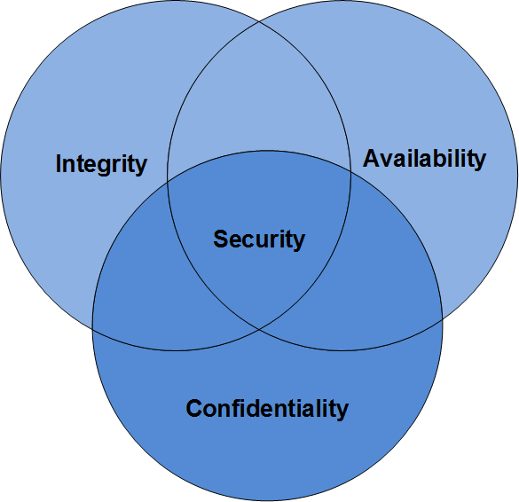
Confidentiality
Two aspects: Authentication and Authorization: both related to privacy
Ensuring only the proper
people have access
Many methods
Username/Password
Multi-Factor Authentication
Access Control
Encryption
Biometrics, etc…

Slide 35
Confidentiality - Example
What would happen if your parents were able to access your grades in eConestoga?
Here is where we have the concept of
“permissions”

Slide 36

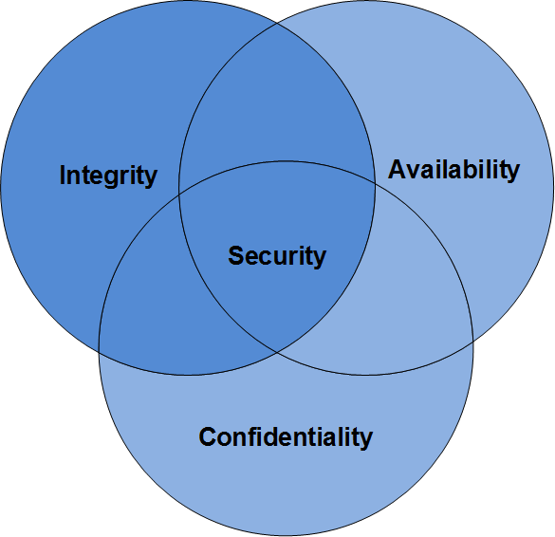
Ensuring the information in use is correct
Data integrity
Data has not been changed inappropriately
May be accidental
May be deliberate
Backups often essential as well as the use of cryptography to secure the data

Slide 37
Integrity - Example
What would happen if another student was able to ‘hack’ into eConestoga and change your grades?
Another case where permissions is in place

Slide 38

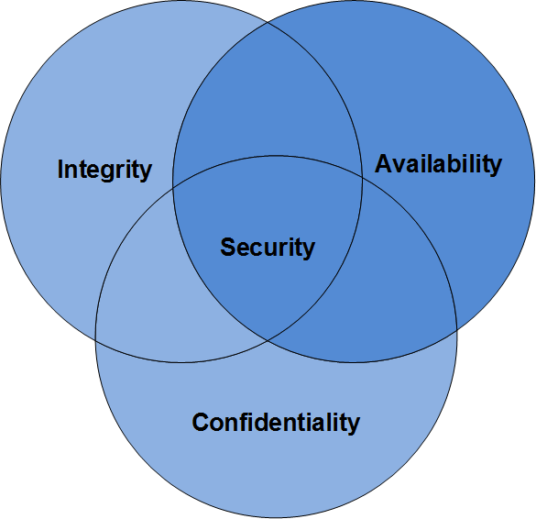
The ability to access a computer resource
Importance ranges greatly depending on domain
Library resource
Hospital system
An unavailable resource (such as a firewall or router) can impact security in other areas
Redundancy and failover are key

Slide 39
Availability - Example
What would happen if eConestoga was taken down in an apparent DDOS attack and you had an assignment due?
Safeguards such as backups are in place
as well as network monitoring tools and
redundant pairs

Slide 40
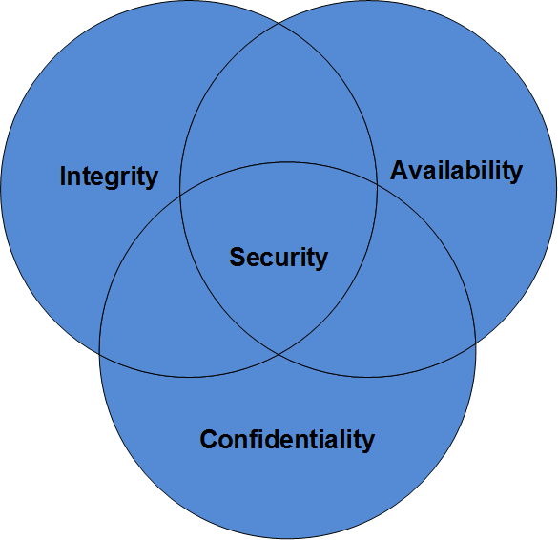
Effort can be divided into two distinct areas
Prevention
Stop before it begins
Username/Password
Detection
Alert once it has occurred
Burglar alarm

Slide 41

CIA is heavily dependant on the domain requirements of a system
What is "appropriate" or "adequate"
The balance between
prevention and detection

Slide 42

Security is a vast topic
Must think beyond the computer system, to include the users and the environment
There are many cases where there is no one correct answer
Many principles to guide us in making decisions

Slide 43
Consistent ethics must guide the decisions made
CIA can provide a guide to what to protect and how

Slide 44
Discussion
Let’s take some time to think about how we can (as developers) safeguard our systems from the CIA perspective.
That is, when developing a computer program / application, what can we do to ensure security in it?
Jot down your answers in the Discussion for this week and we’ll take it up as a group

Slide 45




Any questions?

