Slide 1
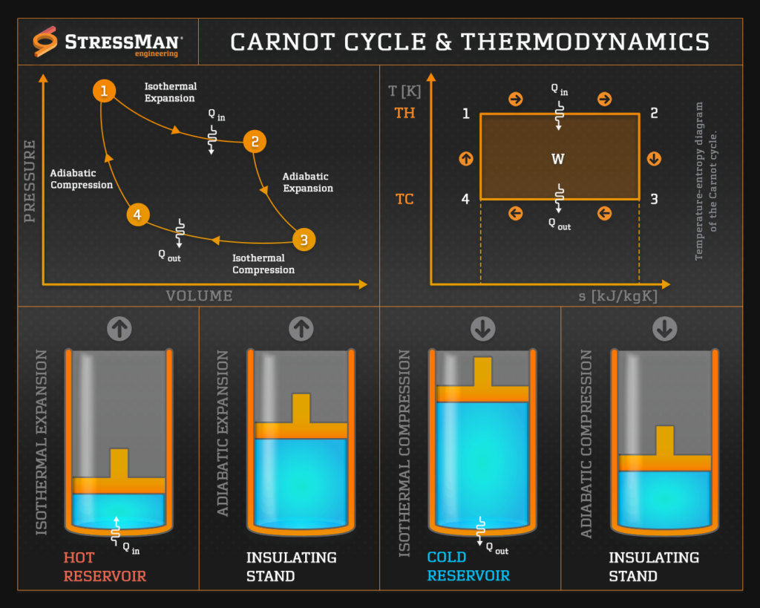
Course: Thermofluids ( MEC235)
Prepared By: Sudhanshu Dogra
Assistant Professor/COD(Thermal Engineering)
UID: 16900
School of Mechanical Engineering
Lovely Professional University

Slide 2
Carnot cycle
The cycle was first suggested by a French engineer Sadi Carnot in 1824 which works on reversible cycle and is known as Carnot cycle.
Any fluid may be used to operate the Carnot cycle which is performed in an engine cylinder the head of which is supposed alternatively to be perfect conductor or a perfect insulator of a heat. Heat is caused to flow into the cylinder by the application of high temperature energy source to the cylinder head during expansion, and to flow from the cylinder by the application of a lower temperature energy source to the head during compression.

Slide 3
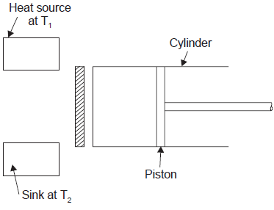
Assumptions
The assumptions made for describing the working of the Carnot engine are as follows :
(i) The piston moving in a cylinder does not develop any friction during motion.
(ii) The walls of piston and cylinder are considered as perfect insulators of heat.
(iii) The cylinder head is so arranged that it can be a perfect heat conductor or perfect heat insulator.
(iv) The transfer of heat does not affect the temperature of source or sink.
(v) Working medium is a perfect gas and has constant specific heat.
(vi) Compression and expansion are reversible.

Slide 4
Processes in Carnot Cycle
1) Reversible Isothermal process (1-2): in which Q₁ heat enters the system at t₁ reversibly from a constant temperature source at t₁ whe the cylinder is in contact with diathermic cover. The Internal energy of the system increases.
From 1st law: Q = ∆U + W
Q₁₋₂ = U₂ – U₁ + W₁₋₂ (1)

Slide 5
Contd…
2) Reversible Adiabatic process(2-3): in which diathermic cover is replaced with adiabatic cover and work is done by the system due to expansion. Temperature of the system decreases from t₁ to t₂.
From 1st law: Q = ∆U + W
Q₂₋₃ = U₃ – U₂ + W₂₋₃
0 = U₃ – U₂ + W₂₋₃ (2)

Slide 6
Contd…
3) Reversible Isothermal process (3-4): in which Q₂ heat leaves the system reversibly to a constant temperature sink at t₂ whe the cylinder is in contact with diathermic cover. The Internal energy of the system decreases.
From 1st law: Q = ∆U + W
Q₃₋₄ = U₄ – U₃ + W₃₋₄ (3)

Slide 7
Contd…
4) Reversible Adiabatic process(4-1): in which diathermic cover is replaced with adiabatic cover and work is done on the system due to compression. Temperature of the system increases from t₂ to t₁.
From 1st law: Q = ∆U + W
Q₄₋₁ = U₁ – U₄ + W₄₋₁
0 = U₃ – U₂ + W₄₋₁ (4)

Slide 8
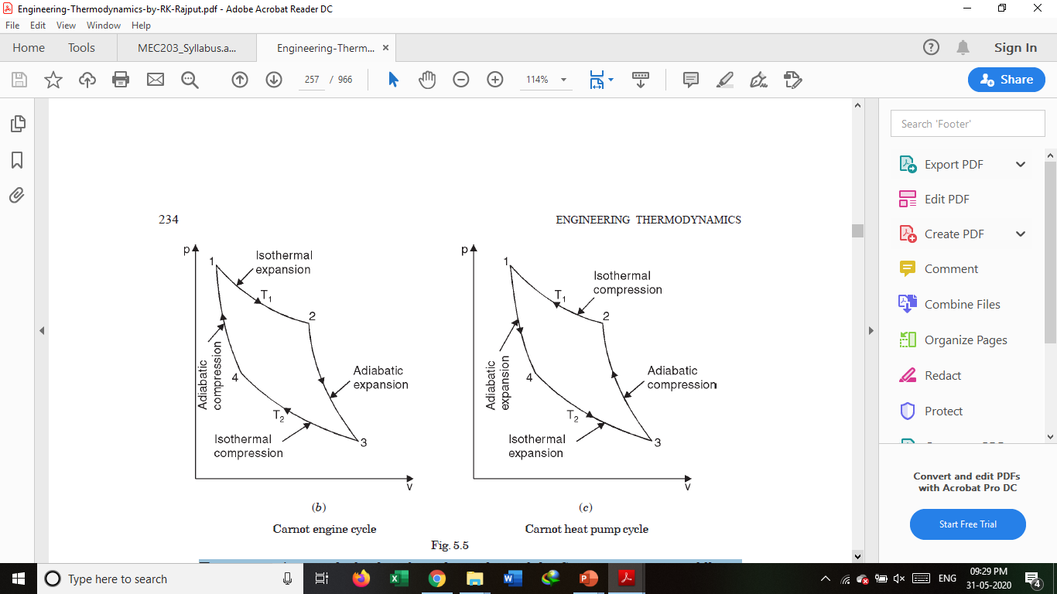
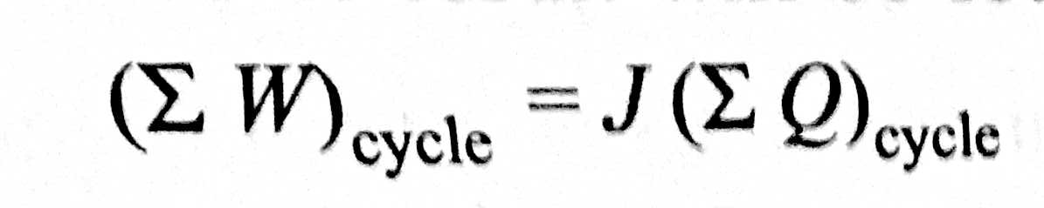
Contd…
The equations are:
Q₁₋₂ = U₂ – U₁ + W₁₋₂ (1)
0 = U₃ – U₂ + W₂₋₃ (2)
Q₃₋₄ = U₄ – U₃ + W₃₋₄ (3)
0 = U₃ – U₂ + W₄₋₁ (4)
Adding all the above equations, we get:
Q₁₋₂ + 0 + Q₃₋₄ + 0 = U₂ – U₁ + W₁₋₂ + U₃ – U₂ + W₂₋₃ + U₄ – U₃ + W₃₋₄ + U₃ – U₂ + W₄₋₁
Q₁₋₂ + Q₃₋₄ ₌ W₁₋₂ + W₂₋₃ + W₃₋₄ + W₄₋₁ (First law of Thermodynamics for a Cyclic process)

Slide 9
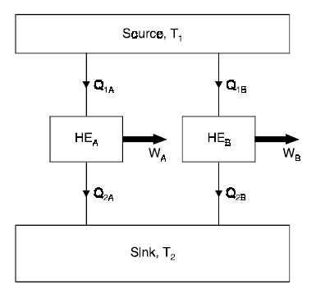
Carnot Theorem
“It states that of all engines operating between a given constant temperature source and a given constant temperature sink, none has a higher efficiency than a reversible engine”.
HE_{A} and HE_{B} are the two engines operating
between the given source at temperature T₁
and the given sink at temperature T₂.
Let HE_{A} be any heat engine and HE_{B} be any
reversible heat engine. We have to prove that
efficiency of HE_{B} is more than that of HE_{A}.
Let us assume that η_{A} > η_{B}.

Slide 10
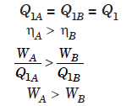
Contd…
Let the rates of working of the engines be such that

Slide 11
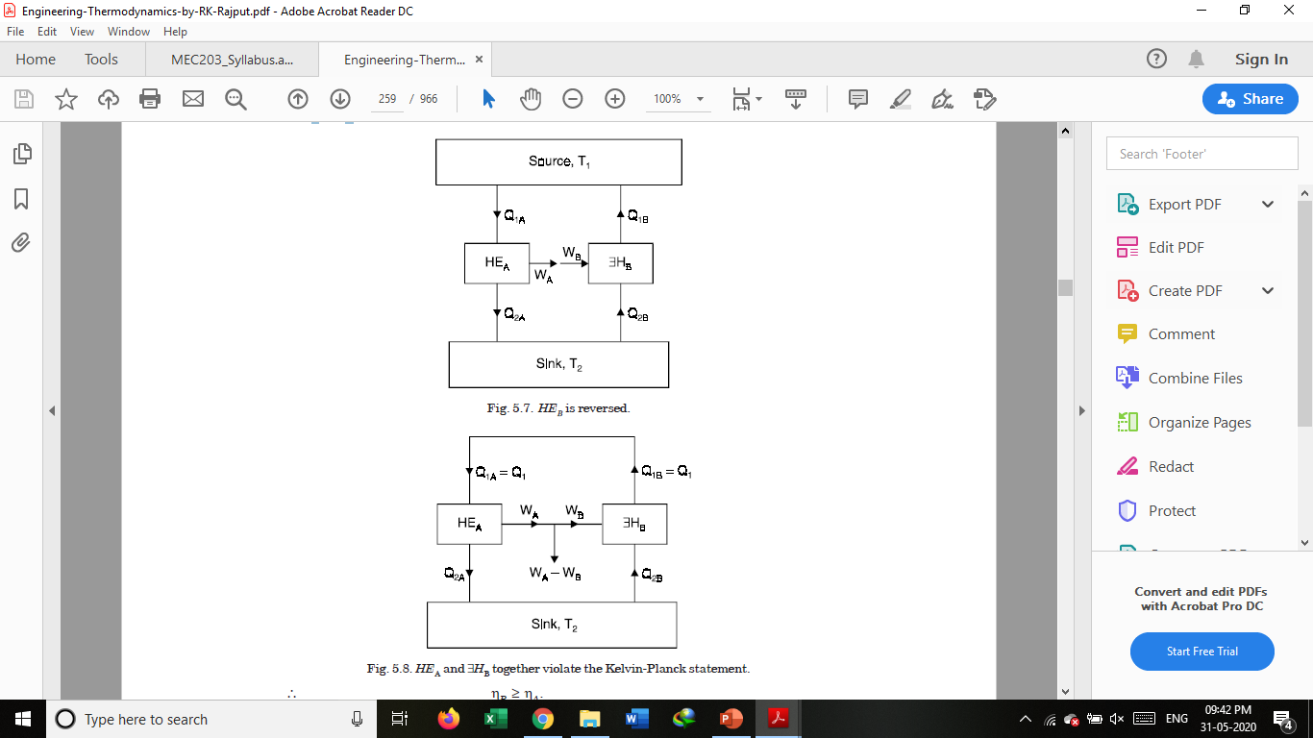
Contd…
Now, let HE_{B} be reversed. Since HE_{B} is a reversible heat engine, the magnitudes of heat and work transfer quantities will remain the same, but their directions will be reversed. Since W_{A} > W_{B}, some part of W_{A} (equal to W_{B}) may be fed to drive the reversed heat engine ∃H_{B}. Since Q_{1A} = Q_{1B} = Q₁, the heat discharged by ∃H_{B} may be supplied to HE_{A}. The source may, therefore, be eliminated. The net result is that HE_{A} and ∃H_{B} together constitute a heat engine which, operating in a cycle produces net work W_{A} – W_{B} while exchanging heat with a single reservoir at T₂. This violates the Kelvin-Planck statement of the second law. Hence the assumption that η_{A} > η_{B} is wrong. Hence, η_{B} > η_{A} .

Slide 12
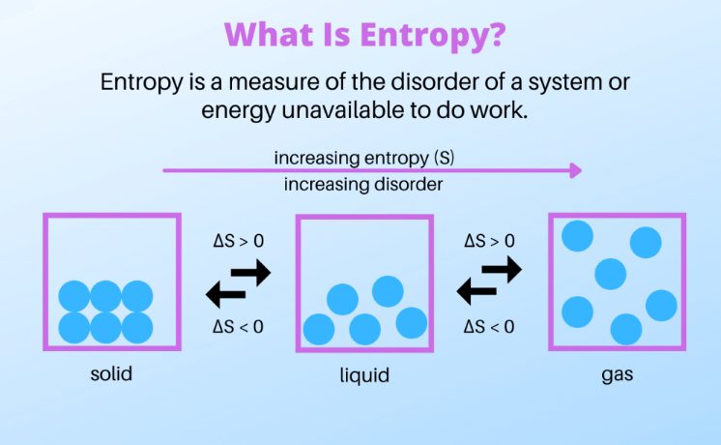
Entropy

Slide 13
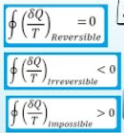
Clausius inequality

Slide 14
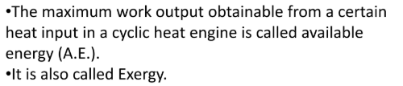
Available energy

Slide 15
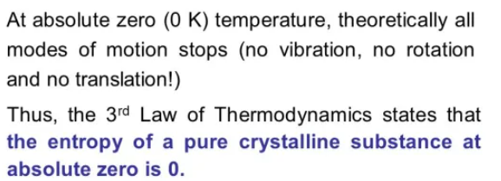
Third law of Thermodynamics

Slide 16
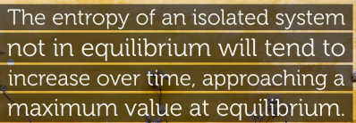
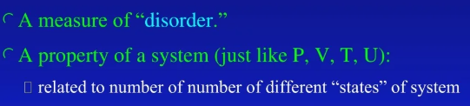
Entropy of Isolated system

Slide 17
THANKS

