Slide 1
SegWrap
Problem: Traditional video object segmentation struggles to maintain temporal consistency.
Approach: We use diffusion models to iteratively refine segmentation masks from input iframes.
Motivation: While Diffusion Models have set new benchmarks in image segmentation, their potential in Video Object Segmentation remains largely under-explored.
Key References: CoVOS [2022] & SegDiff [2021]
Notes:
1

Slide 2
CoVOS Foundation: I-Frames & B-Frames
Core Insight: Video codecs already compute motion. CoVOS exploits this to avoid redundant computation.
I-Frame (Keyframe)
  Complete image
  Large architecture (~122M parameters)
  Output: initial mask from full 100-step reverse diffusion
Both models use Mean Squared Error (MSE) loss, optimized for different regions of the diffusion process.
B-Frame
  Stores only motion vectors (move pixels left/right)
  Lightweight architecture (~25M parameters)
  Predictor: Warp mask using free motion vectors: \hat{P}_i = \mathrm{Warp}(P_{i-1}, MV_{i-1\to i})
  Corrector: Light model snaps to true boundaries: P_i = \theta_{\text{light}}(\hat{P}_i, F_i)
Sequence & Output
Notes:
2

Slide 3
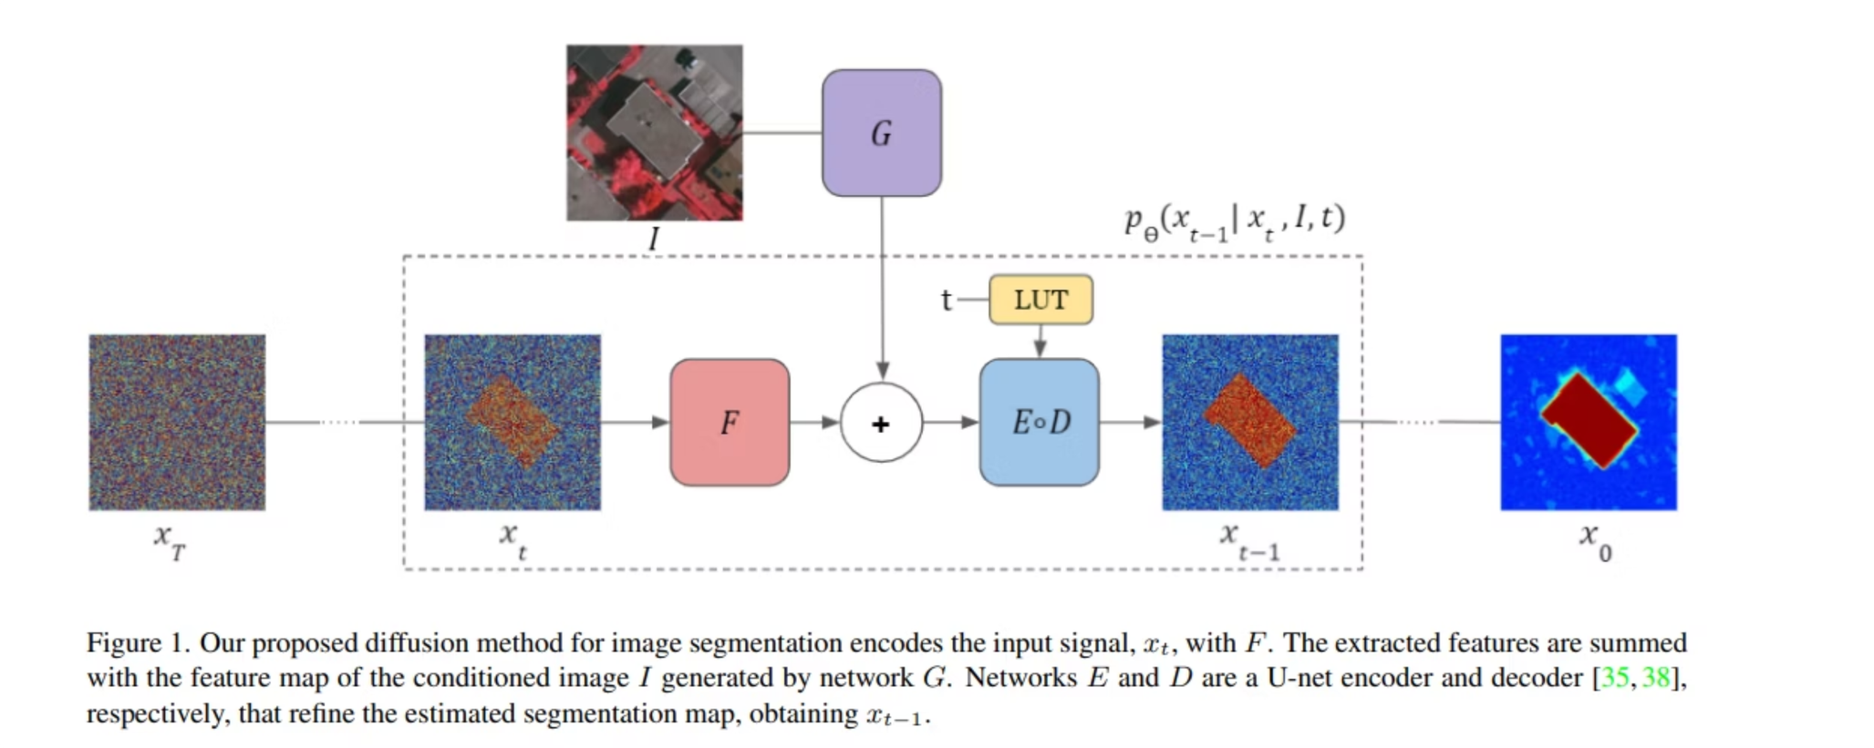
SegDiff Architecture
Notes:
3

Slide 4
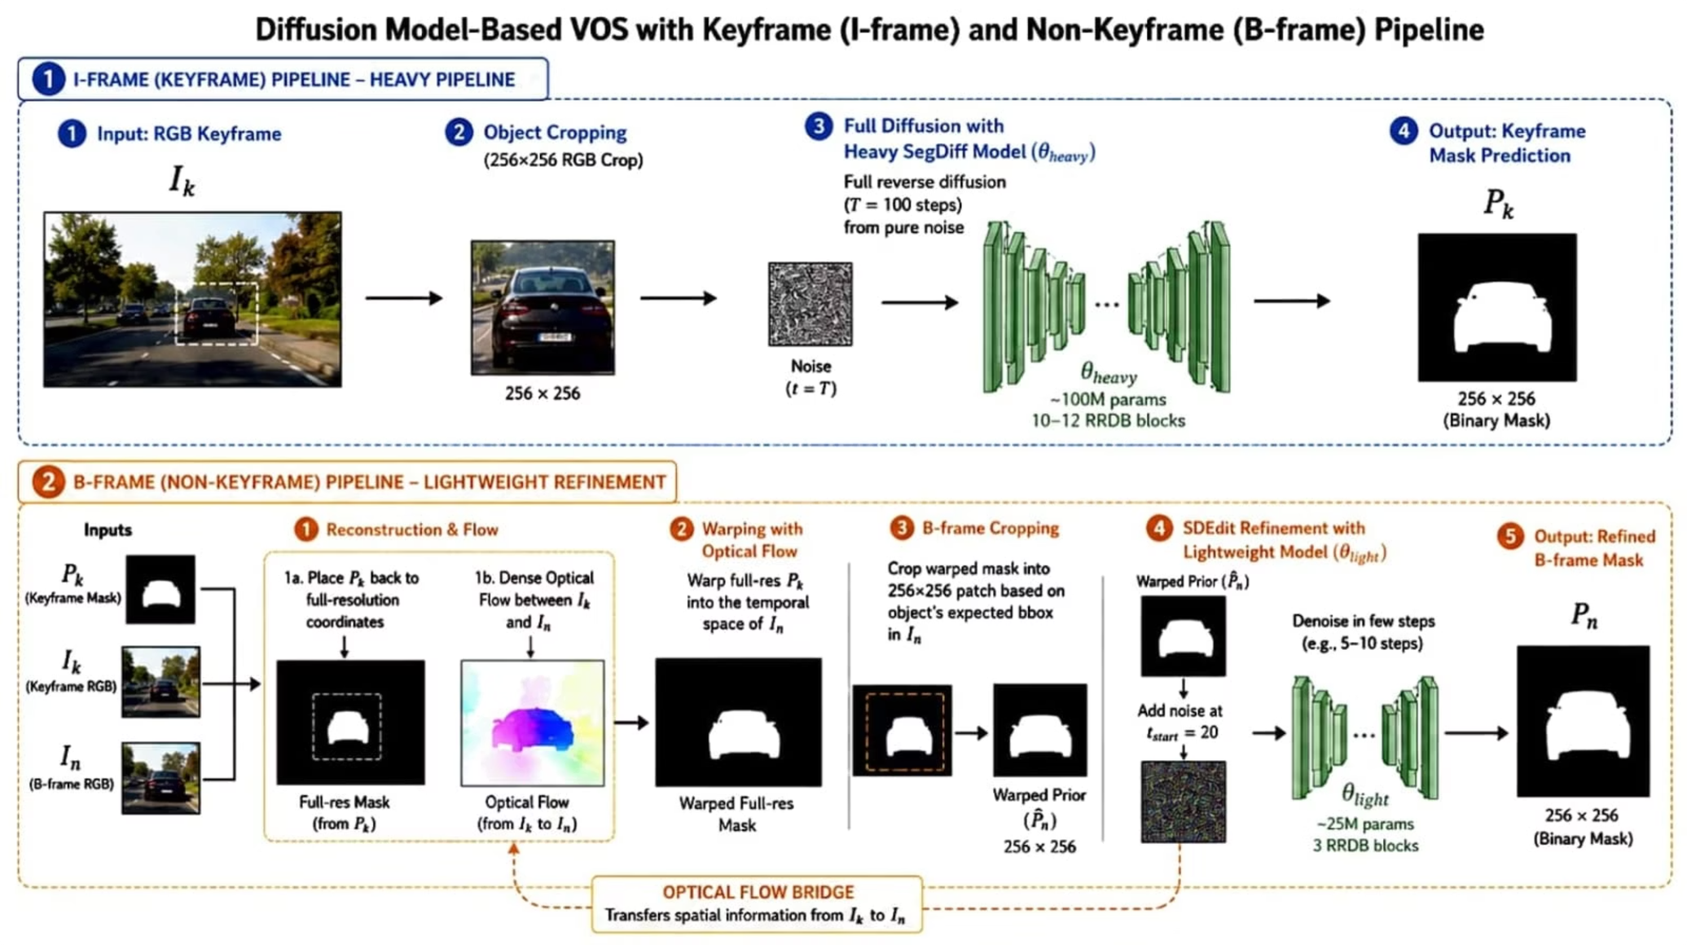
SegWrap Architecture
Notes:
4

Slide 5
Initial Dataset Exploration
weights of the Segdiff model were not available
Vaihingen & MoNuSeg
Cityscapes
ADE20K
Decision
Missing key annotations, and the authors were unreachable.
Too many classes for our small model capacity.
Switched to video datasets (YTVOS → YTVIS) for I-frame training.
Static image datasets, but no video context.
Notes:
5

Slide 6
Dataset Transition: YTVOS → YTVIS
Problem: YTVOS annotation inconsistency (multiple vs. single masks per frame) degraded model performance.
Solution: Switched to YTVIS with consistent single-instance annotations and smart cropping.
YTVOS Results
Metric
Value
IoU
0.468
F1
0.574
WCOV
0.631
F-Bound
0.501
Notes:
6

Slide 7
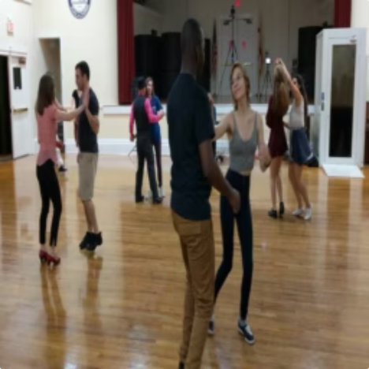
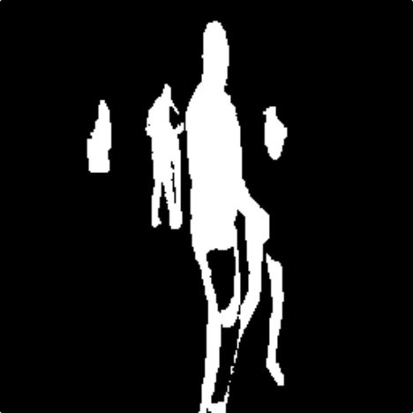
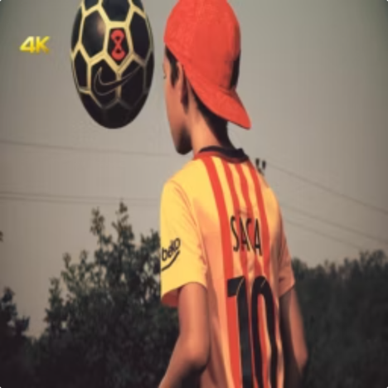

Results
Input Frame
Segmentation Output
Input Frame
Segmentation Output
Notes:
7

Slide 8
Results: YTVIS Benchmark
0.734
0.831
0.783
Mean IoU
Mean F1
J & F
Training :150k iterations on YTVIS Dataset, finetuned for 20k iterations on DAVIS 16
Inference time: 100 seconds per iframe AND 20 seconds per bframe on L40s (majority vote number = 10)
B-Frame Comparison
Case
Warp-only IoU
Warp-only F1
GT
0.615
0.704
I-Frame Pred
0.503
0.623
Notes:
8

Slide 9


Novel Contributions
1
2
Computational Efficiency
Occlusion Handling
Heavy model inference is run only on I-frames, while B-frames use lightweight warping and correction to reduce compute cost.
Periodic I-frame resets rediscover occluded objects and prevent permanent tracking failure.
Notes:
9

Slide 10
