Slide 1
I1
w1
H1
J1
b1
w5
b2
w8
w2
b3
O1
I2
w6
w9
w3
H2
J2
E
w7
w10
I3
O2
w4
H3
J3
I4

Slide 2

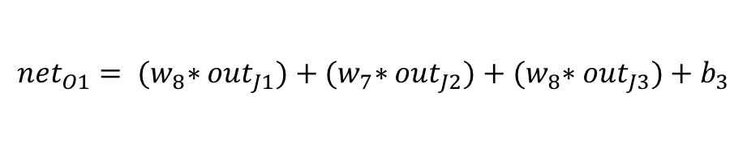

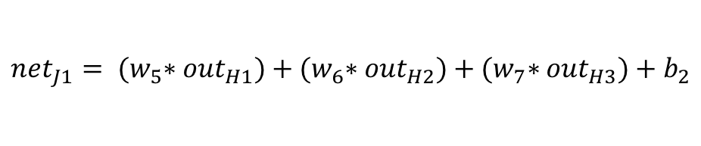

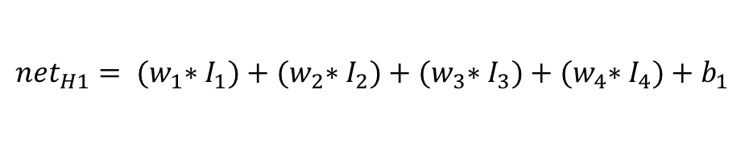
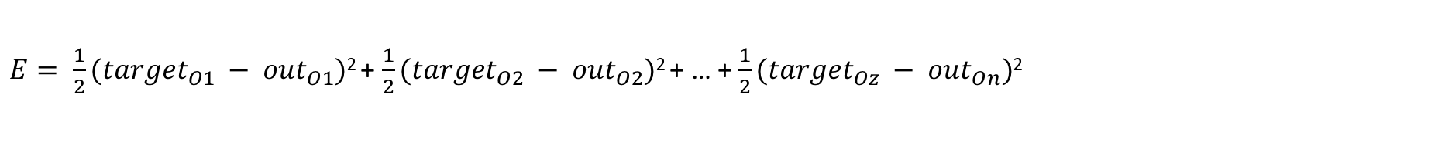
$E= \frac{1}{2}({target}_{O1} − {out}_{O1})$² + $\frac{1}{2}({target}_{O2} − {out}_{O2})$² + … + $\frac{1}{2}({target}_{Oz} − {out}_{On})$²
$${out}_{O1}=\frac{1}{1+e^{−{net}_{O1}}}$$
$${net}_{O1}= {(w}_{8}∗{out}_{J1})+{(w}_{7}∗{out}_{J2})+{(w}_{8}∗{out}_{J3})+b_{3}$$
$${out}_{J1}=\frac{1}{1+e^{−{net}_{J1}}}$$
$${net}_{J1}= {(w}_{5}∗{out}_{H1})+{(w}_{6}∗{out}_{H2})+{(w}_{7}∗{out}_{H3})+b_{2}$$
$${out}_{H1}=\frac{1}{1+e^{−{net}_{H1}}}$$
$${net}_{H1}= {(w}_{1}∗I_{1})+{(w}_{2}∗I_{2})+{(w}_{3}∗I_{3})+{(w}_{4}∗I_{4})+b_{1}$$

Slide 3
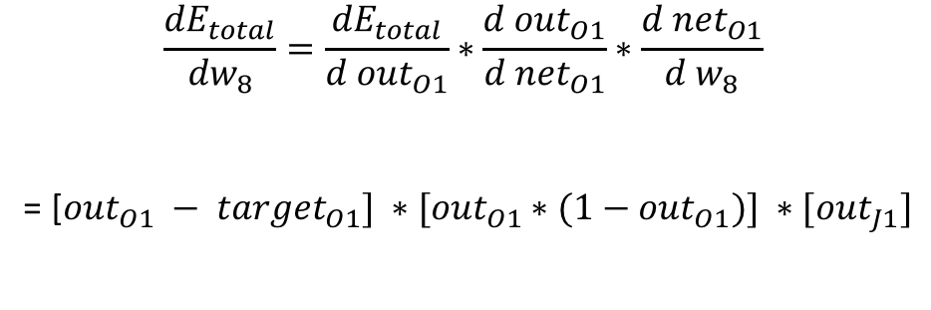
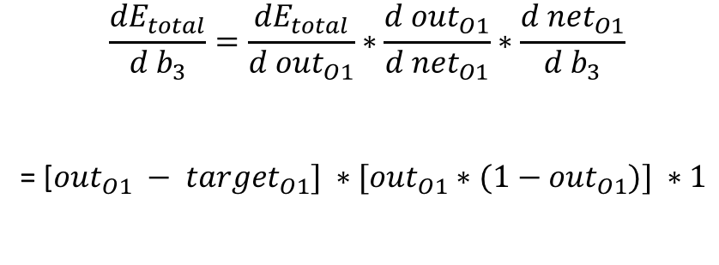
$$\frac{{dE}_{total}}{{dw}_{8}}=\frac{{dE}_{total}}{{d out}_{O1}}∗\frac{{d out}_{O1}}{{d net}_{O1}}∗\frac{{d net}_{O1}}{{d w}_{8}}$$
= [${out}_{O1} − {target}_{O1}] ∗[{out}_{O1}∗(1−{out}_{O1})] ∗[{out}_{J1}]$
$$\frac{{dE}_{total}}{{d b}_{3}}=\frac{{dE}_{total}}{{d out}_{O1}}∗\frac{{d out}_{O1}}{{d net}_{O1}}∗\frac{{d net}_{O1}}{{d b}_{3}}$$
= [${out}_{O1} − {target}_{O1}] ∗[{out}_{O1}∗(1−{out}_{O1})] ∗1$

Slide 4
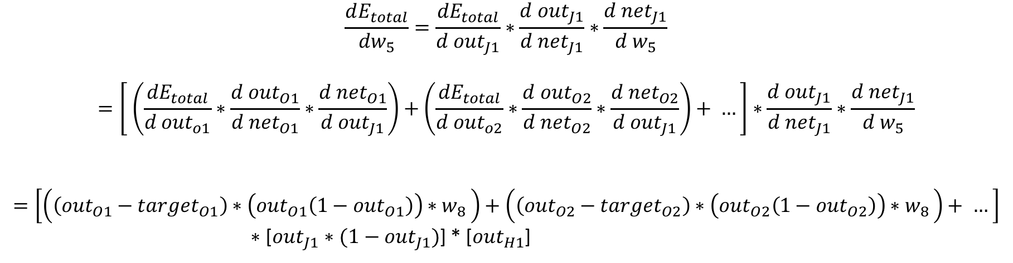
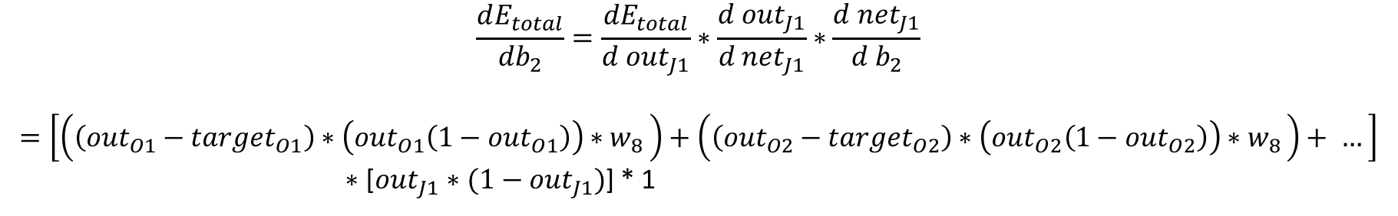
$$\frac{dE_{total}}{{dw}_{5}}=\frac{{dE}_{total}}{d{ out}_{J1}}∗\frac{d{ out}_{J1}}{d {net}_{J1}}∗\frac{d {net}_{J1}}{{d w}_{5}}$$
$$=\left[ \left(\frac{{dE}_{total}}{{d out}_{o1}}∗\frac{d{ out}_{O1}}{{d net}_{O1}}∗\frac{d{ net}_{O1}}{{d out}_{J1}}\right)+\left(\frac{{dE}_{total}}{{d out}_{o2}}∗\frac{d{ out}_{O2}}{{d net}_{O2}}∗\frac{d{ net}_{O2}}{{d out}_{J1}}\right)+ …\right]∗\frac{d{ out}_{J1}}{d {net}_{J1}}∗\frac{d {net}_{J1}}{{d w}_{5}}$$
$$=\left[\left(\left({out}_{O1}−{target}_{O1}\right)∗\left({out}_{O1}\left(1−{out}_{O1}\right)\right)∗w_{8 }\right)+\left(\left({out}_{O2}−{target}_{O2}\right)∗\left({out}_{O2}\left(1−{out}_{O2}\right)\right)∗w_{8 }\right)+ …\right]$$
$∗$ [${out}_{J1}∗(1−{out}_{J1})$] * [${out}_{H1}$]
$$\frac{dE_{total}}{{db}_{2}}=\frac{{dE}_{total}}{d{ out}_{J1}}∗\frac{d{ out}_{J1}}{d {net}_{J1}}∗\frac{d {net}_{J1}}{{d b}_{2}}$$
$$=\left[\left(\left({out}_{O1}−{target}_{O1}\right)∗\left({out}_{O1}\left(1−{out}_{O1}\right)\right)∗w_{8 }\right)+\left(\left({out}_{O2}−{target}_{O2}\right)∗\left({out}_{O2}\left(1−{out}_{O2}\right)\right)∗w_{8 }\right)+ …\right]$$
$∗$ [${out}_{J1}∗(1−{out}_{J1})$] * 1

