Slide 1
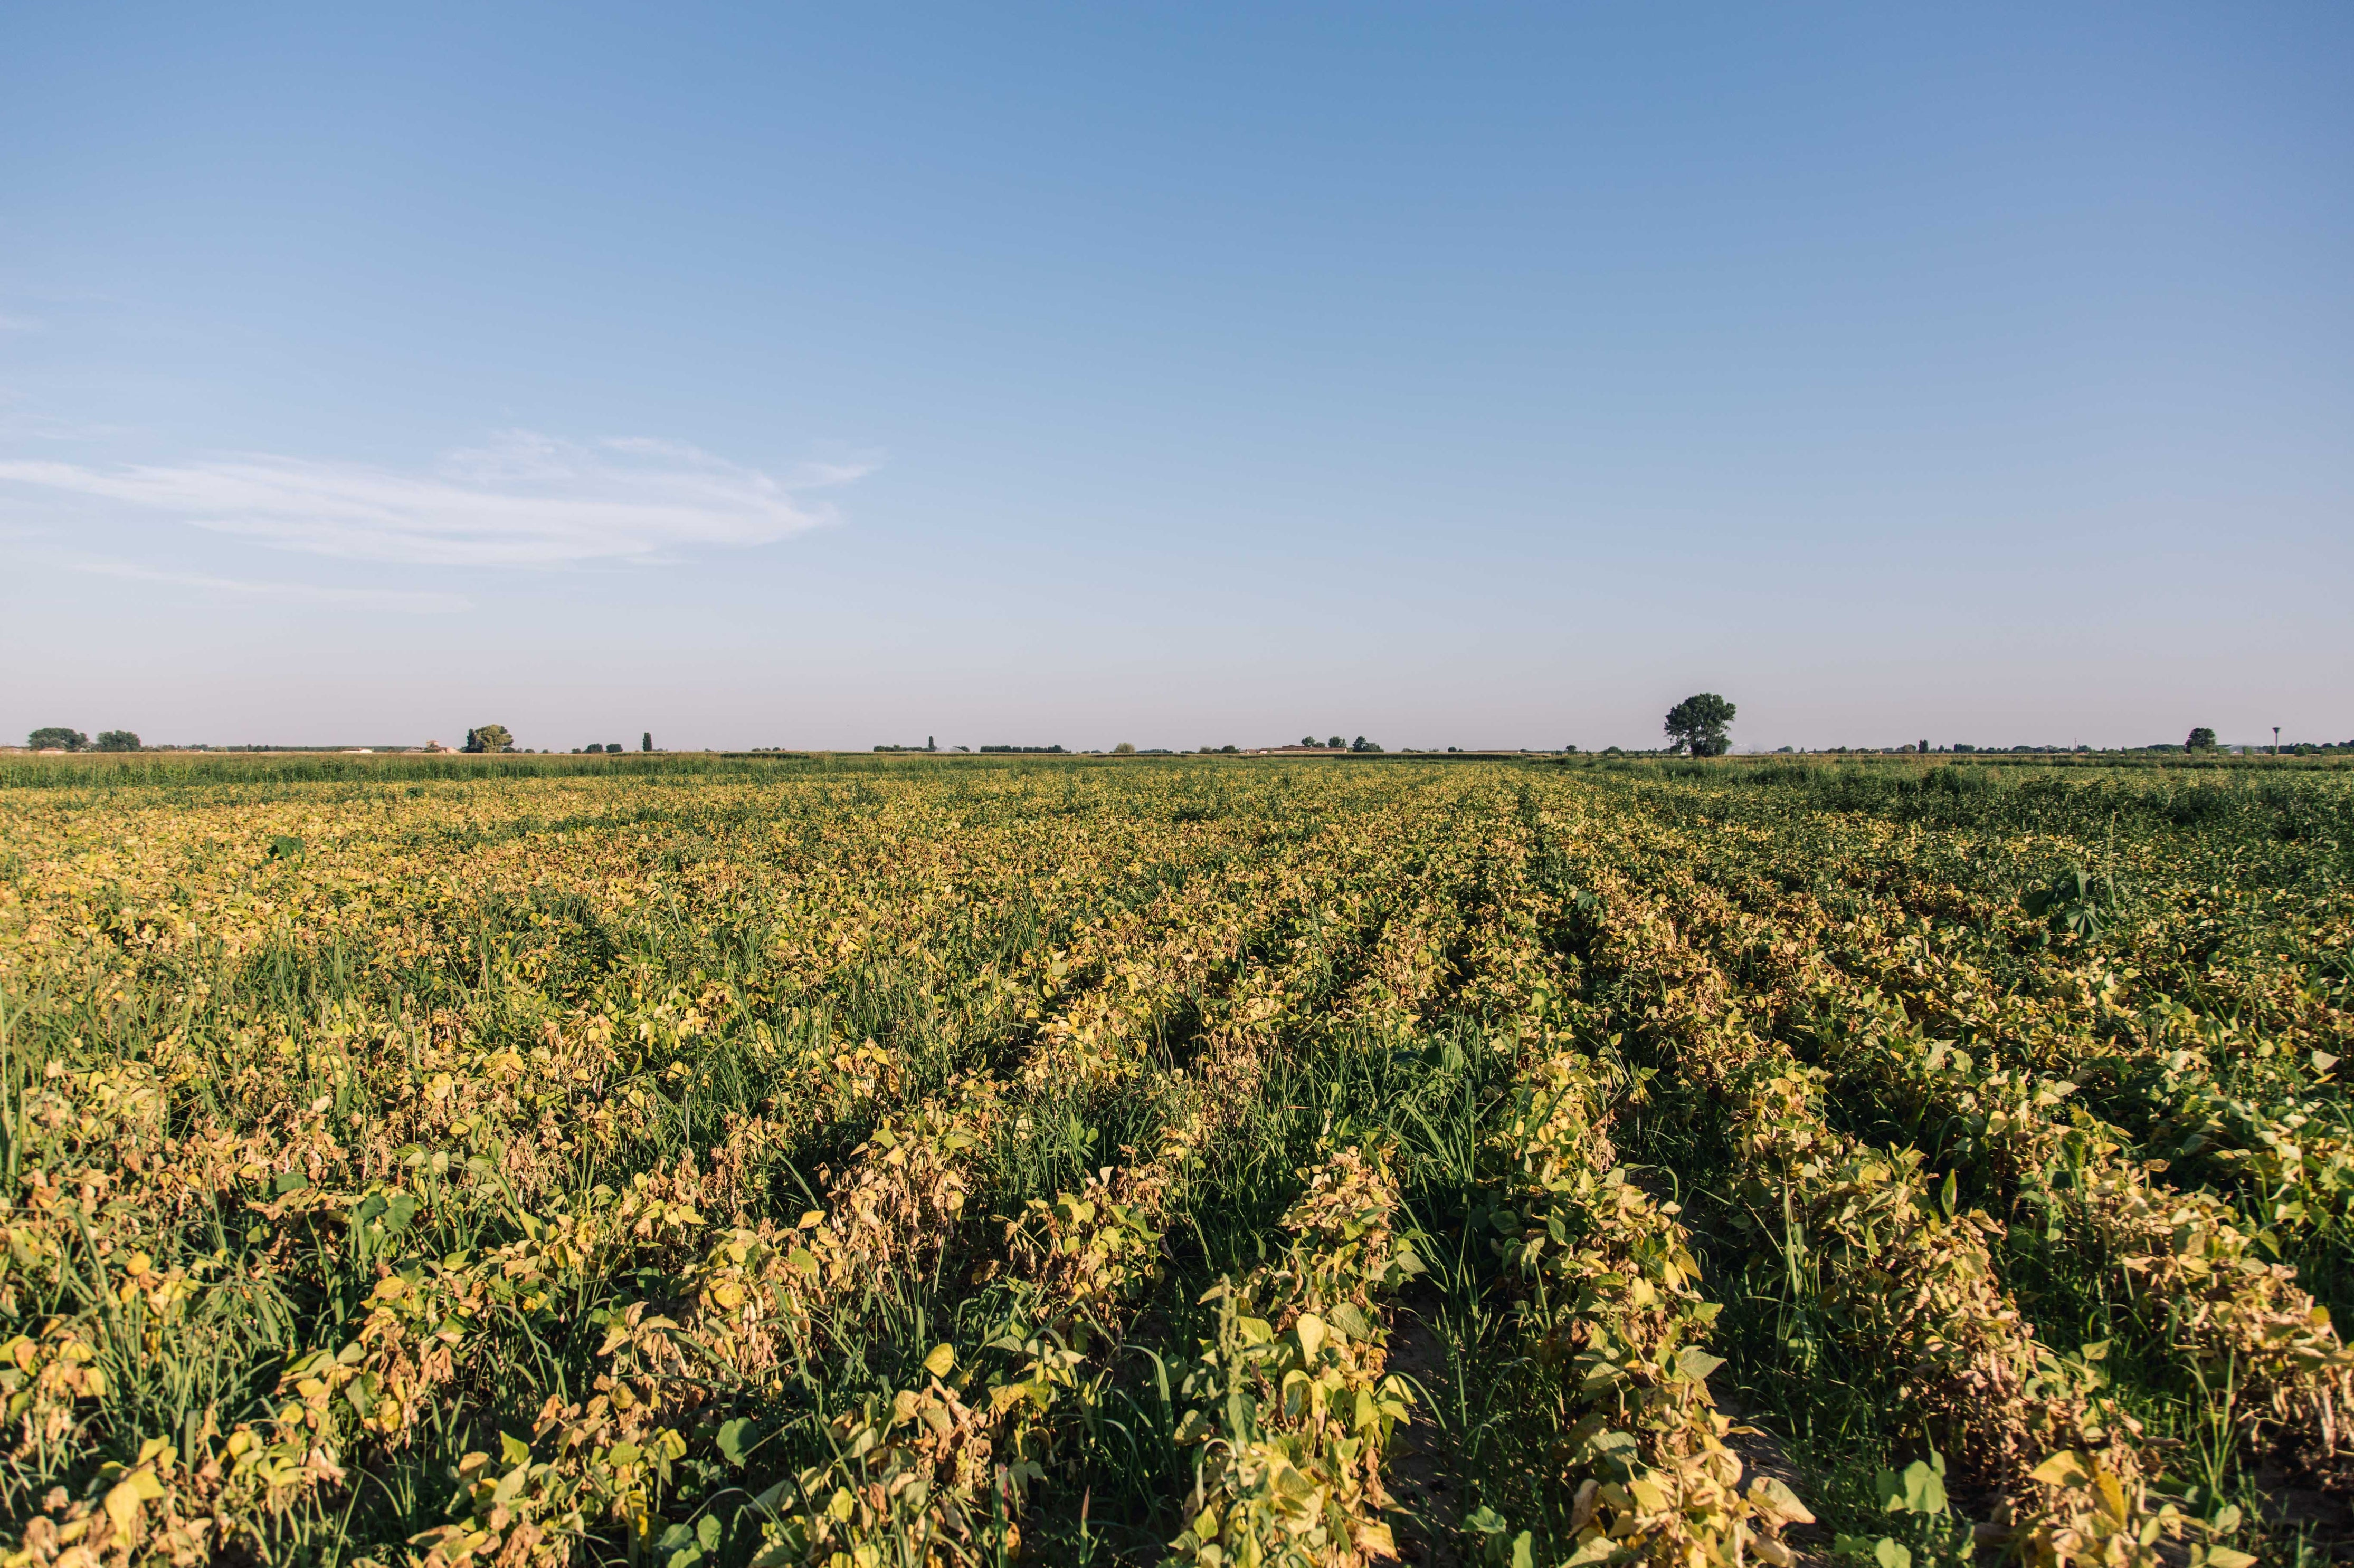
THE FARM AGRICULTURE
GROUP 10

Slide 2
Table of content
Module used
Sources
Group members

Slide 3
NAVIGATION MENU
Greetings from Agriculture and Food Production, your go-to resource for sustainable farming and food preparation methods. Explore our selection of services that are intended to improve food processing, advance ecological sustainability, and maximize farming techniques.

Slide 4
Homepage
In homepage, various products, projects, advocacy, opportunities and livestock of our company can be seen. This was done to see briefly what our company can do.

Slide 5
About
We have done agriculture and food production to supply various agricultural products and tools such as vegetable foods, fruits, plants and others. We also created this website to make it easier for them to get their needs when they want to get something that is difficult to get in their area.

Slide 6
Products
Fresh Vegetables: Our fresh produce, which ranges from colorful heirloom tomatoes to crunchy organic lettuce, is a testament to the abundance of our rich soil. Discover our wide selection, which is expertly gathered and supplied when it's still as fresh as possible.
Specialty Items: Use our unique goods to enhance your cooking experience. Unique offers, uncommon herbs, and carefully chosen spices give your kitchen a hint of exclusivity.

Slide 7
Services
In this part, you can navigate through our offered services such as business partnership, farmland expansion, fishpond services ,farmer outsourcing and lastly to become as one of our staff.

Slide 8
Login or Sign Up
This part was exclusive only for the employee or admin that can access and navigate through the dashboard system and checks inventory and such things

Slide 9
Employee portal
On this portal the employee or admin can access all throughout the inventory system, check sales, orders

Slide 10
Dashboard
In the dashboard part, you can see the summary that show the sales results of our company, Orders and condition of the e commerce shop and lastly the inventory of the whole store as well

Slide 11
Orders
In the orders tab, you can see the different products that has been sold that is categorized by the name , item , product, address

Slide 12
Inventory
In the inventory tab, we can see the different food products of our company along with the quantity

Slide 13
Sales
In the Sales tab, we can see total revenue of the sold items

Slide 14
Teams
In the team’s section, the user can see and the hierarchical layout of the manager from the employee members, in which can be a way to let the new employee see and

Slide 15
Profile
In this part the user can change its information like Name, Birthdate, address

Slide 16
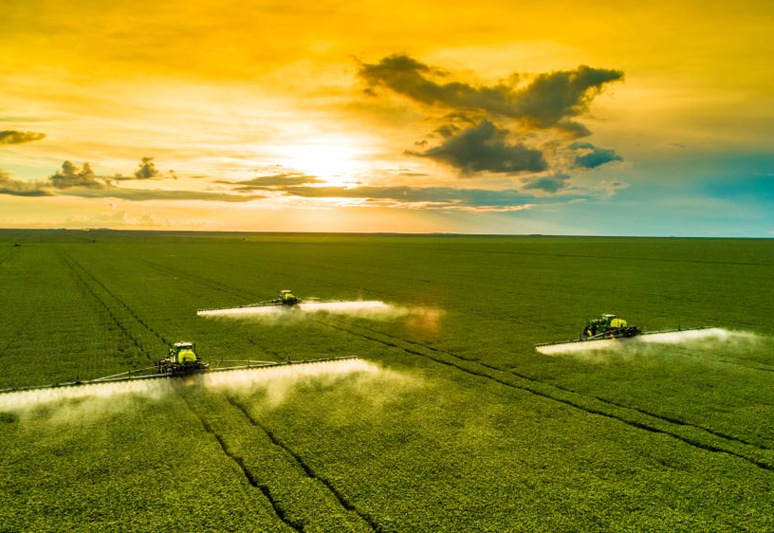
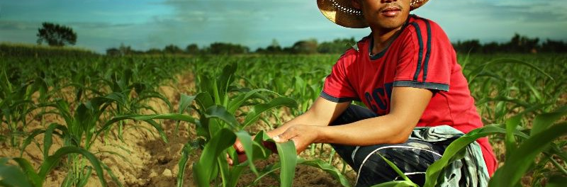
SOURCES

Slide 17
Google map API
In this part you can see the designated farmlands pin, located to the map of the Philippines that our company partnered with.

Slide 18
MySQL
All the data on the website collected is store on it

Slide 19
File Explorer
All the offline data on the website such as the images icons and that has been used was stored on it

