Slide 1
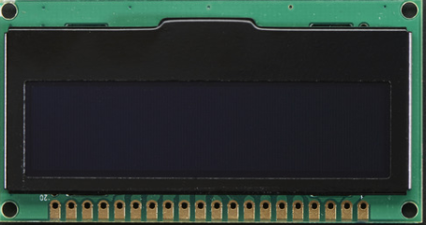
Monochrome OLED Display :
By Jasleen Kaur

Slide 2
INTRODUCTION
This display is 2.3" diagonal, and very readable due to the high contrast of an OLED display.
This display is made of 128x32 individual blue OLED pixels, each one is turned on or off by the controller chip. Because the display makes its own light, no backlight is required. This reduces the power required to run the OLED.
The driver chip, SSD1305 can communicate in three ways: 8-bit, I2C or SPI.

Slide 3
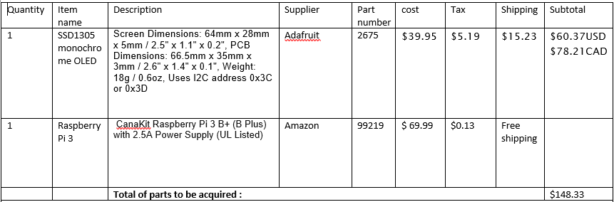
BUDGET
For my hardware project I just ordered Raspberry pi 3 from Amazon and Monochrome OLED display from Adafruit, therefore my whole budget is same.

Slide 4
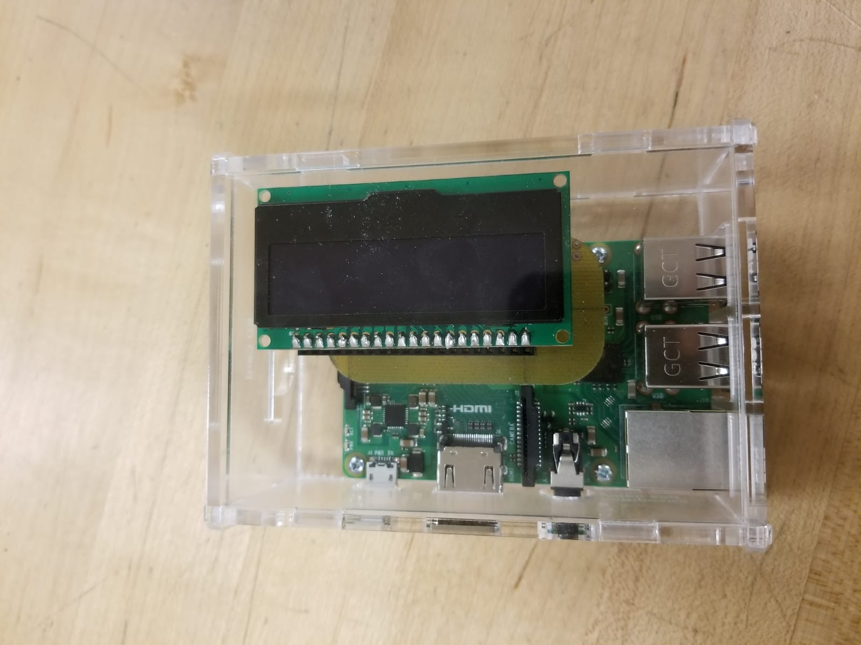
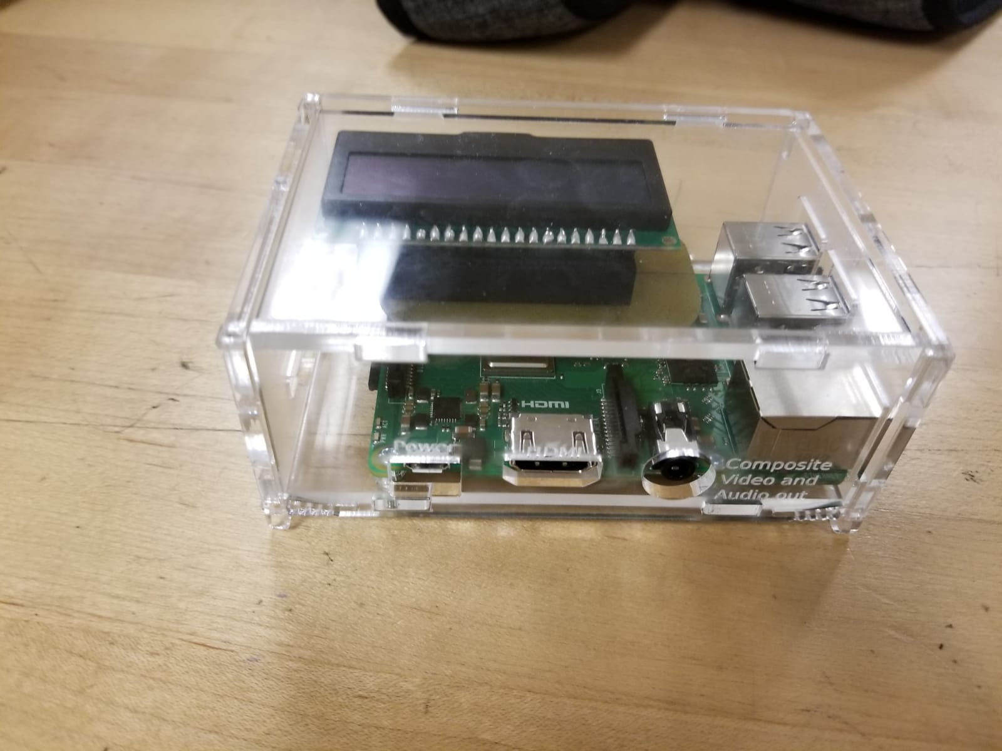
Case Designing

Slide 5
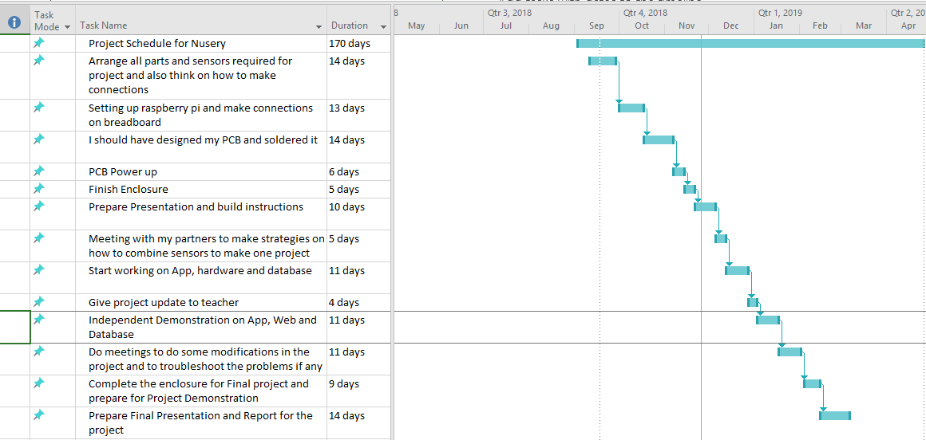
SCHEDULE
I pretty much completed all my stuff as I decided in my schedule.

Slide 6
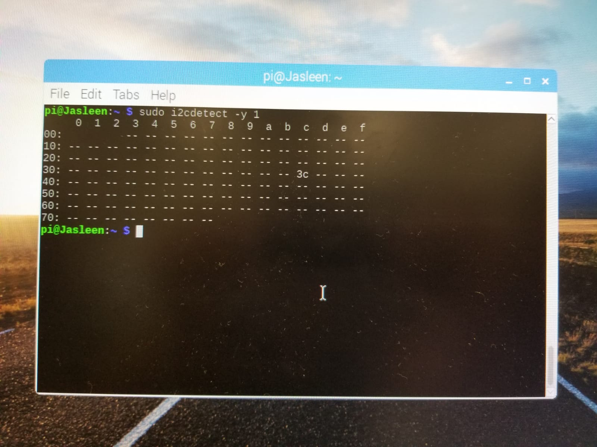
I2C Address

Slide 7
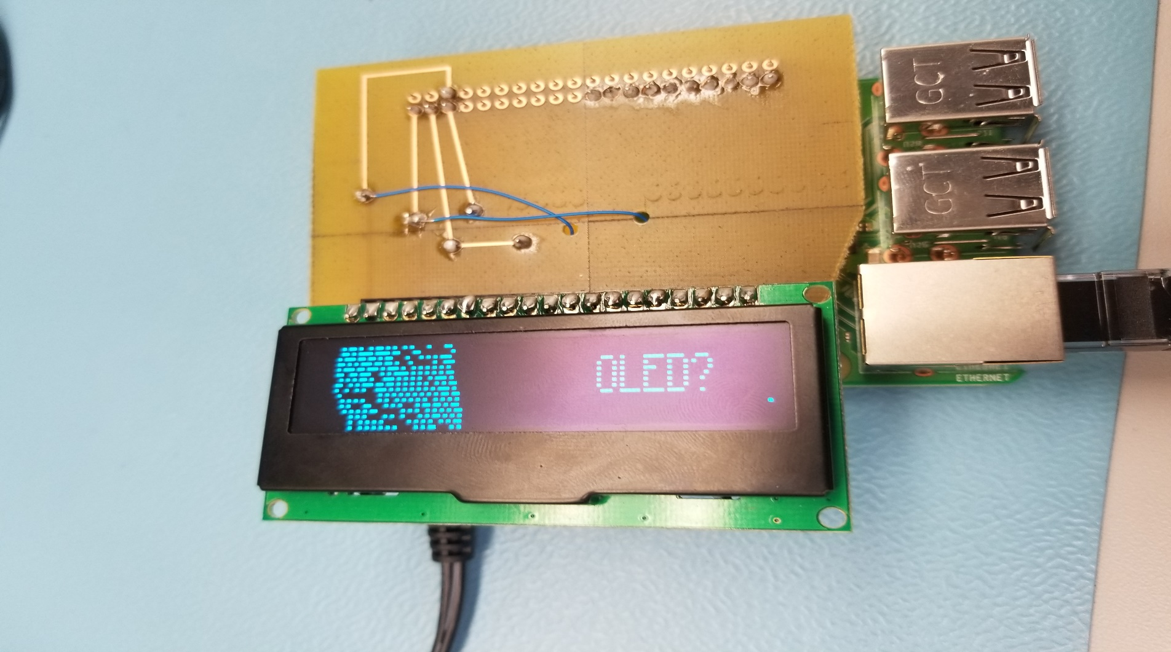
Display from my sensor ”s

Slide 8
Knowledge from the previous courses
TECH 153:- We became familiar to Raspberry pi.
Tech 101:- Familiar to work with electronic circuits.
CENG216:-Made familiar to Gantt Chart.

Slide 9
Reference
https://www.adafruit.com/product/2719--> adafruit
https://jasleen-grewal.github.io/Nursery/ →github

Slide 10
Thank you

