Slide 1

Project Progress
Group 6
Budget Buddy
(Finance Tracking WebApp)
Group Members:
Jasleen Minhas [202481225] – Group Lead
Masroor Rahman [202482239]
Sumaiya Khan [202480995]
Joel George Sam [202483190]
Kaustubh Patil [202580621]
Ronit Gajjar [202488048]
COMP 6905 Software Engineering

Slide 2
INDEX
Next Steps
Goal for the Next Phase
Adjustment to the Plan
Updated Timeline
Updated Team Members progress
Live Demo of the Project Progress
Summary of the Project
Progress to Date
Completed Work
Delivered Artifacts
Glimpses of our project so far
Challenges and Solutions

Slide 3
SUMMARY OF THE PROJECT

Slide 4

BUDGET BUDDY
Overview of the Project:
Budget Buddy is a personal expense management web application.
Helps users track, visualize, and manage their spending efficiently.
Built with React (frontend) and Firebase (backend & database).
Key Features:
Login and Signup authentication
Add, Edit, Delete Expenses easily
Categorize Transactions for better organization
Interactive Dashboards & Charts for expense insights
Export Reports as PDF for record keeping and sharing
Responsive Design optimized for mobile and desktop

Slide 5

Tech Stack: Reactjs + Firebase
Methodology: Agile (5 Sprints, 2 weeks each)
Live App: Budget Buddy Live
CI/CD: Setup completed and deployment live on Vercel

Slide 6
Progress to Date

Slide 7
Progress to Date (Iteration 1–2)
Iteration 1 (Sept 22 – Oct 5): Setup & Requirements - ✅ Completed
GitHub repo setup, team roles, requirements gathering, UML diagrams, Firebase project setup
Artifacts: Requirement docs, UML diagrams
Iteration 2 (Oct 6 – Oct 19): Authentication & Deployment - ✅ Completed
Login/Signup/Logout, Firebase Auth, Landing Page, CI/CD setup & deployment
Artifacts: Auth screens, Landing page, Unit tests, Deployment Logs, Live app

Slide 8
Progress to Date (Iteration 3–4)
Iteration 3 (Oct 20 – Nov 2): Expense & Category Management - 🟡 Partially Completed
Expense CRUD, Firebase integration, unit tests
Artifacts: Expense page Completed, Category page in progress
Iteration 4 (Nov 3 – Nov 16): Dashboard & Reporting - ⏳ Planned
Dashboard layout, charts, expense summary, PDF/CSV export, unit tests
Artifacts: Dashboard Mockups, Report Generation Planned

Slide 9
GLIMPSES OF OUR PROJECT SO FAR

Slide 10
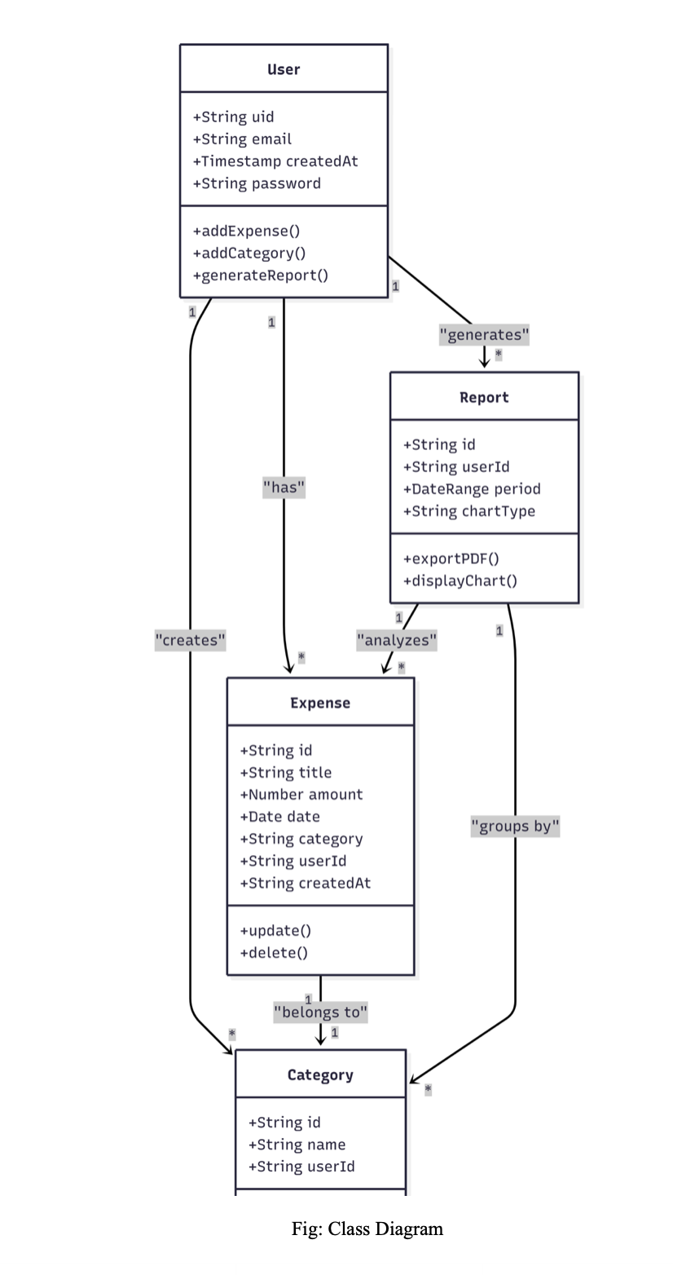
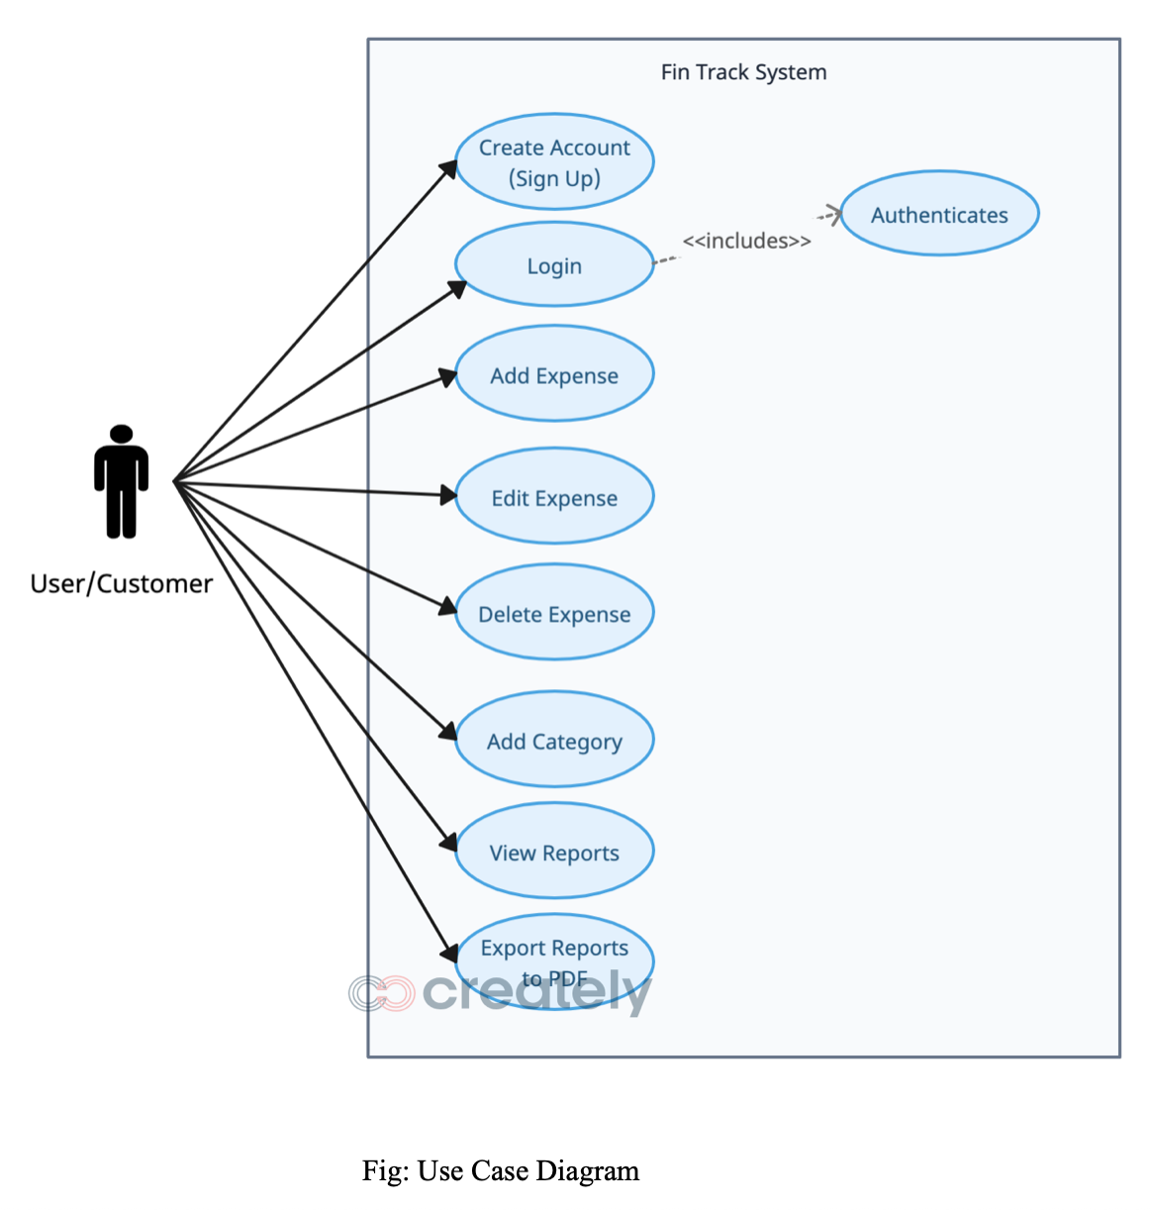
Class and Use case diagram (Done in the Requirements phase)

Slide 11
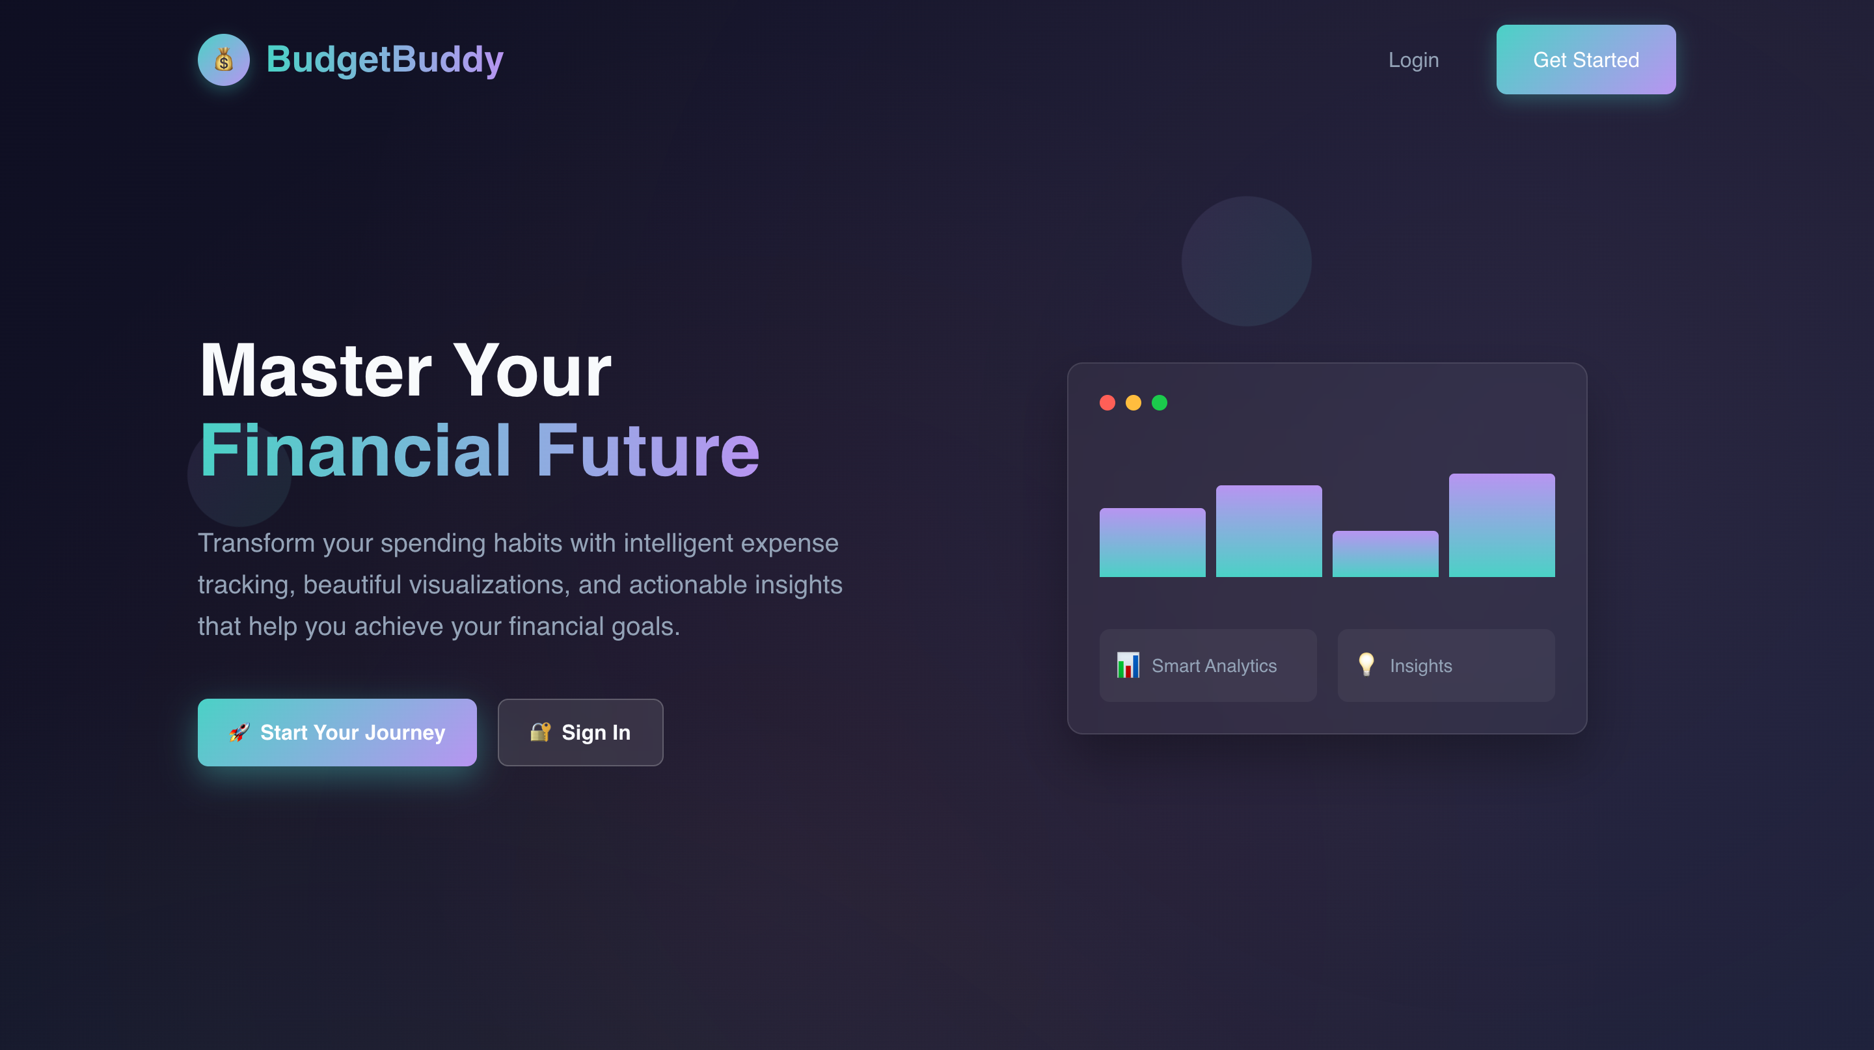
LANDING PAGE

Slide 12
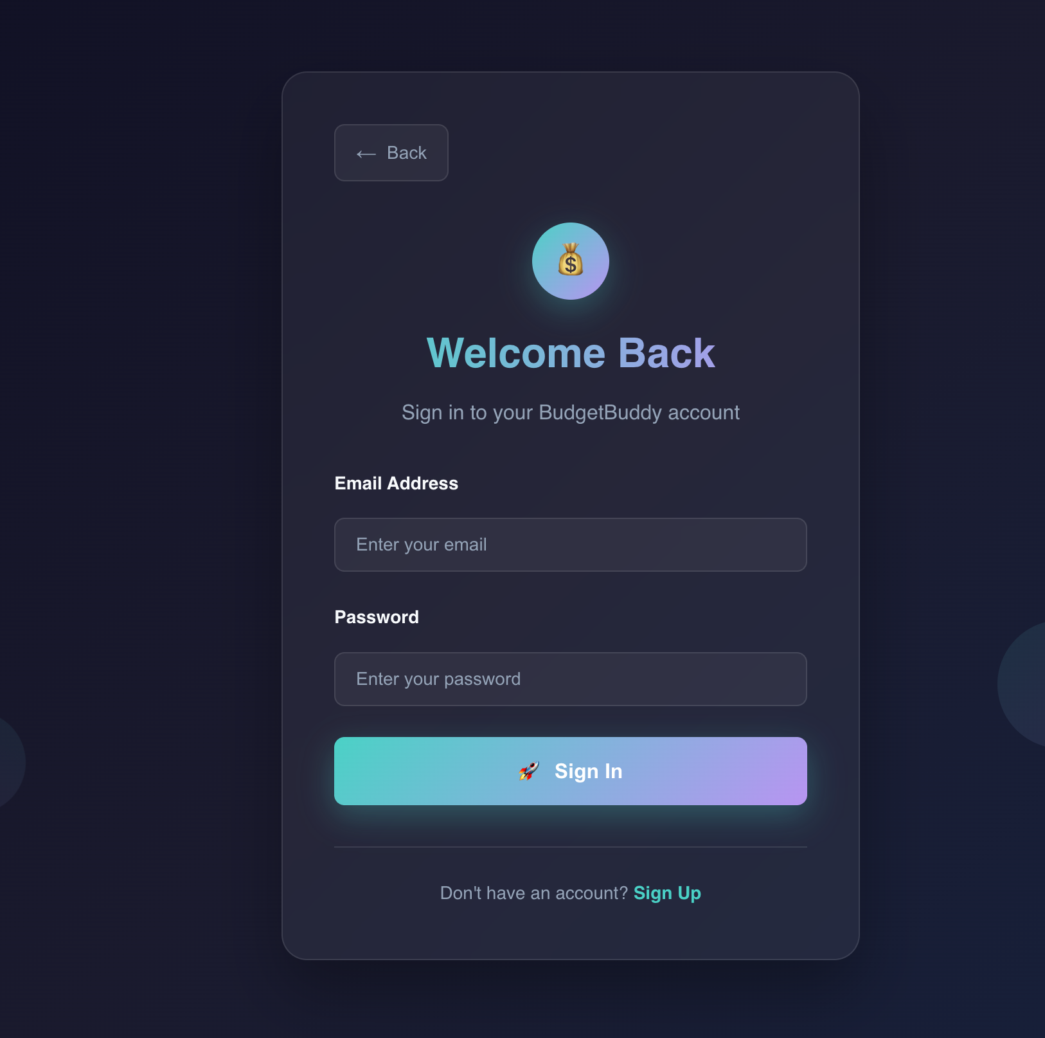
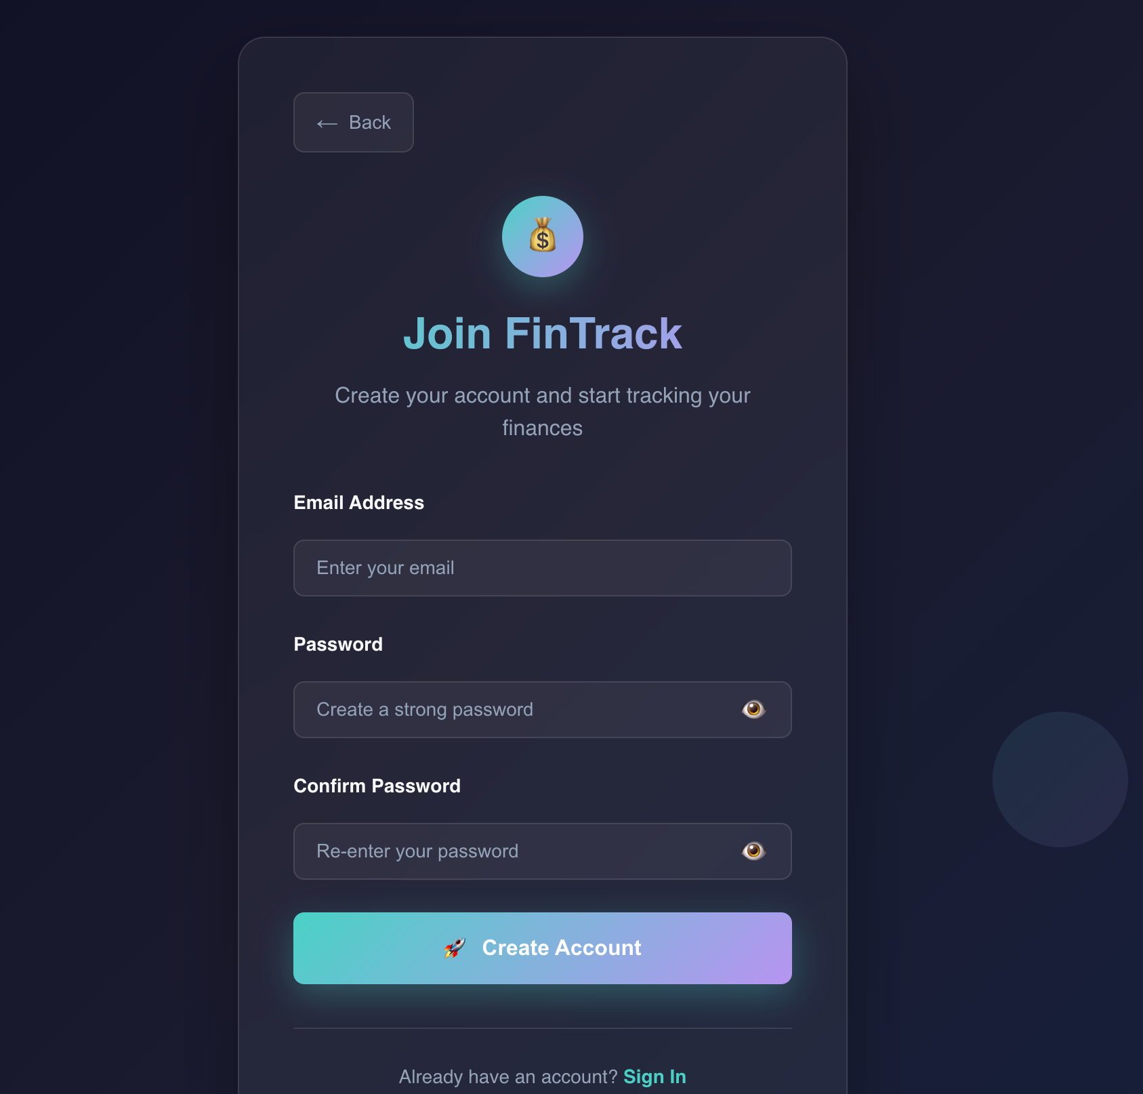
lOGIN AND SIGNUP PAGE

Slide 13
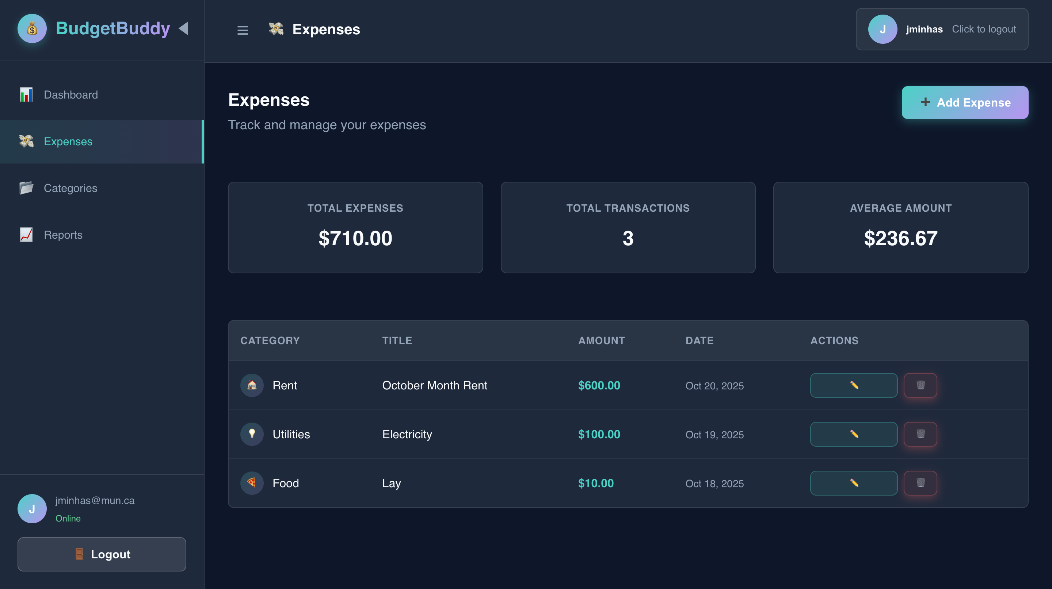
Expenses page

Slide 14
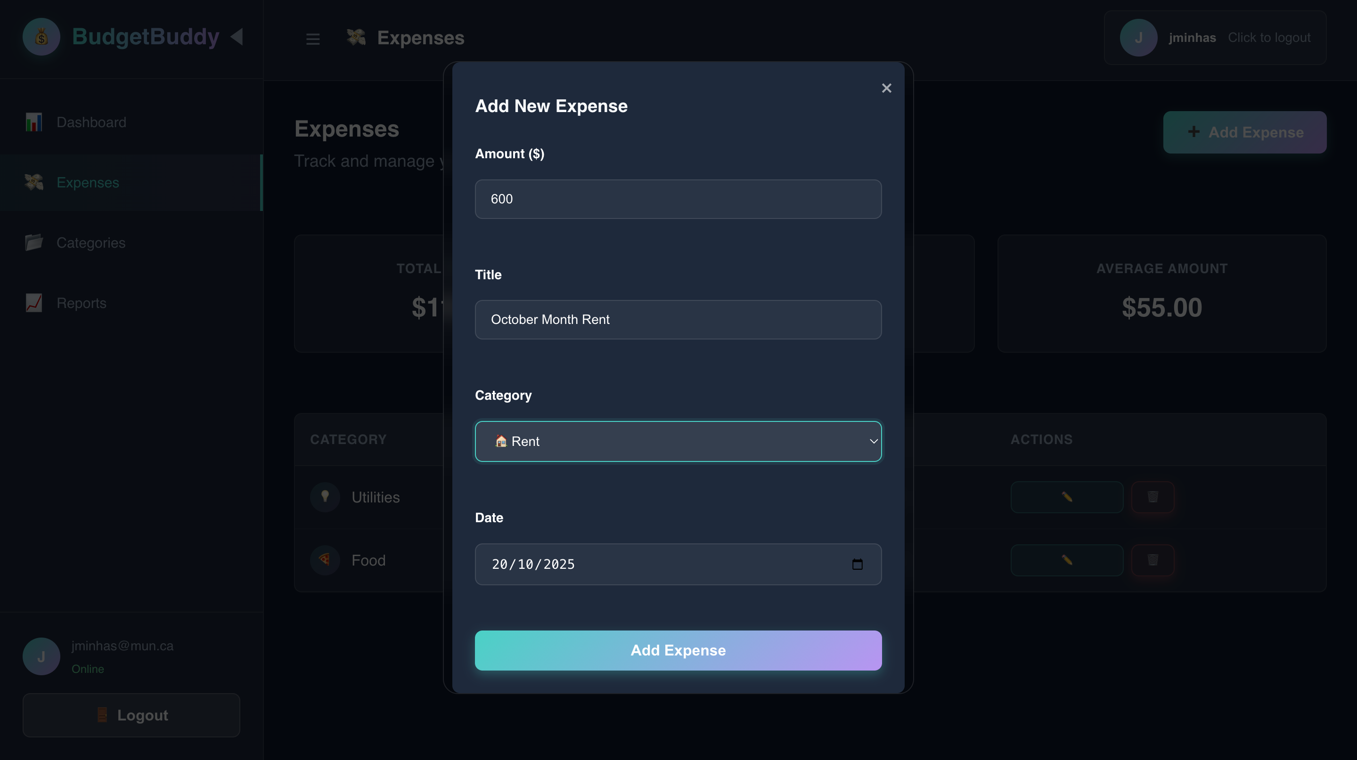
Adding an expense

Slide 15
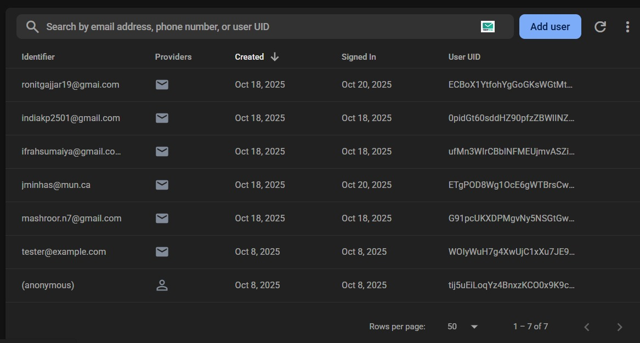
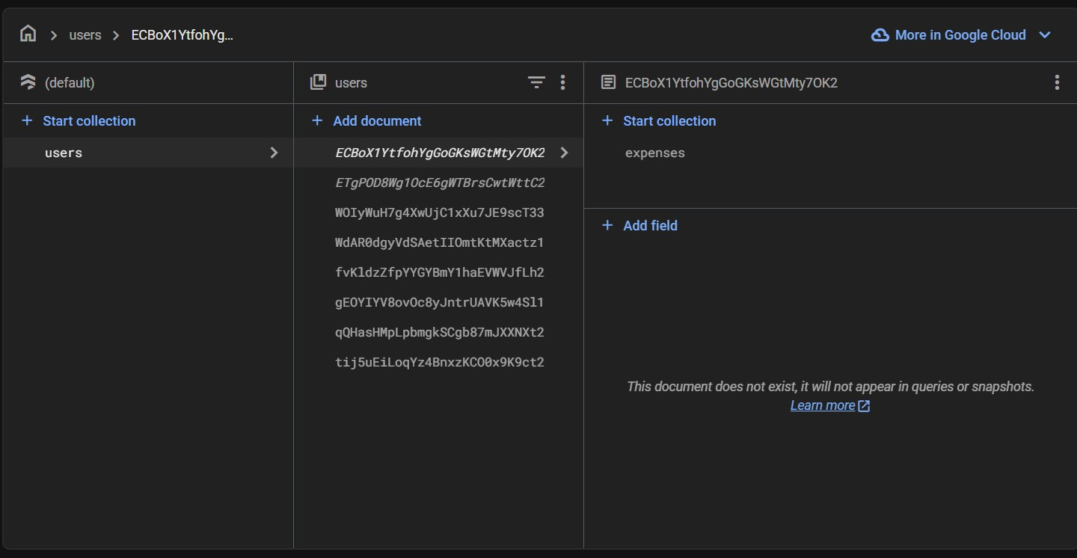
firebase
The image depicts a Firebase user management interface showing email addresses, providers, creation dates, sign-in dates, and unique user IDs.

Slide 16
Challenges faced in the initial iterations AND proposed SOLUTIONs to those

Slide 17
Challenge | Description | Solution
GitHub Collaboration | Difficulties managing commits/branches | Team session + branching guide from Github
Wrong Commits/Merge Conflicts | Overlapping work caused issues | Peer review policy
Working on Main Branch | Accidental direct commits | Protected the main branch, Just the team lead can do that
Wrong Issue References | Incorrect issue numbers in commits | Standard commit message format + Pair programming
Code Crashes | Integration errors | Local testing before commits
Task Coordination | Aligning timelines | GitHub Projects + weekly sync meetings

Slide 18
Next steps

Slide 19
Next steps
Complete Category Management Page
Dashboard visualization (Chart.js: Pie & Bar charts)
Report export (PDF/CSV using jsPDF + html2canvas)
Budget Summary Section (monthly totals, category stats)
Integration & regression testing
Finalize documentation & presentation slides

Slide 20
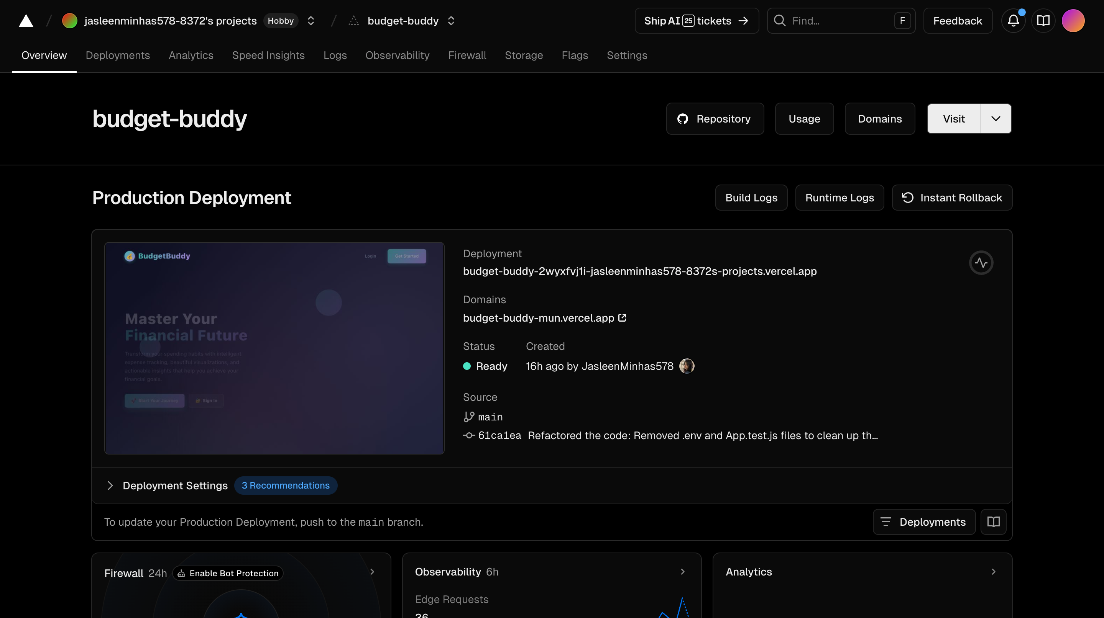
Adjustments to Plan
CI/CD integrated earlier
Live deployment on Vercel
Auto-deploy on
main branch pushes

Slide 21
Updated Timeline The issues we have completed and in progress

Slide 22
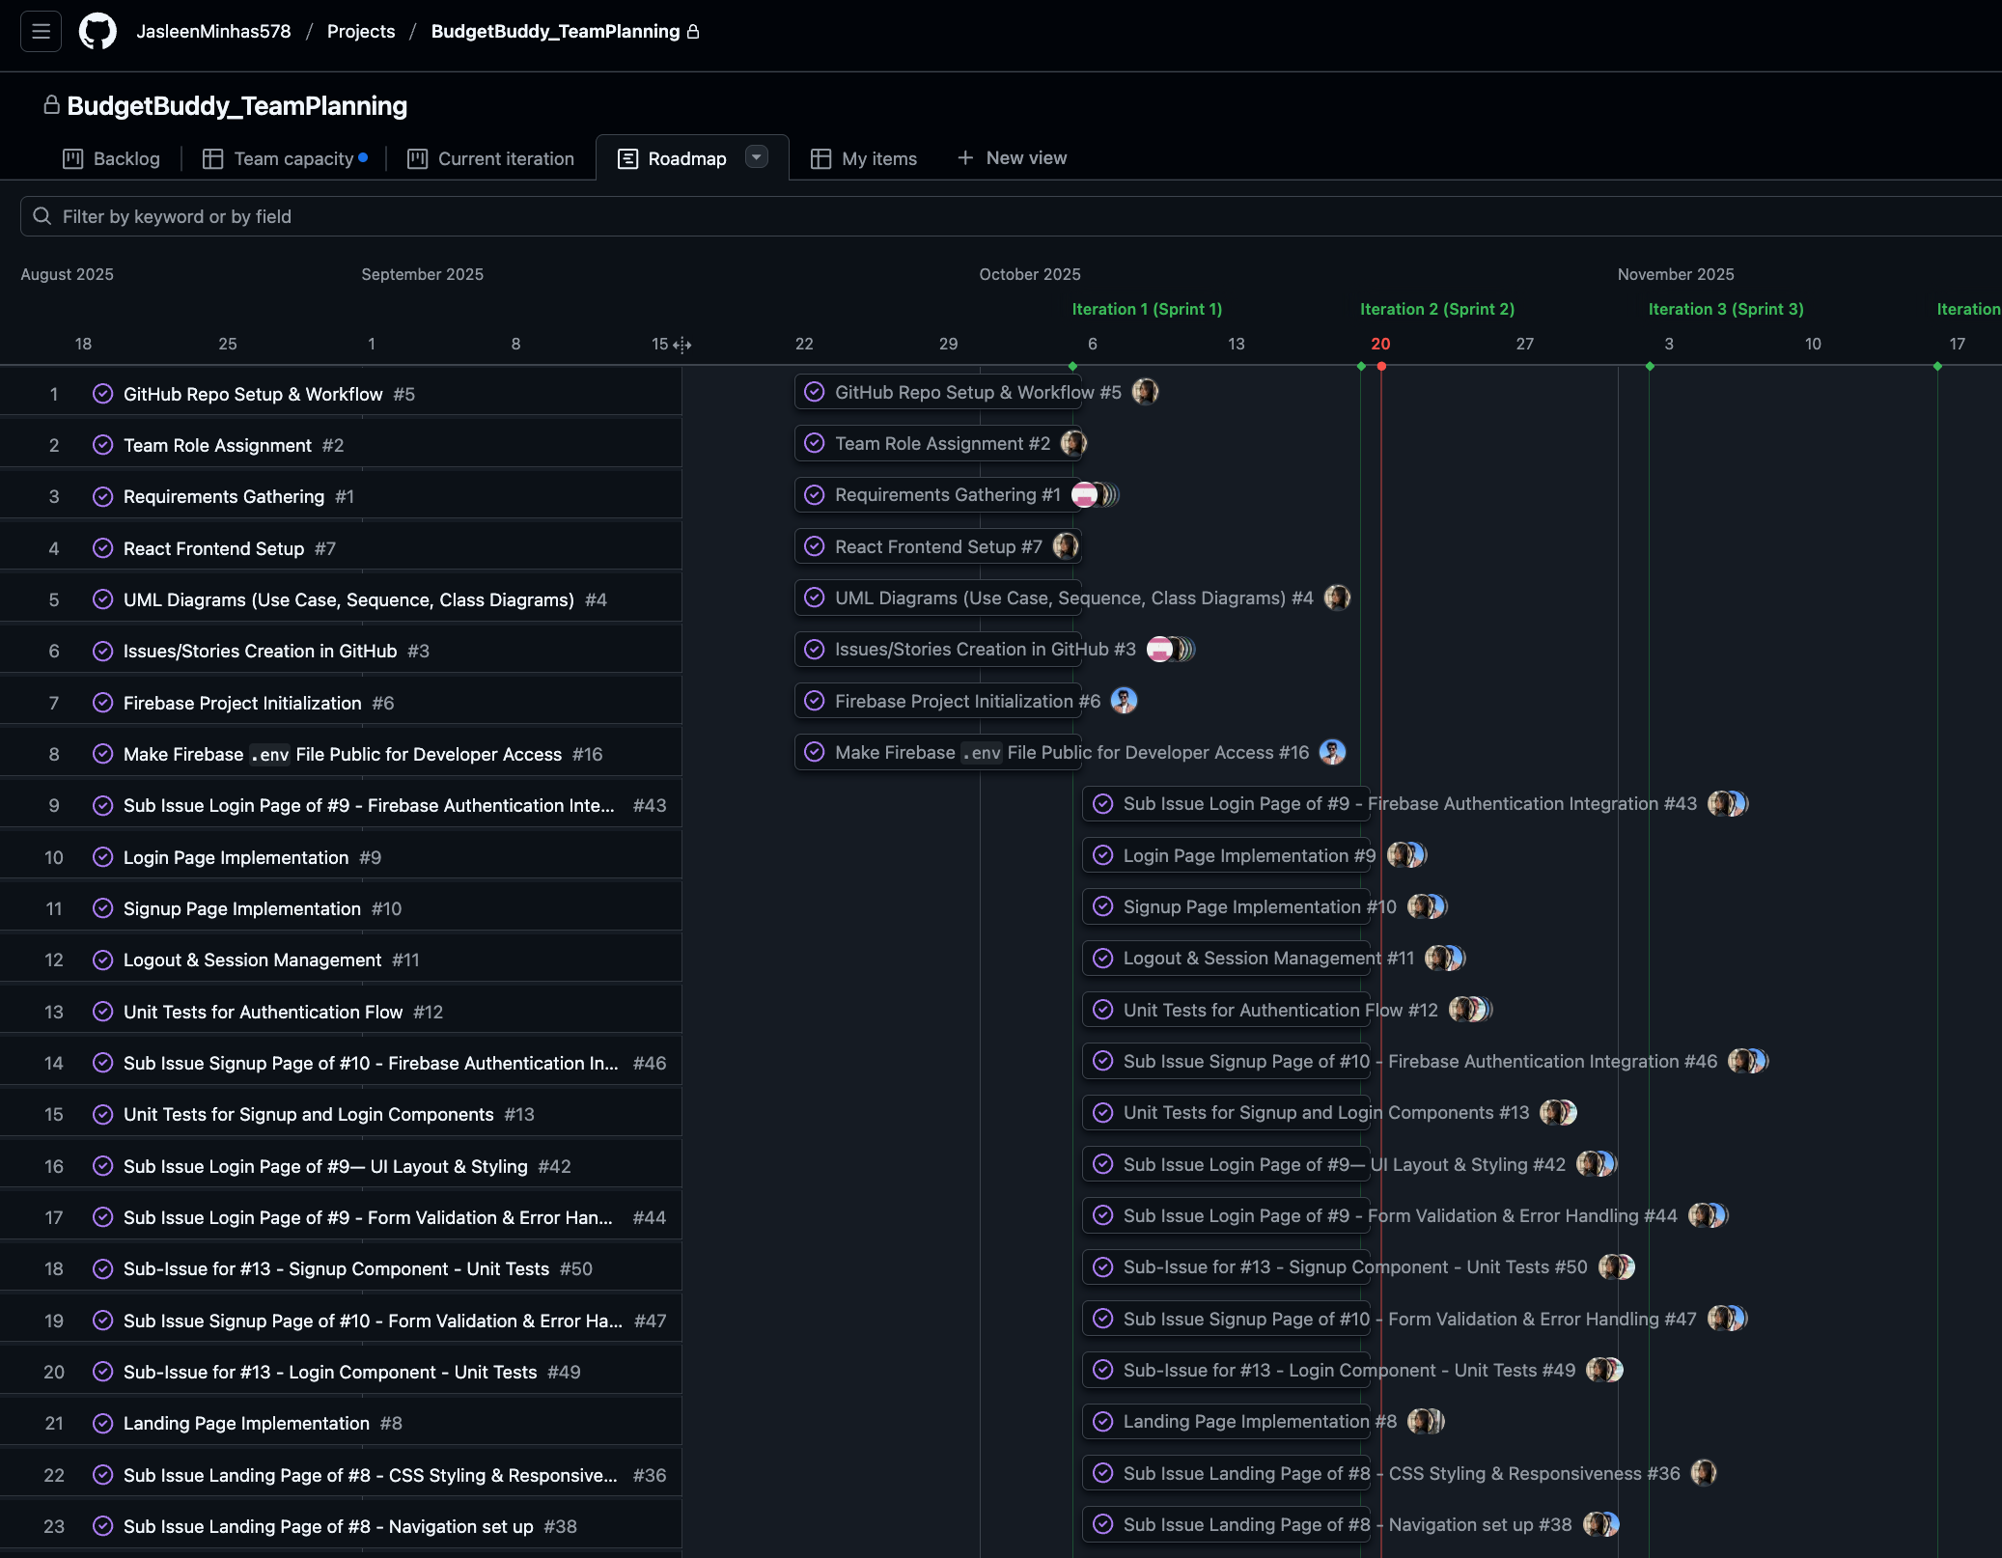
Our Github Planning board
Iteration 1 and 2 issues are all completed

Slide 23
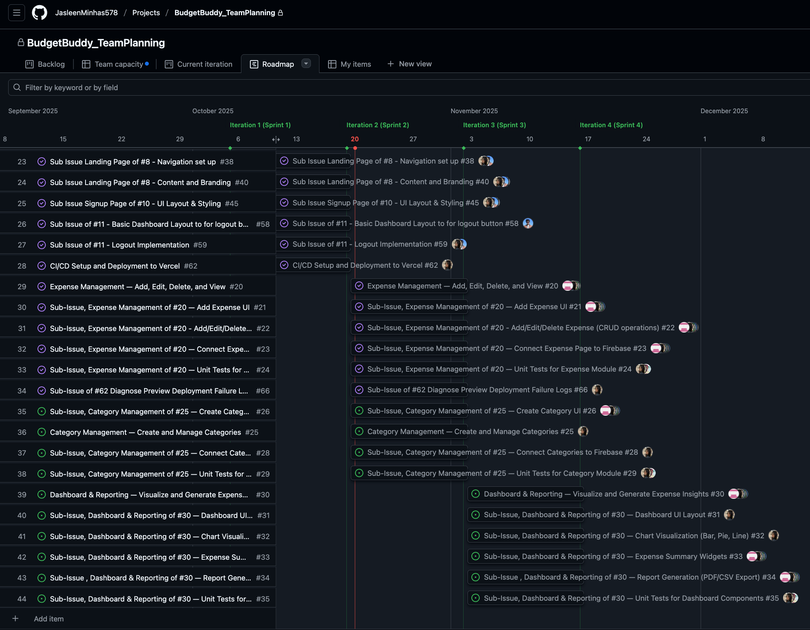
Iteration 3 is in progress
Iteration 4 will start from Nov 3rd

Slide 24
Updated TEAM MEMBER RESPONSIBILITIES PROGRESS

Slide 25
Member | Role | Key Contributions | Progress
Jasleen | Project Lead, Frontend, Testing | Repo setup, Requirements, Auth, Landing, Expense Module, Unit Tests, Deployment | 🟢 100%
Mashroor | Firebase & CI/CD | Firebase setup, Auth integration, Logout/session handling, Deployment | 🟢 100%
Sumaiya | UI/UX Design | Landing page design, Auth UI, Branding | 🟢 100%
Joel | Testing & Firebase | Unit tests, Firebase validation | 🟢 100%
Ronit | Backend & Expense | Expense CRUD, Firebase integration | 🟢 100%
Kaustubh | Frontend (Expense) | Expense UI, CRUD operations | 🟢 100%

Slide 26
Summary of Progress
Sprints 1–2: Fully completed (setup, authentication, CI/CD) - ✅ Completed
Sprint 3: Expense module functional & tested; Category management - 🟡 Partially Completed
Sprint 4: Dashboard & reporting started; visualization and export upcoming – ⏳ Planned
Sprint 5: System testing and Fix the bugs, Final documentation - ⏳ Planned
Next Focus: Analytics dashboard, report export, final integration testing

Slide 27

LIVE demo of the PROJECT progress
https://budget-buddy-mun.vercel.app/

Slide 28

Thank you any question?

