Slide 1

String matching
Jasmeet kaur dua
Final project
CS-575

Slide 2
INTRODUCTION
What is String Matching ?
The problem of finding occurrences of a pattern string with another string or a body of text.
Why String matching is important ?
String matching strategies provide key role in various real-world problems or application.

Slide 3
How string-matching works ?
For string matching we need : a text and a pattern.
String-matching algorithms basically matches every element of the text to every element of the pattern to give the perfect match .
We will be learning more about the below string-matching algorithms.
Naïve Algorithm
Rabin Karp Algorithm
Knuth-Morris-Pratt Algorithm

Slide 4





Few Application on string-matching
Few Applications

Slide 5
Naïve Algorithm
Naïve Algorithm uses two loops to compare each value within a text to every other value in the pattern until it finds a match.

Slide 6
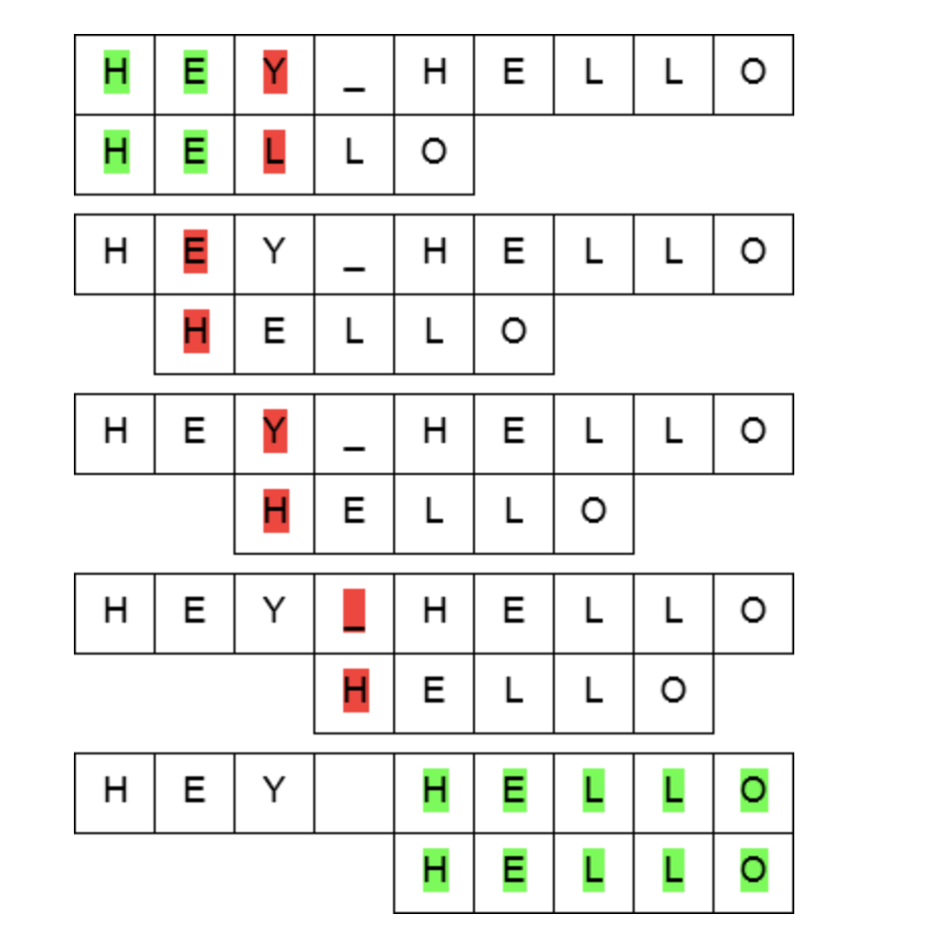
Naïve Algorithm
Naïve algorithm take two loops 1 for the text (i)and 1 for the pattern (j)
The value one by one of the pattern matches with the value one by one with the text , in the figure we can see we have the match highlight from green color and have the first mismatch with red
After getting the first mismatch, the pattern shifts from i to i+1, until we find a match.
The loops will iterate until we find the match.

Slide 7
Naïve Algorithm
1.n← length [text]
2. m← length [pattern]
3. for s ← 0 to n -m
4. do if pattern [1.....m] = text [s + 1....s + m]
5. then print "pattern find on index", s
Time Complexity
O(nm)

Slide 8
RABIN KARP ALGORITHM
Rabin Karp Algorithm use hash value to match the pattern with the text.
It generate the hash value of the pattern and then compare it with the string
If the hash value matches, then only it will compare all the characters of that string

Slide 9
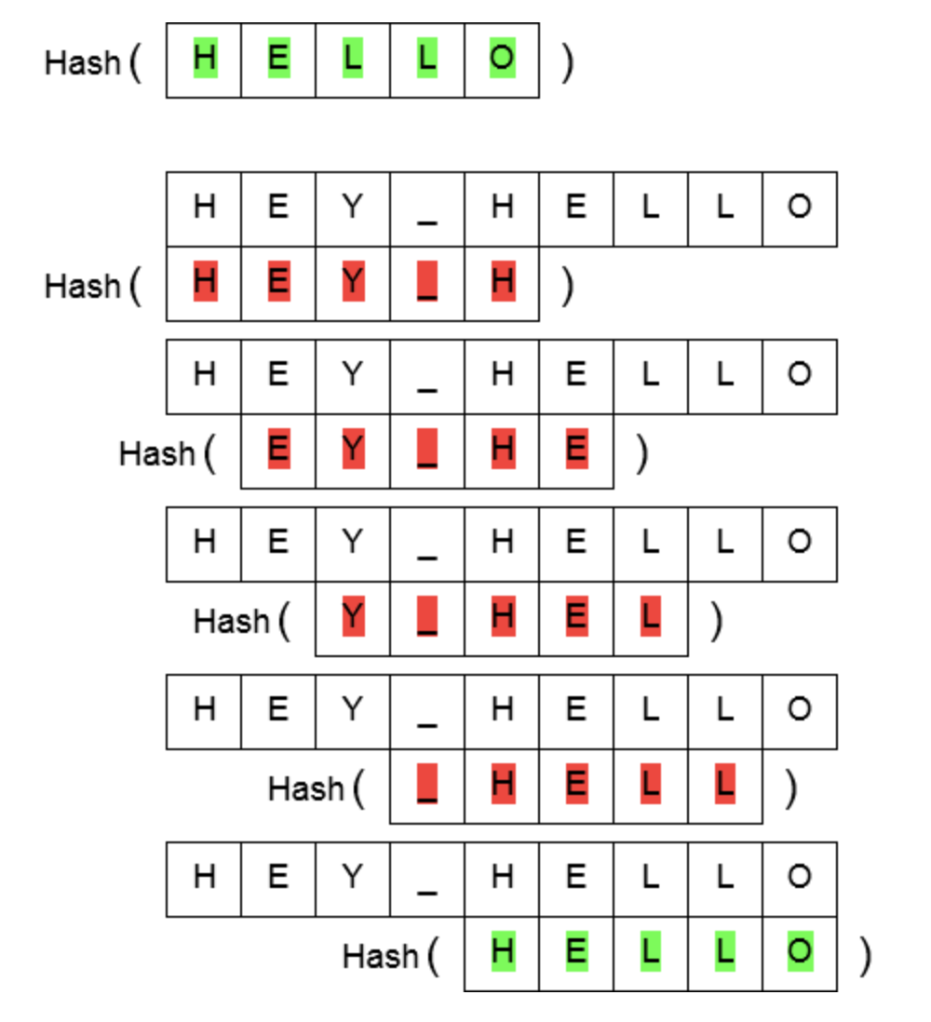
RABIN KARP ALGORITHM
Hash generated for the pattern
Generating the hash of the text and comparing it by one one with the hash of the pattern
Hash value match , now the loop will iterate to match the text and the patter to confirm the match

Slide 10
RABIN KARP ALGORITHM Pseudo Code
1. t← length [text]
2. p← length [pattern]
3. hp ← hash value of pattern
4. ht ← hash value of text till index (t-p)
5. for i← 1 to (t-p)
6. if hp = ht
7. then if pattern [1.....p] = T [i+1.....i + p]
8. then print "pattern find on index", i
9. else , update the ht for the next window
10. compare again with the new hash value
Time Complexity:
average case : O(t+p)
worst case: O(tp)

Slide 11
KMP Algorithm
Knuth Morris and Pratt proposed a linear time algorithm.
Components of KMP
The prefix function
KMP matching
The prefix function encapsulate the knowledge about how the pattern matches against shift of itself.
This information can be used to avoid the useless shifts in the pattern.

Slide 12
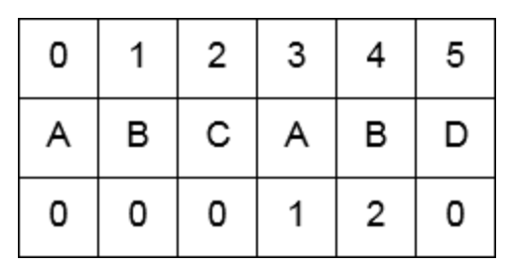
The Prefix Function
First index element value set to 0
Now move to from index 1 to 2 and match it with the index 5, values are not matching, we will move the first index to from 3 to 2 and check the value of index 2 which is 0 , so my next matching index is 0 with index 5.
Comparing elements of index 0 and 1, both are not matching set it to 0
Comparing elements of index 0 and 2, both are not matching. set it to 0
Comparing elements of index 0 and 3, it matches, set it to matching index +1
Now move the index from 0 to 1 and compare it with index 4, we got a match set it matching index +1

Slide 13
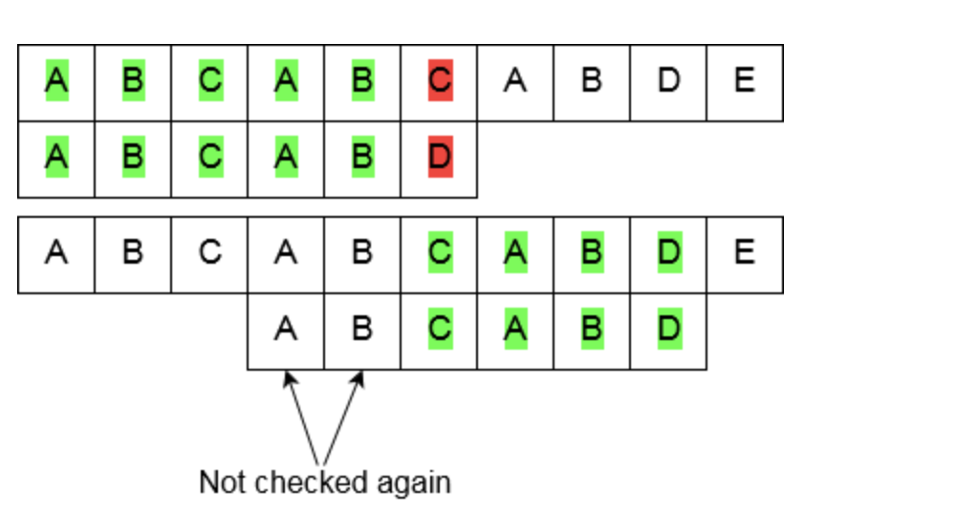
KMP Matching
Comparing the pattern ABCABD with the text ABCABCABDE, we can see in the figure that the patter in green color matches with the text, however, the part of the patter colored in red gives a mismatch.
Here, we check the prefix function values, since there is a mismatch with C and D, we go to last matched index on the pattern and check its value from the prefix function which is 2, hence we will start the next matching with the index 2 i.e. C in the pattern
Here need not to match the repeating substring in the pattern, which reduces the time complexity

Slide 14
KMP Algorithm
1. t← length [text]
2. p← length [pattern]
3. f← compute prefix function O(1)
4. i← 0 ,j←0
5. for i < t do
6. while j > 0 and pattern[j + 1] , f[i] do
7. j ← f[j]
8. if pattern[j + 1 = f[i] then
9. j← j+1
10. if j == p then
11. j ← f[j]
Time Complexity:
O(t)

Slide 15
Time Complexity Comparison
Algorithms | Complexity
Naive Technique | O(mn)
Rabin Karp Algorithm | Average O(n+m) worst case O(mn)
Knuth-Morris-Pratt Algorithm | O(n)

Slide 16
Problem
-- Given a string s and a non-empty string p, find all the start indices of p's anagrams in s.
Strings consists of lowercase English letters only and the length of both strings s and p will not be larger than 20,100.
The order of output does not matter.
Input:
s: "cbaebabacd"
p: "abc”
Output: [0, 6]
Explanation: The substring with start index = 0 is "cba", which is an anagram of "abc". The substring with start index = 6 is "bac", which is an anagram of "abc".

Slide 17
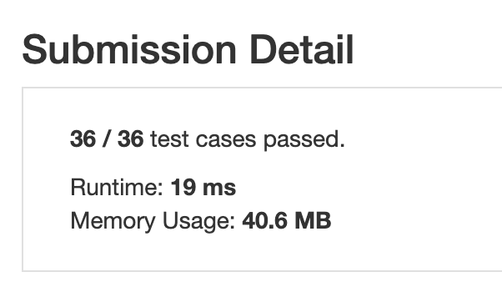
Using Rabin Karp concept:
The above problem is solved by using the hashing method
Using the concept of the Rabin- karp algorithm, for the 36 cases, the time taken is 19ms

Slide 18
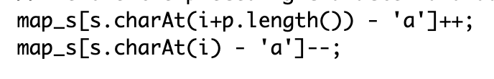
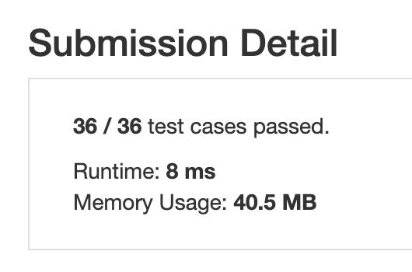
Using KMP concept:
The same problem is solved by the concept of prefix function
Using the concept of the Knuth-Morris-Pratt algorithm, for the 36 cases, the time taken is 8ms

Slide 19
Conclusion
Theoretically, by going through the different algorithm we understand the difference in time complexities.
In the above problem we see that how a problem can be solved in different ways , however, there time complexities depend on the algorithm/approach we take to solve it.
In the last problem we observe the approach by using algorithm KMP is much more efficient than Rabin-Karp.

Slide 20
References:
https://www.slideshare.net/alokeparnachoudhury/string-matching-algorithm
https://www.slideshare.net/Ashikapokiya12345/string-matching-algorithms-52582907
https://daankolthof.com/2019/09/01/common-string-matching-algorithms-theoretical-and-practical-performance/

Slide 21


Thank you

