Slide 1
Interactive Parser Visualizer
An Educational Tool for Understanding Parsing Techniques

Slide 2
Team Information
Team Name : PBL-CD
Team id : CD-VI-T077
Team member 1 (Team Lead)
Jasmeet Singh – 22011017
singhjasmeet200526@gmail.com
Team member 2
Karan Negi – 22021583
karanegi076@gmail.com
Team member 3
Anshul Sati– 220211252
satianshul9@gmail.com

Slide 3
Project Idea/Overview
User Provides Grammar & Input String
Backend Processes Grammar:
Identifies terminals & non-terminals
Computes FIRST & FOLLOW sets
Parsing Table Construction:
Constructs LL / LR / SLR / CLR tables
Highlights conflicts (shift/reduce)
Comparison & Learning Support:
Compare results of different parsers
Enhance concept clarity through visuals
Real-Time Parser Simulation:
Shows stack, input, and actions
Step-by-step parsing execution

Slide 4
Objective
Build an Interactive Parser Simulator Create a visual tool that simulates how different parsers (LL, LR, SLR, CLR) work, helping users understand the internal mechanisms of parsing rather than just the final result.
Enhance Learning through Visualization Represent parsing steps like stack operations, input consumption, parsing table lookups, and action decisions (shift/reduce) with animations and step-by-step breakdowns to aid comprehension.
Compute and Display FIRST and FOLLOW Sets Automatically generate and present the FIRST and FOLLOW sets of any user-provided grammar in a readable and structured format, helping users understand how they’re derived and why they matter in parsing.
Simulate Parsing in Real-Time Allow users to input strings and simulate parsing on them step-by-step. Show how the stack, input buffer, and action changes at each stage to mimic how real parsers work under the hood.
Compare Multiple Parsing Techniques Offer a side-by-side comparison of how different parsing methods handle the same grammar and input, allowing users to directly observe the differences in parsing strategies.

Slide 5
Technology Stack
Frontend: Interactive Visual Interface
Backend: Core Parsing Engine
Others & Tools: Support and Communication
Built using ReactJS (planned) to provide a dynamic and responsive user experience for grammar input, table display, and parser simulation.
Utilizes Tailwind CSS for rapid and clean UI design with consistent styling.
Integrates visualization libraries to animate stack operations, parsing table highlights, and parsing actions (shift/reduce).
Developed in Python, responsible for grammar validation, FIRST/FOLLOW computation, parsing table generation, and parsing logic.
Implements detailed parsing simulations for techniques like LL, LR, SLR, and CLR, returning every step of the parsing process.
Uses Flask or FastAPI to expose backend functionality via RESTful APIs, ensuring seamless interaction with the frontend.
Git & GitHub for version control and team collaboration, making project tracking and contribution management smooth.
REST API layer enables real-time communication between the user interface and logic engine.
Optional tools like Graphviz or NetworkX may be used to visualize grammar trees or parsing automata for deeper understanding.

Slide 6
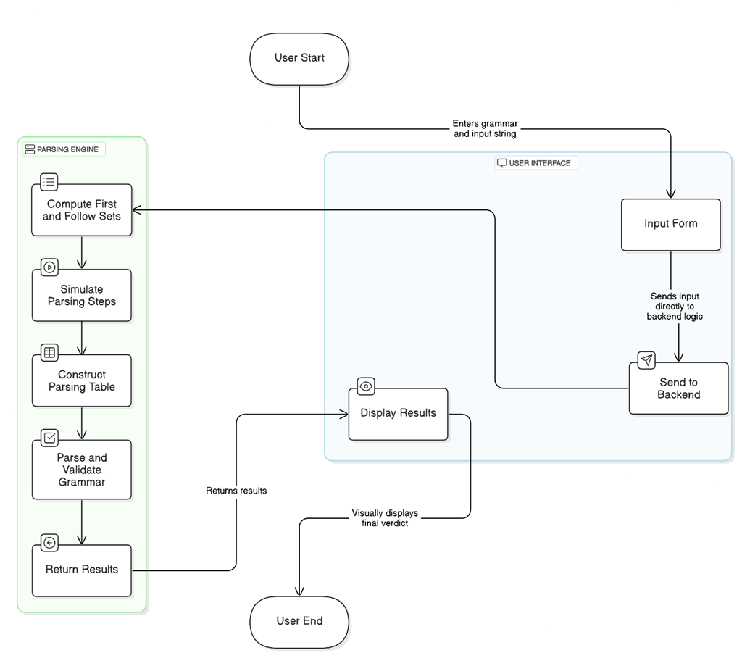
Workflow/Architecture

Slide 7
Roles and Responsibilities of Each Team Member
Karan Negi
Jasmeet Singh (Team Lead)
Anshul Sati
Responsible for project planning, task delegation, and milestone tracking.
Handles core backend development in Python—especially grammar processing, FIRST/FOLLOW set computation, and parser logic (LL, LR, SLR, CLR).
Coordinates integration between frontend and backend modules.
Focuses on parsing simulation and step-by-step execution engine—showing stack, input buffer, and actions clearly.
Assists in visual animation logic (stack updates, table lookups, etc.) and debugging complex parser behaviors.
Develops conflict detection algorithms and builds logic for parsing table construction.
Leads the frontend development, especially user interface and visualizations using ReactJS and Tailwind CSS.
Works on the REST API layer using Flask or FastAPI.
Maintains GitHub repository, ensuring code is version-controlled and well-documented.

Slide 8


