Slide 1
Multithreaded Client-Server File Transfer
A faster and much secure way to transfer files.

Slide 2
Team Information
Team Name : PBL-OS
Team id : SE(OS)-VI-T127
Team member 1 (Team Lead)
Jasmeet Singh – 22011017
singhjasmeet200526@gmail.com
Team member 2
Karan Negi – 22021583
karanegi076@gmail.com
Team member 3
Anshul Sati– 220211252
satianshul9@gmail.com

Slide 3
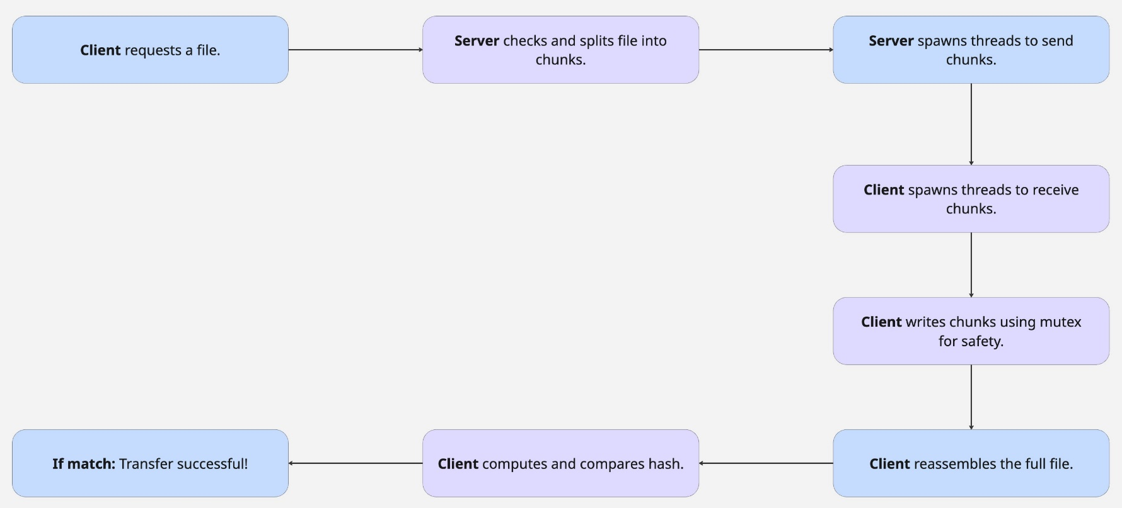
Project Idea/Overview

Slide 4
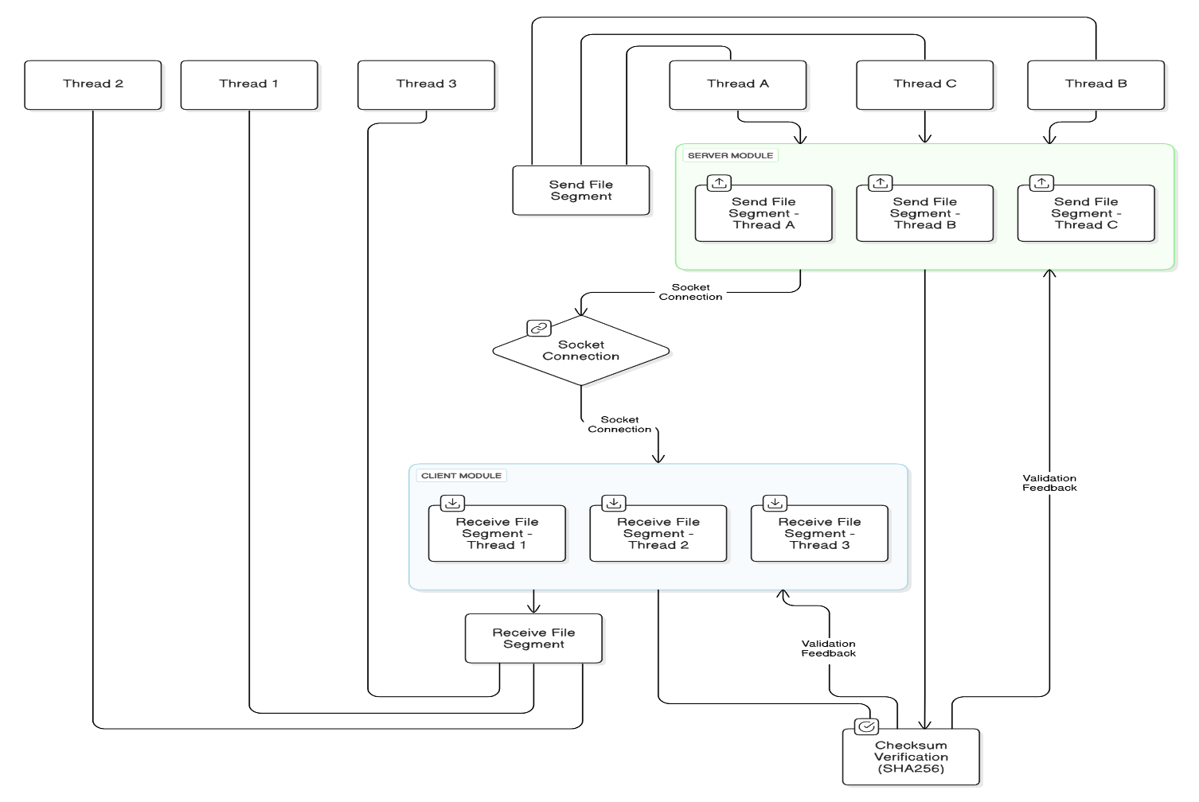
Workflow/Architecture

Slide 5
Objective
Lightweight Implementation The system is built from scratch in C with minimal external dependencies, providing full control over how files are transmitted, processed, and verified.
High-Speed File Transfer Multithreading is used on both client and server sides to transfer file segments concurrently, reducing total transfer time and improving efficiency.
Reliable Communication TCP sockets ensure ordered, lossless, and error-checked data transmission between the client and server.
Data Integrity Verification SHA-256 checksum is calculated on the server before transmission and compared with the client’s checksum after reassembly to confirm that the file is received without corruption.
Real-Time Transmission and Processing As files are segmented and transferred in parallel, the system supports immediate processing and assembly of data on the client side.
Thread-Safe File Handling Mutex locks are used to synchronize file writes on the client side, preventing race conditions and ensuring that each segment is written correctly.

Slide 6
Technology Stack
Programming Language
C – Core development of client-server architecture, multithreading, and file I/O.
Networking
TCP Sockets – For reliable, connection-oriented communication between client and server.
Socket Programming APIs – Standard POSIX socket interfaces.
Concurrency
POSIX Threads (pthreads) – To enable multithreaded transmission and reception of file segments.
Security & Integrity
OpenSSL Library – Used for generating and verifying SHA-256 checksums to ensure file integrity.
File Handling
Standard C File I/O – Reading, writing, and managing file segments on both client and server sides.

Slide 7
Roles and Responsibilities of Each Team Member
Jasmeet Singh (Team Lead) | Anshul Sati | Karan Negi
Develop core server logic in server.c, handle socket programming, connection acceptance, and implement server-side mutexes. Calculate file size and divide into segments; implement and verify SHA-256 hash generation for integrity checks. Create and run a test suite using tests.sh to validate server functionality and security features. | Implement core client logic in client.c, establish socket-based communication with the server, and handle file reassembly from received segments. Integrate client-side mutexes for thread safety and implement SHA-256 checksum verification to ensure file integrity. Organize the project structure and create a Makefile to automate the build process. | Handle thread creation, task division (server.c), and receiving logic (client.c) with proper synchronization. Implement shared file transfer protocol and integrate error handling in both client and server. Write a comprehensive README.md explaining setup and functionality.

Slide 8


