Slide 1
Computer Organization & Architecture UNIT II
Assembly Language and Input/output Organization

Slide 2
Overview
Assembly Language Concepts
Stacks
Subroutines
Additional Instructions
Accessing I/O Devices
Interrupts
Bus Structure
Bus Operation
Arbitration

Slide 3
1.Assembly Language Concepts
Machine instructions are represented by patterns of 0s and 1s
Symbolic names to represent the patterns are Load, Store, Add, and Branch
While writing programs for a specific computer, such words are normally replaced by acronyms called mnemonics, such as LD, ST, ADD, and BR.
A complete set of such symbolic names and rules for their use constitutes a programming language, referred to as an assembly language.

Slide 4
The set of rules for using the mnemonics and for specification of complete instructions and programs is called the syntax of the language.
Programs written in an assembly language can be automatically translated into a sequence of machine instructions by a program called an assembler
The assembler program is a part of the system software of a computer and stored as a sequence of machine instructions in the memory of the computer.

Slide 5
When the assembler program is executed, it reads the user program, analyzes it, and then generates the desired machine language program.
The user program in its original alphanumeric text format is called a source program, and the assembled machine-language program is called an object program.

Slide 6
Ex: a Store instruction as ST R2, SUM
mnemonic ST represents the binary pattern, or operation (OP) code, for the operation performed by the instruction.
The assembler translates this mnemonic into the binary OP code that the computer recognizes.
OP-code mnemonic is followed by at least one blank space or tab character
Then the information that specifies the operands is given.
source operand is register R2, followed by the specification of the destination operand, separated from the source operand by a comma

Slide 7
Since there are several possible addressing modes for specifying operand locations, an assembly-language instruction must indicate which mode is being used
ADD R2, R3, #5
LD R3, (R2)

Slide 8
Assembler Directives
Assembly language allows the programmer to specify information needed to translate the source program into the object program
Equate statement
TWENTY EQU 20
informs the assembler that the name TWENTY should be replaced by the value 20 wherever it appears in the program.
assembler directives (or commands), are used by the assembler while it translates a source program into an object program

Slide 9
Assembler Directives
In addition to translating the instructions of the source program, the assembler must process statements called assembler directives.
These are pseudo instructions,
They provide definition to the assembler itself.
They are not translated into machine operation code.

Slide 10
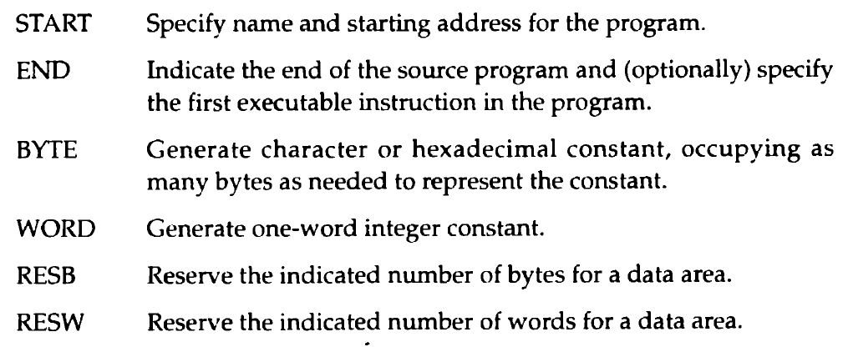
Assembler Directives

Slide 11
If the assembler is to produce an object program, it has to know
How to interpret the names
Where to place the instructions in the memory
Where to place the data operands in the memory
To provide this information, the source program may be written as in Fig. b (next slide)

Slide 12
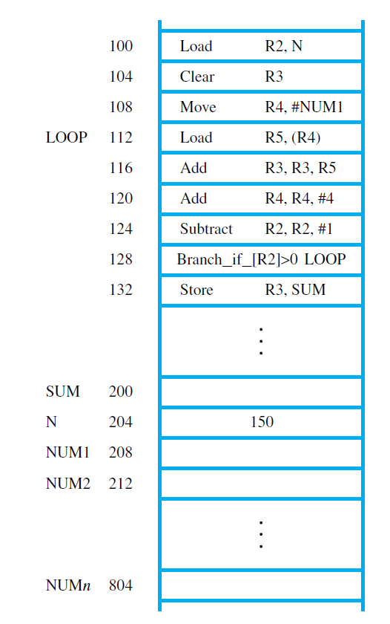
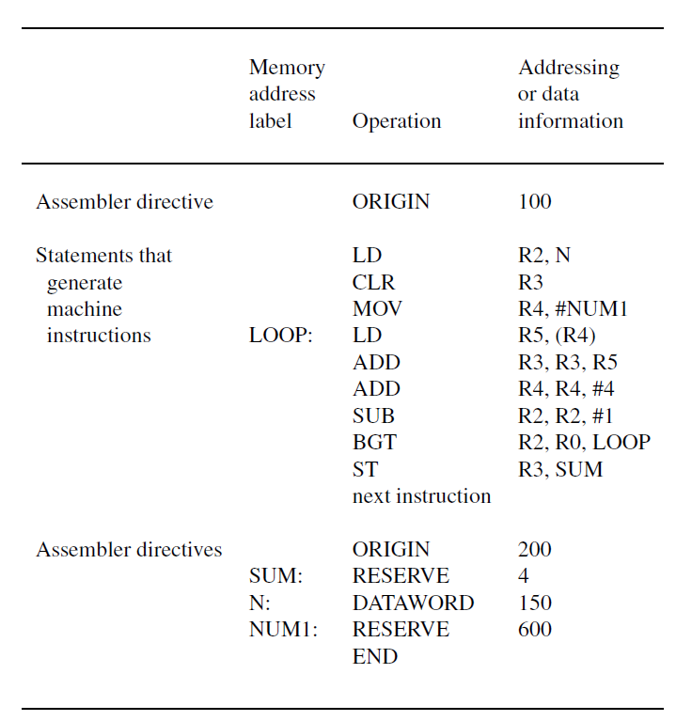
a. Memory arrangement b. Assembly language representation

Slide 13
Assembler directive, ORIGIN, tells the assembler program where in the memory to place the instructions that follow
Instructions of the object program are to be loaded in the memory starting at address 100
second ORIGIN directive tells the assembler program where in the memory to place the data block that follows.
In this case, the location specified has the address 200.
This is intended to be the location in which the final sum will be stored.

Slide 14
A 4-byte space for the sum is reserved by means of the assembler directive RESERVE.
The next word, at address 204, has to contain the value 150 which is the number of entries in the list
The DATAWORD directive is used to inform the assembler of this requirement.
The next RESERVE directive declares that a memory block of 600 bytes is to be reserved for data.
This directive does not cause any data to be loaded in these locations
The last statement in the source program is the assembler directive END, which tells the assembler that this is the end of the source program text.

Slide 15
Any statement that results in instructions or data being placed in a memory location may be given a memory address label.
The assembler automatically assigns the address of that location to the label.
For example, in the data block that follows the second ORIGIN directive, we used the labels SUM, N, and NUM1.
Because the first RESERVE statement after the ORIGIN directive is given the label SUM, the name SUM is assigned the value 200.
Whenever SUM is encountered in the program, it will be replaced with this value.
Using SUM as a label in this manner is equivalent to using the assembler directive
SUM EQU 200

Slide 16
Similarly, the labels N and NUM1 are assigned the values 204 and 208, respectively, because they represent the addresses of the two word locations immediately following the word location with address 200.

Slide 17
Most assembly languages require statements in a source program to be written in the form
Label: Operation Operand(s) Comment
These four fields are separated by an appropriate delimiter, perhaps one or more blank or tab characters.
The Label is an optional name associated with the memory address where the machine-language instruction produced from the statement will be loaded.
Labels may also be associated with addresses of data items.
In Figure (slide 12) there are four labels: LOOP, SUM, N, and NUM1.

Slide 18
The Operation field contains an assembler directive or the OP-code mnemonic of the desired instruction.
The Operand field contains addressing information for accessing the operands.
The Comment field is ignored by the assembler program.
It is used for documentation purposes to make the program easier to understand.
Assembly languages differ in detail and complexity from one computer to another.

Slide 19
Assembly and Execution of Programs
A source program written in an assembly language must be assembled into a machine language object program before it can be executed.
Assembler program replaces all symbols denoting operations and addressing modes with the binary codes used in machine instructions, and replaces all names and labels with their actual values.
A key part of the assembly process is determining the values that replace the names (EQU directive)
The assembler must keep track of addresses as it generates the machine code for successive instructions.

Slide 20
In some cases, the assembler does not directly replace a name representing an address with the actual value of this address.
A branch instruction is implemented in machine code by specifying the branch target as the distance (in bytes) from the present address in the Program Counter to the target instruction.
The assembler stores the object program on the secondary storage device available in the computer.
The object program must be loaded into the main memory before it is executed.
For this, a utility program called a loader must already be in the memory.

Slide 21
Having loaded the object code, the loader starts execution of the object program by branching to the first instruction to be executed, which may be identified by an address label such as START.
The assembler places that address in the header of the object code for the loader to use at execution time.
When the object program begins executing, it proceeds to completion unless there are logical errors in the program.
The assembler can detect and report syntax errors, the system software usually includes a debugger program.

Slide 22
Number Notation
Most assemblers allow numerical values to be specified in different ways, using conventions that are defined by the assembly-language syntax.
ADDI R2, R3, 93
ADDI R2, R3, %01011101
Percent: assembler-specific prefix symbol for binary
Binary numbers can be written more compactly as hexadecimal(93 becomes 5D)
hex representation is identified by the prefix 0x
ADDI R2, R3, 0x5D

Slide 23
2.Stacks
A stack is a list of data elements, usually words, with the accessing restriction that elements can be added or removed at one end of the list only.
This end is called the top of the stack, and the other end is called the bottom.
The structure is sometimes referred to as a pushdown stack.
last-in–first-out (LIFO) stack, is a type of storage mechanism; the last data item placed on the stack is the first one removed when retrieval begins.
The terms push and pop are used to describe placing a new item on the stack and removing the top item from the stack, respectively.

Slide 24
A processor register, called the stack pointer (SP), is used to point to a particular stack structure called the processor stack
Data can be stored in a stack with successive elements occupying successive memory locations.

Slide 25
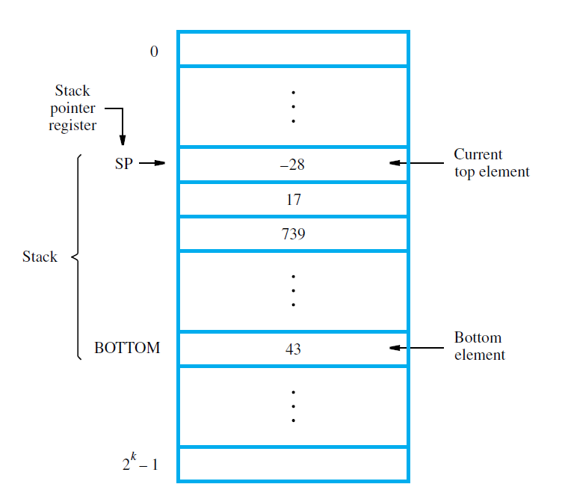
push operation
Subtract SP, SP, #4
Store Rj, (SP)
new item to be pushed on the stack is in processor register Rj, the Store instruction will place this value on the stack
copy the word from Rj onto the top of the stack, decrementing the stack pointer by 4 before the store (push) operation.
pop operation
Load Rj, (SP)
Add SP, SP, #4
These two instructions load (pop) the top value from the stack into register Rj and then increment the stack pointer by 4 so that it points to the new top element
43 at the bottom and −28 at the top
stack pointer, SP, is used to keep track of the address of the element of the stack that is at the top at any given time.

Slide 26
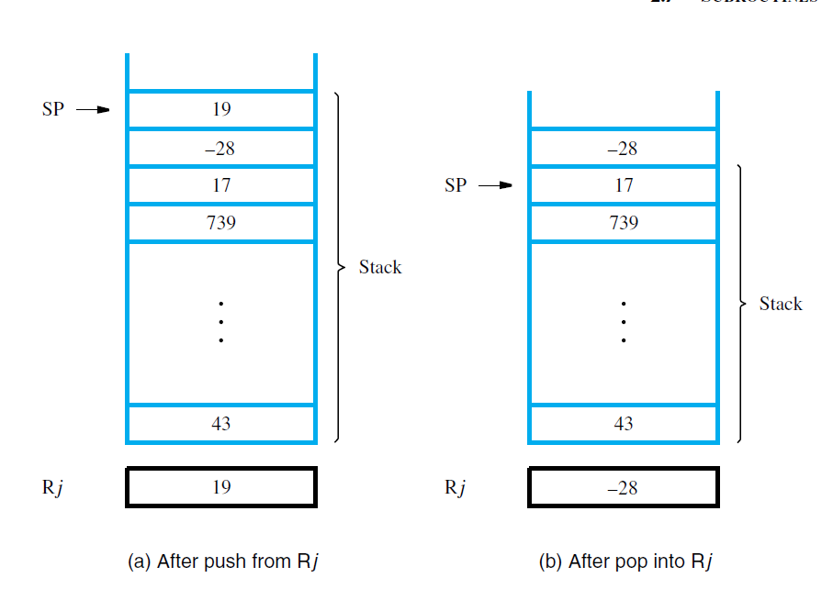

Slide 27
3.Subroutines
In a given program, it is often necessary to perform a particular task many times on different data values.
Implementing this task as a set of instructions to be executed whenever the task needs to be performed is a sensible approach.
Such a block of instructions is usually called a subroutine
EX: sort a list of values into increasing or decreasing order.
Only one copy of this block is placed in the memory to save space and any program that requires the use of the subroutine simply branches to its starting location.

Slide 28
When a program branches to a subroutine then it is calling the subroutine.
The instruction that performs this branch operation is named a Call instruction.
After a subroutine has been executed, the calling program must resume execution, continuing immediately after the instruction that called the subroutine.
The subroutine is said to return to the program that called it by executing a Return instruction.

Slide 29
The contents of the PC must be saved by the Call instruction to enable correct return to the calling program.
Subroutine linkage method:
The way in which a computer makes it possible to call and return from subroutines.
Simple way is use of a link register to save the return address in a specific location.

Slide 30
The Call instruction is a branch instruction that performs the following operations:
Store the contents of the PC in the link register
Branch to the target address specified by the Call instruction
The Return instruction branches to the address contained in the link register

Slide 31
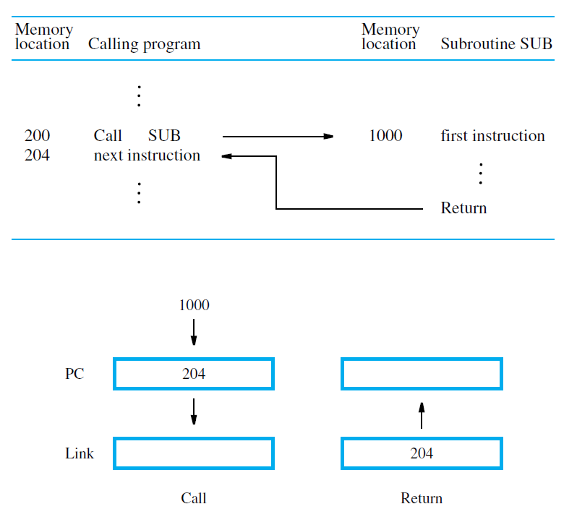
Subroutine linkage using a link register

Slide 32
Subroutine Nesting and the Processor Stack
subroutine nesting: one subroutine call another
the return address of the second call is also stored in the link register, overwriting its previous contents
Important to save the contents of the link register in some other location before calling another subroutine.
Otherwise, the return address of the first subroutine will be lost.
In Subroutine nesting, return addresses are generated and used in a last-in–first-out order.

Slide 33
Correct sequencing of nested calls is achieved if a given subroutine SUB1 saves the return address currently in the link register on the stack, accessed through the stack pointer, SP, before it calls another subroutine SUB2.
Then, prior to executing its own Return instruction, the subroutine SUB1 has to pop the saved return address from the stack and load it into the link register.

Slide 34
Parameter Passing
Exchange of information between a calling program and a subroutine is referred to as parameter passing
calling a subroutine: a program must provide to the subroutine the parameters(the operands or their addresses)to be used in the computation.
the subroutine returns other parameters, which are the results of the computation.
The parameters are placed
in registers or in memory locations, where they can be accessed by the subroutine.
on the processor stack.

Slide 35
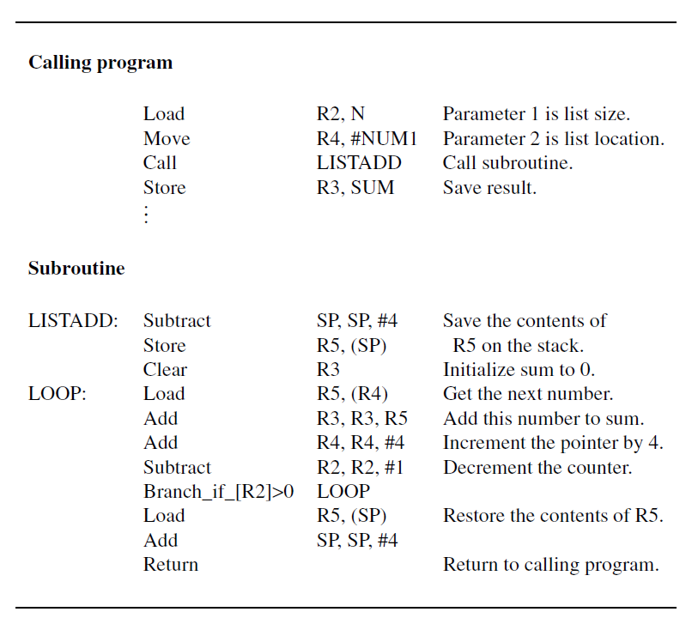
Adding N numbers using a subroutine; parameters passed through registers.

Slide 36
Subroutine: LISTADD, parameters passed through registers
The Call instruction branches to the subroutine starting at location LISTADD
also saves the return address (address of the Store instruction) in the link register.
The subroutine computes the sum and places it in R3.
After the Return instruction is executed by the subroutine, the sum in R3 is stored in memory location SUM by the calling program.

Slide 37
subroutine uses R5:
R5 is used in the calling program, its contents are saved by pushing them onto the processor stack upon entry to the subroutine and
restored before returning to the calling program.
If many parameters are involved, there may not be enough general-purpose registers available for passing them to the subroutine.
The processor stack provides a convenient and flexible mechanism for passing an arbitrary number of parameters

Slide 38
Figure(next slide) shows the program rewritten as a subroutine, LISTADD, which uses the processor stack for parameter passing.
The address of the first number in the list and the number of entries are pushed onto the processor stack pointed to by register SP.
The subroutine is then called.
The computed sum is placed on the stack before the return to the calling program.

Slide 39
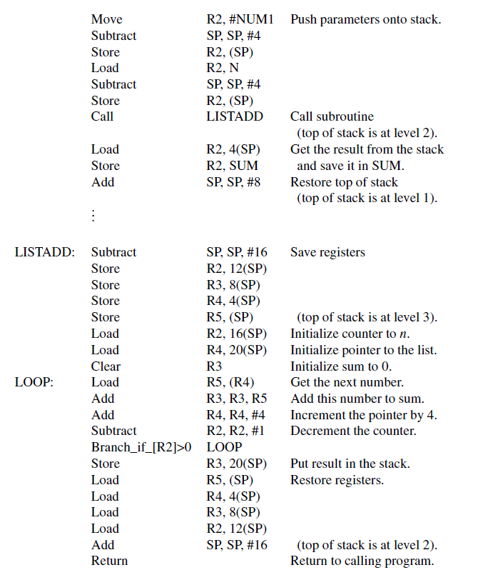

Slide 40
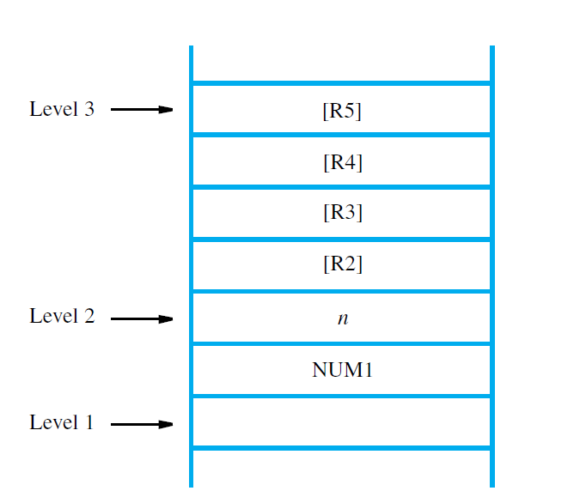
Stack contents for the program
..

Slide 41
Assume that before the subroutine is called, the top of the stack is at level 1.
The calling program pushes the address NUM1 and the value n onto the stack and calls subroutine LISTADD
The top of the stack is now at level 2.
The subroutine uses four registers while it is being executed.
Since these registers may contain valid data that belong to the calling program, their contents should be saved at the beginning of the subroutine by pushing them onto the stack.

Slide 42
The top of the stack is now at level 3.
The subroutine accesses the parameters n and NUM1 from the stack using indexed addressing with offset values relative to the new top of the stack (level 3).
Note that it does not change the stack pointer because valid data items are still at the top of the stack.
The value n is loaded into R2 as the initial value of the count, and the address NUM1 is loaded into R4, which is used as a pointer to scan the list entries.

Slide 43
At the end of the computation, register R3 contains the sum.
Before the subroutine returns to the calling program, the contents of R3 are inserted into the stack, replacing the parameter NUM1, which is no longer needed.
Then the contents of the four registers used by the subroutine are restored from the stack.
The stack pointer is incremented to point to the top of the stack that existed when the subroutine was called, namely the parameter n at level 2.
After the subroutine returns, the calling program stores the result in location SUM and lowers the top of the stack to its original level by incrementing the SP by 8.

Slide 44
Observe that for subroutine LISTADD in Figure(slide 39 ), we did not use a pair of instructions
Subtract SP, SP, #4
Store Rj, (SP)
to push the contents of each register on the stack.
Since we have to save four registers, this would require eight instructions.
We needed only five instructions by adjusting SP immediately to point to the top of stack that will be in effect once all four registers are saved.
Then, we used the Index mode to store the contents of registers.
We used the same optimization when restoring the registers before returning from the subroutine.

Slide 45
Some computers have special instructions for loading and storing multiple registers.
For example, the four registers in Figure(R to R5)may be saved on the stack by using the instruction
StoreMultiple R2−R5, −(SP)
The source registers are specified by the range R2−R5.
The notation −(SP) specifies that the stack pointer must be adjusted accordingly.
The minus sign in front indicates that SP must be decremented (by 4) before the contents of each register are placed on the stack.

Slide 46
Similarly, the instruction
LoadMultiple R2−R5, (SP)+
will load registers R2, R3, R4, and R5, in reverse order, with the values that were saved on the stack.
The notation (SP)+ indicates that the stack pointer must be incremented (by 4) after each value has been loaded into the corresponding register.

Slide 47
Parameter Passing by Value and by Reference
Note the nature of the two parameters, NUM1 and n, passed to the subroutines
The purpose of the subroutines is to add a list of numbers.
Instead of passing the actual list entries, the calling program passes the address of the first number in the list.
This technique is called passing by reference.
The second parameter is passed by value, that is, the actual number of entries, n, is passed to the subroutine.

Slide 48
The Stack Frame
During execution of the subroutine, locations needed by them constitute a private work space, allocated at the time the subroutine is entered and deallocated when the subroutine returns control to the calling program.
Such space is called a stack frame.
space for local memory variables, if needed, can also be allocated on the stack.

Slide 49
Figure (next slide) is an example of a layout for information in a stack frame.
In addition to the stack pointer SP, the frame pointer (FP),is used for access
to the parameters passed to the subroutine and
to the local memory variables used by the subroutine.
In the fig, four parameters are passed to the subroutine, three local variables are used within the subroutine, and registers R2, R3, and R4 need to be saved because they will also be used within the subroutine.
When nested subroutines are used, the stack frame of the calling subroutine would also include the return address

Slide 50
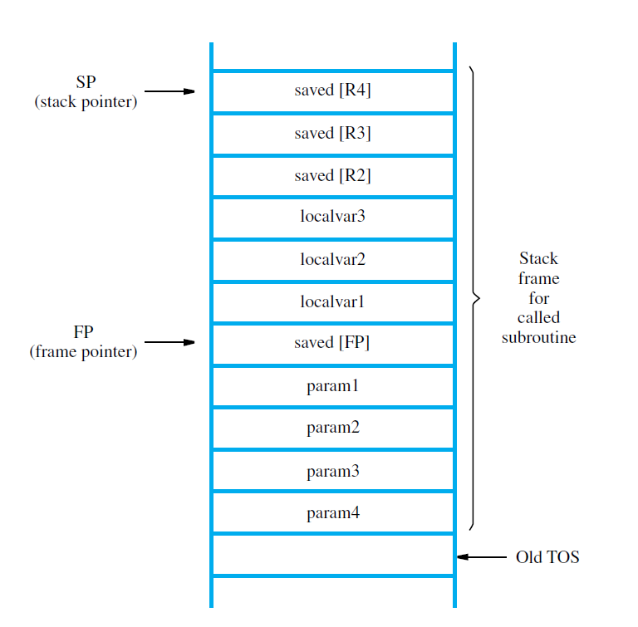
A subroutine stack frame example
x

Slide 51
With the FP register pointing to the location just above the stored parameters, the parameters and the local variables can be accesses by using the Index addressing mode.
The parameters can be accessed by using addresses 4(FP), 8(FP), . . . .
The local variables can be accessed by using addresses −4(FP), −8(FP), . . . .
The contents of FP remain fixed throughout the execution of the subroutine, whereas the stack pointer SP, must always point to the current top element in the stack.

Slide 52
How the pointers SP and FP are manipulated as the stack frame is allocated, used, and deallocated for a particular invocation of a subroutine?
Assume that SP points to the old top-of-stack (TOS) element.
Before the subroutine is called, the calling program pushes the four parameters onto the stack.
Then the Call instruction is executed.
At this time, SP points to the last parameter that was pushed on the stack.
If the subroutine is to use the frame pointer, it should first save the contents of FP by pushing them on the stack, because FP is usually a general-purpose register and it may contain information of use to the calling program.
Then, the contents of SP, which now points to the saved value of FP, are copied into FP.

Slide 53
Thus, the first three instructions executed in the subroutine are
Subtract SP, SP, #4
Store FP, (SP)
Move FP, SP
The Move instruction copies the contents of SP into FP.
After these instructions are executed, both SP and FP point to the saved FP contents.
Space for the three local variables is now allocated on the stack by executing the instruction
Subtract SP, SP, #12
Finally, the contents of processor registers R2, R3, and R4 are saved by pushing them onto the stack.
At this point, the stack frame has been set up as shown in Figure

Slide 54
The subroutine then executes its task.
When the task is completed, the subroutine pops the saved values of R4, R3, and R2 back into those registers, deallocates the local variables from the stack frame by executing the instruction
Add SP, SP, #12
and pops the saved old value of FP back into FP.
At this point, SP points to the last parameter that was placed on the stack.
Next, the Return instruction is executed, transferring control back to the calling program.

Slide 55
The calling program is responsible for deallocating the parameters from the stack frame, some of which may be results passed back by the subroutine.
After deallocation of the parameters, the stack pointer points to the old TOS, and back to where we started.

Slide 56
Stack Frames for Nested Subroutines
When nested subroutines are used, ensure that the return addresses are properly saved.
When a calling program calls a subroutine, say SUB1, the return address is saved in the link register.
If SUB1 calls another subroutine, SUB2, it must save the current contents of the link register before it makes the call to SUB2.
The appropriate place for saving this return address is within the stack frame for SUB1.

Slide 57
An example of a main program calling a first subroutine SUB1, which then calls a second subroutine SUB2, is shown in Figure(slide 58 & 59)
The stack frames corresponding to these two nested subroutines are shown in Figure (slide 60).
All parameters involved in this example are passed on the stack.
Note: The two figures only show the flow of control and data among the main program and the two subroutines(actual computations are not shown).

Slide 58
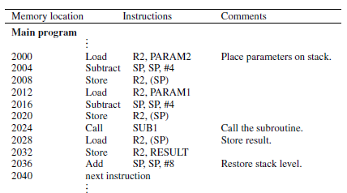
x

Slide 59
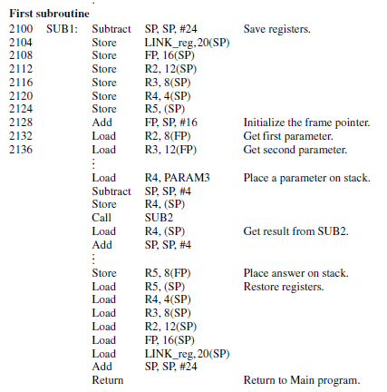
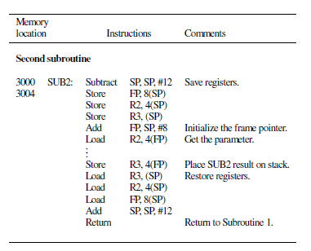

Slide 60
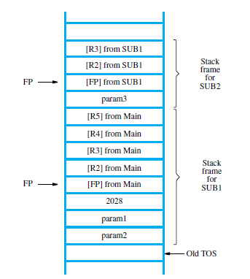

Slide 61
The flow of execution is as follows.
The main program pushes the two parameters param2 and param1 onto the stack, and then calls SUB1.
This first subroutine is responsible for computing a single result and passing it back to the main program on the stack.
During the course of its computations, SUB1 calls the second subroutine, SUB2, in order to perform some other subtask.
SUB1 passes a single parameter param3 to SUB2, and the result is passed back to it via the same location on the stack.
After SUB2 executes its Return instruction, SUB1 loads this result into register R4.
SUB1 then continues its computations and eventually passes the required answer back to the main program on the stack.

Slide 62
When SUB1 executes its return to the main program, the main program stores this answer in memory location RESULT, restores the stack level, then continues with its computations at the next instruction at address 2040.
Note how the return address to the calling program, 2028, is stored within the stack frame for SUB1 in Figure(slide 60).
The first action performed by each subroutine is to save on the stack the contents of all registers used in the subroutine, including the frame pointer and link register (if needed).
This is followed by initializing the frame pointer.

Slide 63
SUB1 uses four registers, R2 to R5, and SUB2 uses two registers, R2 and R3.
These registers, the frame pointer, and the link register in the case of SUB1, are restored just before the Return instructions are executed.
The Index addressing mode involving the frame pointer register FP is used to load parameters from the stack and place answers back on the stack.
The byte offsets used in these operations are always 4, 8, . . .
Each calling routine is responsible for removing its own parameters from the stack.
This is done by the Add instructions, which lower the top of the stack.

Slide 64
4.Additional Instructions

Slide 65
5.Accessing I/O Devices

Slide 66
6.Interrupts

Slide 67
7.Bus Structure

Slide 68
8.Bus Operation

Slide 69
9.Arbitration

