Slide 1

Decrypting Deceit- Unveiling Patterns of Credit Card Fraudulent Activities
Jasmika Vemulapalli
Under the Guidance of Dr. Yanqing Zhang

Slide 2

Introduction
Credit card fraud poses a significant threat to the financial security of individuals and institutions alike, necessary for robust detection systems. The implications of fraud extend beyond monetary loss, affecting consumer trust and financial stability. However, crafting an effective detection strategy is challenging due to the sophisticated and evolving tactics of fraudsters, as well as the need to minimize false positives that can disrupt legitimate transactions.

Slide 3
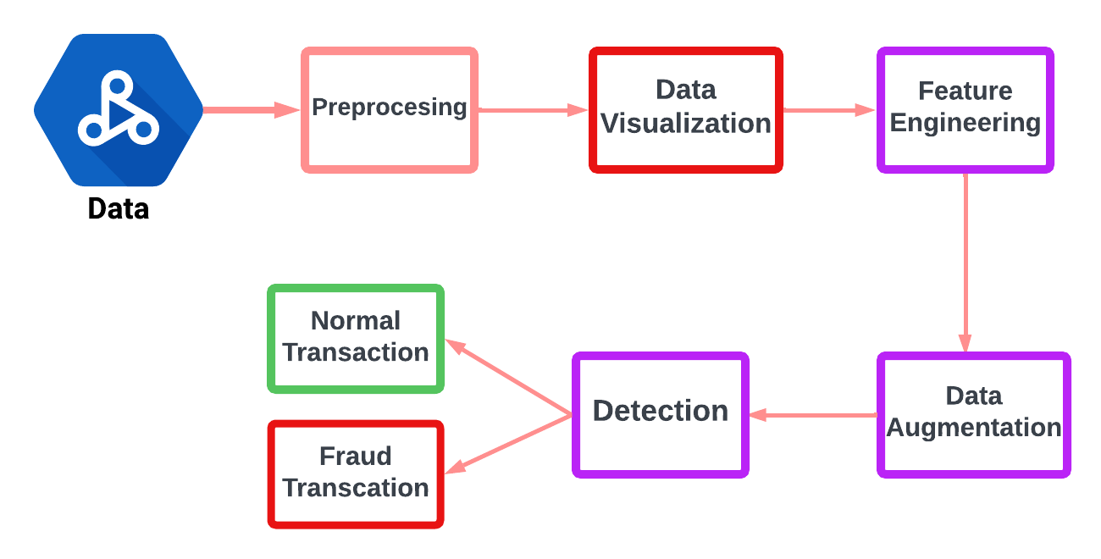
Architecture

Slide 4
Data sets
Data sets are from Kaggle.
Kaggle.com
Train Data set- 1296675 * 23
Test Data set- 555719 *23

Slide 5
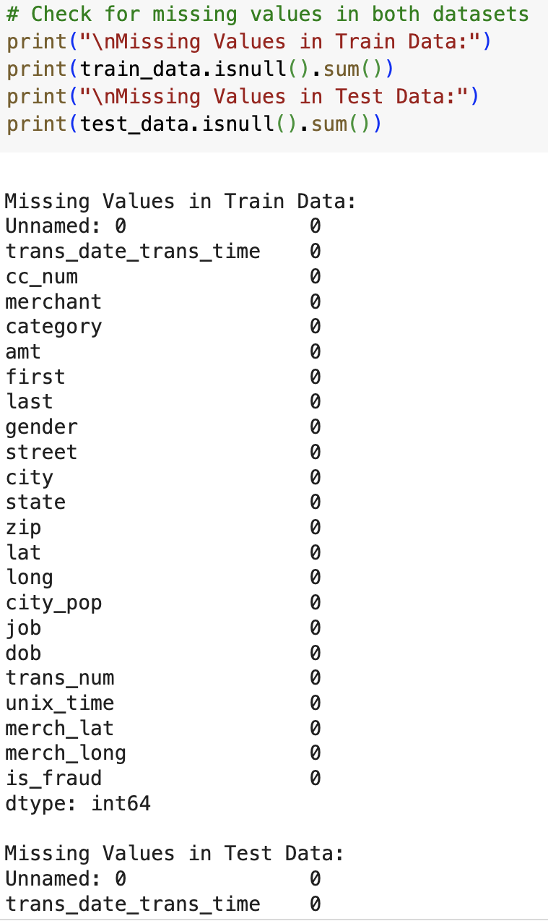
Preprocessing
In the preprocessing phase of a machine learning project, one of the initial steps is to handle missing values in the data.

Slide 6
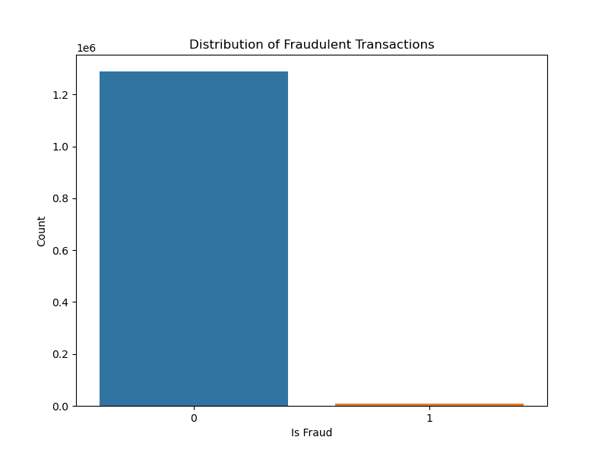
Data Visualization
Visualization tools are employed to gain insights into the data distribution and to guide the feature engineering process.
Legitimate transactions (denoted by 0) vs Fraudulent transactions (denoted by 1):
This visualization is a crucial step in the data analysis process as it highlights the class imbalance issue a common challenge in fraud detection tasks.

Slide 7
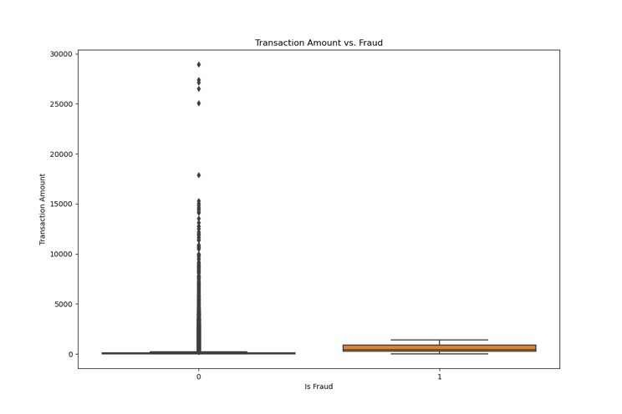
contd
ii) Non-fraudulent transactions (labeled '0') vs fraudulent transactions (labeled '1’):
It helps in understanding the distribution of these two classes and the challenges posed by class imbalance in fraud detection tasks.

Slide 8
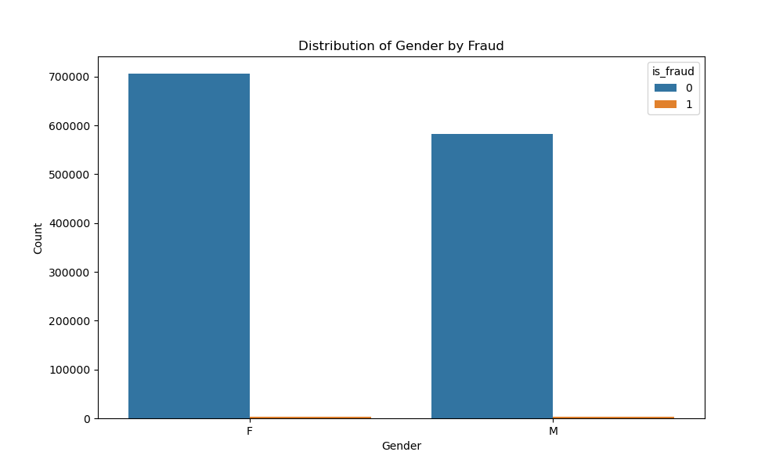
iii) Distribution of Gender by Fraud:
It helps in assessing whether gender is a significant feature in predicting fraudulent transactions and if there are gender-based differences in fraud occurrence.

Slide 9
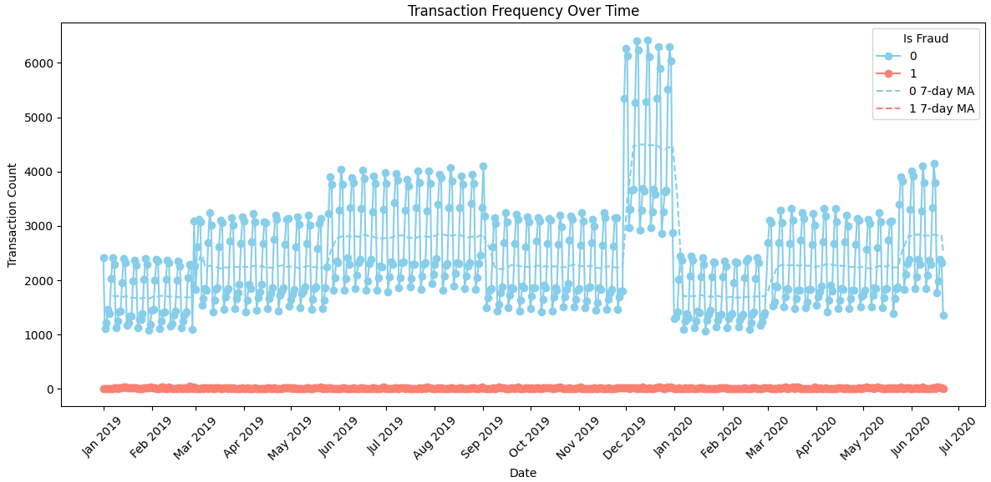
iv) Transaction Frequency Over Time:
It helps in detecting patterns and anomalies in transaction behavior, such as spikes in fraudulent transactions that may require further investigation.
Understanding transaction dynamics over time is crucial for forecasting regular transaction volumes and optimising fraud detection resources.

Slide 10
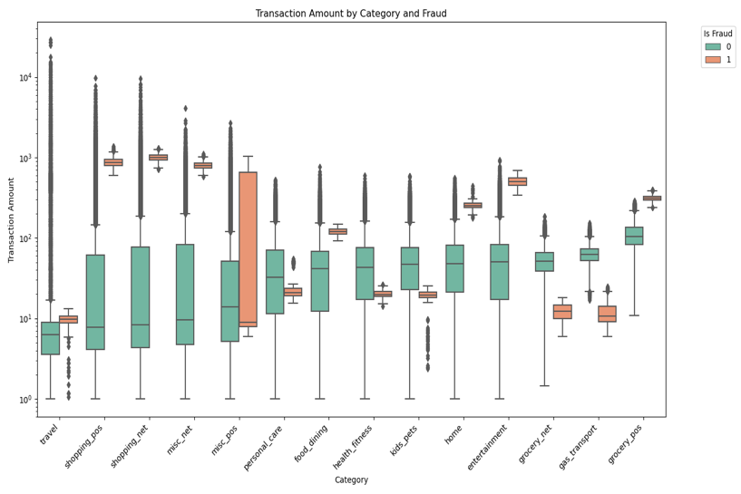
V) Transaction by Category:
It highlights the variation in transaction amounts within each category and the differences between fraudulent and non-fraudulent transaction amounts.

Slide 11
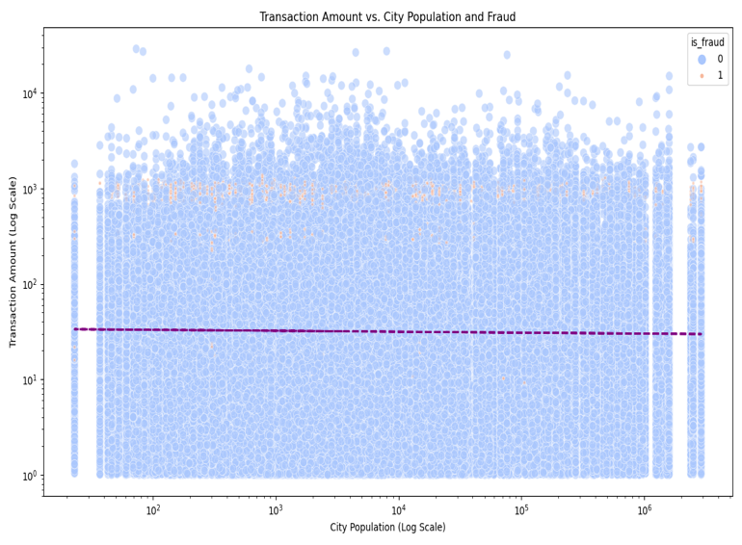
vi) Transaction Amount vs City Population:
It aims to understand if there are common transaction amounts across cities of different sizes and if fraud occurrence correlates with population size. This analysis provides insights into potential patterns in transaction behavior based on city population.
Key observations might include-
Transaction Amounts.
City Population.
Fraudulent Transactions.
Non-Fraudulent Transactions.
Data Density.

Slide 12
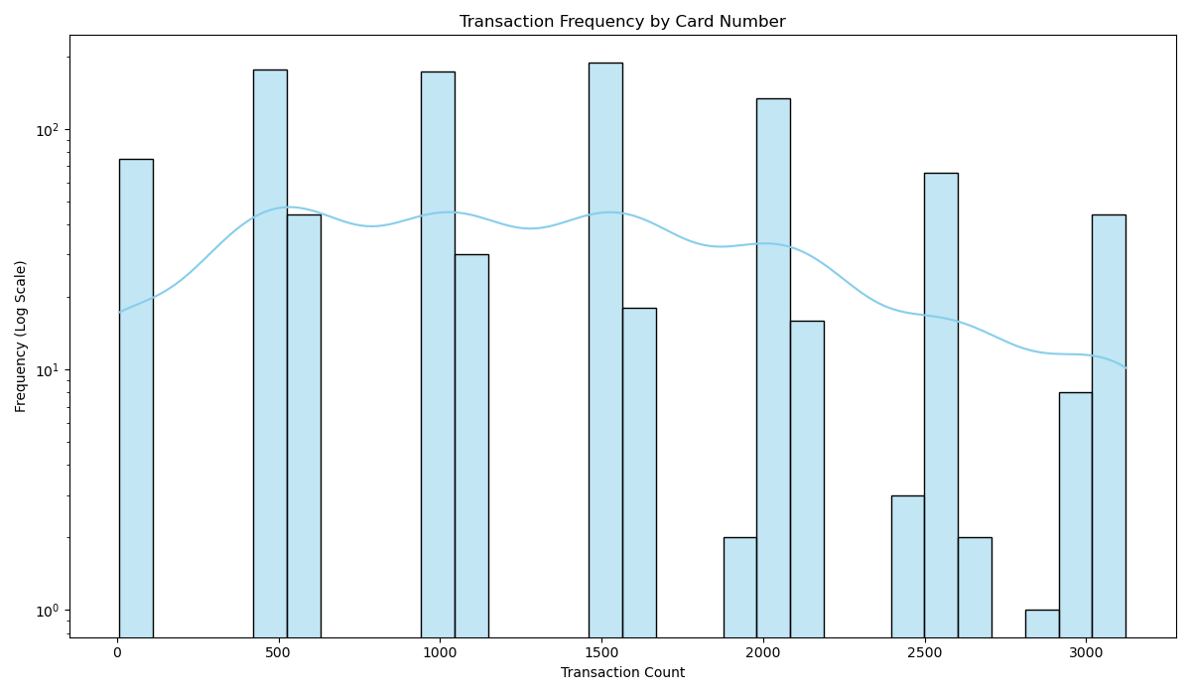
Vii) Transaction by Card number:
This type of visualization helps in understanding the distribution of transaction counts per card and identifying any anomalies or patterns.
Key observations might include-
Transaction Count Variability.
Logarithmic Scale.
Potential Anomalies.
Overall Trend.

Slide 13
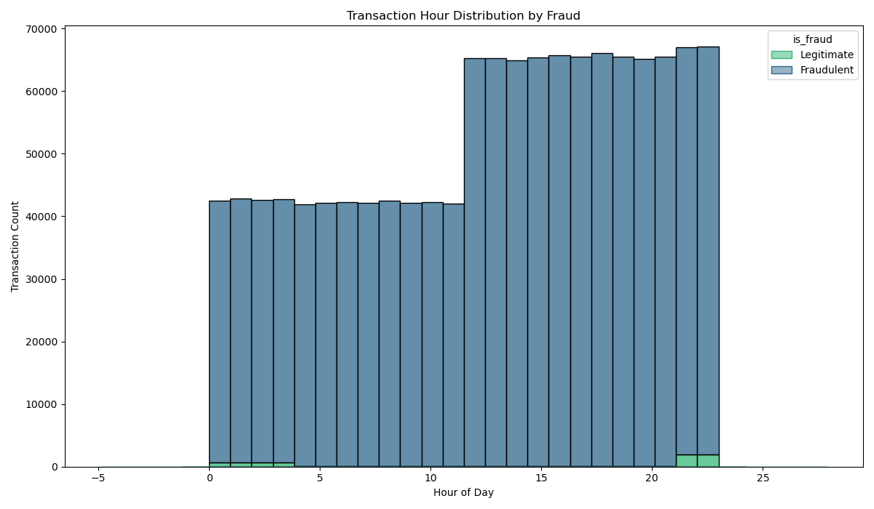
Viii) Transaction analysis by Hours:
It indicates the relative rarity of fraudulent transactions compared to legitimate ones and the distribution of transaction activity by hour.
Understanding transaction patterns by hours is crucial for identifying potential windows of time where additional fraud monitoring measures may be needed.
Key observations might include-
Transaction Volume.
Fraudulent Transactions.
Temporal Pattern.

Slide 14
Feature Engineering
The approach involved both encoding categorical variables and scaling numerical variables to ensure that our models interpret the features correctly.
Identified specific categorical columns – 'gender', 'category', and 'state' – which I believed would provide meaningful insights into patterns of fraudulent transactions.
Numerical columns – 'amt', 'latitude', 'longitude', 'city population', 'Unix time', 'merchant latitude', and 'merchant longitude' – were standardized using a StandardScaler.

Slide 15
Data Augmentation
Synthetic Minority Over-sampling Technique (SMOTE): It is an advanced over-sampling method that creates synthetic samples for the minority class.
SMOTE helps prevent biases in the model that may arise from imbalanced data distributions, ensuring a more equitable representation of both classes in the training dataset.

Slide 16
Models
Logistic Regression.
Random Forest.
Decision Tree.
XGBoost.
Artificial Neural Networks (ANN),

Slide 17
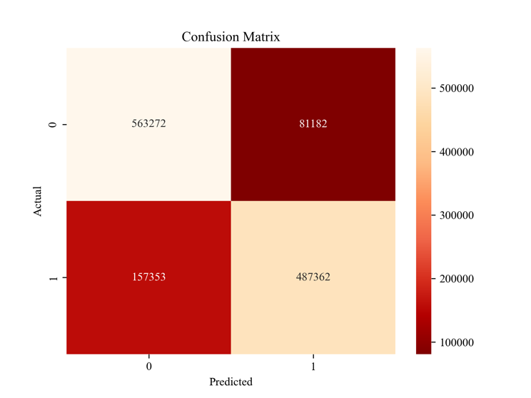
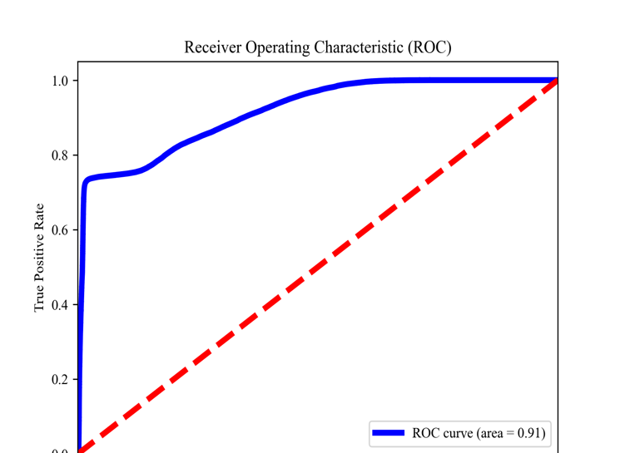
Logistic regression

Slide 18
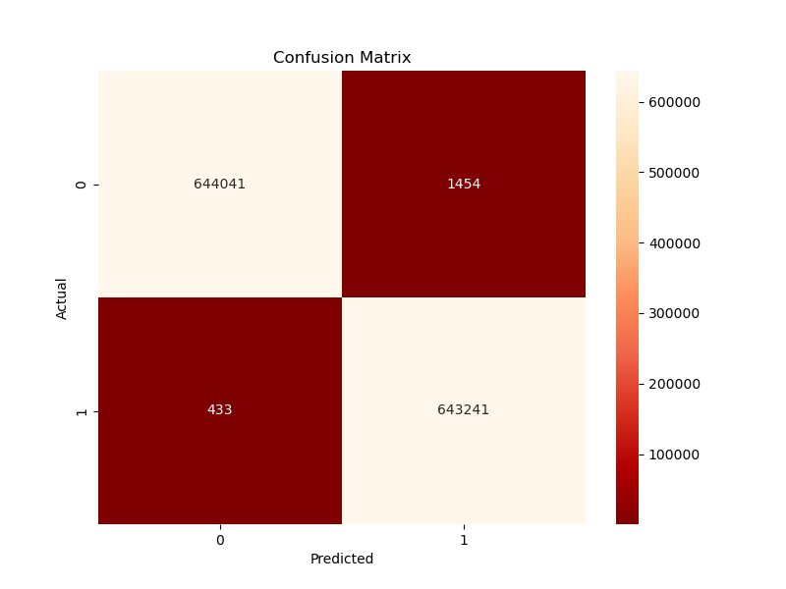
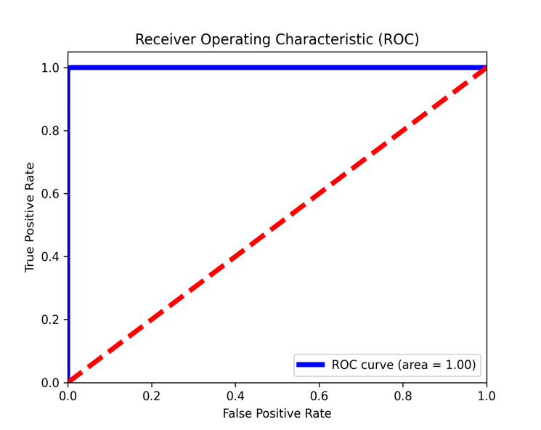
Random forest

Slide 19
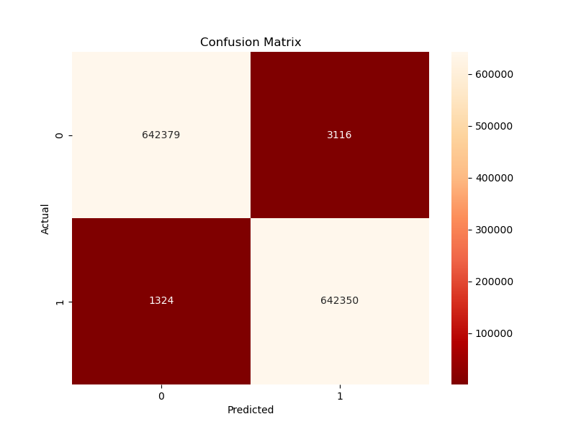
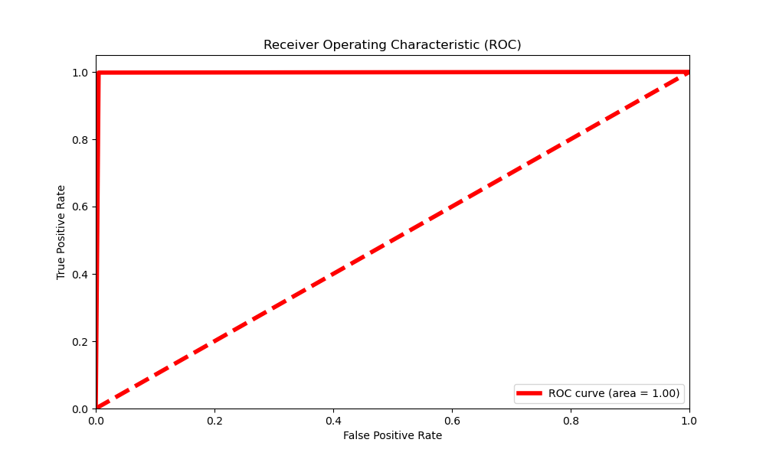
Decision Tree

Slide 20

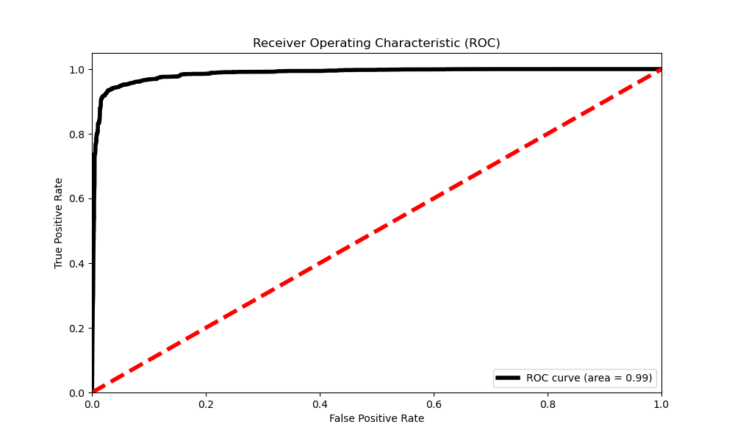
XGBoost

Slide 21
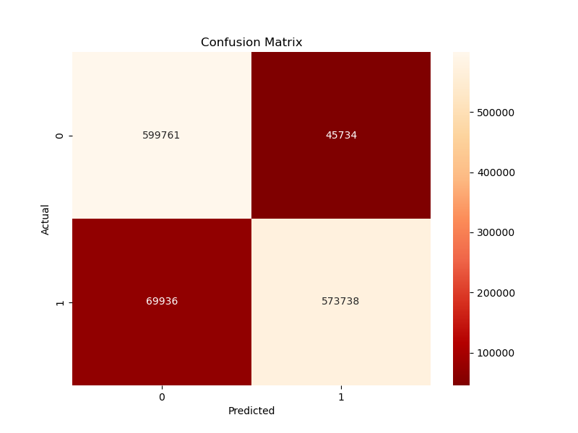
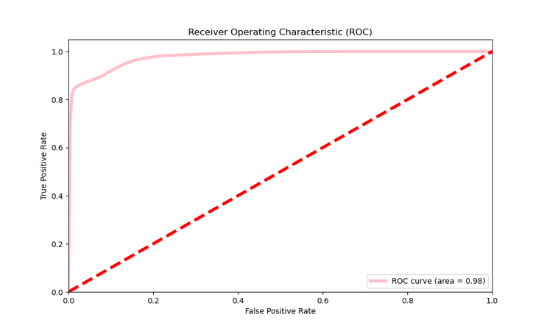
ANN

Slide 22
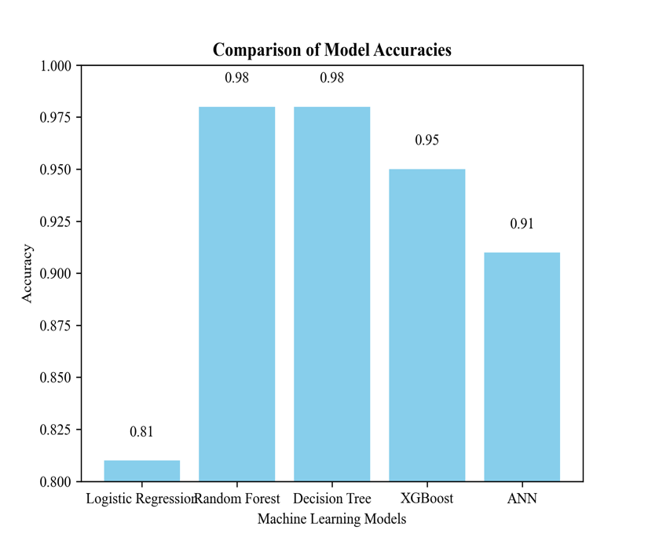
Comparision of models

Slide 23
Conclusion
My comprehensive approach to preprocessing, which included handling missing values, encoding categorical variables, and scaling numerical variables, laid the groundwork for effective model comparisons.
The implementation of the SMOTE was crucial in addressing the imbalance in my dataset, enhancing the ability of our models to detect fraud by providing a balanced view of both fraudulent and legitimate transactions.
Through rigorous training and validation, we evaluated the performance of five different machine learning models: Logistic Regression, Random Forest, Decision Tree, XGBoost, and Artificial Neural Networks (ANN).
Each model had its strengths, with ensemble methods like Random Forest and advanced algorithms like XGBoost showing particularly high accuracy.
The precision, recall, and F1-scores of the models also played an essential role in understanding their performance, especially in a domain where the cost of false positives and false negatives can be high.
I found that while more complex models like Random Forest and XGBoost offered high accuracy, simpler models such as Logistic Regression provided a strong baseline and could be preferable due to their interpretability and speed.

Slide 24
Future Scope
Enhanced Model Performance:
Real-Time Fraud Detection.
Model Interpretability

Slide 25

Any Questions?

Slide 26

Thank you.

