Slide 1
Introduction of Object Oriented Programming (OOPs)
Jasmin Hirani (MST03-0038)

Slide 2
OOPs
Object-Oriented Programming (OOPs) is a programming paradigm that revolves around the concept of "objects," which are instances of classes.
The primary goal of OOPs is to organize code in a way that models real-world entities and their interactions.
Class: A blueprint or template for creating objects. It defines attributes (properties) and methods (functions) common to all objects of a certain kind.
Object: An instance of a class, representing a specific entity with its unique characteristics and behaviors.

Slide 3
Four pillars of OOPs
Encapsulation
Abstraction
Inheritance
Polymorphism

Slide 4
1. Encapsulation
Encapsulation involves bundling the data (attributes) and the methods that operate on the data into a single unit or class.
It restricts direct access to some of the object's components and prevents the accidental modification of data.

Slide 5
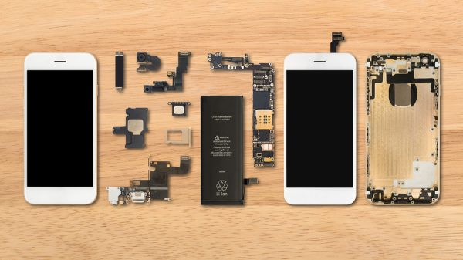

Slide 6
2. Abstraction
Abstraction is the process of hiding the complex implementation details of an object and exposing only the essential features.
It allows developers to interact with objects at a higher level, focusing on what an object does rather than how it achieves its functionality.
Abstraction simplifies the complexity of code and enhances its understandability.

Slide 7
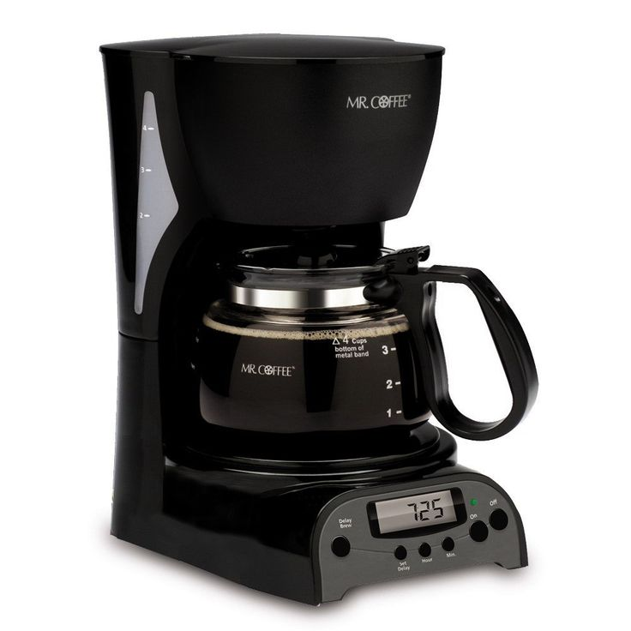
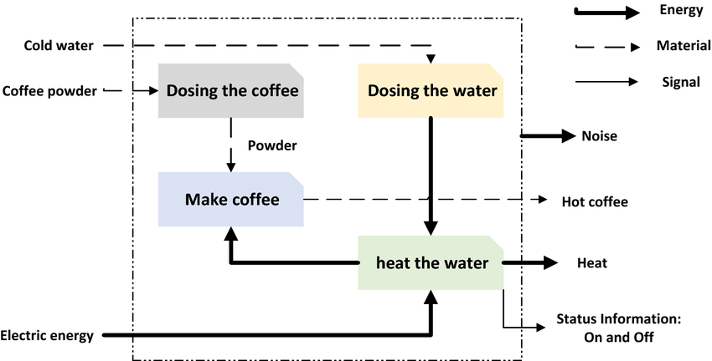
Object
Function

Slide 8
3. Inheritance
Inheritance is the capability of one class to derive or inherit the properties from another class. The class that derives properties is called the derived class or child class and the class from which the properties are being derived is called the base class or parent class. It represents real-world relationships well.
It provides the reusability of a code. We don’t have to write the same code again and again. Also, it allows us to add more features to a class without modifying it.
It is transitive in nature, which means that if class B inherits from another class A, then all the subclasses of B would automatically inherit from class A.

Slide 9
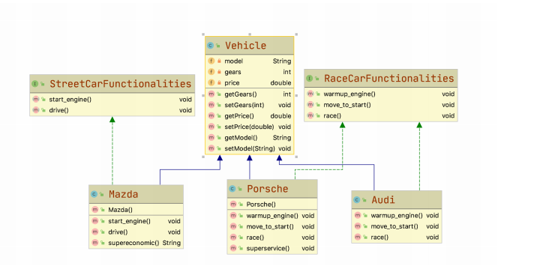

Slide 10
4. Polymorphism
Polymorphism allows objects of different types to be treated as objects of a common type.
It provides a unified interface for different classes, enabling them to be used interchangeably.
In programming, polymorphism means the same function name being used for different types. The key difference is the data types and number of arguments used in function.

Slide 11


Slide 12
Thank you

