Slide 1
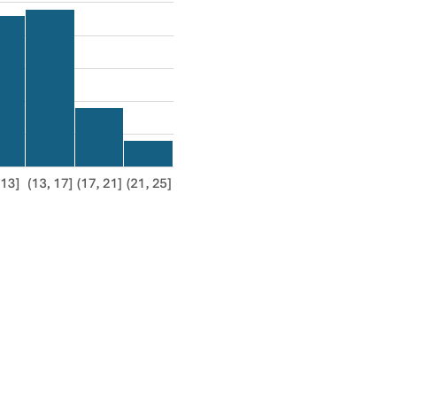
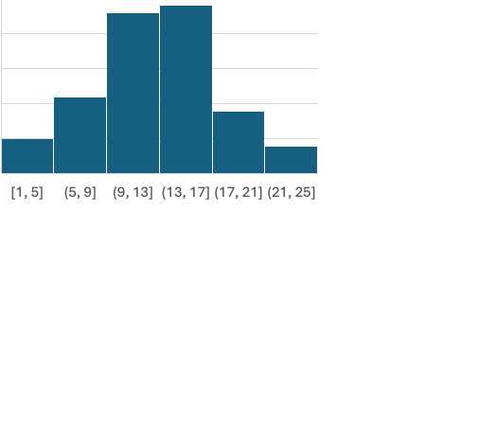
Diabetes
Age and BMI
Diet Type

Slide 2
HEALTH_METRICS
patient_id
hypertension
cholesterol_level
diabetes_pedigree_function
PATIENT
patient_id
age
gender
bmi
diabetes
LIFESTYLE
patient_id
diet_type
physical_activity_level
bmi

