Slide 1

Employee Portal Website Presentation
BY JASMIN WIND
CST310: SOFTWARE DEVELOPMENT (CSC2245A)

Slide 2

Purpose of the Project
EMPLOYEE PORTAL
HOME PAGE
REGISTRATION
Agenda
VIEW PROFILE
UPDATE PROFILE
SIGN OUT
ADMIN

Slide 3
Purpose:
Companies can use the portal to store employee data for:
Payroll
Employee information purposes
Assign Leaves
Assign project
etc..
Learning Experience to set up a system.
The Employee Portal
Utilizes PHP, HTML, PHPMYADMIN and Bootstrap for styles.

Slide 4
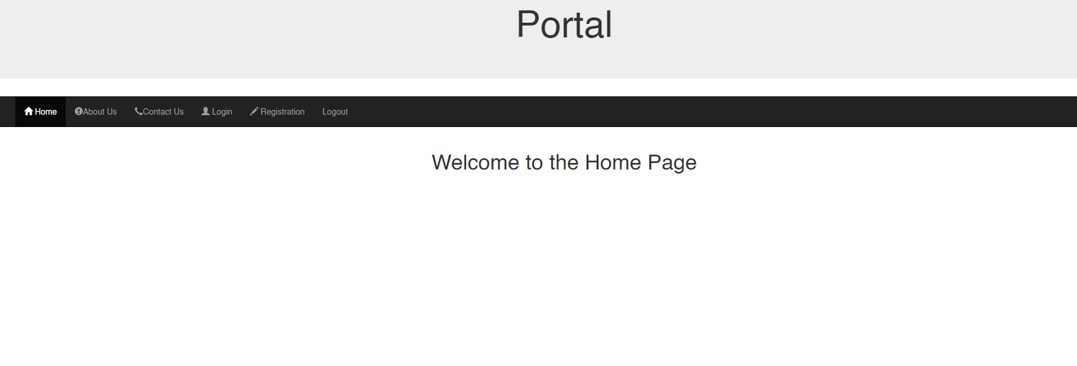
Homepage

Slide 5
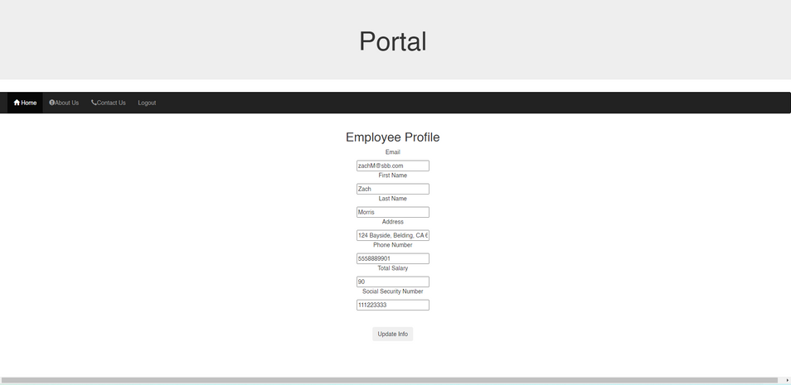
REGISTRATION
Employees can register
VIEW PROFILE
Employees can view the profile
UPDATE PROFILE
Employees can update the information or the password

Slide 6
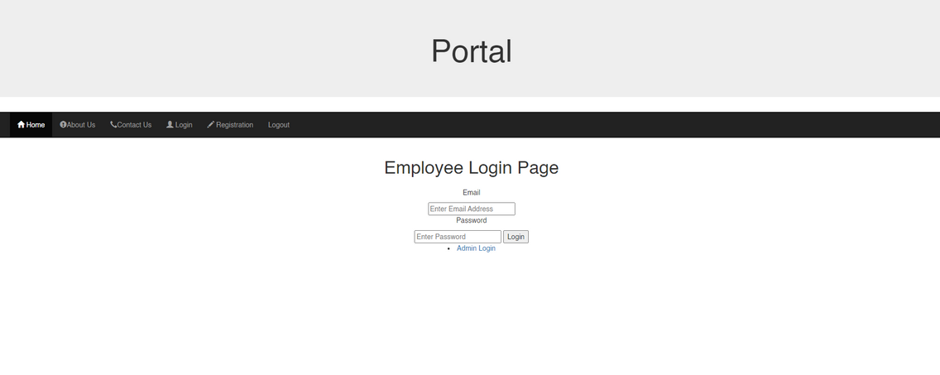
Sign out
The employee can sign out.

Slide 7
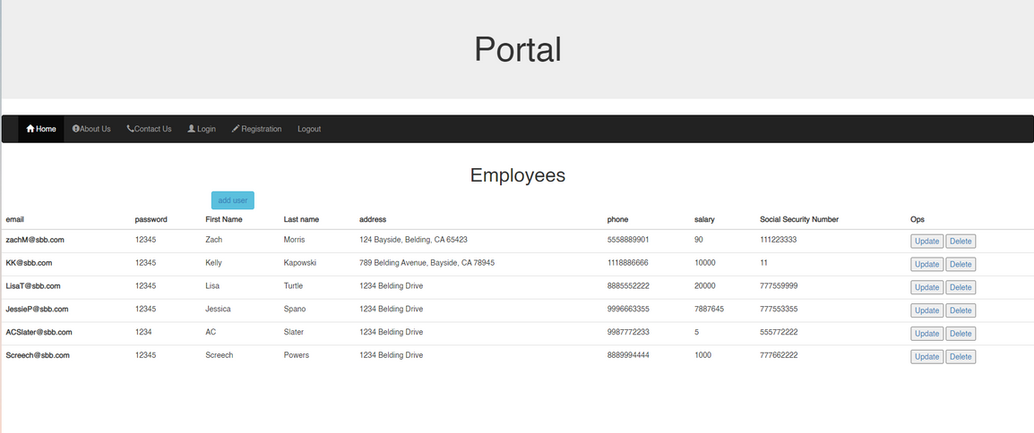
Admin Access
The admin can sign in and see the employees.
Admin

Slide 8
The End
THANKS FOR VIEWING THIS PRESENTION

Slide 9
References
Employee Management System in PHP. (2020, September 11). Retrieved from
1sourcecodr.blogspot.com: https://1sourcecodr.blogspot.com/2020/09/employee-managementsystem-in-php-mysql.html
geeksforgeeks.org. (2022, July 22). HTML form Tag. Retrieved from geeksforgeeks.org: https://www.geeksforgeeks.org/html-form-tag/
getbootstrap.com/. (n.d.). Buttons. Retrieved from getbootstrap.com/: https://getbootstrap.com/docs/5.2/components/buttons/
getbootstrap.com/. (n.d.). Tables. Retrieved from getbootstrap.com: https://getbootstrap.com/docs/4.0/content/tables/
stackoverflow.com. (2013, Augst 13). PHP parse/syntax errors; and how to solve them. Retrieved from stackoverflow.com: https://stackoverflow.com/questions/18050071/php-parse-syntax-errors-and-how-to-solve-them
Step, S. b. (2021, May 28). PHP CRUD || Create, Read, Update, Delete. Retrieved from youtube.com: youtube.com/watch?v=72U5Af8KUpA
W3Schools. (n.d.). PHP OOP - Classes and Objects. Retrieved from www.w3schools.com: https://www.w3schools.com/php/php_oop_classes_objects.asp

Slide 10
References Continued
www.geeksforgeeks.org/. (2022, May 19). How to Insert Form Data into Database using PHP ? Retrieved from www.geeksforgeeks.org/: https://www.geeksforgeeks.org/how-to-insert-form-data-into-database-using-php/
www.tutorialsteacher.com. (n.d.). Insert Data into Tables in SQL Server using INSERT Statement. Retrieved from TutorialsTeacher.com: https://www.tutorialsteacher.com/sqlserver/insert-data
Ycomp. (2016, Feb 29). Column count doesn't match value count at row 1. Retrieved from stackoverflow.com: https://stackoverflow.com/questions/18369252/column-count-doesnt-match-value-count-at-row-1

