Slide 1
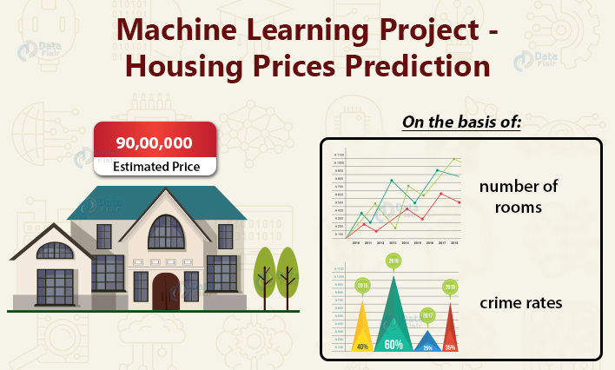
Jasmine Kaur Internship 18 Flip Robo Technologies

Slide 2
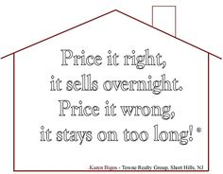
Why predicting the right price is important?

Slide 3
PROBLEM STATEMENT
A US-based housing company named Surprise Housing has decided to enter the Australian market. The company uses data analytics to purchase houses at a price below their actual values and flip them at a higher price. For the same purpose, the company has collected a data set from the sale of houses in Australia.
For this company wants to know:
Which variables are important to predict the price of variable?
How do these variables describe the price of the house?

Slide 4
MOTIVATION
Houses are one of the necessary need of each and every person around the globe and therefore housing and real estate market is one of the markets which is one of the major contributors in the world’s economy.
It is a very large market and there are various companies working in the domain.
Data science comes as a very important tool to solve problems in the domain to help the companies increase their overall revenue, profits, improving their marketing strategies and focusing on changing trends in house sales and purchases.
Predictive modeling, Market mix modeling, recommendation systems are some of the machine learning techniques used for achieving the business goals for housing companies. Our problem is related to one such housing company.

Slide 5
UNDERSTANDING THE PROBLEM
This machine learning problem is characterized as supervised learning.
SUPERVISED LEARNING: In supervised learning, we are given a dataset along with the correct output , and thus we are able to find a relationship between input and output.
REGRESSION PROBLEM: As we dealing with continuous target variable, it means that our goal to map input variable to some continuous function. This is called regression problem.

Slide 6
BUSINESS GOAL
You are required to model the price of houses with the available independent variables.
This model will then be used by the management to understand how exactly the prices vary with the variables.
They can accordingly manipulate the strategy of the firm and concentrate on areas that will yield high returns.
Further, the model will be a good way for the management to understand the pricing dynamics of a new market.

Slide 7
DATASET INFORMATION
The dataset 1168 rows and 81 columns. This means 1168 values for each of the feature and target variable.
There are 80 features and Sale Price is the target variable. As the target variable is a continuous variable, so it is a regression problem .
There are null values in the data.
There is presence of outliers and skewness in the data.
Some of the features are of object data type while others are numerical.

Slide 8
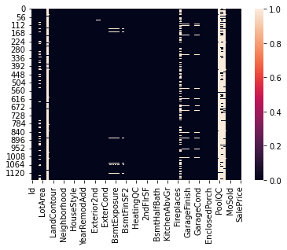
MISSING DATA
Missing data, or missing values, occur when no data value is stored for the variable in an observation. Missing data are a common occurrence and can have a significant effect on the conclusions that can be drawn from the data.

Slide 9
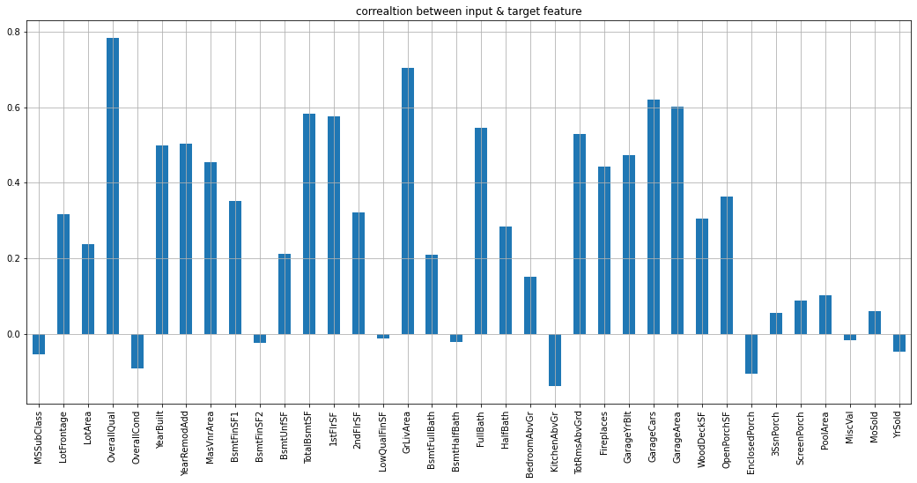
CORRELATION
Correlation is a statistic that establishes the relationship between two variables.
OverallQual column is most positively correlated with saleprice.
KitchenAbvGrd column is most negatively correlated with saleprice.

Slide 10
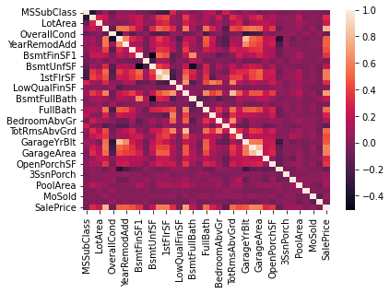
CORRELATION MATRIX
1. SalePrice is highly positively correlated with the columns OverallQual, YearBuilt, YearRemodAdd, TotalBsmtSF, 1stFlrSF, GrLivArea, FullBath, TotRmsAbvGrd, GarageCars & GarageArea.
2. SalePrice is negatively correlated with OverallCond, KitchenAbvGr, Encloseporch & YrSold columns.
3. Multicollinearity is present between various columns so using Principal Component Analysis(PCA) will be a great choice.

Slide 11
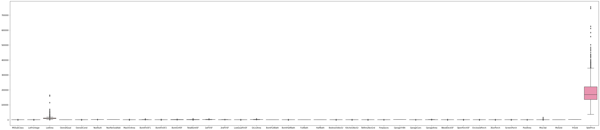
PLOTTING OUTLIERS
An outlier is an observation that lies an abnormal distance from other values in a random sample from a population.
OBSERVATION: Outliers are present in various columns. But applying z score and IQR method leads to huge amount of data loss.
Thus, we will not use these two methods to deal with the problem of outliers.

Slide 12
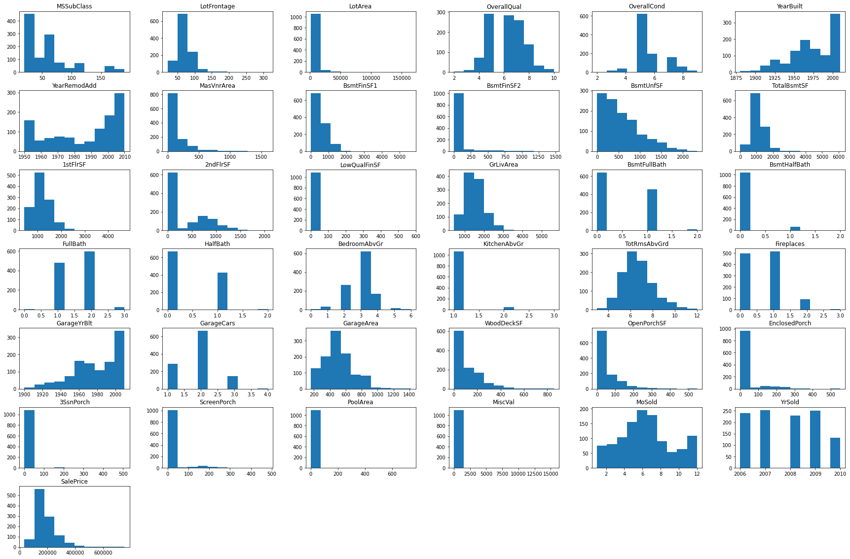
HISTOGRAM
OBSERVATION:
There are some unusual values in histograms.
The distribution is not normal for some columns.
This might be the reason of potential outliers.

Slide 13
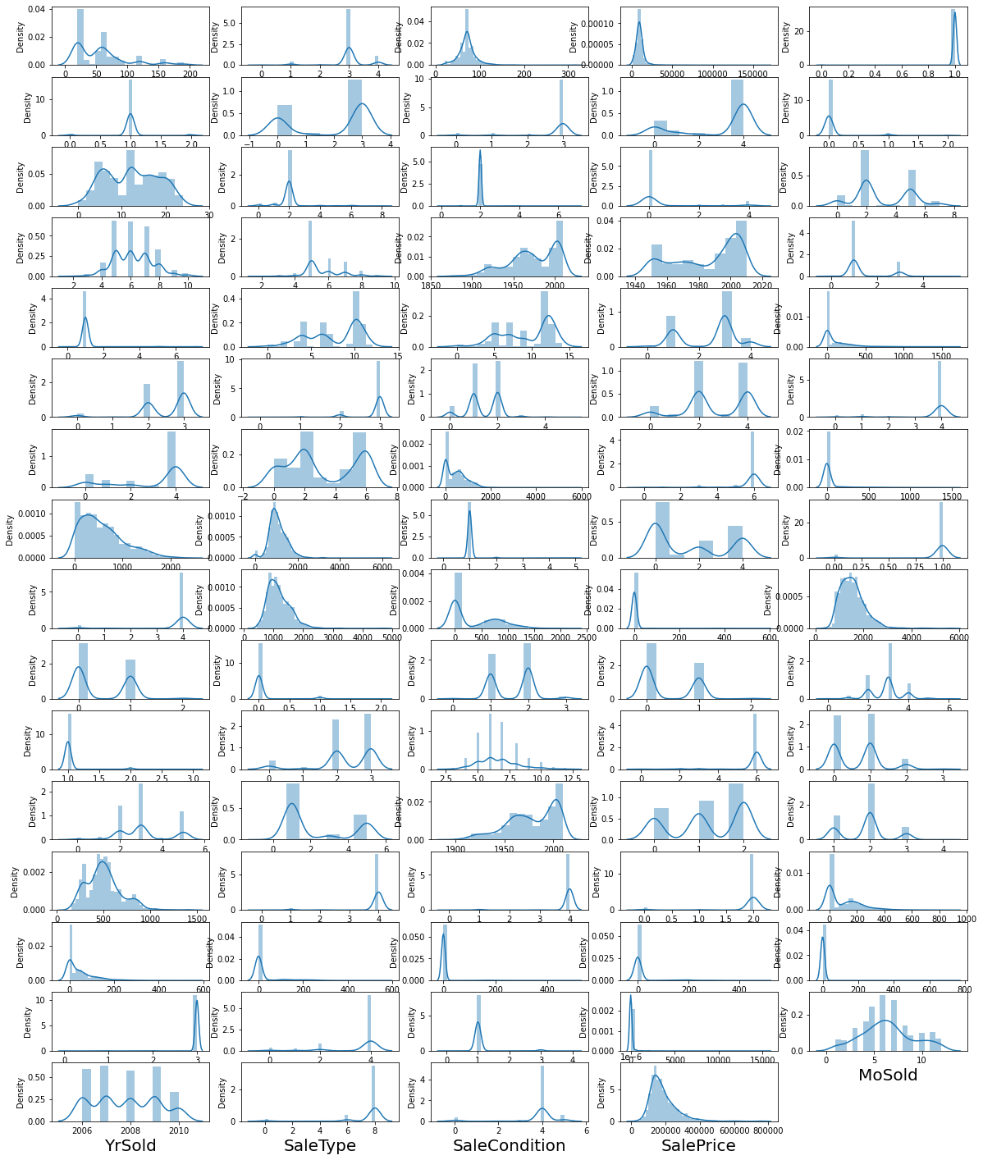
SKEWNESS
Skewness represents an imbalance and asymmetry from the mean of a data distribution.
OBSERVATION:
Many features have skewed data.
We have removed the skewness using log transformation.

Slide 14
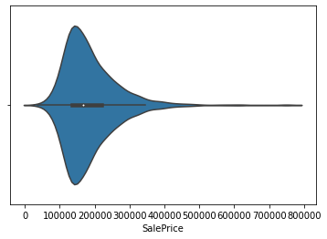
EXPLORING OUTPUT VARIABLE
The target variable of a dataset is the feature of a dataset about which you want to gain a deeper understanding. A supervised machine learning algorithm uses historical data to learn patterns and uncover relationships between other features of your dataset and the target.
OBSERVATION:
In this dataset, the target/output variable is sale price.
The data suggests that most of the sale price of houses ranges between 140000 and 23000
The maximum sale price is around 800000

Slide 15
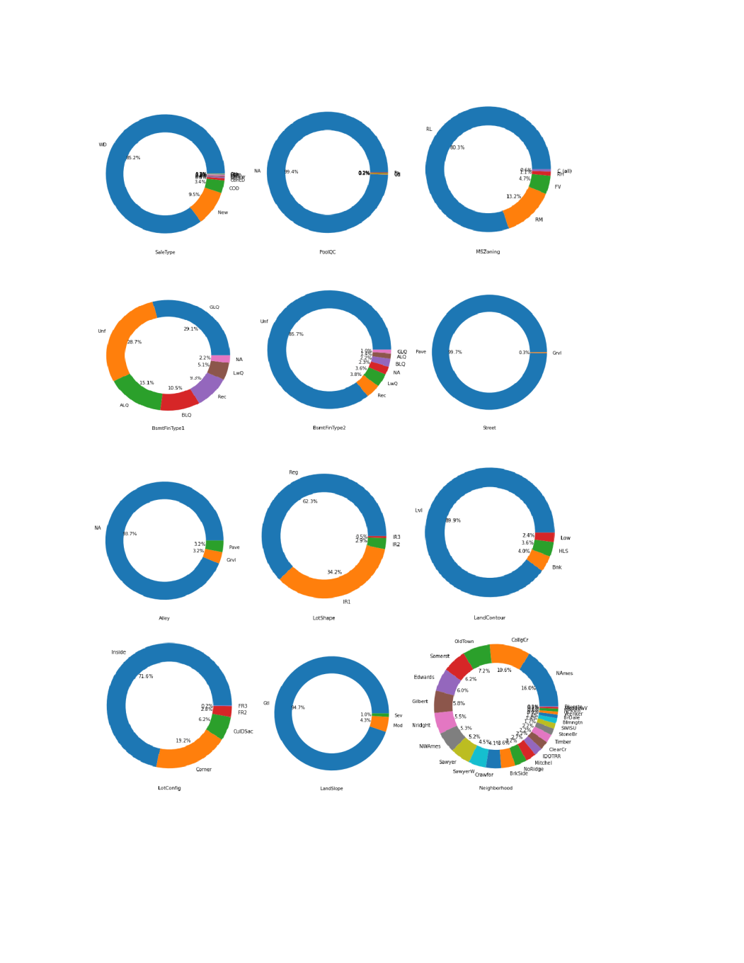
EXPLORING CATEGORICAL FEATURES
A categorical variable is a variable that can take on one of a limited, and usually fixed number of possible values
OBSERVATION:
Some categorical features have most data with one of the categories.
Some of the categorical features are evenly distributed.

Slide 16
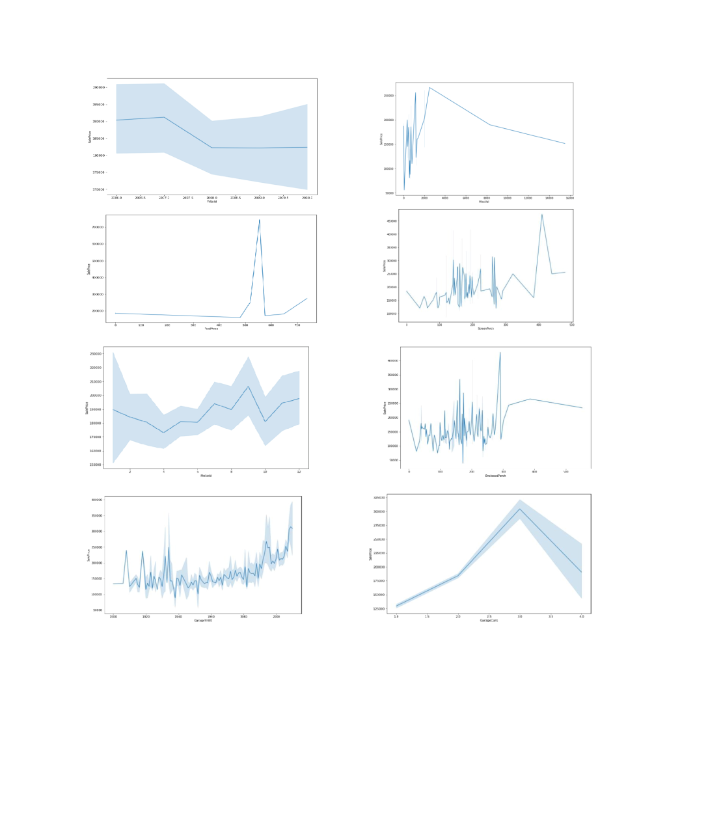
EXPLORING CONTINUOUS FEATURES
If a variable can take on two or more distinct real values so that it can also take all real values between them (even values that are randomly close together). In this case, the variable is continuous in the given interval
Some continuous features have strong pattern in a particular direction
Some of them are random and do not have a specific pattern

Slide 17
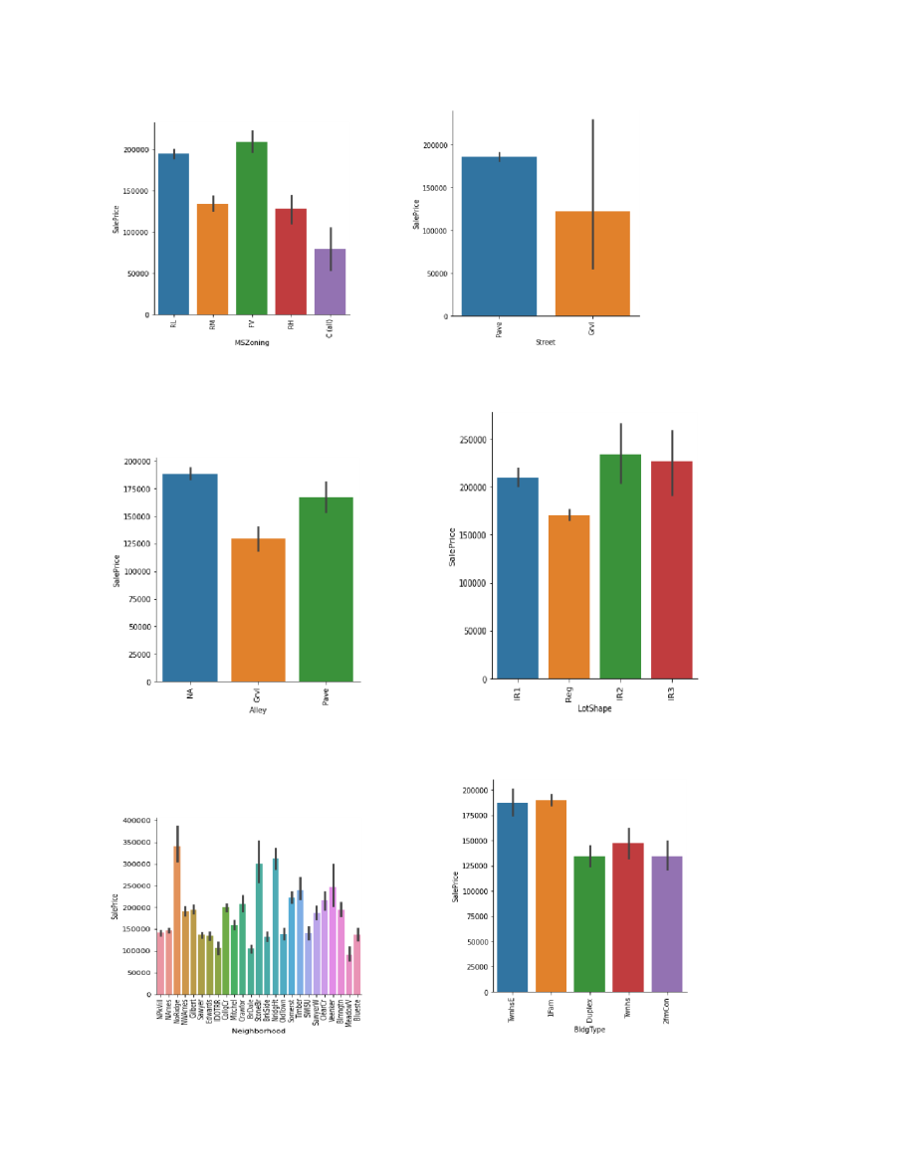
BAR GRAPHS
The grouped bar graph is also called the clustered bar graph, which is used to represent the discrete value for more than one object that shares the same category
OBSERVATION:
There are different distribution of each feature with corresponding sale price variable
The target variable sale price is maximum with FV MS Zoning, Pave Street, IR2 Lot Shape, HLS Land Contour, No Ridge Neighborhood

Slide 18
ASSUMPTION AND TOOLS USED
ASSUMPTIONS:
There is presence of multicollinearity between various columns. Thus, PCA is used.
We have removed columns with only one category or columns like ID as these are assumed to irrelevant in the process of analysis.
TOOLS USED:
Hardware: 4 GB RAM, Intel 13 processor
Software:
Anaconda(64 bit)
Jupytor notebook
Python
MS-Office
Google Chrome Web Browser

Slide 19
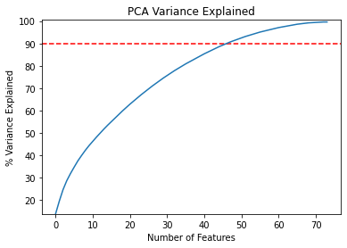
PRINCIPAL COMPONENT ANALYSIS
Principal Component Analysis (PCA) uses an orthogonal transformation that converts a set of correlated variables to a set of uncorrelated variables
OBSERVATION:
As per PCA and variance analysis, we need 45 independent features.
Thus, in order to minimise the data loss and to use a large percentage of information, we took 45 features for our final model.

Slide 20
REGRESSION ALGORITHM USED
Linear Regression
Random Forest Regressor
Kneighbors Regressor(n_neighbors = 4)
Gradient Boosting Regressor

Slide 21
EVALUATION
R2 SCORE(COEFFICIENT OF DETERMINATION): It is the proportion variation in the dependent variable that is predictable from the independent variables.
MEAN SQUARE ERROR(MSE): MSE calculates mean or average of the squared differences between predicted and expected target variable in a dataset.

Slide 22
REGRESSION ALGORITHM RESULT
INDEX | Modeling Algorithm | R2 score | MSE
0 | Linear Regression | 0.796679 | 1.719831e+09
1 | Random Forest | 0.792607 | 1.754272e+09
2 | Kneigbors Regressor | 0.662880 | 2.851595e+09
3 | Gradient Boosting Regressor | 0.816165 | 1.555002e+09

Slide 23
CROSS VALIDATION SCORE
Index | Modeling Algorithm | CV SCORE
0 | Linear Regression | 0.759852
1 | Random Forest | 0.785777
2 | Kneighbors Regressor | 0.693756
3 | Gradient Boosting Regressor | 0.812586

Slide 24
DIFFERENCE BETWEEN r2 SCORE AND CROSS VALIDATION SCORE
INDEX | MODELING ALGORITHM | R2 SCORE | CV SCORE | DIFFERENCE
0 | LR | 0.796679 | 0.759852 | 0.036827
1 | RF | 0.792607 | 0.785777 | 0.006831
2 | KNN | 0.662880 | 0.693756 | -0.030876
3 | GB | 0.816165 | 0.812586 | 0.003580

Slide 25
INTERPRETATION OF THE RESULTS
The difference between the r2 score and cv score is minimum for the gradient boosting regressor.
So, we will apply hyperparameter tuning on gradient boosting regressor.
After applying grid search CV, we got 81.33% r2 score.

Slide 26
CONCLUSION
By using machine learning algorithm, we predicted the housing prices.
We did data cleaning, handled missing values, removed skewness, performed PCA, and applied regression algorithm.
The hyperparameter tuning is applied on the best model i.e. gradient boosting.

