Slide 1
MICRO-CREDIT LOAN DEFAULTER PROJECT
SUBMITTED BY:
Jasmine Kaur
Internship 18
Flip Robo Technologies

Slide 2

One should always remember that:

Slide 3
PROBLEM STATEMENT
A Microfinance Institution (MFI) is an organization that offers financial services to low income populations.
MFS becomes very useful when targeting especially the unbanked poor families living in remote areas with not much sources of income. The Microfinance services (MFS) provided by MFI are Group Loans, Agricultural Loans, Individual Business Loans and so on.
Many microfinance institutions (MFI), experts and donorsare supporting the idea of using mobile financial services (MFS) which they feel are more convenient and efficient, and cost saving, than the traditional high-touch model used since long for the purpose of delivering microfinance services.
Though, the MFI industry is primarily focusing on low income families and are very useful in such areas, the implementation of MFS has been uneven with both significant challenges and successes.
Today, microfinance is widely accepted as a poverty-reduction tool, representing $70 billion in outstanding loans and a global outreach of 200 million clients.

Slide 4
ANALYTICAL PROBLEM
The target variable is a two class label where label 1 represents non-defaulters and label 0 represents defaulters. Thus, this is a binary classification problem.
We have to predict the probability of repayment of loan, that is, whether the customer will repay the loan within 5 days or not.
The criteria is that if the loan amount is 5 then the payback amount is 6 and if the loan amount is 10 then the payback amount is 12.

Slide 5
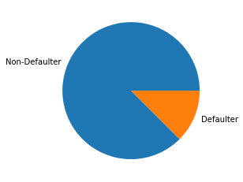
EDA AND VISUALIZATION- TARGET VARIABLE

Slide 6
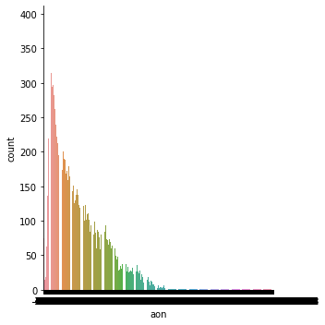
FEATURE VARIABLE- AON

Slide 7
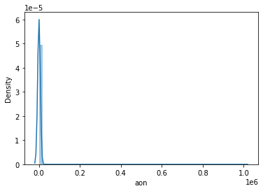
FEATURE VARIABLE- DISTRIBUTION OF AON

Slide 8
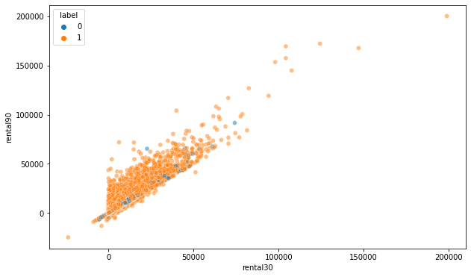
FEATURE VARIABLE- SCATTERPLOT

Slide 9
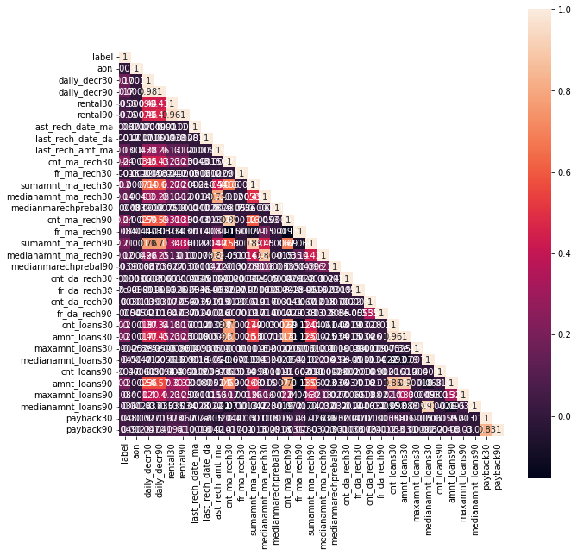
CORRELATION

Slide 10
ASSUMPTIONS AND
We have assumed that it is not possible to negative values in various features. Those features must have minimum values as zero. So, we have applied it in the project.
We have assumed that outliers distort our analysis, so we have applied tools to remove them from the data.
We have assumed that if any column has only one unique value then it will not help us in analysing, so we have removed it.
We have assumed that the number of the customer cannot tell anything about the behaviour of the customer related to the repayment of the loan, so we have removed it.
We have assumed that imbalanced class distribution of the target variable will give biased results, so we have balanced the class using SMOTE.

Slide 11
CLASSIFICATION ALGORITHMS USED
1. KNEAREST NEIGHBORS
2. RANDOM FOREST CLASSIFIER
3. DECISION TREE CLASSIFIER
4. GRADIENT BOOSTING CLASSIFIER

Slide 12
EVALUATED METRICS:
1. Accuracy score
2. ROC_AUC_curve
3. F1 score
4. Classification report
5. Confusion Matrix

Slide 13
FINAL MODEL
Comparing the accuracy score and cross validation score, we got that gradient boosting classifier gives the least difference.
So, we applied hyper-parameter tuning on gradient boosting classifier and received the score of 80.22%.

Slide 14
CONCLUSION
The project demonstrated the use of machine learning on a challenging dataset to analyse the ability of repaying the loan.
To achieve the best result, data pre-processing is performed very carefully.
We have applied PCA and selected top 10 features as they were giving more than 95% of the information.
Random forest was also performing very well but we took gradient boosting classifier for applying hyper-parameter tuning.

Slide 15
THANK YOU!

