Slide 1

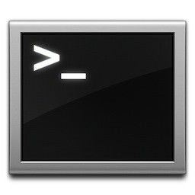

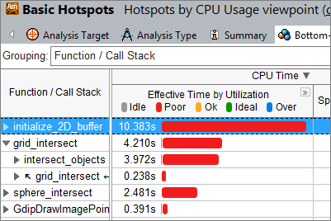
SSH for dev
Program bin
Profiling results;
program src & bins
Profiling results
PC (viewer)
Win/OSX/Linux
w/ VTune
Server (target+dev)
PC (viewer+dev)
Linux w/ VTune
& build env
Server (target)

Slide 2


Worker threads
Worker threads
Our “bigtable”
H(K)
The glib’s hashtable
… …
N hashtables

Slide 3
worker 0
worker 1
worker 2
worker N-1
main
main
The init phase
The parallel phase
The cleanup phase (+validating)

Slide 4
Input:
an array of keys, unsorted
key
worker
threads
output: a doubly linked list, unsorted
list head
key
key
key
key
key

Slide 5
Input:
an array of keys
key
list head
key
key
key
key
key

