Slide 1
Impact Analysis of Covid-19 on the Housing Market of Shelby County, TN
DATA 512: Human-centered Data Science
Presenter: Jasmine Bhalla

Slide 2
MOTIVATION
Housing Market faced severe brunt of the pandemic combined with anxious buying, remote work, relocation to suburbs, piling up of recession, etc.
Pandemic created uncertainty in the overall housing market- created short periods of bumps and falls. It was hard to understand and analyze where the house market was going NEXT!

Slide 3
QUESTIONS BEING EXPLORED
Did Covid-19 impact the housing market for Shelby County, TN with respect to housing inventory, sale price, number of listings? If yes, then HOW?
How did Covid-19 impact the mortgage interest rates and how did that in turn impact the housing market?
How was the overall housing market trend impacted during covid-19?

Slide 4
WHY IT IS HUMAN-CENTERED?
This problem is human-centered in two-fold way:
In terms of cause, anxiety from people, sudden change in the lifestyle, etc. created the effects and uncertainty that we saw in the housing market.
In terms of the effect/result, we saw that it directly impacted us in all the aspects- be it emotionally, financially or physically.

Slide 5
THREE MAIN DATA SOURCES
The Housing Market Data from Redfin's Data Center (Weekly and Monthly).
30-year Mortgage Interest Data
US Covid cases Data from the Kaggle repository of John Hopkins University COVID-19 data.

Slide 6
METHODS USED
Python for weekly analysis of the impact of Covid on:
Housing Inventory
Median Sale Price
New Listings
New homes sold
- Python for interest-rate and covid-19 analysis
Simple Linear Regression to compare predicted and actual housing prices for the analysis timeline (February 2020 to October 2021)

Slide 7
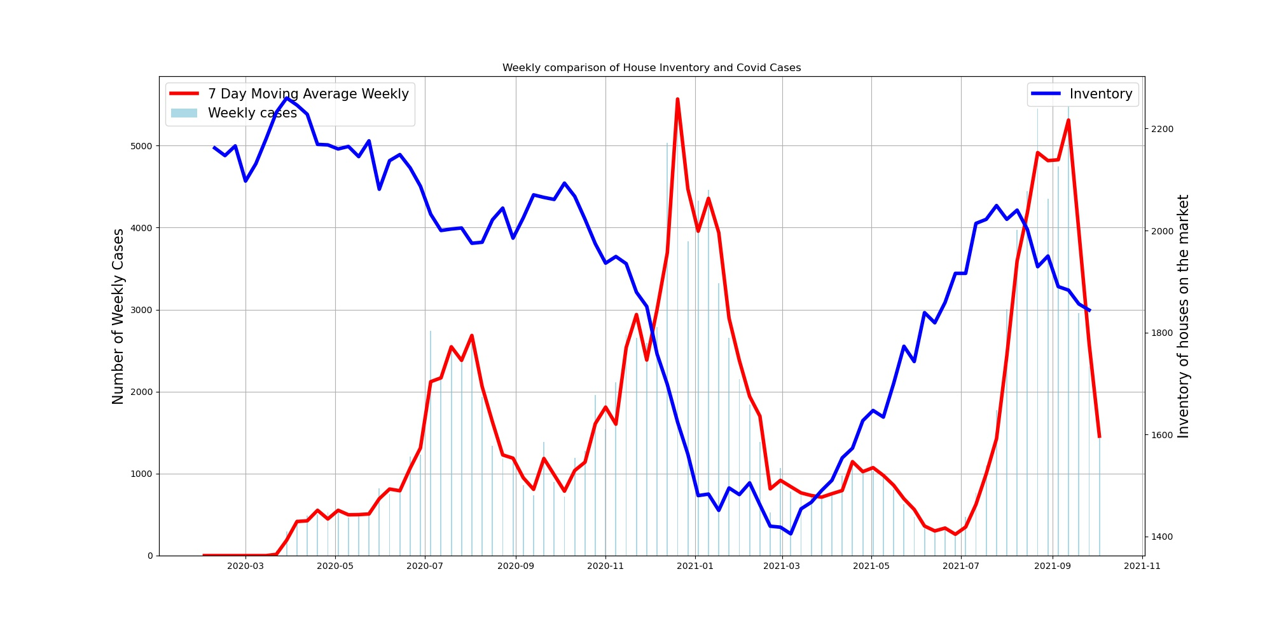
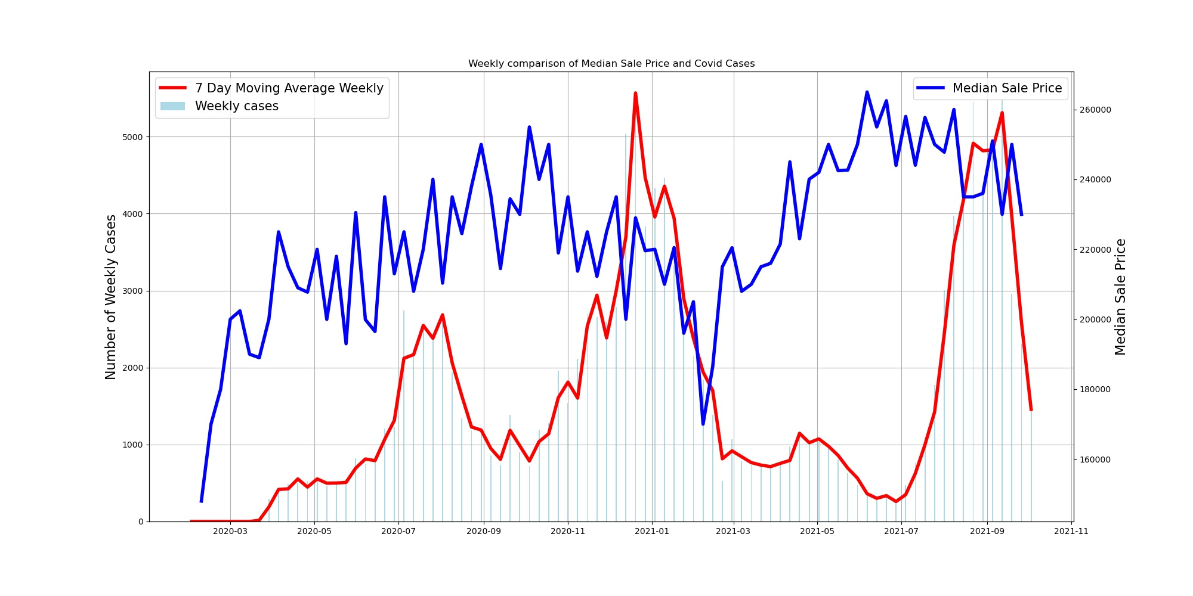
RESULTS
Weekly Analysis: Inventory and Median Sales Price
- Sharp drop in the housing inventory in Q1 of 2021 after which it began to recover and bounce back. (Graph 1)
- The median sales price show an upward trend after Q1 of 2021 when the covid cases went down. (Graph 2)

Slide 8
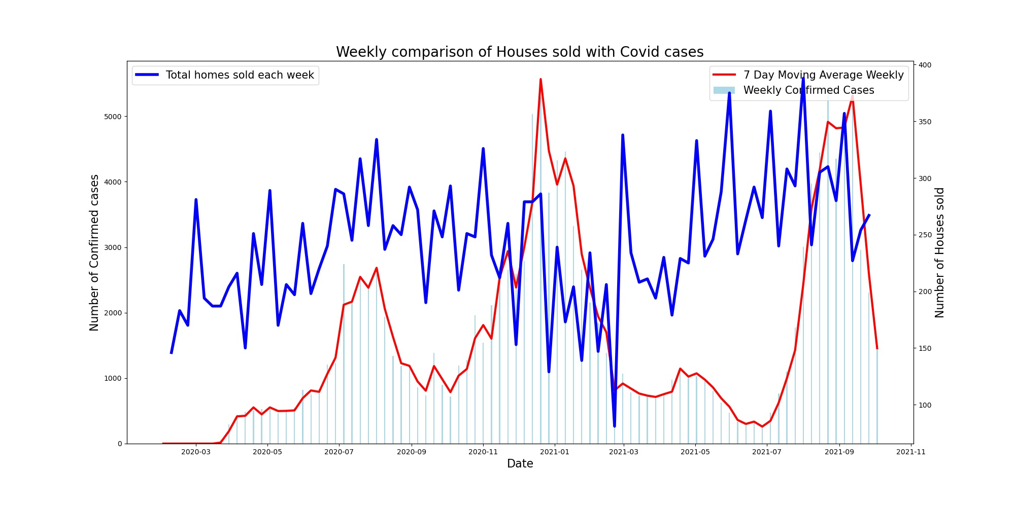
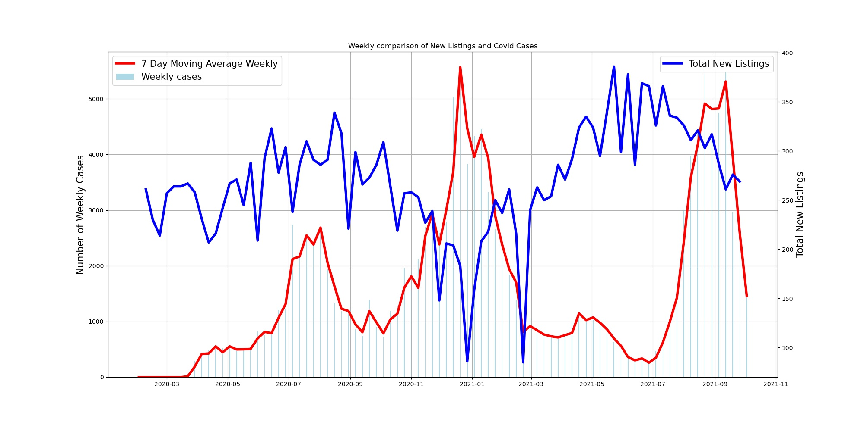
RESULTS
Weekly Analysis: Homes Sold and New Listings
Houses sold show an overall very volatile trend. Sharp drop again in Q1 of 2021. The average days for a house on market kept increasing.(Graph 1)
The new listings increased with the decrease in the number of cases. (Graph 2)

Slide 9
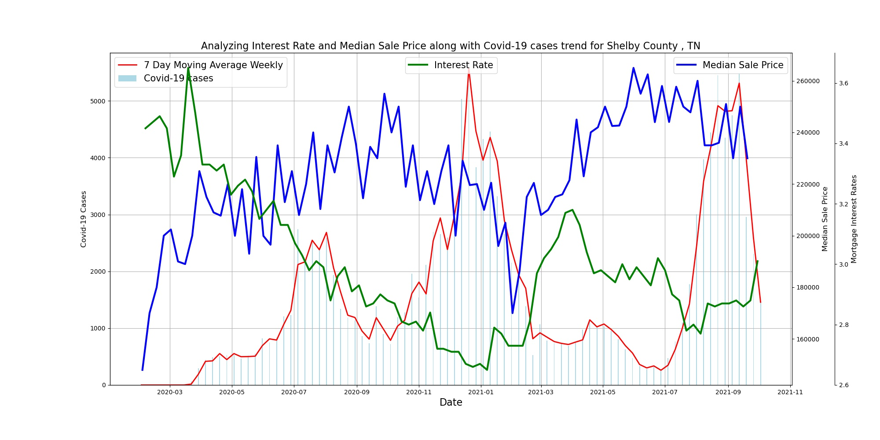
RESULTS
Interest Rates <> Covid <> Sale Price
Sharp drop in the mortgage interest rates with the spike in covid cases followed by a recovering trend with the decline in latter.
We see the sale prices remain high only except the sharp drop in Q1 of 2021.

Slide 10
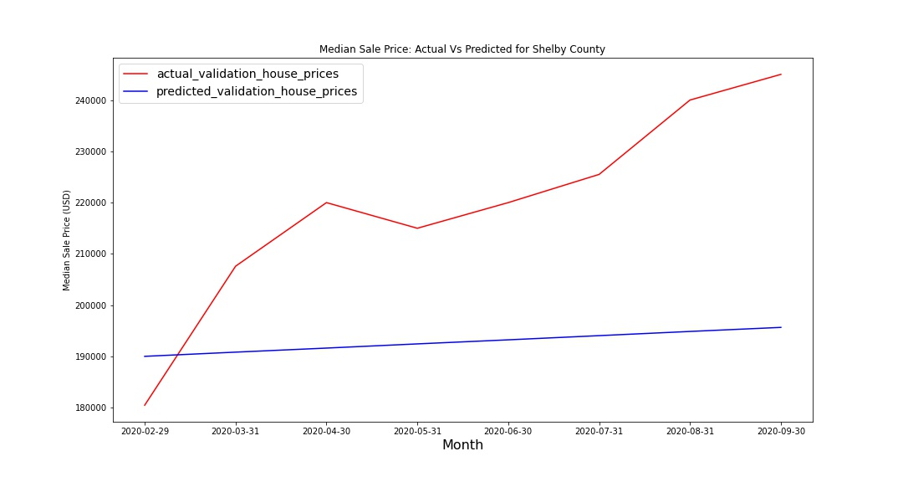
RESULTS
LINEAR REGRESSION
Performed Simple Linear Regression to predict housing prices for 2020- 2021 and compared it with the actual housing prices.
The price increase trend in Predicted and Actual housing prices varies significantly.
Period as X, Median sales price as y
Test : Train Split- 75:25

Slide 11
IMPLICATIONS
The results matter because it clearly represents the chaos in the housing market during Covid-19.
This led to lifestyle changes for many people especially the young millennials population who were the primary home buyers during this time.
‘Rise of the Rest’: The pandemic helped spread the sky-high housing prices of coastal hubs to other cities across the US.
Added even more volatility to an already existing housing bubble.

Slide 12
Thanks!

