Slide 1
Machine Learning Pipeline Analyzer (MLPA)
CS 515
Winter 2022
Aniket Fadia
Jasmine Bhalla
Sravan Kumar Reddy Hande
Tharun Kumar Reddy

Slide 2
Overview …
MLPA is a Machine Learning pipelines’ analyzer, visualizer, and suggestor package
User can either manually specify their model or use a downloaded .pkl file to:
Get an outline diagram for the pipeline (.show)
Get a detailed pipeline diagram with hyperparameters (.show_params)
Get the best pipeline/model (.suggest)

Slide 3
Motivation
To provide for :
The time and again need of manually visualizing pipelines through flowcharts which is often infeasible and hard to understand
Different scope needs by providing an overview pipeline diagram along with the detailed hyperparameter diagram
Getting the most effective and accurate ML model based on the user’s specified parameters

Slide 4
show
show() function is catered to the high-level needs of the user and outputs an outline diagram of the model’s pipeline for purposes such as documentation.
Comparison Package: ArgusEyes
ArgusEyes is a wrapper around mlinspect that extracts ML pipelines and enables a set of automated issue detection and data refinement techniques.

Slide 5
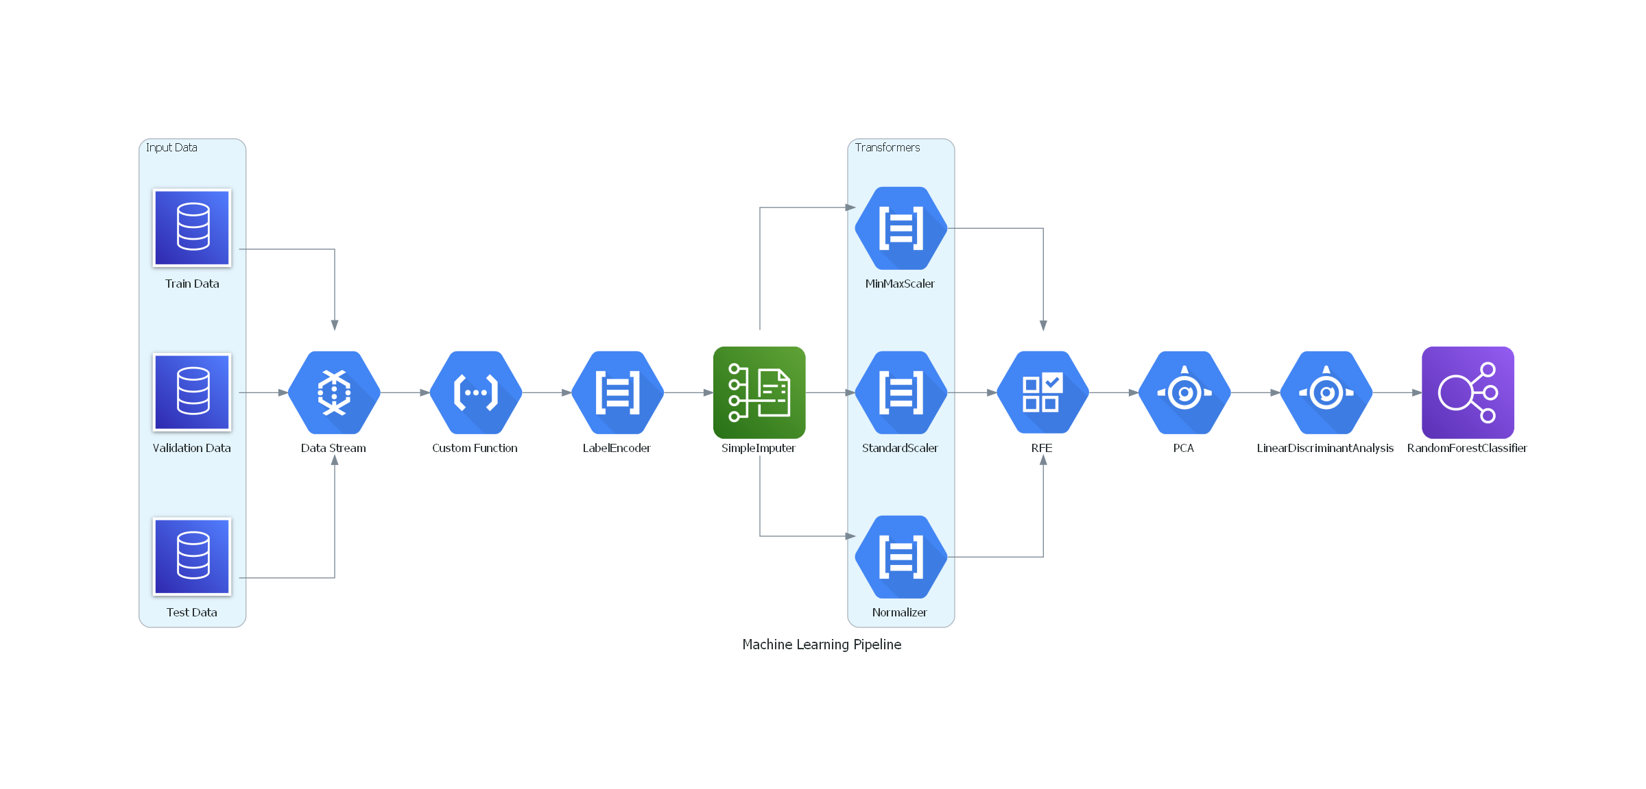
Outline Diagram

Slide 6
show_params
show_params() function is catered to deeper-level needs of the user and outputs a detailed hyperparameter diagram of the model’s pipeline for further analysis and understanding.
Comparison Package: graph from AutoMLSearch (EvalML library)
Graph from AutoMLSearch displays the component graphs that represent and describe the flow of data.

Slide 7
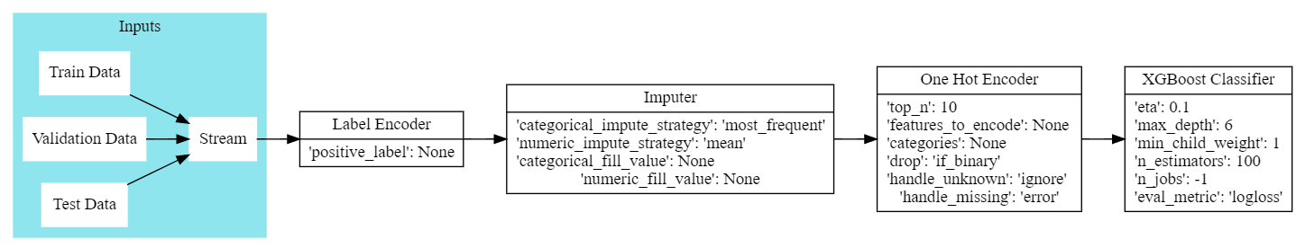
Detailed Pipeline Diagram with hyperparameters

Slide 8
suggest
suggest() function is a wrapper on top of EvalML to search for the most effective and accurate pipeline components and outputs the best pipeline model for the user. Provides the following capabilities for the user:
Looking at just the pipeline components (suggest_type='fe')
Looking at just the model aspect of the pipeline (suggest_type='model')
Full Model with pipeline components/features (suggest_type='all')
Comparison Package: AutoMLSearch.search
AutoML searches for ML model or models to fit the dataset during which it explores different combinations of model type, model parameters and model architecture.

Slide 9
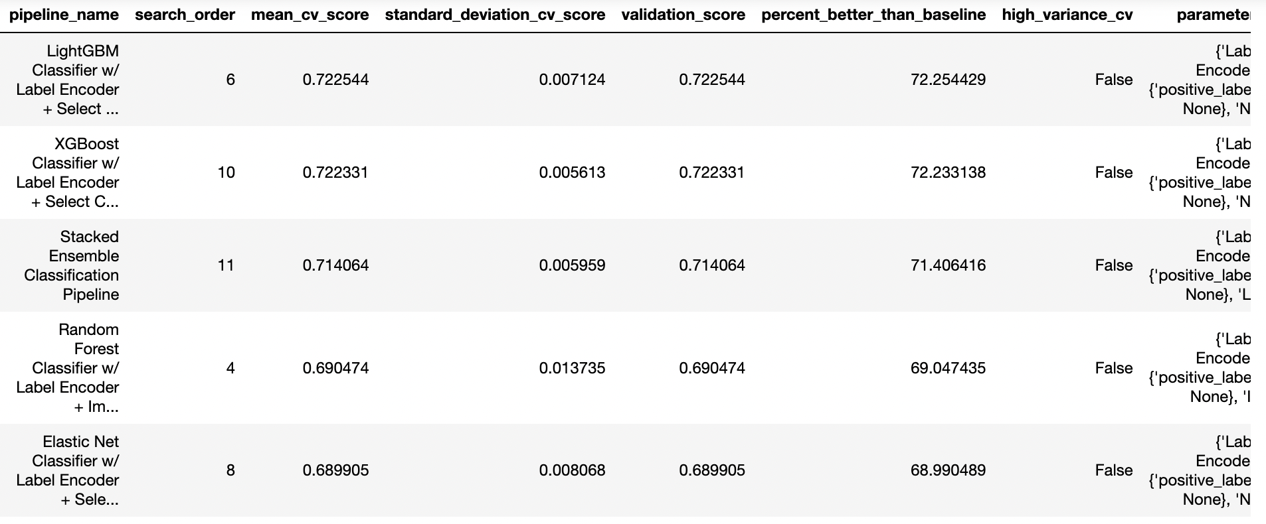
Best Pipeline Model

Slide 10
Design Principles Applied
Abstraction
Coding Style
PEP8
Docstrings
Modular Design
‘Somewhat General Purpose’ Module
Deep Modules
Separation of concerns
Reusability/Extensibility
Intuitable
Version Control
Exception Handling
Support for automated CI/CD using Travis
Unit testing and coverage for quality assurance

Slide 11
Unit test
Unit tests for the Pipeline Diagram module
Check return type of objects created during the pipeline steps
Test individual functionalities like saving model architecture file and model hyperparameter file
Unit tests for Pipeline Suggest module
Test for fit function to make sure proper parameter initialization and train test split for the dataset

Slide 12
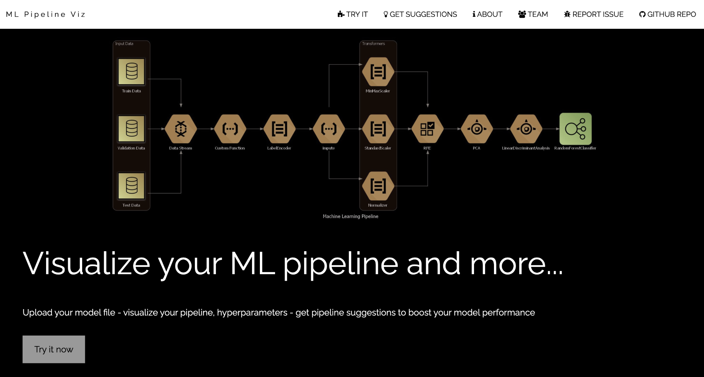
ML Pipeline Viz
A simpler interface for the user to drop the .pkl file directly without the need to install the dependencies or do any coding!

Slide 13
Future Works
Although currently MLPA already supports feature engineering to some extent, however, with expandability as one of the project goals, we plan to add more and specific capabilities catered to the following areas:
Feature Engineering
Feature Extraction/Selection
Feature Reduction
For project extension, one possible functionality could be the capability for the user to specify the engine that they want to use for their model (example: TPOT, EvalML) and run the MLPA package on top of that engine.

Slide 14
Thank You!
Questions???

