Slide 1
IMPLEMENTATION OF SMART HOME USING CISCO PACKET TRACER

Slide 2
AGENDA
Introduction​
Problem Statement
​Methodology
Implementation
Result & Interpretation
​Summary​

Slide 3
Introduction
Smart home is a living home that include smart object to improve home activities in advance, that can be automating activities of home without users’ involvement such as monitoring home environment condition by various sensor (Temperature, Humidity, smoke, wind, sound) then ventilate the environment based on sensor information. Smart home can provide different function rather than providing safety that is security by providing more automate security using different alarm system such siren sound, LCD display and sending email to legitimate user if security issue is detected by sensor. Home automation states managing and controlling home objects by using micro-controller or computer technology. Automation is popular because it provides ease, efficiency and secure environment. In this project, all smart appliance is registered to home gateway and controlled by legitimate person. Smart Home reduces user's involvement in monitoring home settings and controlling home appliances by including different sensor in home automation.

Slide 4
PROBLEM STATEMENT
The objective of this research in smart home technology is to acquire knowledge and understanding to build a low cost embedded system in which mobile controllers such as smart phones, laptops, PCs, etc. can be used to automate the entire home. In this system, the user will have remote access and control over all the system present in the house.
Home automation provides security, energy efficiency and ease of use. Hence, it is adopted more.

Slide 5
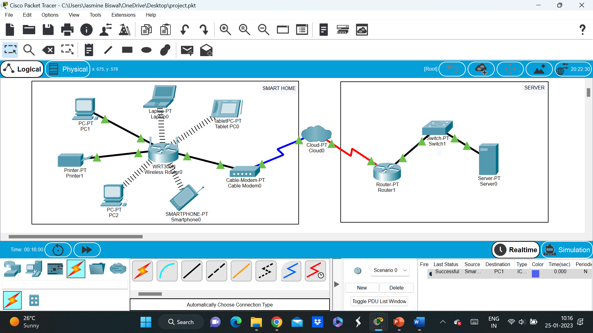
METHODOLOGY
Smart Home
Server

Slide 6
IMPLEMENTATION
Connect all the components according to the given topology.
Assign IP Address to the components of the smart home, i.e., PCs, Wireless Tablet, Laptop and Smartphone.
Check connectivity of all the components using ping.

Slide 7
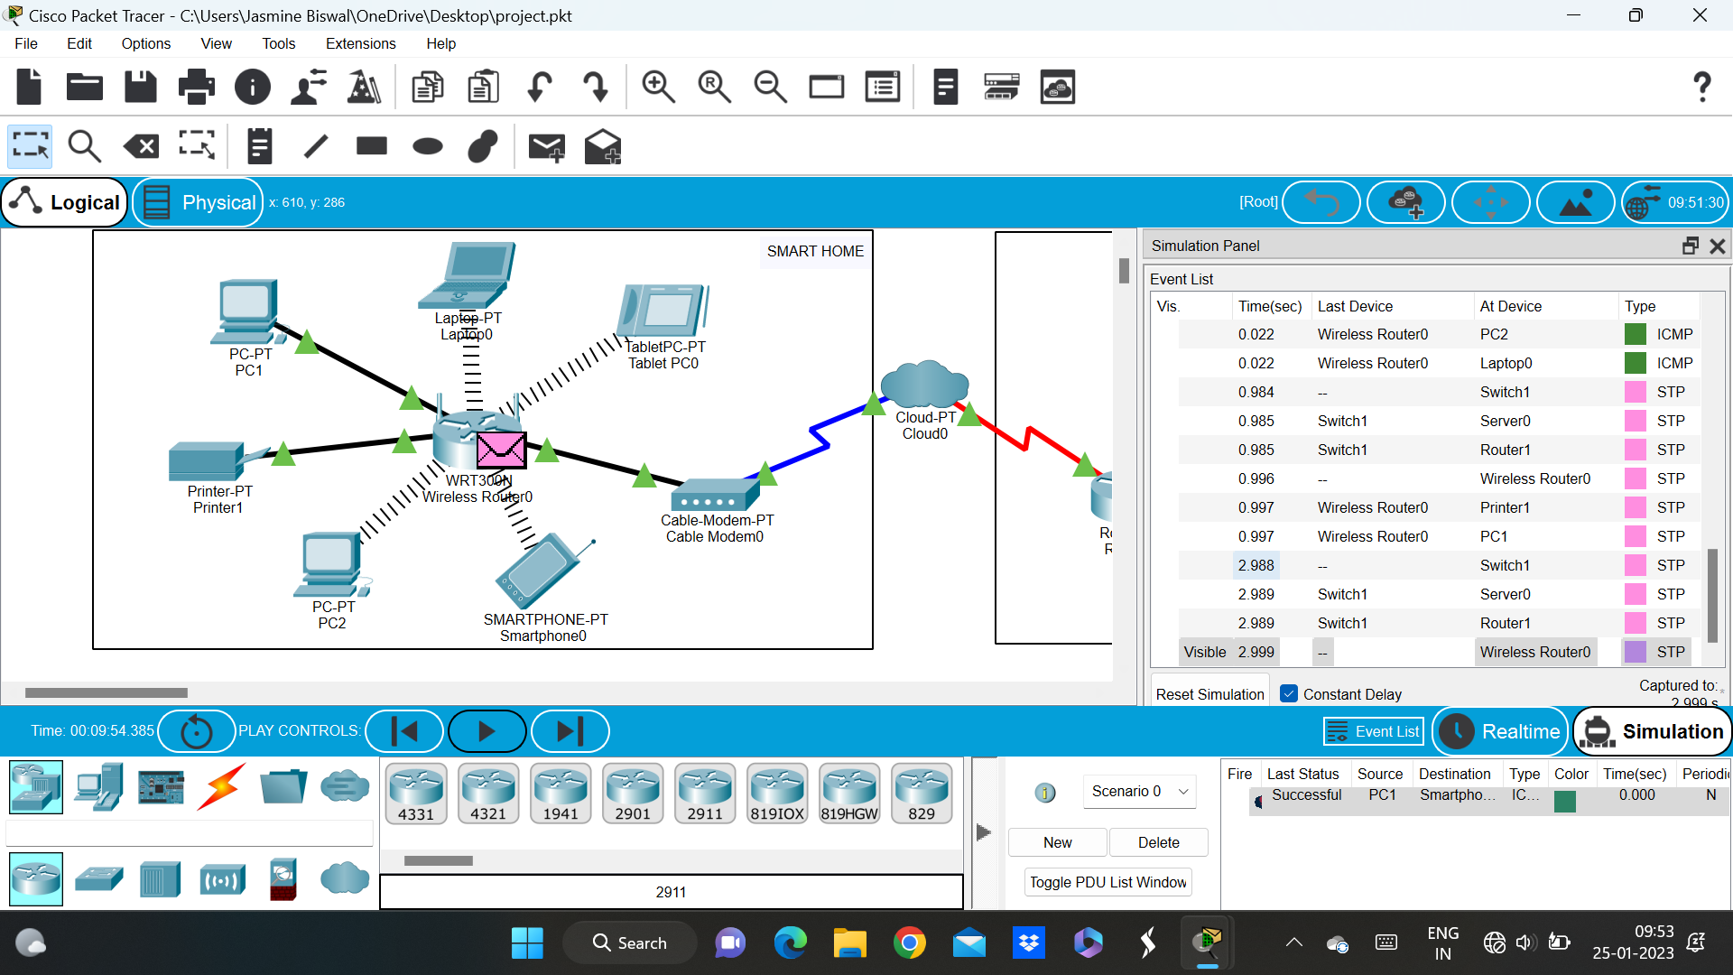
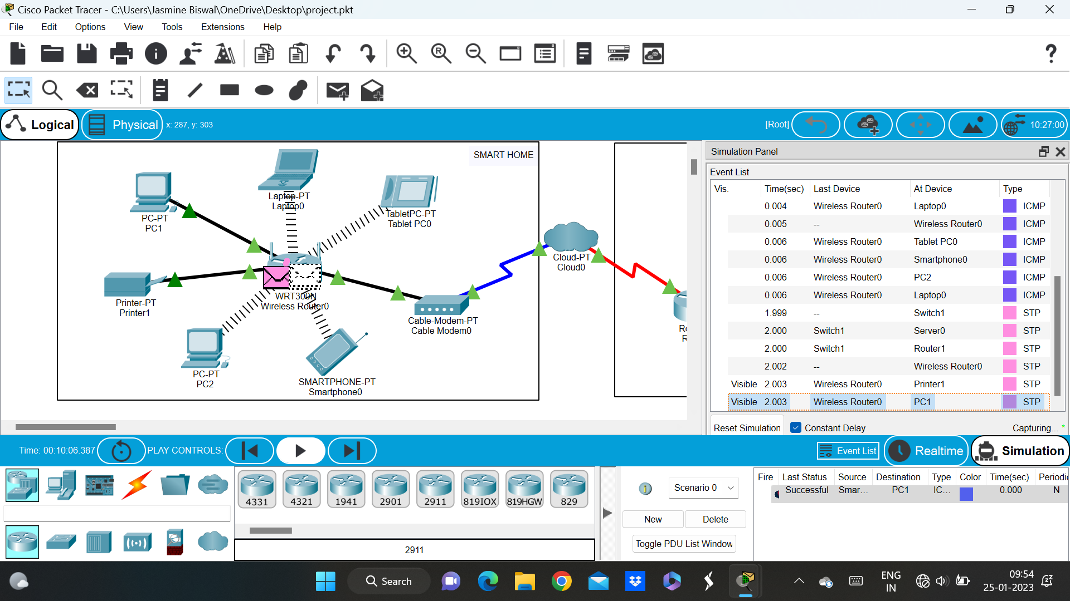
RESULT & INTERPRETATION
Here, we’ve sent packet from smartphone to PC1, which was successful.
Here, we’ve sent packet from PC-1 to smartphone, which was successful.

Slide 8
SUMMARY
In this article, we used the latest cisco packet tracer version to introduce smart home, as this version includes numerous IOE devices. We used the home portal for home automation and record smart devices for monitoring them and Microcontroller (MCU-PT) to connect various sensors as well as IOE devices. MCU moreover offers computing environment for different devices and different language of programming.

