Slide 1
FPGA Based Convolutional Encoder for Reliable Communication
Name | USN
Jasmine Jevita Dsouza | 4SO24EC048
Jeevan R | 4SO24EC051
Karthik | 4SO24EC057

Slide 2
PLANNING
Start date :March 12 2026
End date: May 2 2026
Research papers from IEEE:
Assigned date:April 05 2026
On 13th March each member started searching for the topics related to error control coding using FPGA.
From 13th to 14th March everyone started to search for application based topic according to the problem statement and “FPGA Based Convolutional Encoder for Reliable Communication” topic was selected.
From 16th March everyone in the team started to search the concepts used in the topic mentioned above.
Everyone was assigned to search 1 or more research papers before 27th March and had at least one paper each, so everyone had searched for the paper.
Jeevan R was assigned to find block diagram before 5th April and ws submitted prior.

Slide 3
On 17th April documentation work was split between the team members.
The actual work started on 18th of April and deadline was given on 2nd May before 4:00 pm.
Chapter 1 and block diagram was assigned to Karthik
Chapter 2 focusing on research paper and simulation in Simulink was done by Jeevan R.
Chapter 3 and 4 which consists of analysing block diagram and identification of leaf cell, codes for those leaf cell was done by Jasmine Jevita Dsouza .
And all these work assigned to each of them was done according and submitted on time (prior).
The was done completely as assigned (work completed).

Slide 4
Objectives
Problem Statement
Reliable data transmission over noisy communication channels is challenging due to errors introduced by noise and limitations in efficient hardware implementation. There is a need to design a hardware-efficient system that improves transmission reliability using error-control coding, with support for modulation techniques in system-level design.
The main objective of this project is to design and implement a convolutional encoder using FPGA to improve reliable digital communication over noisy channels. The system converts parallel input data into serial data for proper transmission. Convolutional encoding is applied to introduce redundancy and reduce transmission errors. BPSK modulation is considered to convert binary data into a transmittable signal. An AWGN channel is also included to model noise conditions and evaluate system performance under practical communication environments.

Slide 5
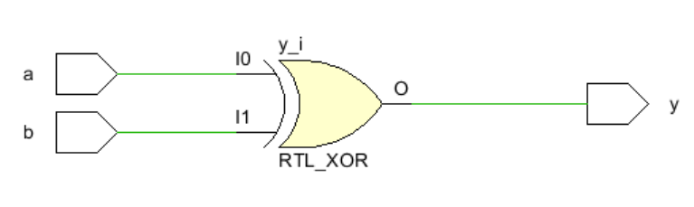
The XOR gate in our design performs only the
required logical operation for convolutional
encoding. Since it is a fundamental combinational
element, no separate optimization technique was XOR Gate
applied to it in this project.

Slide 6
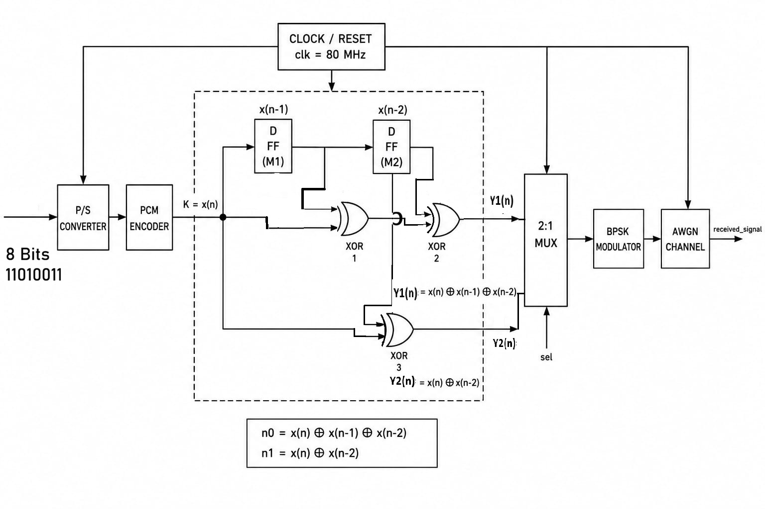
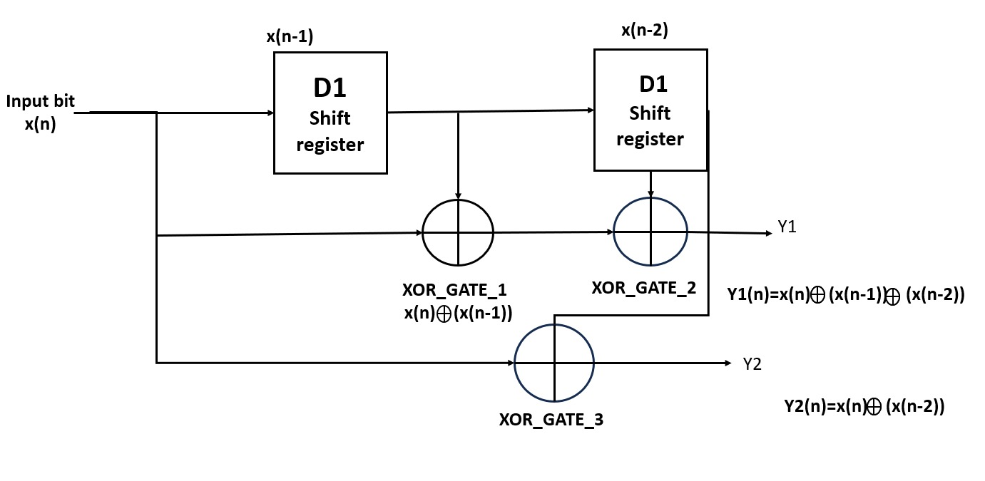
Convolutional Encoder
BLOCK DIAGRAM
16 Bits
Convolutional Encoder

Slide 7
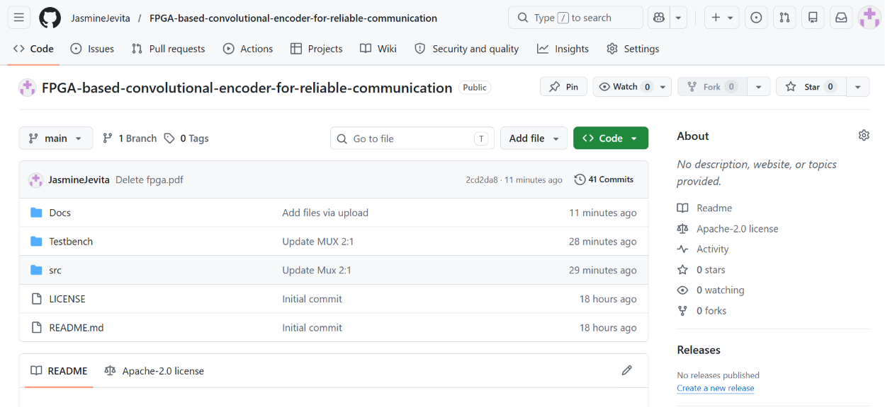
GITHUB repository details
https://github.com/JasmineJevita/FPGA-based-convolutional-encoder-for-reliable-communication.git

