Slide 1


Linux from the Command Line
Dave Dalsveen

Slide 2
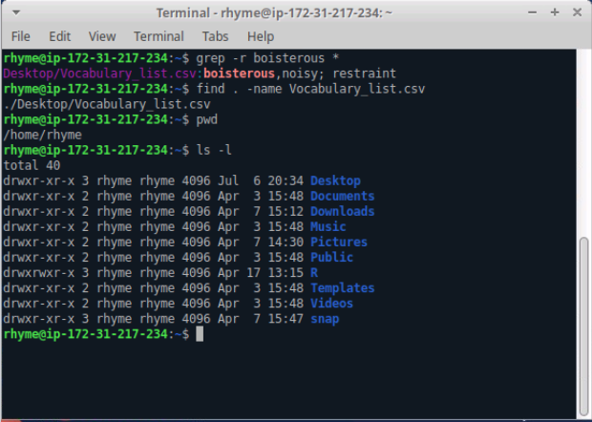
The Terminal Window

Slide 3
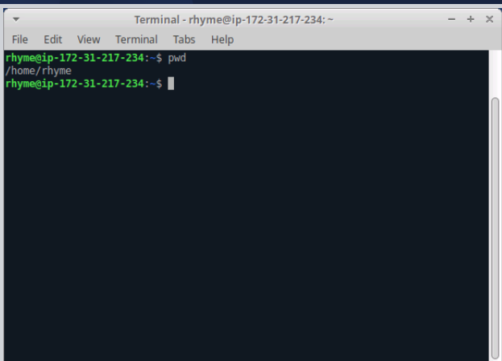
Task1: Display the home directory from a terminal
Open a terminal on Ubuntu Linux.
Display the SHELL environment variable.
Use the pwd command to display the current location in the file system.
Display the HOME directory using the HOME environment variable.

Slide 4
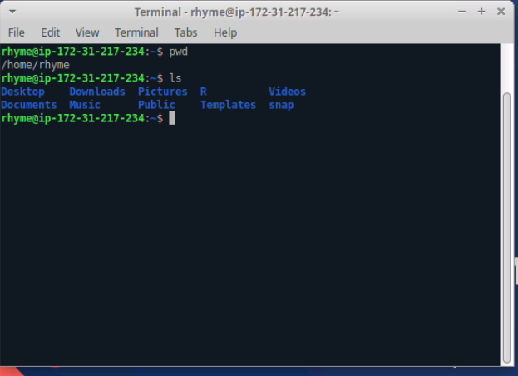
Task2: List files and directories using ls
List files and directories using ls
Get details of files and directories using –l option..
Us e a directory argument to list its files and directories.
Display information about a directory
Display hidden files (begin with a dot).

Slide 5
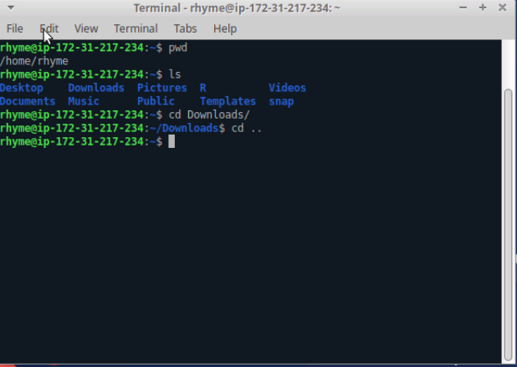
Task3: Use the cd command to change directories
Use the cd command to move to a directory
Use HOME environment variable with cd.
Use a relative path with cd.
Use cd with no arguments.

Slide 6
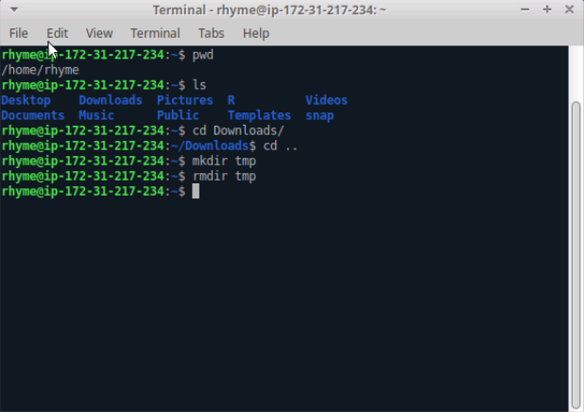
Task4:Use touch, mkdir, and rm to Make and Remove Files and Directories
Use mkdir to make a directory.
Change permissions on the directory. The bit positions are as follows: rwx rwx rwx
User Group World
111 = 7 = rwx 101 = 5 = r_x
3. Create and then remove a file using touch and rm.
Use cp to copy a file.
Remove a directory using rmdir and rm -rf

Slide 7
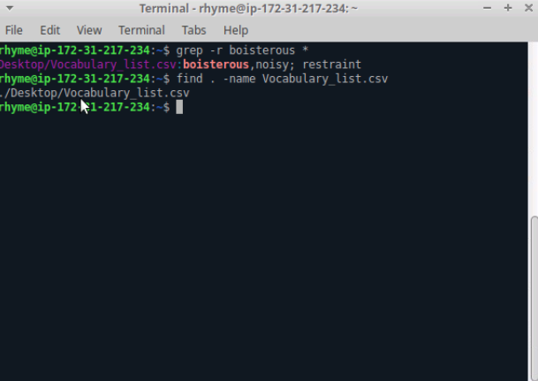
Task5: Search for Files using find, Search for patterns using grep
Use grep to find a pattern in a file.
Use grep with the recursive option to search through files and directories for the pattern.
Use find to find a file..
Use find with redirect to avoid error messages.

