Slide 1
Uncertainty Quantification
Bayesian Neural Networks vs Gaussian Processes

Slide 2
What is Uncertainty?
Uncertainty - captures our inability to precisely predict outcomes
Variability - distribution derived from many instances of the data
Uncertainty - I predict it will rain tomorrow with 80% certainty
Variability - it rains 30% of days in Autumn

Slide 3
Why is it important to capture uncertainty?
Uncertainty can tell us when a model is likely to make mistakes
Useful for self-driving cars as if the model is uncertain about which action to take safety measures can be engaged
Useful for when we want to approximate a physical process in order to quantify our expected error in any predictions

Slide 4
What was the aim of this project?
Understanding whether Bayesian Neural Networks (BNNs) are able to capture variability in the data using uncertainty in a similar way to Gaussian processes
Wanted to understand in what ways it might be appropriate and safe to use a Bayesian neural network over a Gaussian process
Neural networks may be more efficient in some cases but we don’t know if their uncertainty can be trusted

Slide 5
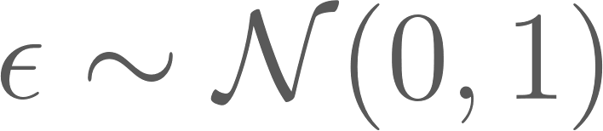
Methodology
Used the function
With 10000 data points generated for the training set and another 10000 for the test set
Ran Bayesian neural networks in two forms (variational inference and MCMC) including versions with and without dropout and compared it to running a Gaussian process on the same function to see if they would produce similar results
Used Python and Pytorch for my calculations
Used the libraries torchbnn, GPyTorch and Uber’s Pyro

Slide 6
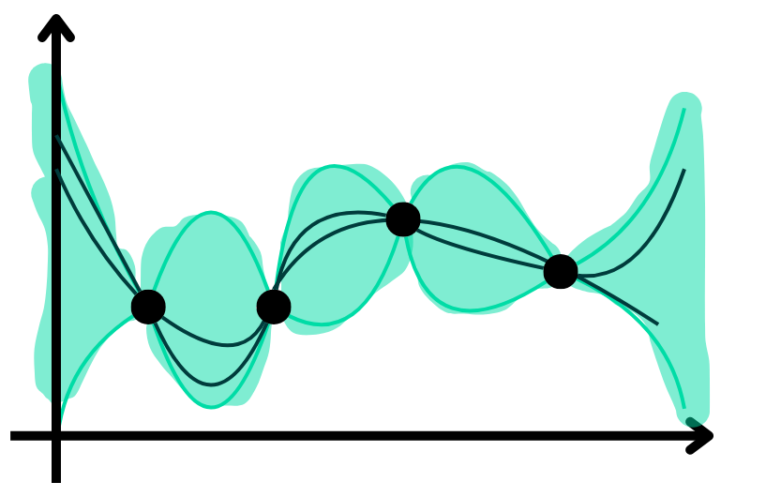
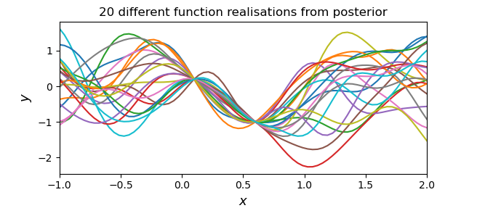
What is a Gaussian Process?
Gaussian process as being an ensemble of infinite possible functions (usually continuous and smooth depending on the kernel) which are conditional on the data.
It is defined by a mean function which gives a mean prediction and a covariance function known as a kernel which describes the similarity between any two particular observations.

Slide 7
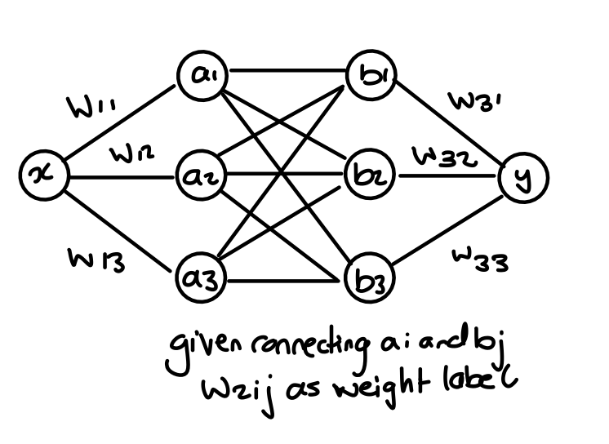
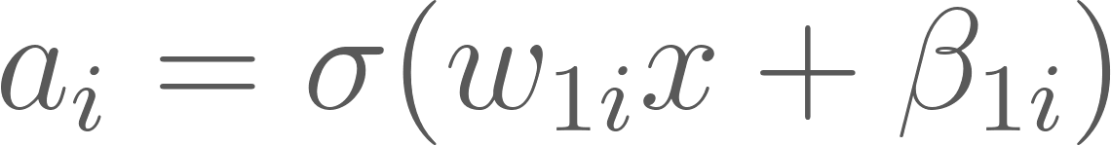
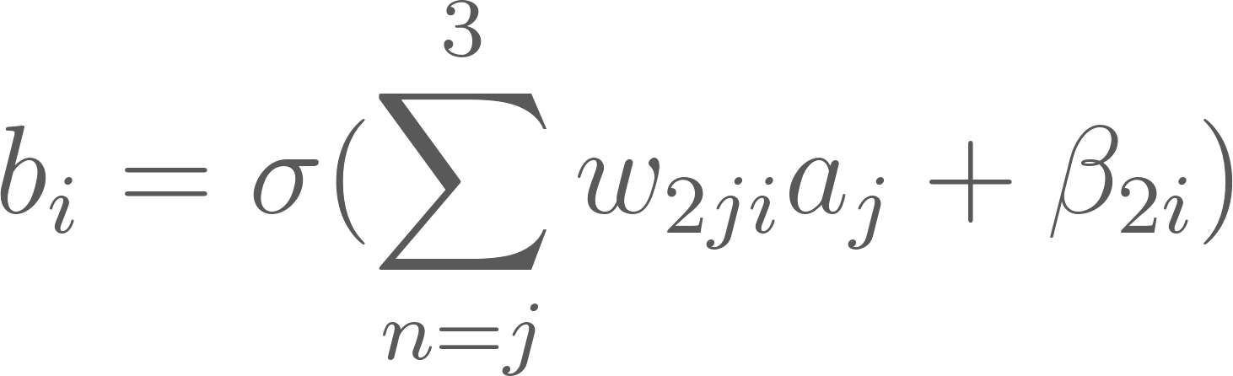
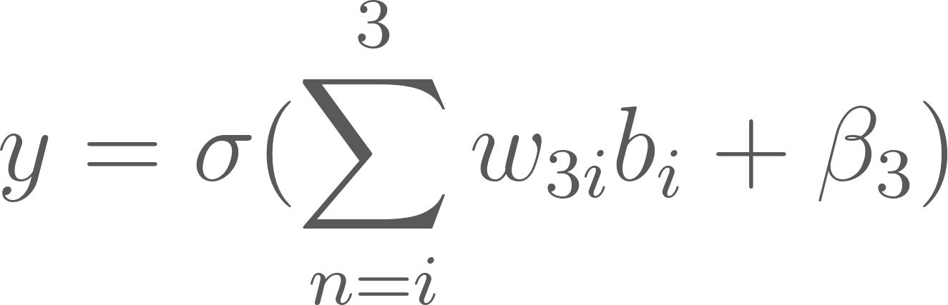
What is a Neural Network?
label connecting a_{i} and b_{j} is w_{2ij}

Slide 8
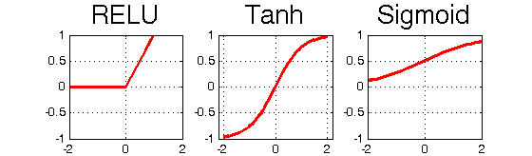
Activation functions
Purpose: To make the outcome non-linear

Slide 9
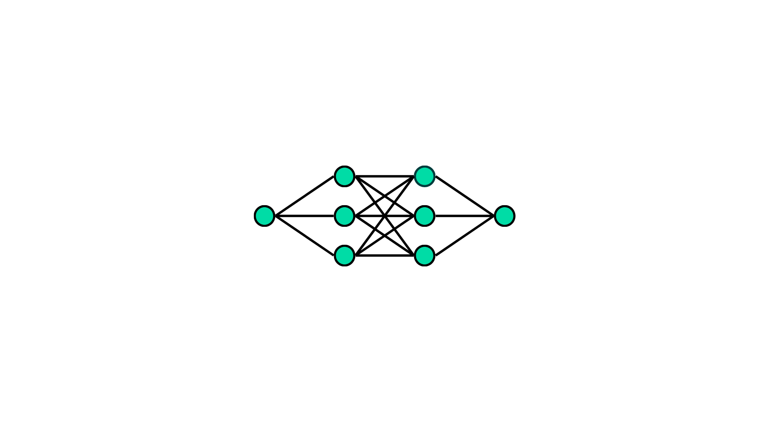
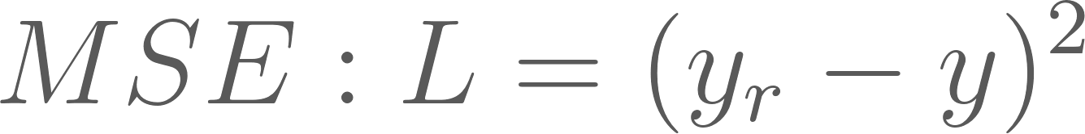
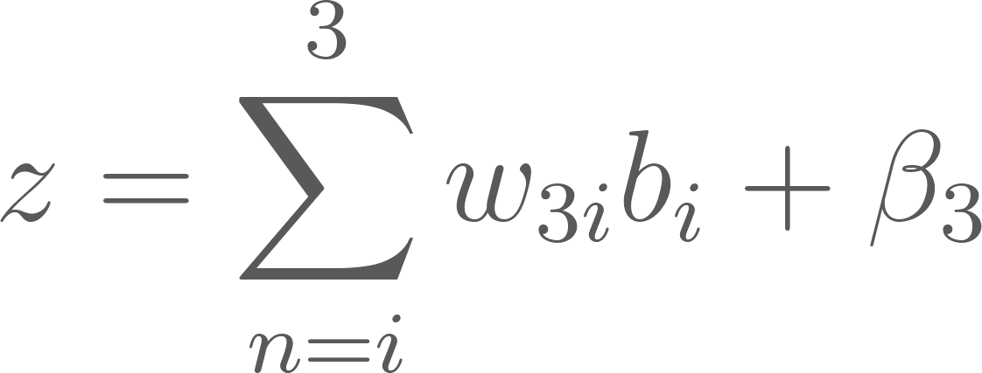
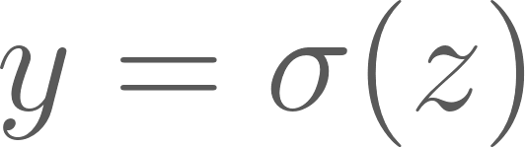
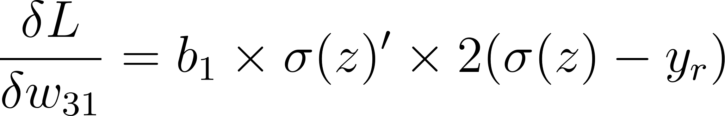
Backpropagation
Work out the gradient of the loss by each weight and use this to adjust the weights
y_{r}
real value
We have our estimated value of y as seen before
We calculate the gradient of the loss (how the loss changes) for each specific weight

Slide 10
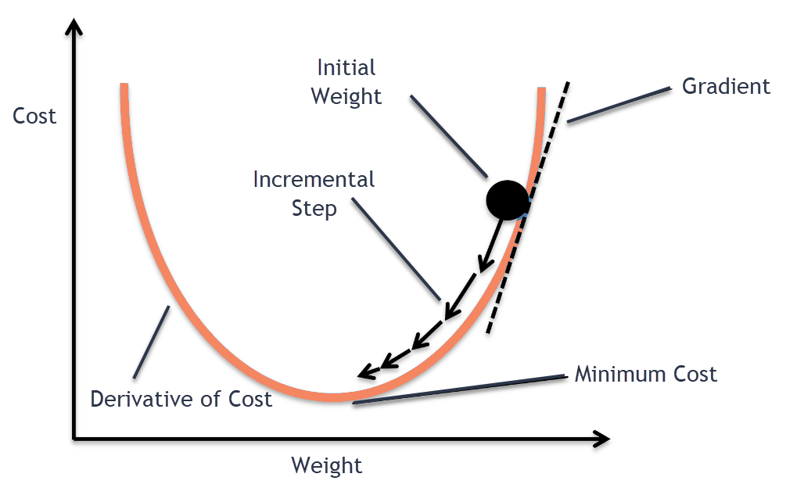
Backpropagation 2
Once we have the gradients for loss given each of the weights, we use a form of gradient descent for adjusting our weights

Slide 11
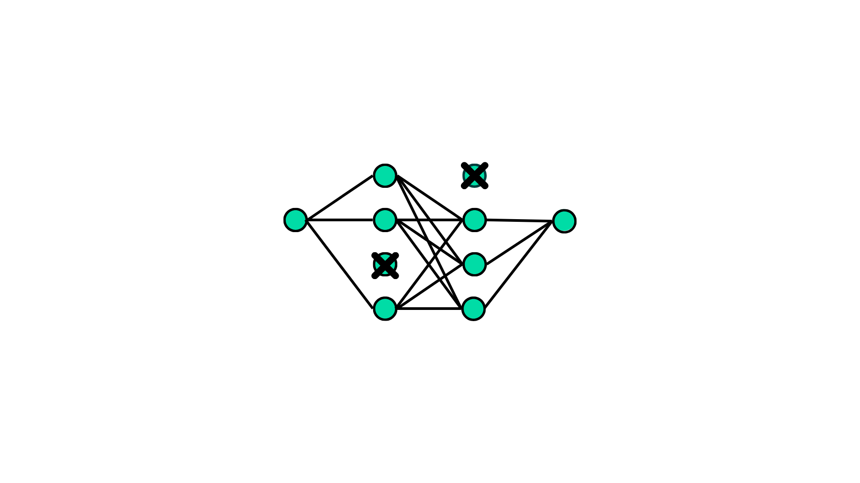
What is dropout?
Dropout is when during training of the neural network a certain percentage of nodes at each layer are removed
Works as a form of regularization
Also produces uncertainty if used when getting results from a regular neural network

Slide 12
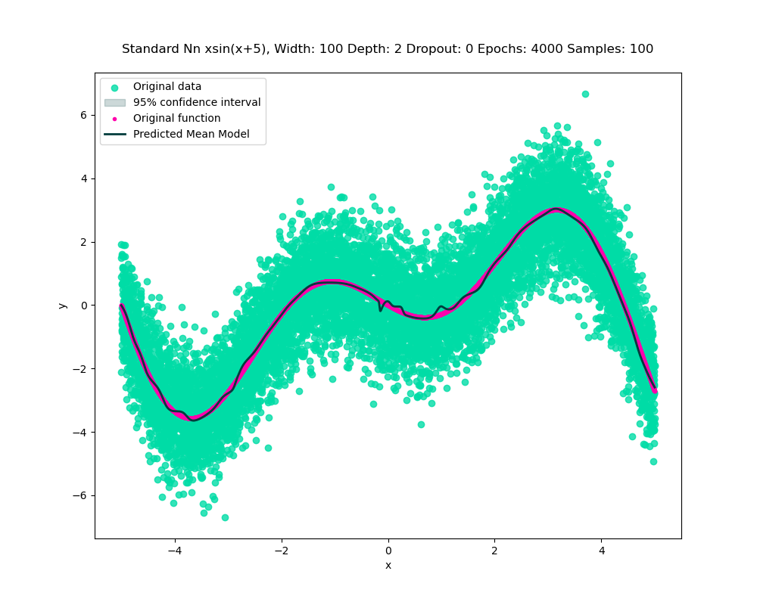

Dropout comparison for regular neural network
Without dropout
With dropout

Slide 13
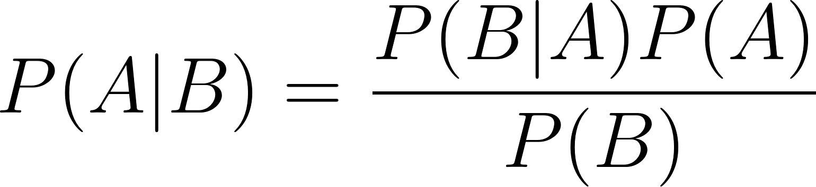
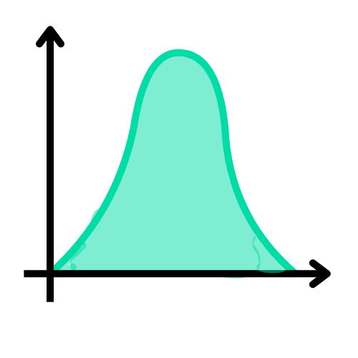
What is a Bayesian Neural Network?
We use (usually normal distribution) priors for all the weights which means all nodes other than the input node have a distribution
We use Bayes’ Theorem to train the network
We can do this in a method similar to backpropagation with some key changes
(Bayes by backprop)

Slide 14
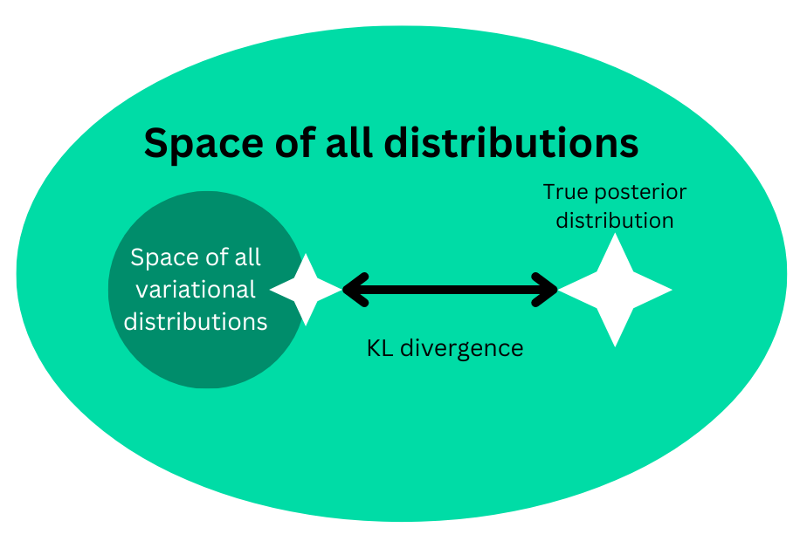
What is Variational Inference
Instead of sampling from the posterior directly, instead a distribution that is easy to sample from is created
Then the distance between the real posterior and our approximated distribution is added as a form of loss for optimisation

Slide 15
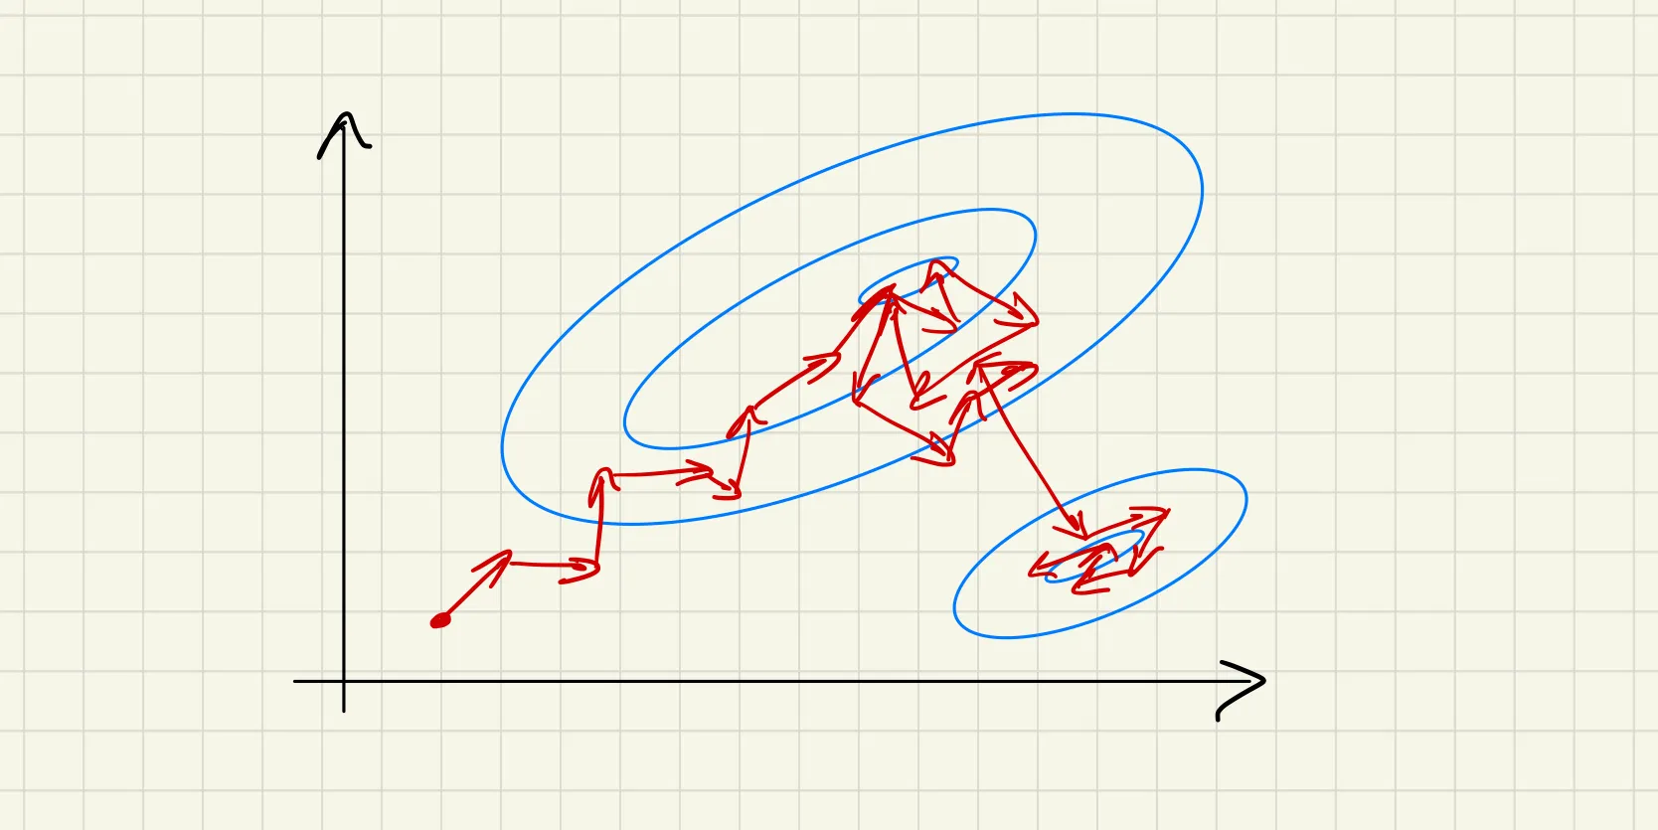
What is MCMC (Markov Chain Monte Carlo)
Method for sampling the posterior distribution
Involves exploring the space in a non-deterministic way
Samples areas of higher probability more

Slide 16
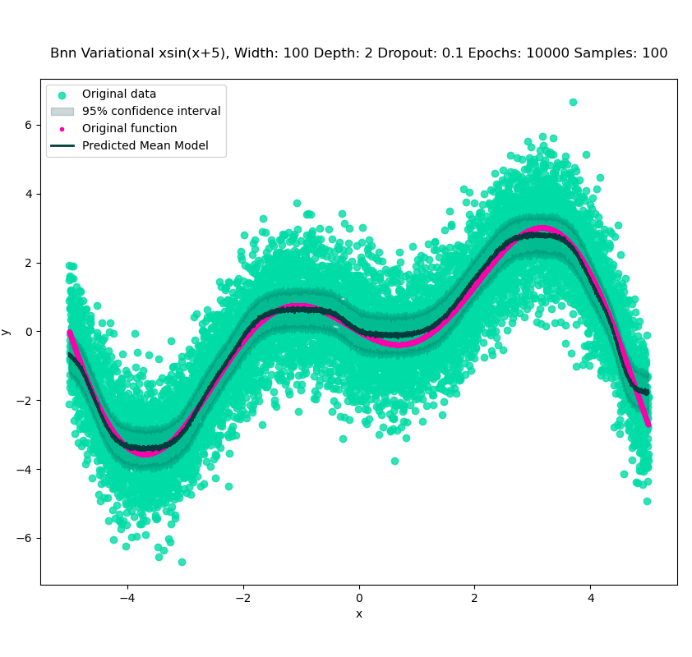
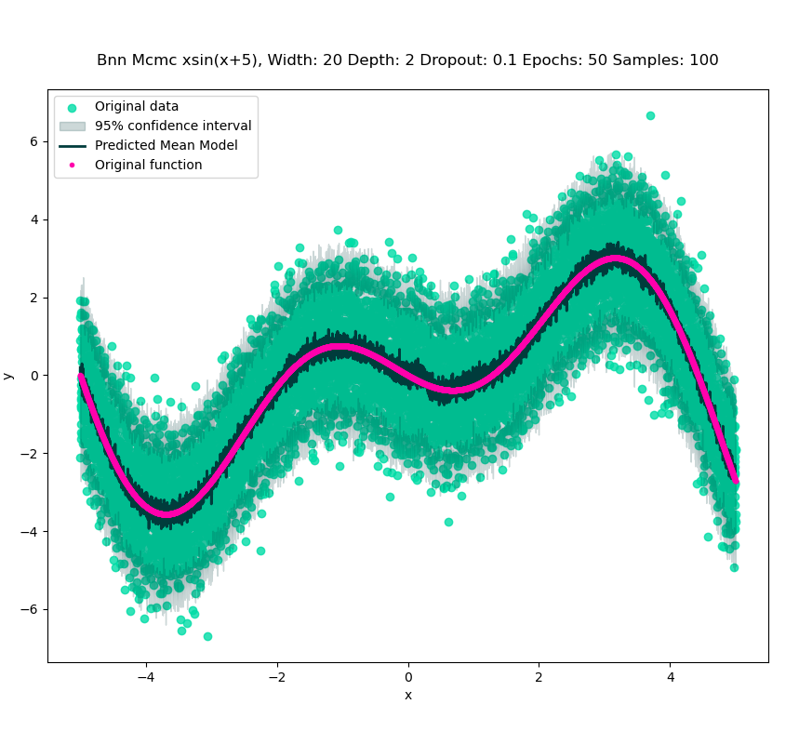
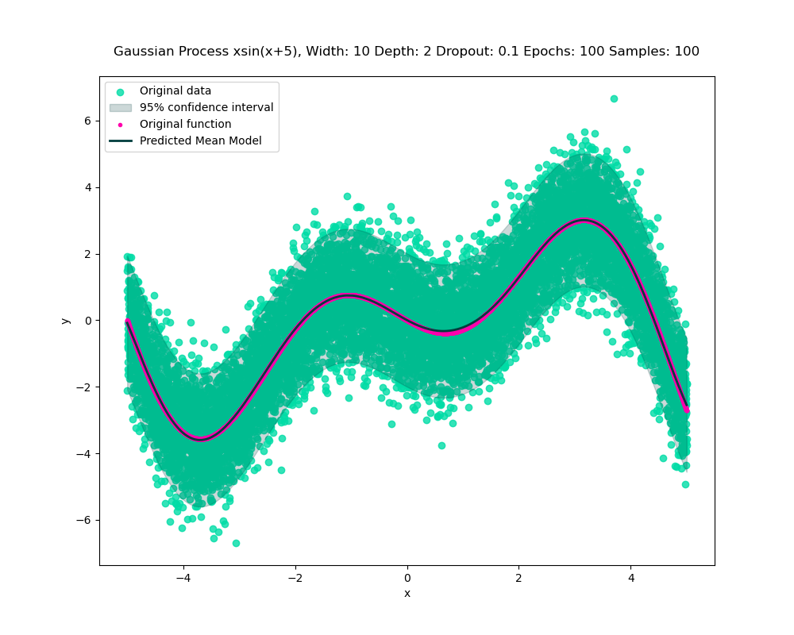
Graphs comparison
BNN Variational
BNN MCMC
Gaussian Process

Slide 17
Comparison of results
Type of Model | Variational BNN | MCMC BNN | Gaussian Process
Training Time | 169 | 469 | 199
MSE | 17.17 | 14.80 | 2.97
Coverage | 0.414 | 0.9468 | 0.9562
Epochs | 10000 | 50 (50 burn in) | 100
Width | 100 | 20 | N/A
Depth | 2 | 2 | N/A

Slide 18
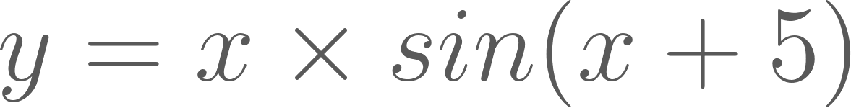
Discussion of Findings
with 10,000 data points between -5 and +5
Found that the form of Bayesian neural network (BNNs) using variational inference which I used couldn’t capture the variation in the data with uncertainty but BNNs using Markov Chain Monte Carlo (MCMC) could capture it
BNNs using MCMC took longer to run than Gaussian processes which achieved similar accuracy
MCMC in practice may run into issues as it will only be successful if the model converges
Gaussian process was more accurate, faster and gave a smoother result

