Slide 1

Department of Applied Sciences
The Kickstart Session – Lecture #0
Introduction to Programming (CSE1001)
Prepared by: Ms.Surbhi
Assistant Professor

Slide 2
Course Details
Course Title: Introduction to Programming
Course Code: CSE1001
TPC (Theory-Practical-Credit): 3 - 0 - 3

Slide 3
Why C & C++?
Where C is used
Operating systems – core of Linux, Windows and UNIX kernels
Embedded systems & IoT devices, microcontrollers, consumer electronics
Compilers, interpreters, and device drivers
Database engines (e.g., core of MySQL, SQLite)
Where C++ is used
Game engines (e.g., Unreal Engine) and high-performance graphics
Web browsers (core rendering engines), OS-level applications
Financial trading systems, robotics, and real-time simulations
Why we study this in Semester 1
Builds core programming logic and problem-solving skills used in every later course.
Direct prerequisite for Data Structures, Algorithms, and Object-Oriented Design.
Memory management concepts here (pointers) are foundational to Computer Science.
Frequently tested in technical interviews and competitive programming.

Slide 4
Course Objectives
To understand the concepts of structured and object-oriented, paradigms and develop skills by using these paradigms in C and C++.
To choose the right data representation formats based on the requirements of the problem.
To learn writing a computer program to solve specified problems.
Use the comparisons and limitations of the various programming constructs and choose the right one for the task in hand.

Slide 5
Course Outcomes (CO-PO Mapping)
Unit | Unit Name | Course Outcome Statement ( CO )
1 | Introduction to C Programming | CO1:Understand the structured programming language fundamentals.
2 | Arrays and Functions | CO2:Implement programs using arrays and functions.
3 | Pointers and Memory Management in C | CO3:Develop applications using pointers.
4 | Structure and Union | CO4:Identify uses of structure and union in programming tasks.
5 | Introduction to C++ and Object-Oriented Programming | CO5:Differentiate structure programming and object-oriented programming; basic concepts of OOP.

Slide 6
Program Outcomes (PO1 – PO6)
PO | Title | Description
PO1 | Engineering knowledge | Apply the knowledge of mathematics, science, engineering fundamentals, and an engineering specialization to the solution of complex engineering problems.
PO2 | Problem analysis | Identify, formulate, review research literature, and analyze complex engineering problems reaching substantiated conclusions using first principles of mathematics, natural sciences, and engineering sciences.
PO3 | Design/development of solutions | Design solutions for complex engineering problems and design system components or processes that meet specified needs with appropriate consideration for public health, safety, and cultural, societal, and environmental considerations.
PO4 | Conduct investigations of complex problems | Use research-based knowledge and research methods including design of experiments, analysis and interpretation of data, and synthesis of information to provide valid conclusions.
PO5 | Modern tool usage | Create, select, and apply appropriate techniques, resources, and modern engineering and IT tools, including prediction and modeling, to complex engineering activities, with an understanding of the limitations.
PO6 | The engineer and society | Apply reasoning informed by contextual knowledge to assess societal, health, safety, legal, and cultural issues and the consequent responsibilities relevant to professional engineering practice.

Slide 7
Program Outcomes (PO7 – PO12)
PO | Title | Description
PO7 | Environment and sustainability | Understand the impact of professional engineering solutions in societal and environmental contexts, and demonstrate knowledge of, and need for, sustainable development.
PO8 | Ethics | Apply ethical principles and commit to professional ethics and responsibilities and norms of engineering practice.
PO9 | Individual and team work | Function effectively as an individual, and as a member or leader in diverse teams, and in multidisciplinary settings.
PO10 | Communication | Communicate effectively on complex engineering activities with the engineering community and with society at large, including writing effective reports, design documentation, presentations, and giving/receiving clear instructions.
PO11 | Project management and finance | Demonstrate knowledge and understanding of engineering and management principles and apply these to one's own work, as a member and leader in a team, to manage projects and in multidisciplinary environments.
PO12 | Life-long learning | Recognize the need for, and have the preparation and ability to engage in, independent and life-long learning in the broadest context of technological change.

Slide 8
Course Outcomes (CO-PO Mapping)
CO | Course Outcome Statement | PO's / PSO's
CO1 | Understand the structured programming language fundamentals. | PO1,PO2,PO3,PO5/PSO1,PSO2
CO2 | Implement programs using arrays and functions. | PO1,PO2,PO3,PO5/PSO1,PSO2
CO3 | Develop applications using pointers. | PO1,PO2,PO3,PO5/PSO1,PSO2
CO4 | Identify uses of structure and union in programming tasks. | PO1,PO2,PO3,PO5/PSO1,PSO2
CO5 | Differentiate structure programming and object-oriented programming; basic concepts of OOP. | PO1,PO2,PO3,PO5/PSO1,PSO2

Slide 9
Syllabus – Course Content Overview
Module 1 – Introduction to C Programming (10 Hours)
Module 2 – Arrays and Functions (8 Hours)
Module 3 – Pointers and Memory Management in C (9 Hours)
Module 4 – Structure and Union (8 Hours)
Module 5 – Introduction to C++ and Object-Oriented Programming (10 Hours)

Slide 10
Syllabus –
Module 1: Introduction to C Programming (10 Hrs)
Components of a computer system, Types of Computers
Introduction to Programming, Algorithm and Flowchart
Overview of C language and its basic structure
Data concepts: Constants, Variables, Expressions, Errors, Operators
Data Types and Statements: Declarations, Input-Output Statements, Compound Statements
Selection Statements, Conditions, Operator Precedence, Branching and Looping Statements

Slide 11
Syllabus – Modules 2 & 3
Module 2: Arrays and Functions (8 Hrs)
Arrays: declaration, initialization, accessing elements, array manipulation
Functions: prototype declaration, definition, function calls, passing arguments (by value/reference), scope of variable names, recursive function calls
Module 3: Pointers and Memory Management in C (9 Hrs)
Understanding pointers and memory addresses, pointer arithmetic
Dynamic memory allocation: malloc(), calloc(), realloc(), free()
Pointer to functions, pointer and array relationship

Slide 12
Syllabus – Modules 4 & 5
Module 4: Structure and Union (8 Hrs)
Structures in C: definition, creating user-defined data types, defining members, accessing and operating on structure elements
Union concept: memory allocation, accessing union members
Module 5: Intro to C++ and Object-Oriented Programming (10 Hrs)
OOP concepts, procedural vs. object-oriented paradigms, classes and objects, constructors, access specifiers
Overloading, friend functions, static/nested/inner classes, inheritance, polymorphism, function and class templates

Slide 13
Course Assessment & Evaluation Mode
Component | Marks | Sample Links
Internal (50%)
Examination-1(FAT) | 30 | https://drive.google.com/file/d/1WtnlCBZT4cTdm1K9a0XvWKN5Fiq8EmpY/view?usp=drive_link
Examination-2(SAT) | 30 | https://drive.google.com/file/d/1fFnoR42w8QtUswBSx2eBVjKJQwPLSfc5/view?usp=drive_link
Assignment / Quiz | 20 | https://docs.google.com/document/d/1ZhzTYJfz_7khTPBOHxuJ7FIPjgfBdwKG/edit?usp=drive_link&ouid=114014621300192778001&rtpof=true&sd=true
External (50%)
End Semester Examination(ESE) | 50 | https://drive.google.com/file/d/12va_41CVs5AI42zHWuUQOG_WenKgUy28/view?usp=drive_link

Slide 14
Academic Calendar – Key Dates
Date | Event | Indicative Syllabus Coverage
31st Aug – 5th Sept 2026 | FAT – Formative Assessment Test | Module 1 & Module 2 Module -3(half)– Introduction to C, Arrays and Functions,Pointers
12th – 17th Oct 2026 | SAT – Summative Assessment Test | Module 3 & Module 4, Module-5 – Pointers, Memory Management, Structure and Union,Intro to C++
16th November 2026 | Last Teaching Day
23rd November 2026 onwards | End Semester Examination | Full Syllabus

Slide 15
Assignments & Weekly Practice
Assignments
A total of 2 assignments will be given during the semester.
Each assignment carries 10 Marks.
Quiz
A total of 2 Quiz will be given during the semester of 20 marks each.

Slide 16
Bloom's Taxonomy
Level | Cognitive Process | Key Question | Sample Action Verbs
L6 (Highest) | Creating | Can the student create a new product or point of view? | Assemble, Construct, Create, Design, Develop, Formulate, Write, Produce, Invent, Compose
L5 | Evaluating | Can the student justify a stand or decision? | Appraise, Argue, Defend, Judge, Select, Support, Value, Evaluate, Critique, Recommend
L4 | Analyzing | Can the student distinguish between different parts? | Analyze, Compare, Contrast, Differentiate, Discriminate, Distinguish, Examine, Experiment, Question, Test
L3 | Applying | Can the student use information in a new way? | Apply, Choose, Demonstrate, Implement, Illustrate, Operate, Schedule, Solve, Use, Execute
L2 | Understanding | Can the student explain ideas or concepts? | Classify, Describe, Discuss, Explain, Identify, Interpret, Recognize, Report, Summarize, Translate
L1 (Lowest) | Remembering | Can the student recall or remember the information? | Define, Duplicate, List, Memorize, Recall, Repeat, State, Identify, Name, Label

Slide 17
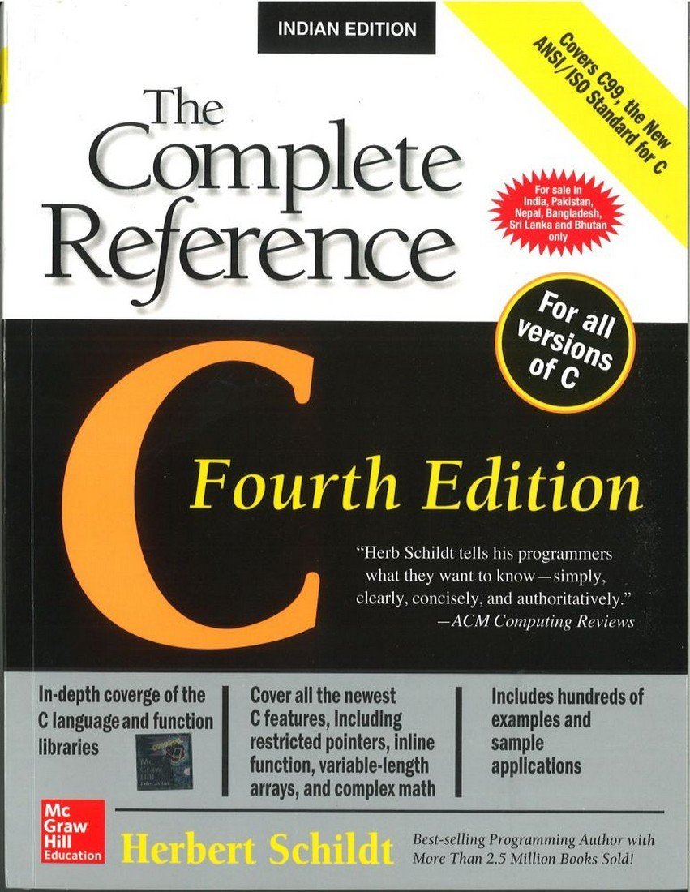
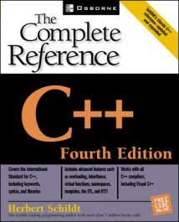
Text Books
1.C:The Complete Reference:Herbert Schildt,McGraw-hill Education, Fourth Edition,2017
2.C++:The Complete Reference:Herbert Schildt,McGraw-hill Education, Fourth Edition,2017

Slide 18
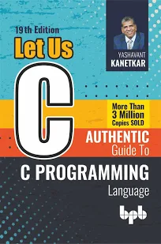
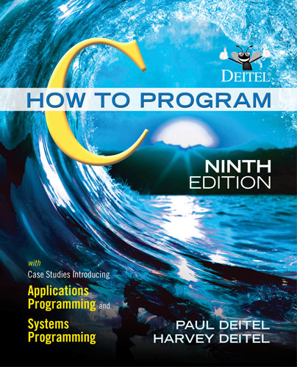
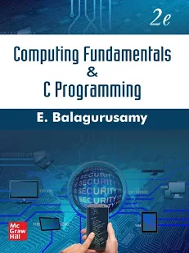
References
Photo | Name | Author | Type | Edition
 | Let Us C | Yashwant Kanetkar | Reference | 17th Ed., 2020
 | C: How to Program | H. M. Deitel, P. J. Deitel | Reference | 9th Ed., 2022
 | Computing Fundamentals & C Programming | E. Balagurusamy | Reference | 2nd Ed.

Slide 19
Open Sources
Resource | Focus | Link
GeeksforGeeks – C Programming | Concepts, examples, interview questions | geeksforgeeks.org/c/c-programming-language
Programiz – Learn C | Beginner-friendly tutorials with an online compiler | programiz.com/c-programming
cppreference.com | Authoritative C / C++ language & library reference | en.cppreference.com
W3Schools – C++ Tutorial | Interactive lessons, “Try it Yourself” editor | w3schools.com/cpp
NPTEL – Intro to Programming in C (IIT Kanpur) | Free video lectures & assignments, optional certification | nptel.ac.in/courses/106104128

Slide 20
C & C++ Skill Set
Programming Fundamentals
Control Structures
Functions & Recursion Arrays,
Strings & Pointers
Dynamic Memory Allocation
Structures & File Handling
Object-Oriented Programming (Classes & Objects)
Inheritance & Polymorphism
Exception Handling Standard Template Library (STL)
Debugging & Problem Solving

Slide 21
Real-World Applications
Operating Systems (Windows, Linux)
Embedded Systems & IoT Devices
Game Development
System Software & Compilers
Device Drivers
Database Management Systems
Robotics & Automation
Networking Applications
High-Performance Computing
Financial & Banking Systems
Desktop Applications
Automotive and Aerospace Software

Slide 22
Career Opportunities in C & C++
Career Role | Key Responsibilities | Industries | Salary Scope (India)
Networking & Protocol Developer | Implement TCP/IP stacks, optimize routing software | Telecom, Cloud, Data Centers | ₹8–18 LPA
Compiler/Toolchain Developer | Create compilers, linkers, debuggers | Software Tooling, Language Development | ₹12–20+ LPA
Automotive Software Engineer | Develop ECU firmware, safety-critical systems | Automotive OEMs, Tier-1 suppliers | ₹6–15 LPA
Game Engine Developer | Work on rendering, physics, real-time performance | Gaming, AR/VR | ₹8–20 LPA
High-Performance Computing (HPC) Engineer | Optimize simulations, parallel computing | Finance, AI, Scientific Research | ₹12–25 LPA
Robotics/AI Systems Engineer | Sensor fusion, real-time control pipelines | Robotics, Autonomous Systems | ₹10–20 LPA

Slide 23

Course Code: CSE1002
Course Name: IP LAB
Prepared by: Ms. Rubani Singla,
Ms. Deepanshi,
Assistant Professor

Slide 24
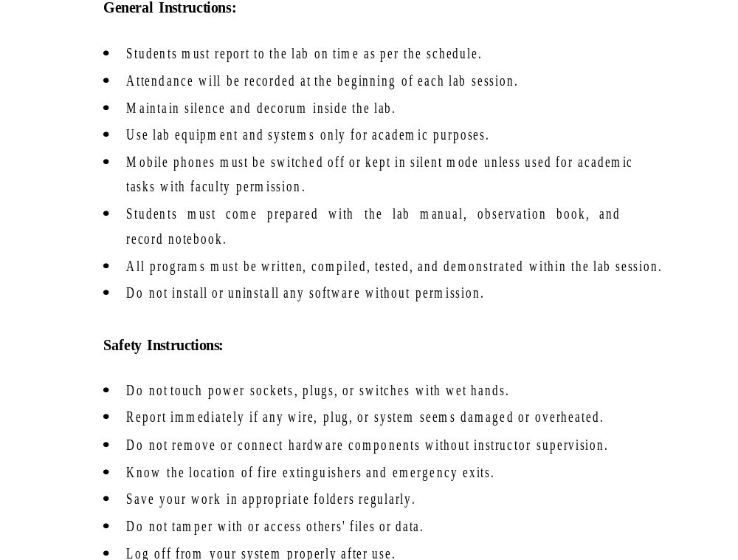

Slide 25
Course Code: CSE1002
Course Name: IP LAB
CO | CO Statements | Bloom Taxonomy
1 | Implement programs using input-output statements, expressions, and decision-making constructs. | Understanding
2 | Develop programs using arrays and functions to solve programming problems. | Applying
3 | Apply pointers for memory handling and problem-solving in C programs. | Analyzing
4 | Apply structures and unions for organizing and processing data in C programs. | Applying
5 | Makeuse of object-oriented programming concepts such as classes, methods, inheritance, and polymorphism to develop C++ programs. | Applying

Slide 26
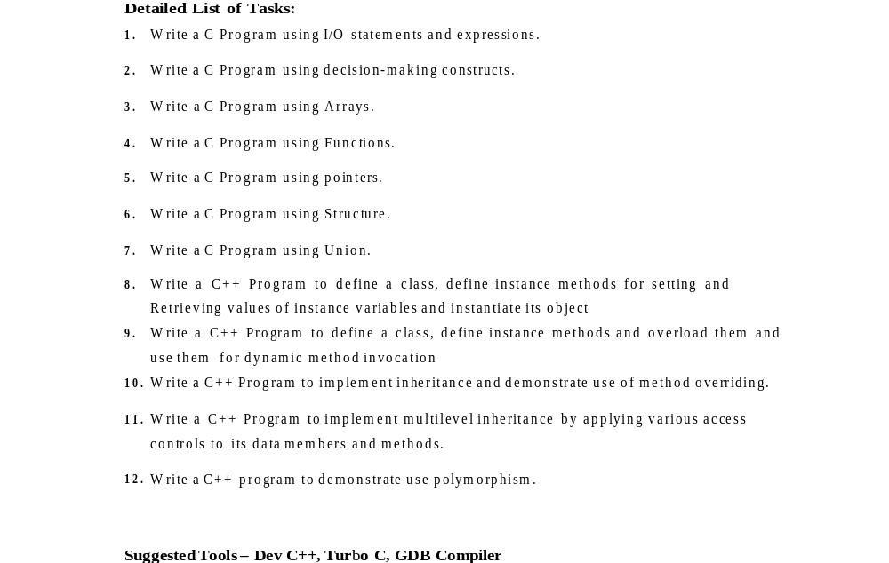
Syllabus

Slide 27
CO’s Mapping with Practical
Sr No. | Course Outcomes | Practical under CO
1 | Understand the structured programming language fundamentals. | 1,2
2 | Implement programs using arrays and functions. | 3,4
3 | Develop applications using pointers | 5
4 | Identify uses of structure and Union in the programming tasks. | 6,7
5 | Differentiate structure programming and object oriented programming, basics concepts of OOP. | 8-12

Slide 28
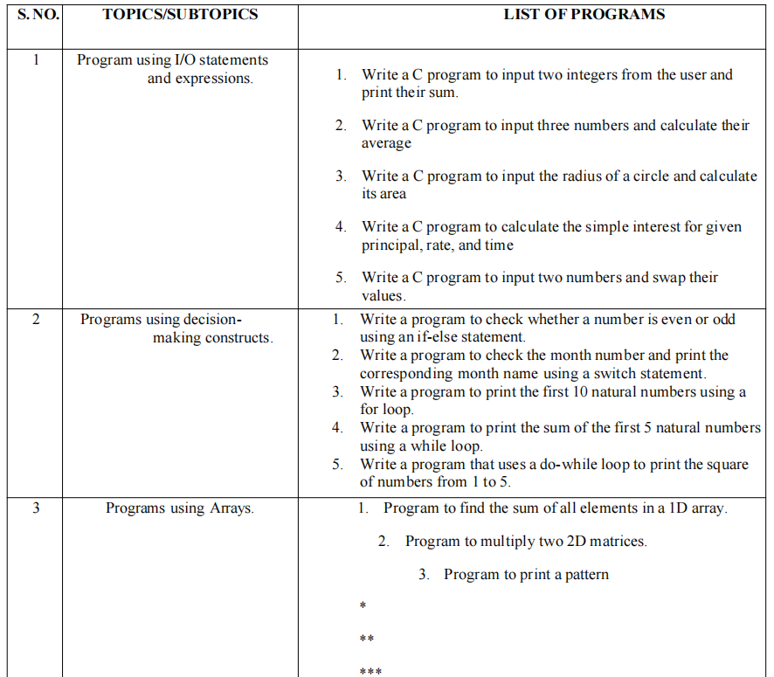
List of Practicals

Slide 29
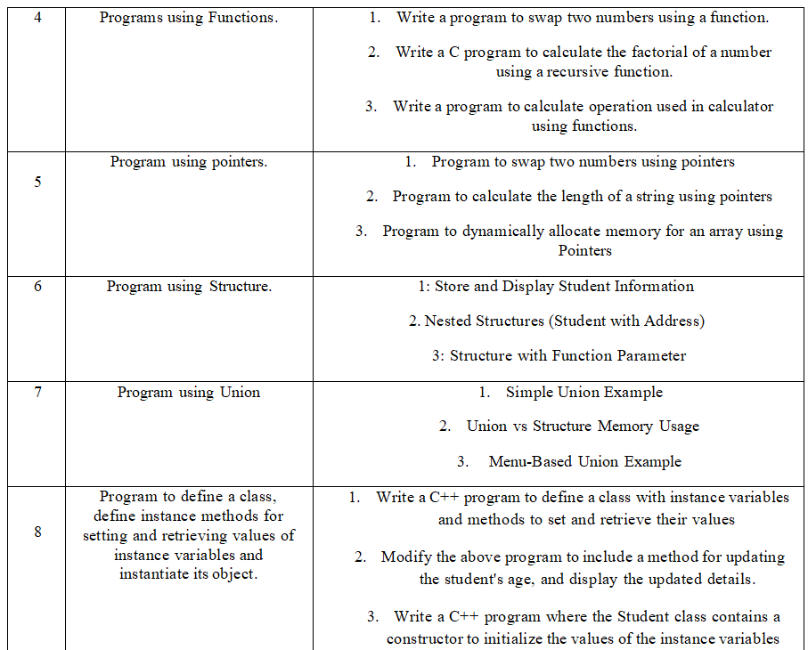

Slide 30
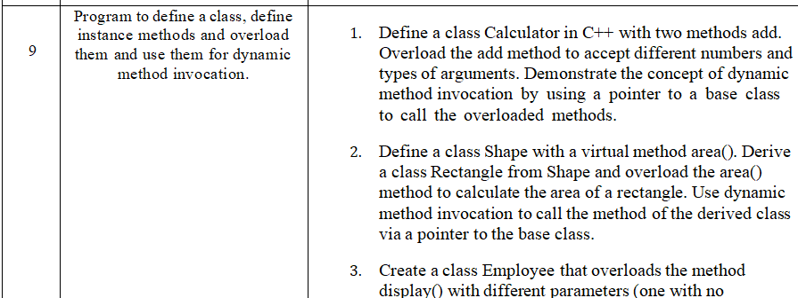
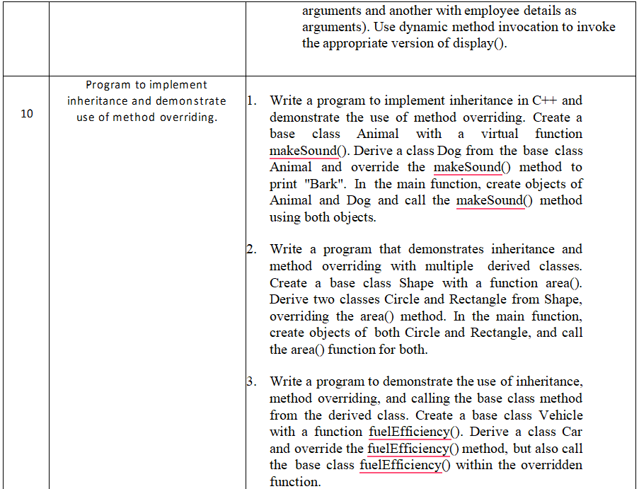

Slide 31
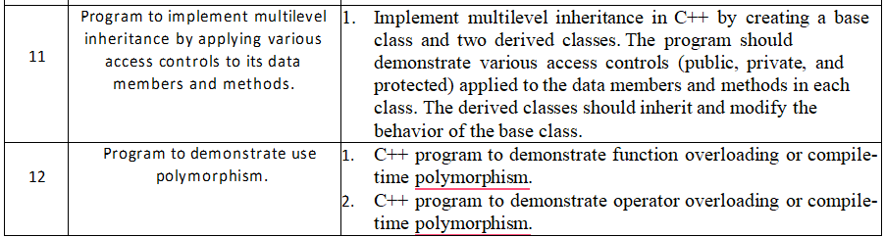

Slide 32
Pre-Placement Foundation(PPF)
HackerRank coding problems for hands-on practice

Slide 33
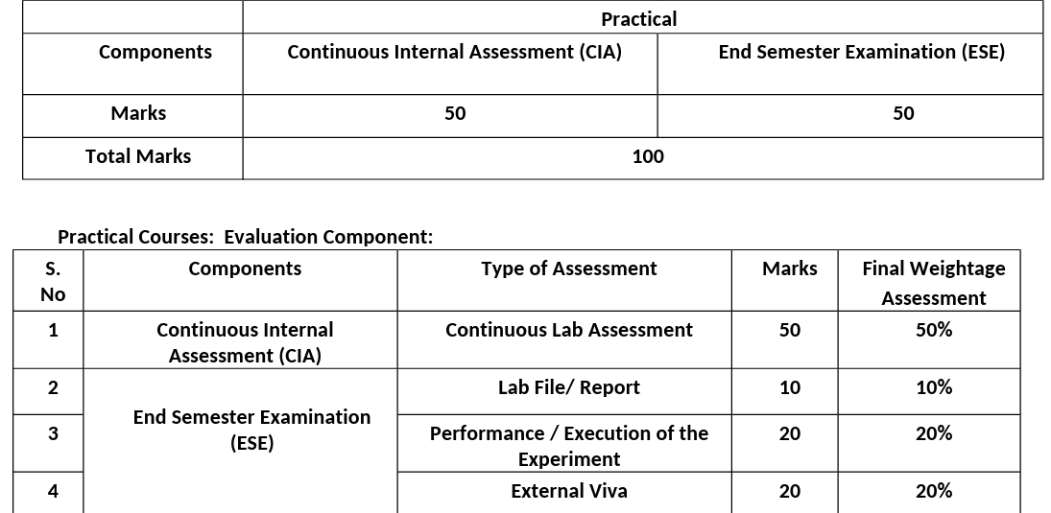
Lab Evaluation

Slide 34
Practical coverage till FAT - 1-6 (Planned)
Practical coverage till SAT - 7-12 (Planned)

Slide 35
Thank you.

