Slide 1
Introduction to Programming
Course Code: CSE1001
MODULE 1 Complete
By Ms Savathallapalli Jasmine

Slide 2
Module no. | Syllabus/Topic | Course Outcome
1 | Introduction to components of computer system, Types of Computer, Introduction to Programming, Algorithm and Flowchart, Overview of C language, Basic structure, Data concepts in C: Constants, Variables, Expressions, Errors, Operators, Data Types And Statements: Declarations, Input-Output Statements, Compound statements, Selection Statements. Conditions, Operators and its precedence, Branching and Looping statements. | CO1 Understand the structured programming language fundamentals

Slide 3
Introduction to Computer System
Computer System
Computer is an electronic device for storing and processing data, typically in binary form, according to instructions given to it in a variable program.
Main task performed by a computer
• Accept the data
• Process or manipulate the data
• Display or store the result in the form of human understanding
• Store the data, instructions and results.

Slide 4
Characteristics of Computers
➢ High Processing Speed : Computers can process data and perform calculations at incredibly high speeds.
➢ Accuracy : Computers perform operations with a high degree of accuracy. Errors usually occur due to human mistakes (like wrong input), not the machine.
➢ Reliability : Computers consistently perform tasks without tiring or losing efficiency.
➢ Versatility : A computer can perform a wide range of tasks — from playing music and games to performing scientific simulations.
➢ Diligence : Unlike humans, computers do not suffer from fatigue or lack of concentration. They can perform repeated tasks without boredom or errors due to tiredness.

Slide 5
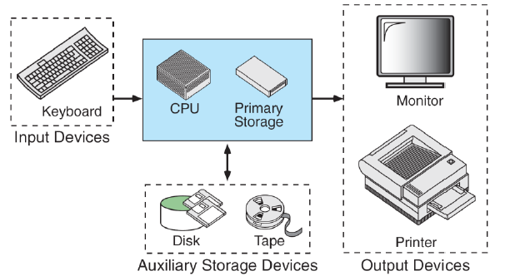
Block Diagram of Computer System
Computer hardware is the collection of physical elements that comprise a computer system. The hardware component of the computer system consists of five parts:
Input Devices
CPU
Primary Memory
Output devices
Storage devices

Slide 6
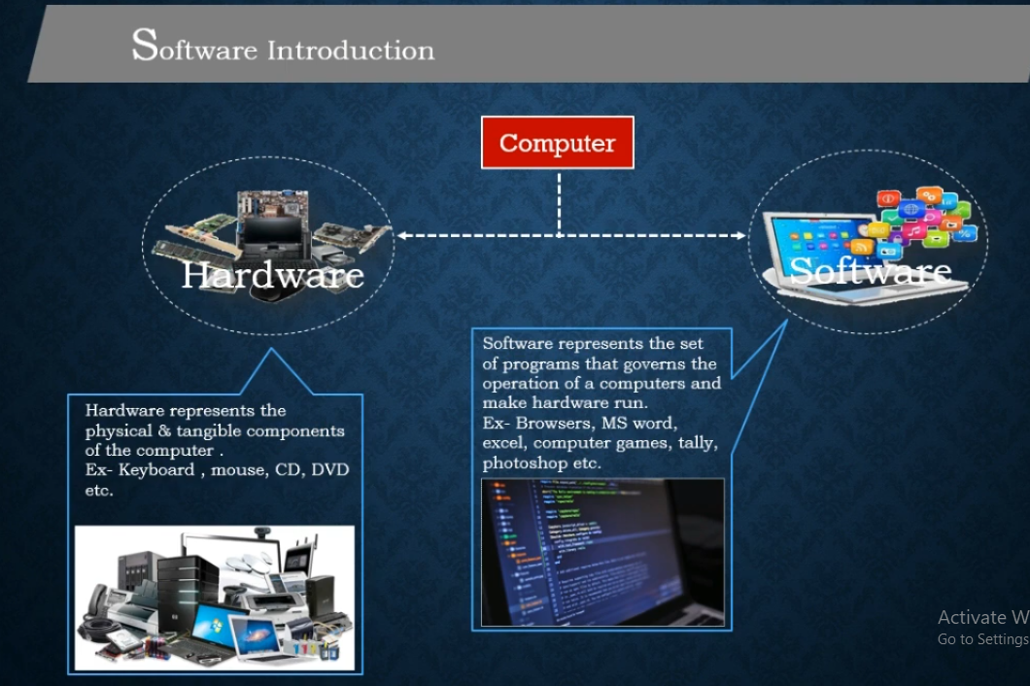
Hardware and Software

Slide 7
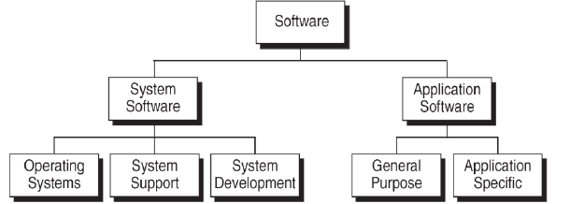
Hardware and Software
Computer software is a collection of computer programs and related data that provides the instructions for a computer what to do and how to do.
Software are further categories into two:
System Software: System software is responsible for managing a variety of independent hardware components, so that they can work together.
Application Software: Application software is developed to aid in any task that benefits from computation

Slide 8
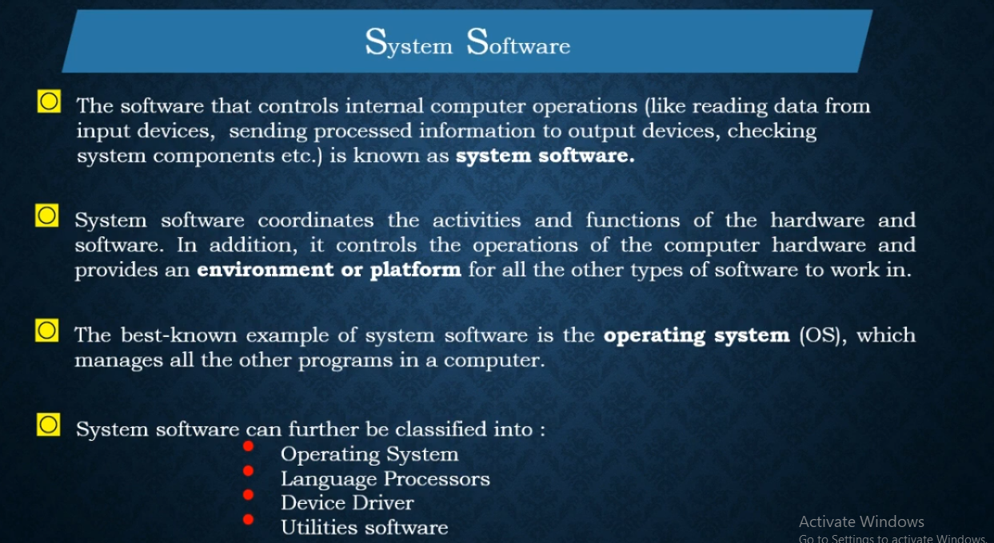

Slide 9
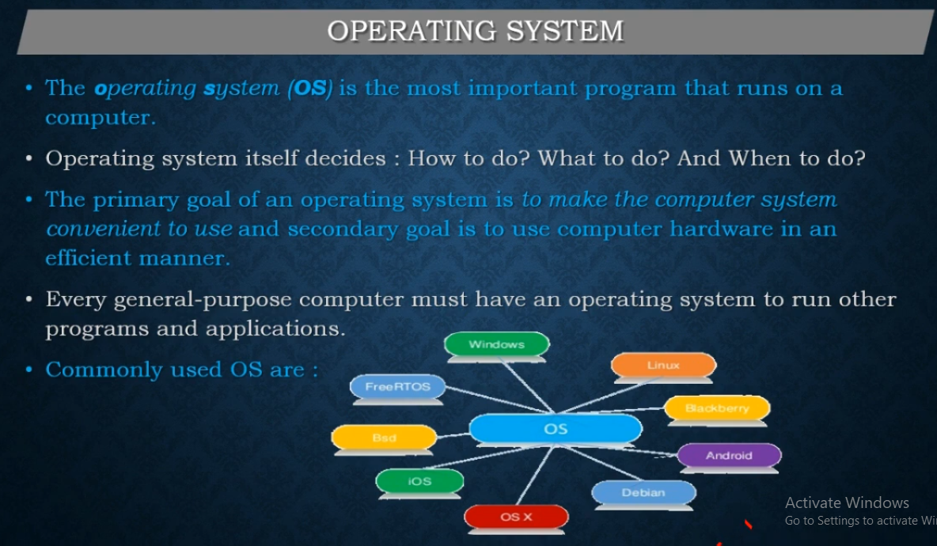
OPERATING SYSTEM

Slide 10
Functions of Operating System
Provide an Interface
Managing Files
Managing peripherals and drivers
Managing Memory
Managing multi-tasking
Managing Interrupts
Providing a platform for run applications
Managing user accounts

Slide 11
System support software provides system utilities and other operating services. Examples of system utilities are sort programs and disk format programs. Operating services consists of programs that provide performance statistics for the operational staff and security monitors to protect the system and data.
System development software, includes the language translators that convert programs into machine language for execution, debugging tools to ensure that the programs are error free and computer.
Application Software
Application Software: Application software is developed to aid in any task that benefits from computation. This category includes:
• Business software
• Computer aided design
• Databases
• Decision making software
• Educational software
• Image editing

Slide 12
Application software is broken in to two classes: general-purpose software and application –specific software.
General purpose software is purchased from a software developer and can be used for more than one application. Examples of general-purpose software include word processors, database management systems, and computer aided design systems. They are labelled general purpose because they can solve a variety of user computing problems.
Application –specific software can be used only for its intended purpose.

Slide 13
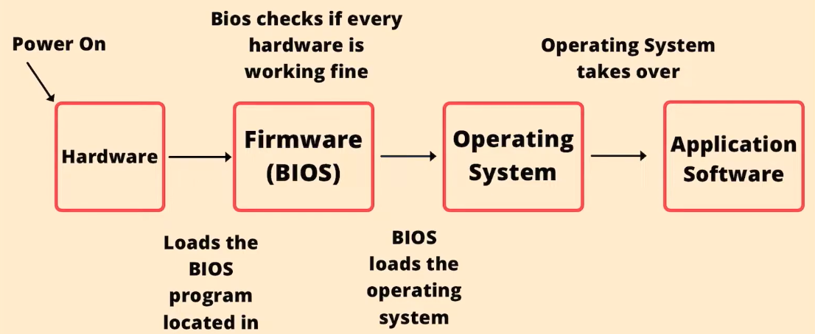
HCI (Human Computer Interaction)

Slide 14
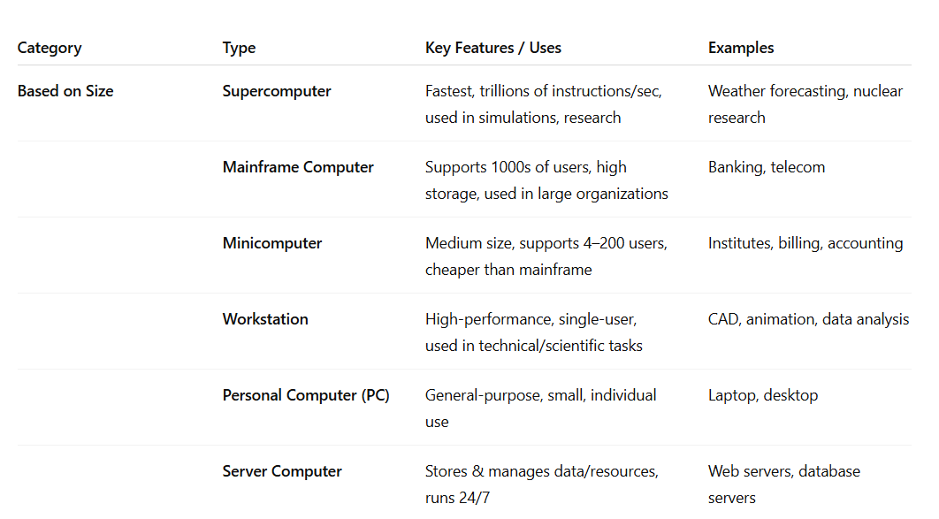
TYPES OF COMPUTER

Slide 15
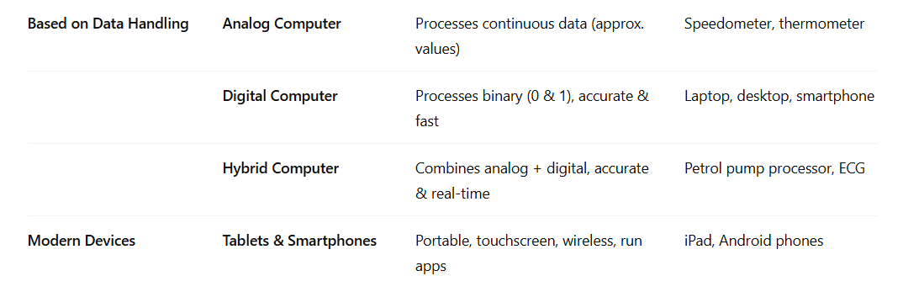
TYPES OF COMPUTER

Slide 16
Programming Languages
In order to communicate with the computer user also needs to have a language that should be understood by the computer.
Languages are divided into three categories-
1940’s - Machine level Languages
1950’s – Middle Language
1960’s - High-Level Languages
Low Level Languages : Low level computer languages are machine codes or close to it. Computer cannot understand instructions given in high level languages or in English. It can only understand and execute instructions given in the form of machine language i.e. language of 0 and 1
Middle Level (Assembly) Language
The programs are written using the instructions of CPU is called Assembly level language. It uses symbols, or mnemonics, to represent the various machine language instructions. Examples are TASM, MASM

Slide 17
Programming Languages
TASM and MASM are both assemblers—programs that convert assembly language code into machine code—but they were developed by different companies and have some differences in syntax and usage.
TASM (Turbo Assembler)
Developer: Borland (founded by Philippe Kahn)
Platform: Primarily for MS-DOS systems
MASM (Microsoft Macro Assembler)
Developer: Microsoft
Platform: MS-DOS and Windows (later versions support 32-bit and 64-bit)

Slide 18
Programming Languages
High Level Languages:
High-level languages are designed to relieve the programmer from the details of the assembly language. High level languages share one thing with symbolic languages, They must be converted into machine language. The process of converting them is known as compilation.

Slide 19
LOW-LEVEL LANGUAGES
Speaking Almost Directly to the Machine
Machine Language
Assembly Language
The only language a CPU executes natively
Human-readable symbols for machine code
10110000 01100001
10100011 00000000
MOV AL, 61h
ADD AL, BL
JMP LOOP
Written in pure binary (0s & 1s)
Uses mnemonics (MOV, ADD, JMP)
Executes with no translation needed
Needs an assembler to convert to binary
Completely hardware-dependent
One step above machine code
Extremely difficult to write & debug
Still tied to a specific processor
03

Slide 20
HIGH-LEVEL LANGUAGES
Designed for People, Translated for Machines
High-level languages read closer to English and math notation. A compiler or interpreter translates the code into machine instructions, which makes these languages portable across different hardware.
1
Portability
2
Readability
Same source code can run on many machines with little or no change.
Uses English-like keywords: if, while, print, function.
3
Faster Development
4
Needs Translation
Less code needed to express the same logic than assembly.
Requires a compiler or interpreter before/while it runs.
COMMON EXAMPLES
C
C++
Java
Python
JavaScript
04

Slide 21
Low-Level vs. High-Level Languages
Aspect | Low-Level Language | High-Level Language
Closeness to hardware | Very close | Abstracted away
Readability | Difficult (binary / mnemonics) | Easy, English-like syntax
Execution speed | Very fast | Slower (needs translation)
Portability | Machine-specific | Portable across platforms
Development time | Long, complex | Short, productive
Typical examples | Machine code, Assembly | C, Python, Java
09

Slide 22
EVOLUTION
Five Generations of Programming Languages
Beyond the low/high-level split, languages are grouped into five generations that trace their historical evolution from raw binary to AI-driven, goal-based programming.
1GL
3GL
5GL
Machine
Language
High-Level
(incl. C)
AI / Logic-Based
(e.g. Prolog)
1940s
1957–70s
1980s–now
2GL
4GL
Assembly
Language
Domain-Specific
(e.g. SQL)
1950s
1970s–80s
05

Slide 23
GENERATIONS 1 & 2
1GL and 2GL: The Foundation Layers
1GL
Machine Language
2GL
Assembly Language
FORM
Pure binary (0s and 1s)
FORM
Mnemonic codes (MOV, ADD, SUB)
ERA
1940s, earliest computers
ERA
1950s, symbolic programming begins
EXECUTION
Runs directly on the CPU — no translation
EXECUTION
Converted to machine code by an assembler
SPEED
Fastest possible execution
SPEED
Very fast, near machine-level performance
DRAWBACK
Unreadable, error-prone, not portable
DRAWBACK
Still processor-specific, tedious to write
06

Slide 24
GENERATION 3
3GL — Where C Enters the Picture
Third-generation languages introduced structured, procedural programming that is portable across machines. C, created by Dennis Ritchie at Bell Labs in 1972, became the defining 3GL — powerful enough for system programming yet readable enough for everyday application code.
hello.c
Procedural
Code organized into functions and step-by-step logic.
#include <stdio.h>
int main() {
printf("Hello, World!");
return 0;
}
Portable
Same source compiles for many hardware platforms.
Close to Hardware
Why C Matters
Supports pointers & direct memory access.
Built Unix. Influenced C++, Java, C#, JavaScript, and more. Still used today in operating systems, embedded devices, and compilers.
Structured
Encourages loops, conditionals, modular design.
07

Slide 25
GENERATIONS 4 & 5
4GL and 5GL: Toward Higher Abstraction
4GL
Domain-Specific Languages
5GL
AI & Constraint-Based Languages
Built for a specific task, e.g. database queries or report generation
Programmer states the goal; the system finds the how
Examples: SQL, MATLAB, R
Examples: Prolog, Mercury, OPS5
Much less code than 3GL for the same result
Used in AI, expert systems, and logic programming
Trades general-purpose flexibility for productivity
Still evolving — closest to natural human instruction
08

Slide 26
Translators
High level and Mid-level languages require translators for communicating the instructions to the computer.
We have three types of translators:
Assembler
Interpreter
Compiler

Slide 27

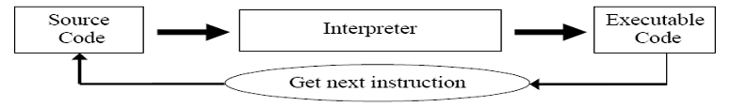
Assembler: An Assembler converts an assembly program into machine code.
Interpreter: An Interpreter is also a program that translates high-level source code into executable code. However, the difference between a compiler and an interpreter is that an interpreter translates one line at a time and then executes it, and then the next instruction is translated. This goes on until the end of the program.
Compiler: A Compiler is a program that translates a high-level language into machine code in one go.

Slide 28
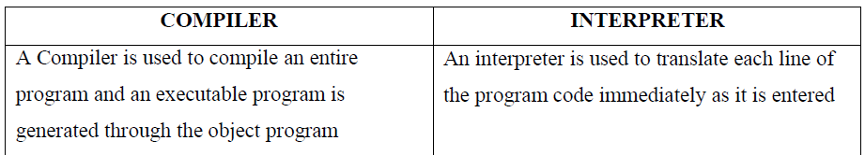
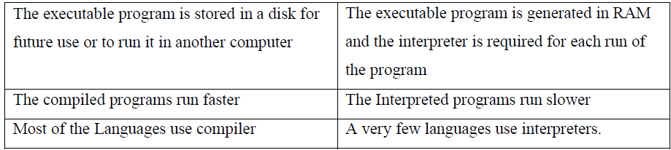
Comparison between a Compiler and Interpreter
Source Code: Source code is the code that is input to a translator.
Executable Code: Executable code is the code that is output from the translator

Slide 29
ALGORITHM
An algorithm is a description of a procedure which terminates with a result. Algorithm is a step-by-step method of solving a problem.
Properties of an Algorithm:
1) Finiteness: - An algorithm terminates after a finite number of steps.
2) Definiteness: - Each step-in algorithm is unambiguous. This means that the action specified by the step cannot be interpreted in multiple ways & can be performed without any confusion.
3) Input: - An algorithm accepts zero or more inputs
4) Output:- An algorithm should produce at least one output.
5) Effectiveness: - It consists of basic instructions that are realizable. This means that the instructions can be performed by using the given inputs in a finite amount of time.

Slide 30
Algorithm
A step-by-step plan to solve a problem, written in plain language
An Algorithm is a set of clear steps to solve a problem
Written in simple English (or pseudocode) — NOT in a programming language
Good Algorithm should be: Clear, have a Finite number of steps, and give the Correct output
We design the algorithm FIRST, then convert it into C code
Example task: add two numbers entered by the user
Algorithm: Add Two Numbers
Step 1: Start
Step 2: Read two numbers a and b
Step 3: Calculate sum = a + b
Step 4: Print sum
Step 5: Stop

Slide 31
Flowcharts
Graphical or symbolic representation of an algorithm is Flow chart.
Diagrammatic representation of the step-by-step solution to a given problem
Advantages of Flowchart:
1. Conveys Better meaning: Since a flowchart is a pictorial representation of an algorithm, it is easier for a programmer to understand and explain the logic of the program to other programmers.
2. Analyses the problem effectively: Flow chart helps the programmers to analyze the problem in detail by breaking the flow chart into detailed parts.
3. Effective Coding: It is very easy for the programmers to write the program, because flow chart will give a clear idea of the steps involved.
4. Systematic Debugging : It enables easy detection of errors.
Disadvantages:
1. For a large program flowchart becomes very complex and confusing.
2. Modification of a flowchart is difficult.
3. Excessive use of connectors may confuse programmers.

Slide 32
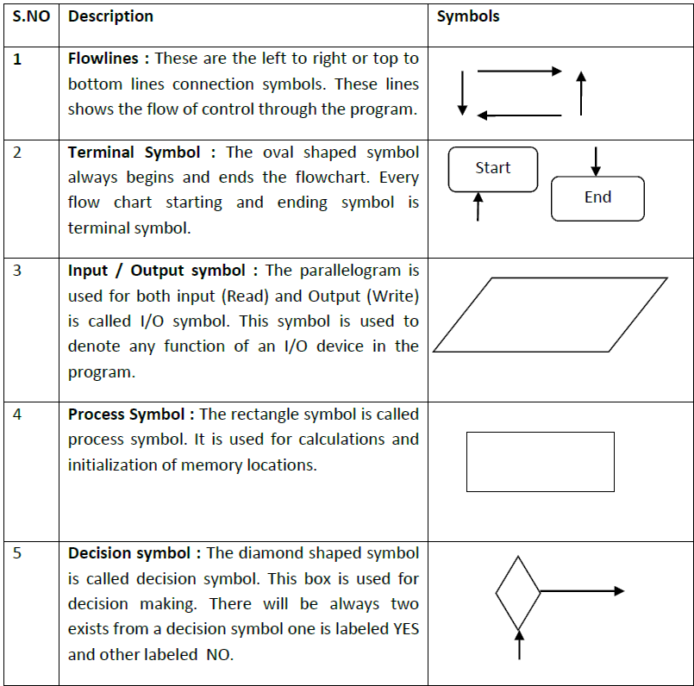
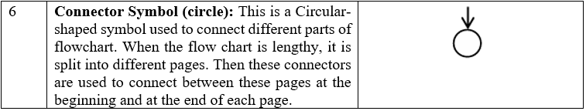

Slide 33
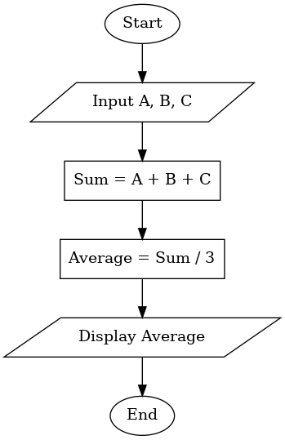
Flowchart for average of three numbers

Slide 34
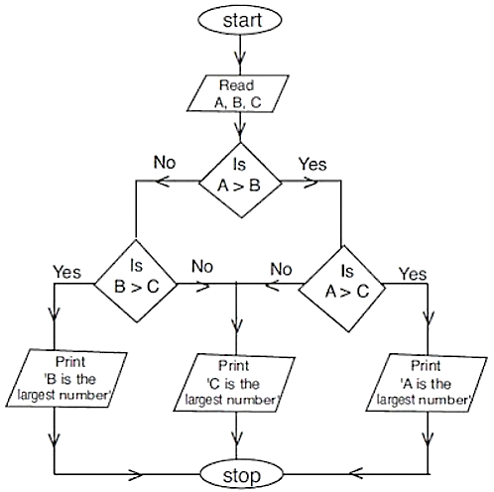
Flowchart for largest of three numbers

Slide 35
Flowchart
A picture (diagram) that shows the steps of an algorithm using symbols
A Flowchart draws the algorithm using easy-to-read symbols and arrows
Oval — Start / Stop
Parallelogram — Input / Output
Rectangle — Process (a calculation or action)
Diamond — Decision (Yes / No question)
Arrows show the ORDER in which steps happen
Start
Input a, b
sum = a + b
Output sum
Stop
Why use a flowchart? It helps us SEE the logic of a program clearly before writing any code, and makes it easy to spot mistakes.

Slide 36
Practice Questions
What are the main tasks performed by a computer system?
Explain any five characteristics of computers with examples?
Differentiate between hardware and software?
What is an algorithm? Explain its properties.
What is a flowchart? Write two advantages and two disadvantages.

Slide 37
INTRODUCTION TO C LANGUAGE
History of C
C is a general-purpose high level language that was originally developed by Dennis Ritchie for the Unix operating system. It was first implemented on the Digital Equipment Corporation PDP-11 computer in 1972.
The Unix operating system and virtually all Unix applications are written in the C language. C has now become a widely used professional language for various reasons.
Easy to learn
Structured language
It produces efficient programs.
It can handle low-level activities.
It can be compiled on a variety of computers.

Slide 38
Facts about C
C was invented to write an operating system called UNIX.
C is a successor of B language which was introduced around 1970
The language was formalized in 1988 by the American National Standard Institute (ANSI).
By 1973 UNIX OS almost totally written in C.
Today C is the most widely used System Programming Language. C is fast, efficient, close to hardware, and portable, making it a preferred choice for performance-critical and system-level applications.
Most of the state of the art software have been implemented using C
Why to use C?
C was initially used for system development work, in particular the programs that make-up the operating system. C was adopted as a system development language because it produces code that runs nearly as fast as code written in assembly language. Some examples of the use of C might be:
Operating Systems
Language Compilers
Assemblers
Text Editors
Databases: MySQL, PostgreSQL.

Slide 39
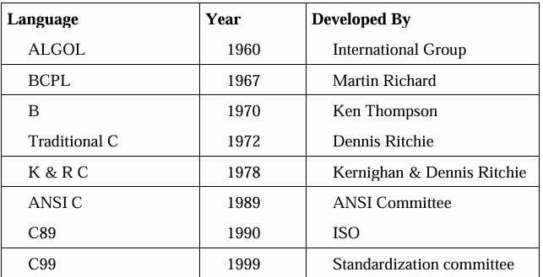
In 1983, ANSI (American national standard institute) established a committee, whose goal was to produce a machine independent definition of the C language.
The committee approved a version of c language known as ANSI C in 1989, then it also approved by ISO the result is C89.
In 1999 the standardization committee released a version of C99 by adding some features of C++ / JAVA.

Slide 40
BASICS
Overview of C Language
What is C?
  A general-purpose, structured programming language. It is called a "middle-level" language because it can work close to hardware and also write normal applications.
Who made it?
  Created by Dennis Ritchie in 1972 at Bell Labs, to build the UNIX operating system.
Why learn C?
  It is easy to learn, fast, portable, and forms the base for languages like C++, Java, and Python.
Where is it used?
  Operating systems, compilers, embedded systems, game engines, and device drivers.
hello.c
// Your very first C program
#include <stdio.h>
int main() {
printf("Hello, World!");
return 0;
}
Output: Hello, World!
03

Slide 41
OVERVIEW OF C
The Journey to C: Languages Before C
Year | Language | Developed By | Contribution
1960 | ALGOL 60 | International committee | Introduced structured, block-based programming concepts
1966 | BCPL (Basic CPL) | Martin Richards, Cambridge | Simple, machine-independent systems language
1970 | B Language | Ken Thompson, Bell Labs | Simplified BCPL further; used to write early UNIX
1972 | C Language | Dennis Ritchie, Bell Labs (AT&T) | Added data types & structures to B; became the systems language for UNIX
1

Slide 42
Characteristics/ Features of C Language
Modularity: Ability to break down large modules into a manageable sub modules.
Example: calculator can be divided into arithmetic and trigonometric and again that is divided into sub modules.
Extendibility: Ability to extend an existing software by adding new features is called extendibility. It is a by-product of modularity.
Portability: Ability to port (install) existing software in different platforms (Unix, dos etc.) is called portability
Efficiency and speed: C language has rich set of data types and operators making the language more faster and efficient.
Flexibility: C complier has only 32 keywords. With 32 keywords a programmer is able to solve any type of task, due to this reason programmers have the complete control over the language their by gaining the flexibility.

Slide 43
Why C? Features & Applications
KEY FEATURES
REAL-WORLD APPLICATIONS
• Simple & structured (functions/blocks)
• Fast — compiles close to machine code
• Portable — 'write once, compile anywhere'
• Rich set of operators & built-in functions
• Supports pointers — direct memory access
• Extensible via user-defined functions
• Middle-level language — bridges low & high level
• Operating systems — UNIX, Linux kernel, parts of Windows
• Embedded systems — microwaves, ATMs, routers
• Compilers & interpreters for other languages
• Database engines — MySQL core
• Game engines & performance-critical software
• Foundation language taught before C++, Java, Python
2

Slide 44
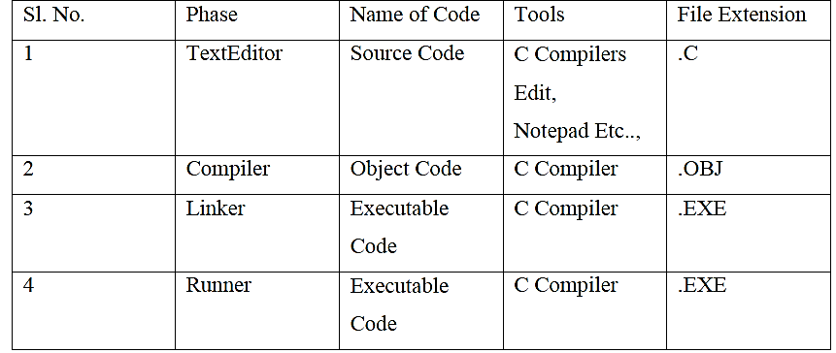
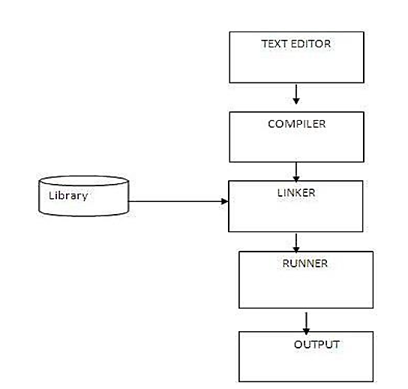
CREATING AND RUNNING PROGRAMS
Writing and Editing Programs: Programs are written using a text editor and saved as source files with C code.
Compiling Programs: The compiler (preprocessor + translator) converts source code into machine-readable object code.
Linking Programs: The linker combines user-defined and library functions into a single executable file.
Executing Programs: The loader loads the executable into memory, and the OS runs the program, handling input, processing, and output.

Slide 45
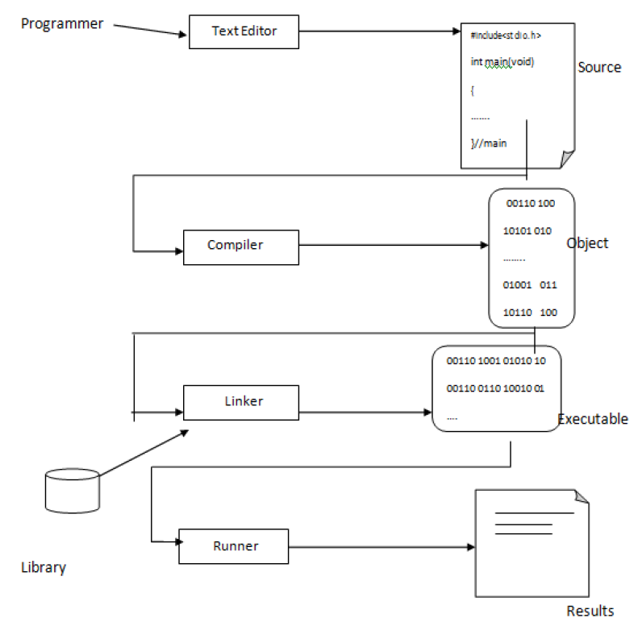
PROCESS OF COMPILING AND RUNNING C PROGRAM

Slide 46
STRUCTURE
Basic Structure of a C Program
The skeleton every C program follows, in order
1
Documentation Section
structure.c
Comments describing the program (optional)
// 1. Documentation section
#include <stdio.h> // 2. Header file
int total; // 3. Global declaration
int main() { // 4. main() function
int a = 5; // -- declaration part
total = a + 10; // -- executable part
printf("%d", total);
return 0;
}
int square(int x) { // 5. User-defined func
return x * x;
}
2
Header File Section
#include statements — bring in ready-made functions
3
Global Declaration
Variables/functions visible to the whole file
4
main() Function
Program execution always starts here
5
↳ Declaration Part
Variables used inside main() are declared
6
↳ Executable Part
The actual statements that do the work
7
User-Defined Functions
Extra functions written by the programmer
Output: 15
04

Slide 47
STRUCTURE
Sections of a C Program — Explained
Documentation section
  Comments (// or /* */). Ignored by the compiler; they only help humans understand the code.
Header file section
  Files like stdio.h contain ready-made functions. #include copies their declarations into your file before compiling.
Global declaration
  Variables declared outside every function. They can be used by main() and by any other function.
main() function
  Every C program MUST have exactly one main(). Execution always begins here, regardless of where other functions are written.
Declaration + Executable parts
  Inside main(), variables are declared first, then statements that use them are written and run in order.
User-defined functions
  Reusable blocks of code written by the programmer, usually placed after main() and called when needed.
sections.c
#include <stdio.h>
int square(int x) { // user-defined
return x * x; // function
}
int main() {
int n = 4; // declaration part
int ans = square(n); // executable part
printf("Square = %d", ans);
return 0;
}
Output: Square = 16
05

Slide 48
TOKENS
Character Set
Meaning
  A character denotes any alphabet, digit, or special symbol used to form words and expressions.
Letters
  Upper-case A–Z and lower-case a–z.
Digits
  All decimal digits 0–9, used in numbers and constants.
Special characters
  Symbols such as + - * / = ( ) { } , ; used as operators and punctuation.
White space
  Blanks, tabs and newlines that separate tokens but are otherwise ignored.
charset.c
#include <stdio.h>
int main() {
char letter = 'A'; // a letter
int digit = 7; // a digit
char symbol = '+'; // special char
printf("%c %d %c", letter, digit, symbol);
return 0;
}
Output: A 7 +
06

Slide 49
TOKENS
Tokens in C
Meaning
  The smallest individual units of a C program are called tokens.
Six types
  Keywords, Identifiers, Constants, Strings, Operators, Special symbols.
Compiler’s view
  The compiler splits every line into tokens before translating it to machine code.
Example
  The statement on the right breaks down into 7 separate tokens.
Why it matters
  Recognising tokens helps you read compiler errors and program structure.
tokens.c
int total = a + 5;
// int -> keyword
// total -> identifier
// = -> operator
// a -> identifier
// + -> operator
// 5 -> constant
// ; -> special symbol
Output: 7 tokens found in this line
07

Slide 50
TOKENS
Identifiers
Meaning
  User-defined names given to variables, functions, and arrays.
First character
  Must start with a letter (a-z, A-Z) or an underscore.
Rest of the name
  Only letters, digits, and underscores are allowed after that.
Case sensitive
  age and Age are two different identifiers in C.
Restriction
  A keyword cannot be used as an identifier; only the first 31 characters are checked.
identifiers.c
#include <stdio.h>
int main() {
int age = 19; // valid
float _price = 9.5; // valid
int Age = 20; // different from age
printf("%d %.1f", age, _price);
return 0;
}
Output: 19 9.5
08

Slide 51
TOKENS
Keywords
Meaning
  Reserved words that already have a fixed meaning built into the compiler.
Rule
  Always written in lowercase; cannot be redefined or used as identifiers.
Count
  C has exactly 32 keywords — the whole language is built from just these.
Building blocks
  They form the basic vocabulary for every statement you write.
Examples
  int, if, for, while, return, void, and 26 others.
keywords.c
auto break case char
const continue default do
double else enum extern
float for goto if
int long register return
short signed sizeof static
struct switch typedef union
unsigned void volatile while
Output: 32 reserved words
09

Slide 52
DATA CONCEPTS
Constants
Meaning
  A constant is a fixed value that does NOT change while the program runs.
Integer constant
  Whole numbers, e.g. 10, -5, 2000.
Real constant
  Numbers with a decimal point, e.g. 3.14, -0.5.
Character constant
  A single character in single quotes, e.g. 'A'.
String constant
  Text in double quotes, e.g. "Hello".
  Backslash / Escape Constant
  Special non-printable characters using backslash
  Example : '\n' newline, '\t' tab, '\0' null
constants.c
#include <stdio.h>
#define PI 3.14159 // symbolic constant
int main() {
const int MAX = 100; // const keyword
char grade = 'A';
printf("PI = %f\n", PI);
printf("MAX = %d\n", MAX);
printf("Grade = %c", grade);
return 0;
}
Output: PI = 3.14159, MAX = 100, Grade = A
10

Slide 53
DATA CONCEPTS
Variables
Meaning
  A variable is a named memory location whose value CAN change during execution.
Naming rules
  Start with a letter or underscore, only letters/digits/underscore, no spaces, and not a keyword like int or for.
Declaration
  You must state the data type before using a variable, e.g. int age;
Assignment
  Use = to store a value in a variable, e.g. age = 19;
variables.c
#include <stdio.h>
int main() {
int age = 19;
float height = 5.8;
char initial = 'R';
age = age + 1; // value changes
printf("Age: %d\n", age);
printf("Height: %.1f", height);
return 0;
}
Output: Age: 20, Height: 5.8
11

Slide 54
DATA CONCEPTS
Expressions
Meaning
  A combination of variables, constants, and operators that computes a single value.
Arithmetic expression
  a + b * c → uses +, -, *, / to calculate a number.
Relational expression
  a > b → gives a true (1) or false (0) result.
Logical expression
  (a > 0) && (b > 0) → combines conditions into one true/false result.
How it is evaluated
  C follows operator precedence rules, similar to normal maths (BODMAS) — covered in detail later.
expression.c
#include <stdio.h>
int main() {
int a = 10, b = 4, c = 2;
int result = a + b * c;
// b*c is done first = 8
// then a+8 = 18
printf("Result = %d", result);
return 0;
}
Output: Result = 18
12

Slide 55
DATA CONCEPTS
Errors in C
Syntax error
  Breaks the grammar rules of C, e.g. a missing semicolon. Caught by the compiler before the program runs.
Logical error
  The program runs and compiles, but gives the wrong answer, e.g. using * instead of +.
Runtime error
  Happens while the program is running, e.g. dividing a number by zero.
Tip
  Always read compiler error messages carefully — they show the exact line number to check.
errors.c
#include <stdio.h>
int main() {
printf("Hi") // <- Syntax error:
// missing semicolon
int a = 5, b = 2;
int wrong = a * b; // Logical error
// (should be a + b)
return 0;
}
Output: Compiler: error: expected ';'
13

Slide 56
OPERATORS
Operators — Overview
Meaning
  Symbols that tell the compiler to perform a specific operation on one or more operands.
Coming up next
  The following slides explain each category below in full detail, one at a time.
operators.c
#include <stdio.h>
int main() {
int a = 9, b = 4;
printf("Sum: %d\n", a + b);
printf("Equal? %d\n", a == b);
printf("Both +ve? %d\n", a>0 && b>0);
a += b; // assignment operator
a++; // increment operator
printf("a: %d", a);
return 0;
}
Category | Example Symbols | Purpose
Arithmetic | + - * / % | Perform maths calculations
Relational | == != > < >= <= | Compare two values
Logical | && || ! | Combine true/false conditions
Assignment | = += -= *= /= %= | Store / update values
Increment & Decrement | ++ -- | Increase or decrease by 1
Bitwise | & | ^ ~ << >> | Operate on individual bits
Output: Sum: 13, Equal? 0, Both +ve? 1, a: 14
14

Slide 57
OPERATORS
Arithmetic Operators
Meaning
  Used to perform basic maths on numeric operands (int, float, double).
arithmetic.c
#include <stdio.h>
int main() {
int a = 9, b = 4;
printf("Add: %d\n", a + b);
printf("Sub: %d\n", a - b);
printf("Mul: %d\n", a * b);
printf("Div: %d\n", a / b);
printf("Mod: %d\n", a % b);
return 0;
}
Operator | Meaning | Example (a=9, b=4)
+ | Addition | a + b → 13
- | Subtraction | a - b → 5
* | Multiplication | a * b → 36
/ | Division | a / b → 2 (integer division)
% | Modulus (remainder) | a % b → 1
Note: 9 / 4 gives 2, not 2.25 — dividing two int values drops the decimal part. Use float to keep it.
Output: Add:13 Sub:5 Mul:36 Div:2 Mod:1
15

Slide 58
OPERATORS
Relational Operators
Meaning
  Compare two values. The result is always 1 (true) or 0 (false).
relational.c
#include <stdio.h>
int main() {
int a = 9, b = 4;
printf("%d\n", a == b);
printf("%d\n", a != b);
printf("%d\n", a > b);
if (a > b) {
printf("a is bigger");
}
return 0;
}
Operator | Meaning | Example (a=9, b=4)
== | Equal to | a == b → 0
!= | Not equal to | a != b → 1
> | Greater than | a > b → 1
< | Less than | a < b → 0
>= | Greater or equal | a >= 9 → 1
<= | Less or equal | a <= 4 → 0
Output: 0, 1, 1, a is bigger
16

Slide 59
OPERATORS
Logical Operators
Meaning
  Combine two or more conditions into a single true/false result.
Short-circuit rule
  && stops as soon as one side is false; || stops as soon as one side is true.
logical.c
#include <stdio.h>
int main() {
int marks = 78, attendance = 85;
if (marks >= 40 && attendance >= 75) {
printf("Eligible for exam");
} else {
printf("Not eligible");
}
return 0;
}
Operator | Name | True when...
&& | Logical AND | BOTH sides are true
|| | Logical OR | AT LEAST ONE side is true
! | Logical NOT | Reverses true to false, and false to true
Output: Eligible for exam
17

Slide 60
OPERATORS
Assignment & Increment/Decrement
Assignment operators
  Shorthand ways to update a variable using its own current value.
++ and --
  Pre (++a) changes the value first, then uses it. Post (a++) uses the current value first, then changes it.
increment.c
#include <stdio.h>
int main() {
int a = 5;
printf("a++ (post) = %d\n", a++);
printf("now a = %d\n", a);
int b = 5;
printf("++b (pre) = %d\n", ++b);
printf("now b = %d", b);
return 0;
}
Operator | Same as | Example (a=5)
a += 2 | a = a + 2 | a becomes 7
a -= 2 | a = a - 2 | a becomes 3
a *= 2 | a = a * 2 | a becomes 10
a /= 2 | a = a / 2 | a becomes 2 (int)
Output: a++ = 5, now a = 6 | ++b = 6, now b = 6
18

Slide 61
Bitwise Operators
Bitwise operators work directly on the individual bits (the 0s and 1s) that make up a number — not on the number as a whole. They are useful for low-level tasks like flags, masking, and fast math.
&
|
~
^
<<
>>
AND
OR
NOT
XOR
LEFT SHIFT
RIGHT SHIFT
We'll go through each one — what it means, its truth table, and a working C example.
03

Slide 62
BITWISE OPERATOR
AND Operator ( & )
&
Compares two numbers bit by bit. The result bit is 1 only when BOTH bits are 1 — otherwise it's 0. Simple rule: both switches must be ON for the light to turn on.
C CODE EXAMPLE
#include <stdio.h>
int main() {
int a = 12; // 1100
int b = 10; // 1010
int result = a & b;
printf("%d & %d = %d",
a, b, result);
return 0;
}
TRUTH TABLE
A | B | A & B
0 | 0 | 0
0 | 1 | 0
1 | 0 | 0
1 | 1 | 1
Output: 12 & 10 = 8
BIT-BY-BIT VIEW
a = 1100 (12)
b = 1010 (10)
a&b= 1000 (8)
Common use: checking or "masking" whether a specific bit is turned on/True/1.
04

Slide 63
BITWISE OPERATOR
OR Operator ( | )
|
Compares two numbers bit by bit. The result bit is 1 if AT LEAST ONE of the bits is 1. It's 0 only when both are 0. Simple rule: if either switch is ON, the light turns on.
C CODE EXAMPLE
#include <stdio.h>
int main() {
int a = 12; // 1100
int b = 10; // 1010
int result = a | b;
printf("%d | %d = %d",
a, b, result);
return 0;
}
TRUTH TABLE
A | B | A | B
0 | 0 | 0
0 | 1 | 1
1 | 0 | 1
1 | 1 | 1
Output: 12 | 10 = 14
BIT-BY-BIT VIEW
a = 1100 (12)
b = 1010 (10)
a|b= 1110 (14)
Common use: SETTING (turning on) specific bits in a number.
05

Slide 64
BITWISE OPERATOR
XOR Operator ( ^ )
^
XOR means "exclusive OR." The result bit is 1 when the two bits are DIFFERENT, and 0 when they are the SAME. Simple rule: the light turns on only if exactly one switch is ON, not both.
C CODE EXAMPLE
#include <stdio.h>
int main() {
int a = 12; // 1100
int b = 10; // 1010
int result = a ^ b;
printf("%d ^ %d = %d",
a, b, result);
return 0;
}
TRUTH TABLE
A | B | A ^ B
0 | 0 | 0
0 | 1 | 1
1 | 0 | 1
1 | 1 | 0
Output: 12 ^ 10 = 6
BIT-BY-BIT VIEW
a = 1100 (12)
b = 1010 (10)
a^b= 0110 (6)
Fun fact: a ^ a = 0 always. This trick lets you swap two variables without a temp variable.
07

Slide 65
BITWISE OPERATOR
NOT Operator ( ~ )
~
NOT works on just ONE number (a unary operator). It flips every single bit: every 0 becomes 1, and every 1 becomes 0. This is called the "one's complement." Because C stores negative numbers in two's complement form, flipping all bits of a number gives −(a + 1).
C CODE EXAMPLE
#include <stdio.h>
int main() {
int a = 12;
int result = ~a;
printf("~%d = %d",
a, result);
return 0;
}
Output: ~12 = -13
BIT-BY-BIT VIEW
a = 00000000 00000000 00000000 00001100
~a = 11111111 11111111 11111111 11110011
Rule of thumb: ~a is always equal to −(a + 1).
06

Slide 66
BITWISE OPERATOR
Left Shift ( << )
<<
Left shift moves every bit to the LEFT by a given number of positions, and fills the empty spots on the right with 0. Shifting left by n positions is the same as multiplying the number by 2ⁿ.
C CODE EXAMPLE
#include <stdio.h>
int main() {
int a = 5; // 00000101
int result = a << 2;
printf("%d << 2 = %d",
a, result);
return 0;
}
Output: 5 << 2 = 20
BIT-BY-BIT VIEW
a = 00000101 (5)
a << 2 = 00010100 (20)
Quick formula: a << n is the same as a × 2ⁿ (here, 5 × 2² = 20).
08

Slide 67
BITWISE OPERATOR
Right Shift ( >> )
>>
Right shift moves every bit to the RIGHT by a given number of positions. For positive numbers the empty spots on the left are filled with 0. Shifting right by n positions is the same as dividing the number by 2ⁿ (dropping any remainder).
C CODE EXAMPLE
#include <stdio.h>
int main() {
int a = 20; // 00010100
int result = a >> 2;
printf("%d >> 2 = %d",
a, result);
return 0;
}
Output: 20 >> 2 = 5
BIT-BY-BIT VIEW
a = 00010100 (20)
a >> 2 = 00000101 (5)
Quick formula: a >> n is the same as a ÷ 2ⁿ (here, 20 ÷ 2² = 5).
09

Slide 68
SUMMARY
Bitwise Operators — Cheat Sheet
Operator | Symbol | Meaning (Simple English) | Example
AND | & | 1 only if BOTH bits are 1 | 12 & 10 = 8
OR | | | 1 if AT LEAST ONE bit is 1 | 12 | 10 = 14
NOT | ~ | Flips every bit (0↔1) | ~12 = -13
XOR | ^ | 1 only if bits are DIFFERENT | 12 ^ 10 = 6
Left Shift | << | Shifts bits left, fills 0 (× 2ⁿ) | 5 << 2 = 20
Right Shift | >> | Shifts bits right (÷ 2ⁿ) | 20 >> 2 = 5
Tip: bitwise operators work on the binary form of a number — always convert to binary first when you're unsure of the result.
10

Slide 69
TERNARY OPERATOR
The Ternary Operator: ?:
C's only operator that takes three operands. It evaluates a condition and returns one of two expressions — a compact, inline replacement for a simple if...else that assigns or returns a value.
ternary_vs_if.c
int a = 12, b = 45;
int max;
// Equivalent if...else:
if (a > b)
max = a;
else
max = b;
// Same logic, one line:
max = (a > b) ? a : b;
condition ? expr_if_true : expr_if_false;
?
Separates the condition from the two results
:
Separates the true-value from the false-value
=
The whole expression evaluates to a single value
Nested if & Ternary Operator in C
7

Slide 70
TERNARY · EXAMPLE 1
Maximum of Two Numbers
max_of_two.c
OUTPUT
#include <stdio.h>
int main() {
int a = 20, b = 35;
int max = (a > b) ? a : b;
printf("Max = %d", max);
return 0;
}
Max = 35
READ IT ALOUD
"If a is greater than b, the expression is a — otherwise it's b." The result is assigned to max directly, with no separate variable declaration inside branches.
Nested if & Ternary Operator in C
8

Slide 71
TERNARY · EXAMPLE 2
Even or Odd Check
even_odd.c
OUTPUT
#include <stdio.h>
int main() {
int n = 17;
printf("%d is %s",
n,
(n % 2 == 0) ? "Even" : "Odd");
return 0;
}
17 is Odd
WHY IT'S HANDY
The ternary sits directly inside the printf() argument list — no temporary variable or separate if block needed just to pick a string to print.
Nested if & Ternary Operator in C
9

Slide 72
TERNARY · EXAMPLE 3
Nested Ternary Operators
Ternaries can be chained by using another ternary as the false-branch — mirroring an else-if ladder in one expression.
nested_ternary.c
OUTPUT
#include <stdio.h>
int main() {
int marks = 82;
char grade = (marks >= 90) ? 'A' :
(marks >= 75) ? 'B' :
(marks >= 60) ? 'C' : 'F';
printf("Grade: %c", grade);
return 0;
}
Grade: B
marks = 82 fails the ≥90 test, passes ≥75, so grade = 'B'.
⚠ READABILITY CAUTION
Nesting beyond 2 levels gets hard to read fast. Many teams cap ternaries at one level and use if...else ladders for anything deeper.
Nested if & Ternary Operator in C
10

Slide 73
Data Types in C
C DATA TYPES
PRIMITIVE (Basic Types)
NON-PRIMITIVE (Derived / User-Defined)
int
float
double
char
void
Array
Pointer
Structure
Union
Enum
Whole numbers
Decimal numbers
Large decimals
Single character
No value / empty
Same-type collection
Stores an address
Groups mixed types
Shares memory
Named constants
4 bytes
4 bytes
8 bytes
1 byte
0 bytes
PRIMITIVE — EXAMPLE
NON-PRIMITIVE — EXAMPLE
int age = 25;
float pi = 3.14;
char grade = 'A';
int marks[5] = {90, 85, 77, 60, 95};
struct Student {
int id;
char name[20];
};
02

Slide 74
DATA CONCEPTS
Data Types
What are data types?
  They tell the compiler what kind of value a variable will store, and how much memory to reserve.
datatypes.c
#include <stdio.h>
int main() {
int age = 20;
float price = 99.5;
char grade = 'A';
double pi = 3.14159265;
printf("%d %.1f %c %lf",
age, price, grade, pi);
return 0;
}
Type | Example | Size*
int | 25, -7 | 4 bytes
float | 3.14 | 4 bytes
char | 'A' | 1 byte
double | 3.14159265 | 8 bytes
void | (no value) | —
*Sizes are typical on most systems (may vary by compiler).
Output: 20 99.5 A 3.141593
20

Slide 75
Data Types in C
Category | Type | Size (typical) | Range / Use
Primary | int | 2 or 4 bytes | -32,768 to 32,767 (16-bit) or larger
Primary | float | 4 bytes | ~ ±3.4E-38 to ±3.4E+38, 6 digit precision
Primary | double | 8 bytes | Larger range & precision than float
Primary | char | 1 byte | -128 to 127 (stores one character)
Primary | void | — | Represents 'no value' (empty return type)
Modifiers | short, long, signed, unsigned | varies | Modify size/range, e.g. unsigned int, long int
Derived | array, pointer, function | varies | Built from primary types
User-defined | struct, union, enum, typedef | varies | Programmer-defined custom types
7

Slide 76
STATEMENTS
Declarations
Meaning
  A declaration tells the compiler the name and data type of a variable before it is used.
Syntax
  data_type variable_name;
Multiple variables
  You can declare several variables of the same type in one line, separated by commas.
Initialization
  Giving a value at the time of declaration, e.g. int x = 5;
declare.c
#include <stdio.h>
int main() {
int x, y, z; // declaration
int total = 0; // declaration +
// initialization
x = 2; y = 3; z = 4;
total = x + y + z;
printf("Total = %d", total);
return 0;
}
Output: Total = 9
21

Slide 77
STATEMENTS
Input–Output Statements
printf()
  Used to display (print) output on the screen.
scanf()
  Used to read (accept) input typed by the user.
Format specifiers
  %d for int, %f for float, %c for char, %s for string.
The & symbol
  scanf needs & before a variable name to store the value at its memory address.
io.c
#include <stdio.h>
int main() {
int age;
printf("Enter your age: ");
scanf("%d", &age); // input
printf("You are %d years old",
age); // output
return 0;
}
Output: Enter your age: 19 -> You are 19 years old
22

Slide 78
STATEMENTS
Compound Statements
Meaning
  Also called a block. A group of two or more statements enclosed in curly braces { }.
Treated as one unit
  The compiler treats the whole block as a single statement, usually after if, else, for, while.
Scope
  Variables declared inside a block exist only inside that block.
compound.c
#include <stdio.h>
int main() {
int marks = 75;
if (marks >= 40) { // block starts
printf("Result: Pass\n");
printf("Marks: %d", marks);
} // block ends
return 0;
}
Output: Result: Pass, Marks: 75
23

Slide 79
CONTROL FLOW
if & if-else Statement
Syntax: if (condition) { ... } else { ... }
if_else.c
#include <stdio.h>
int main() {
int marks = 82;
if (marks >= 90) {
printf("Grade: A");
} else if (marks >= 75) {
printf("Grade: B");
} else if (marks >= 40) {
printf("Grade: C");
} else {
printf("Grade: Fail");
}
return 0;
}
if statement
  Runs its block ONLY when the condition is true. Nothing happens if it is false.
if-else statement
  Runs one block if the condition is true, and a different block if it is false.
else-if ladder
  Chain several conditions with else if to check them one by one, top to bottom.
Output: Grade: B
24

Slide 80
NESTED IF
What Is a Nested if?
An if statement placed inside the body of another if (or else) statement. It lets a program test a second condition only after the first one has already been satisfied — useful for layered, dependent decisions.
syntax.c
if (condition1) {
if (condition2) {
// runs when BOTH
// conditions are true
} else {
// condition1 true,
// condition2 false
}
} else {
// condition1 is false
}
Inner if only runs when the outer condition is true
Each level narrows the decision further
Can be nested to any depth (keep it readable!)
Nested if & Ternary Operator in C
3

Slide 81
NESTED IF · EXAMPLE 1
Largest of Three Numbers
largest.c
OUTPUT
#include <stdio.h>
int main() {
int a = 12, b = 45, c = 7;
if (a >= b) {
if (a >= c)
printf("%d is largest", a);
else
printf("%d is largest", c);
} else {
if (b >= c)
printf("%d is largest", b);
else
printf("%d is largest", c);
}
return 0;
}
45 is largest
HOW IT DECIDES
1
Outer if compares a vs b to shrink to a 2-way race
2
If a >= b: inner if compares a vs c
3
Else: inner if compares b vs c
4
Only 2 real comparisons ever run
Nested if & Ternary Operator in C
5

Slide 82
NESTED IF · EXAMPLE 2
Grading System
grading.c
OUTPUT
#include <stdio.h>
int main() {
int marks = 76;
if (marks >= 90) {
printf("Grade: A+");
} else {
if (marks >= 75) {
printf("Grade: A");
} else {
if (marks >= 60)
printf("Grade: B");
else
printf("Grade: C");
}
}
return 0;
}
Grade: A
WHY THIS SHAPE?
Each else branch opens a fresh if, pushing the check one band lower (90, then 75, then 60). This ladder pattern is the most common real-world use of nested if — and is often rewritten as else if for readability.
Nested if & Ternary Operator in C
6

Slide 83
CONTROL FLOW
switch Statement
Syntax: switch (var) { case v1: ...break; default: ... }
switch.c
#include <stdio.h>
int main() {
int day = 3;
switch (day) {
case 1: printf("Monday"); break;
case 2: printf("Tuesday"); break;
case 3: printf("Wednesday"); break;
default:
printf("Invalid day");
}
return 0;
}
Meaning
  Checks one variable against many possible values (cases), and runs the matching block.
break is important
  Without break, execution 'falls through' into the next case, running it too.
default
  Runs when no case matches. Similar to the final else in an if-else ladder.
Output: Wednesday
25

Slide 84
CONTROL FLOW
Conditions
Meaning
  An expression that is checked to see if it is true (1) or false (0).
Built using
  Relational operators (==, !=, >, <, >=, <=) seen earlier.
Combined using
  Logical operators (&&, ||, !) to test more than one thing at once.
Used in
  if, while, for, and do-while statements to control which code runs.
conditions.c
#include <stdio.h>
int main() {
int age = 20, hasID = 1;
if (age >= 18 && hasID == 1) {
printf("Entry allowed");
} else {
printf("Entry denied");
}
return 0;
}
Output: Entry allowed
26

Slide 85
CONTROL FLOW
Operators and Its Precedence
What is precedence?
  The order in which operators are evaluated in an expression, just like BODMAS in maths.
Same precedence?
  Then associativity decides direction — most operators go left to right.
precedence.c
#include <stdio.h>
int main() {
int result = 10 + 2 * 5;
// * runs before + (precedence)
// 2*5 = 10, then 10+10 = 20
printf("Result = %d", result);
return 0;
}
Order | Operators
1 (highest) | ( ) parentheses
2 | * / %
3 | + -
4 | < <= > >=
5 | == !=
6 | &&
7 (lowest) | ||
Output: Result = 20
27

Slide 86
CONTROL FLOW
Branching: break & continue
Meaning
  Both are jump statements used INSIDE loops to change the normal flow.
break
  Immediately exits (stops) the nearest loop or switch statement completely.
continue
  Skips only the rest of the current cycle, then moves on to the next repetition.
Difference
  break ends the loop early; continue just skips one round and keeps looping.
break_continue.c
#include <stdio.h>
int main() {
for (int i = 1; i <= 6; i++) {
if (i == 5) {
break; // stop looping
}
if (i % 2 == 0) {
continue; // skip even nums
}
printf("%d ", i);
}
return 0;
}
Output: 1 3
28

Slide 87
CONTROL FLOW
Branching: goto Statement
Syntax: goto label; ... label: statement;
goto.c
#include <stdio.h>
int main() {
int i = 1;
start: // label
printf("%d ", i);
i++;
if (i <= 5) {
goto start; // jump back up
}
return 0;
}
Meaning
  Jumps program control directly to a labeled line, skipping normal top-to-bottom flow.
Label
  A name followed by a colon (:) placed before the target statement.
Use with caution
  goto can make programs hard to read and debug. Loops and functions are usually a better choice.
Output: 1 2 3 4 5
29

Slide 88
CONTROL FLOW
Looping: for Statement
Syntax: for (init; condition; update) { ... }
for_loop.c
#include <stdio.h>
int main() {
int sum = 0;
for (int i = 1; i <= 10; i++) {
sum = sum + i;
}
printf("Sum = %d", sum);
return 0;
}
Meaning
  Repeats a block a fixed, known number of times. Entry-controlled — the condition is checked before every run.
Step-by-step flow
  1) init runs once 2) condition is checked 3) if true, body runs 4) update runs 5) repeat from step 2.
Best used when
  You already know how many times to repeat, e.g. looping from 1 to 10.
Output: Sum = 55
30

Slide 89
CONTROL FLOW
Looping: while Statement
Syntax: while (condition) { ... }
while_loop.c
#include <stdio.h>
int main() {
int n = 5;
while (n > 0) {
printf("%d ", n);
n--;
}
return 0;
}
Meaning
  Repeats a block WHILE the condition stays true. Entry-controlled — checked before each run, just like for.
Flow
  Check condition → if true, run body → check again → stops the moment it becomes false.
Best used when
  You don't know exactly how many repeats are needed, only the condition to stop on.
Output: 5 4 3 2 1
31

Slide 90
CONTROL FLOW
Looping: do-while Statement
Syntax: do { ... } while (condition);
do_while.c
#include <stdio.h>
int main() {
int n = 1;
do {
printf("%d ", n);
n++;
} while (n <= 3);
return 0;
}
Meaning
  Similar to while, but exit-controlled — the body runs FIRST, and the condition is checked AFTER.
Key difference
  A do-while loop always runs at least once, even if the condition is false right from the start.
Best used when
  The loop body must execute at least one time, e.g. showing a menu before asking to repeat.
Output: 1 2 3
32

Slide 91
PRACTICE
Practice Questions
Try writing C programs for each of these on your own.
1
Write a C program to declare two integer variables, take their values from the user, and print their sum using printf() and scanf().
2
Write a C program using an if-else statement to check whether a given number is positive, negative, or zero.
3
Write a C program that uses a for loop to print the multiplication table of a number entered by the user.
4
Write a C program to swap the values of two variables using a third (temporary) variable, and explain each step.
5
Write a C program using a switch statement to print the name of the day of the week for a number entered (1 = Monday, ... 7 = Sunday).
33

