Slide 1
Introduction to the Problem
GOAL: Minimize hospital cost for thyroid disorder diagnosis
BACKGROUND:
Types of diagnosis based on current medical tests:
normal (class 1)
having hyperthyroidism (class 2)
or having hypothyroidism (class 3)
Two types of potential cost associated with thyroid disorder diagnosis
Misdiagnosis cost -- e.g. if patient were to file law suit seeking compensation
Abstention cost (abstaining a diagnosis to mitigate misdiagnosis) -- e.g. forwarding the patient to a thyroid specialist
Total Cost = Misclassification Cost + Abstention Cost
Solution: We have built a new algorithm to automate thyroid disorder diagnosis while minimizing hospital total cost

Slide 2
Our Approach
Patient
(Biomarker 1, Biomarker 2)
Given a patient’s biomarker 1 and biomarker 2 values, model outputs the PROBABILITIES of the patient as
normal (class 1),
having hyperthyroidism (class 2),
or having hypothyroidism (class 3)
Model Prediction
P( Normal )
P( Hyper )
P( Hypo )
Model initially classifies the patient as the class with the highest predicted probabilities
P(Class) = max[ P(Normal), P(Hyper), P(Hypo) ]
Initial Diagnosis:
Class; P(Class)
P(Class) <= optimal threshold
P(Class) > optimal threshold
Final Diagnosis
= Abstain
Final Diagnosis
= Initial Diagnosis

Slide 3
Finding Optimal Probability Threshold for Each Class
Cases are abstained too infrequently
SMALL Abstention cost
0
1
Prone to misdiagnosis
LARGE Misclassification cost
Threshold < optimal
Cases are abstained too frequently LARGE Abstention cost
0
1
Not prone to misdiagnosis
SMALL Misclassification cost
Threshold > optimal
Optimal abstain frequency
0
1
Optimal Thresholds
Class 1 (normal): t = 0.688
Class 2 (hyper): t = 0.812
Class 3 (hypo): t = 0.274
Optimal Misclassification frequency
Optimal threshold

Slide 4
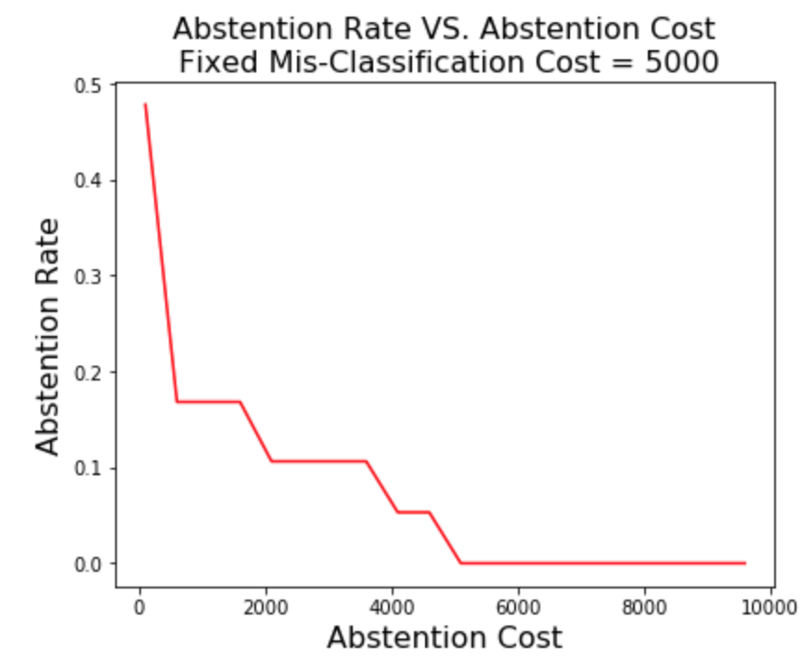
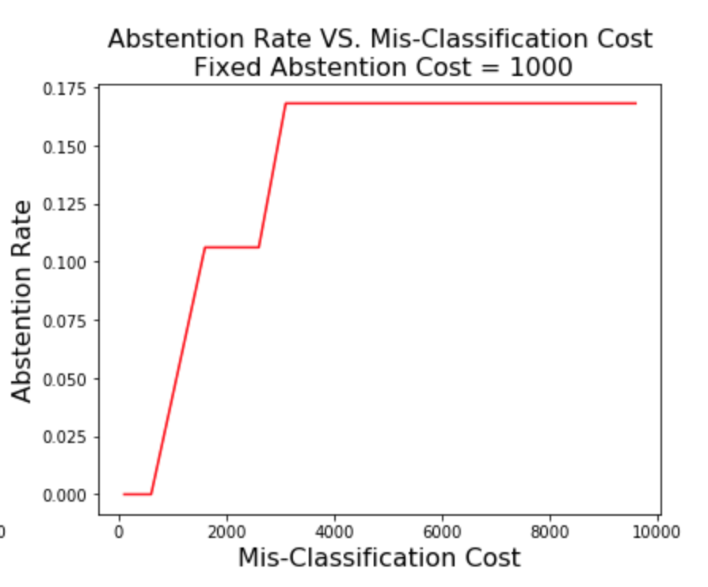
Algorithm Robustness
left plot: Given a misclassification cost, abstention rate decreases as abstention cost increases
right plot: Given a abstention cost, abstention rate increases as misclassification cost increases
This intuitively demonstrate our model's robustness that the total cost would be minimized if either of the following is true:
Abstain less when abstention cost is relatively higher than misclassification cost.
Abstain more when misclassification cost is relatively higher than abstention cost.

Slide 5
Conclusion
We built a new algorithm to automate thyroid disorder diagnosis with an Abstain option while minimizing hospital total cost
We applied our algorithm to One-Vs-Rest Logistic Regression model
We assumed:
Total cost = misclassification cost + abstention cost
Misclassification cost/patient = $5000
Abstention cost/patient = $1000
Model Performance (Have we decreased average cost per patient using the new model?)
Without Abstention option: Average cost/patient = $796.46
With Abstention option: Average cost/patient = $477.88
Average cost saved/patient from using our model = $318.58
Our model is robust to changes in different types of costs

