Slide 1
Investment Manager Robot Based on LLM
Team B3
Yongzhao Mo-ym2918 Yicheng Wang-yw4102
Jinyu Xu-jx2556 Yuhan Xie-yx2850
Jinyu Chen-jc6186 Jiankun Sun-js6418

Slide 2
Contents
1
Overview
2
Chatbot Development
3
Asset Allocation Model
4
Demo

Slide 3
Overview
Who do we serve?
University/College student group
What kind of products should we build?
key steps need to be taken including training natural language processing models, establishing asset allocation algorithms, developing web applications, and constant iterations and optimizations.
What problems do we need to solve?
Lack of financial literacy and experience, requiring tailored financial education and guidance.
Poor monthly budgeting, leading to overspending at the start and tight funds by month-end.
No habit of making financial plans, resulting in disorganized finances.

Slide 4
Chatbot Development
Prompt 1: Directed Conversation
Prompt 2: Extract Insights
A directed conversation with customers by asking them questions from a predefined list in a natural way.
The system extracts insights from unstructured, natural language text in chat logs.
What is prompt engineering?
A technique used to detailed instructions to direct AI models toward desired outcomes.
Essential for accurate, relevant, or creative responses in AI tasks.
Prompt 3: Explain Optimization
The model explains optimization results by transforming structured parameters into fluent, unstructured language.

Slide 5


Chatbot Development
Prompt 1: Directed Conversation
A directed conversation with customers by asking them questions from a predefined list in a natural way.
What are your main financial goals?
How much do you want to keep as funds for emergencies?
What is your comfort level with investment risk? (very low, low, medium, high, very high)
What is your expected rate of return?
What kind of investment period you are looking for? (1-3 years,3-5 years, over 5 years)
Is your investment plan short-term, medium-term, or long-term?
What are your preferred industries? And what is the level of preference? (not interested, a little interested, moderately interested, very interested, extremely interested)
…

Slide 6
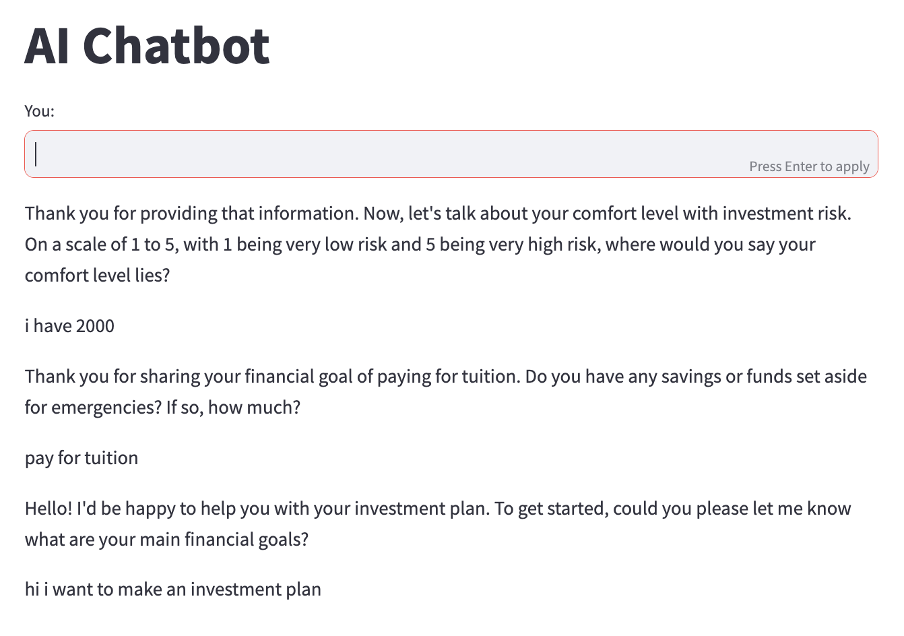
Chatbot Development
Prompt 1: Directed Conversation
A directed conversation with customers by asking them questions from a predefined list in a natural way.

Slide 7
Chatbot Development
Prompt 2: Extract Insights
The system extracts insights from unstructured, natural language text in chat logs.
We quantify some of the user answers using the following criteria:
Risk Tolerance | Volatility
Very low | 5%
Low | 10%
Medium | 15%
High | 20%
Very high | 25%
Investment Period | Volatility Adjustment Factor
1-3 years | 0.7
3-5 years | 1.0
over 5 years | 1.3
Preference Level | Weight
A little interested | 1 - 10%
Moderately interested | 11 - 30%
Very interested | 31 - 50%
Extremely interested | 51 - 100%

Slide 8





Chatbot Development
Prompt 2: Extract Insights
The system extracts insights from unstructured, natural language text in chat logs.
Example output
Money Budget | Emergency Money | Investment Period | Risk Tolerance | Industry Preference | Preference Level | Expected Return
5000 | 1000 | 1-3 year | 20% | healthcare | 11% - 30 % weight | 30%

Slide 9

Chatbot Development
Asset | Weight
SHV US Equity | 0.4
XLV US Equity | 0.31
XLK US Equity | 0.11
USO US Equity | 0.1
XLE US Equity | 0.05
ROBO US Equity | 0.03
Prompt 3: Explain Optimization
The model explains optimization results by transforming structured parameters into fluent, unstructured language.
Example
Model
Output
Row | Constrained Optimization
Total Return | 0.459938569289775
Sharpe Ratio | 0.0296063464276184
Volatility | 0.00685717259460531
Average Turnover | 0.00214935903459497
Max Turnover | 0.354329956891809
Average Return | 0.000241299873397819
Max Drawdown | 0.178491685487022

Slide 10
Chatbot Development
Prompt 3: Explain Optimization
JSON reads some assets and the proportion to be allocated. Please imitate the professional tone of the fund manager and help me explain the results of asset allocation for my clients.
The model explains optimization results by transforming structured parameters into fluent, unstructured language.

Slide 11
Asset Allocation Model
Data Loading
Time Horizon: 12/06/2016 – 10/31/2023 daily price data
Underlying Assets: 27 ETFs
Equity: Large-cap, Mid-cap, Small-cap, Europe, Asia
Sector-specific: Tech, Healthcare, Finance, Real Estate, Consumer, Energy, Industrials, Materials, Communication, Utilities
Bonds: Government, Corporate, High-yield
Commodity: Gold, Oil, Agriculture
International: International, Emerging Markets
Thematic: ESG, AI, Biotech
Cash: Cash

Slide 12
Asset Allocation Model
Parameters Loading from Prompt 2
Example output
Money Budget | Emergency Money | Investment Period | Risk Tolerance | Industry Preference | Preference Level | Expected Return
5000 | 1000 | 1-3 year | 20% | healthcare | 11% - 30 % weight | 30%
Cash Ratio | Volatility Adjustment Factor | Volatility | Industry Preference | Expected Return
1000/5000 * 0.8 = 16% | 0.7 | 20% * 0.7 = 14% | healthcare min weight: 11% healthcare max weight: 30 % | 30%

Slide 13
Asset Allocation Model
Optimization Models in Backtesting Workflow
Min&Max ETFs Weights
Weights Sum Constraint
Expected Return
Max Volatility
Constraints
Strict Constraints
Penalty Terms
Constraints
Type
Constrained Optimization Model
Mean-variance Optimization
Small deviations on ETFs weights
Markowitz
Model
Mean-variance Optimization
Robust Optimization Model
Mean-variance Optimization
Robust term to handle uncertain expected returns
Optimization
Models

Slide 14
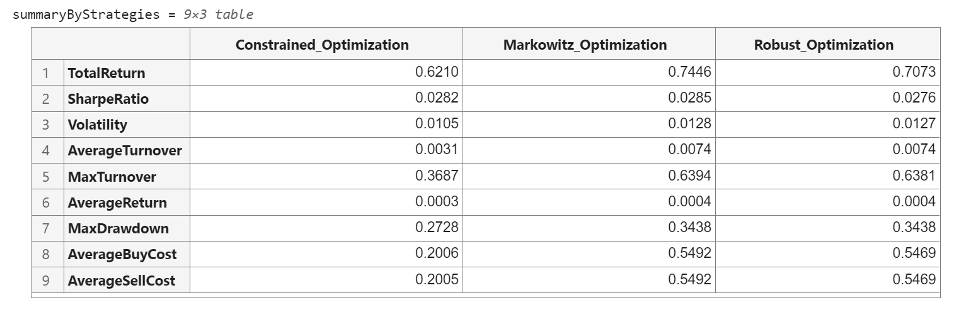
Asset Allocation Model
Backtesting Results
Select the best strategy with highest return

Slide 15
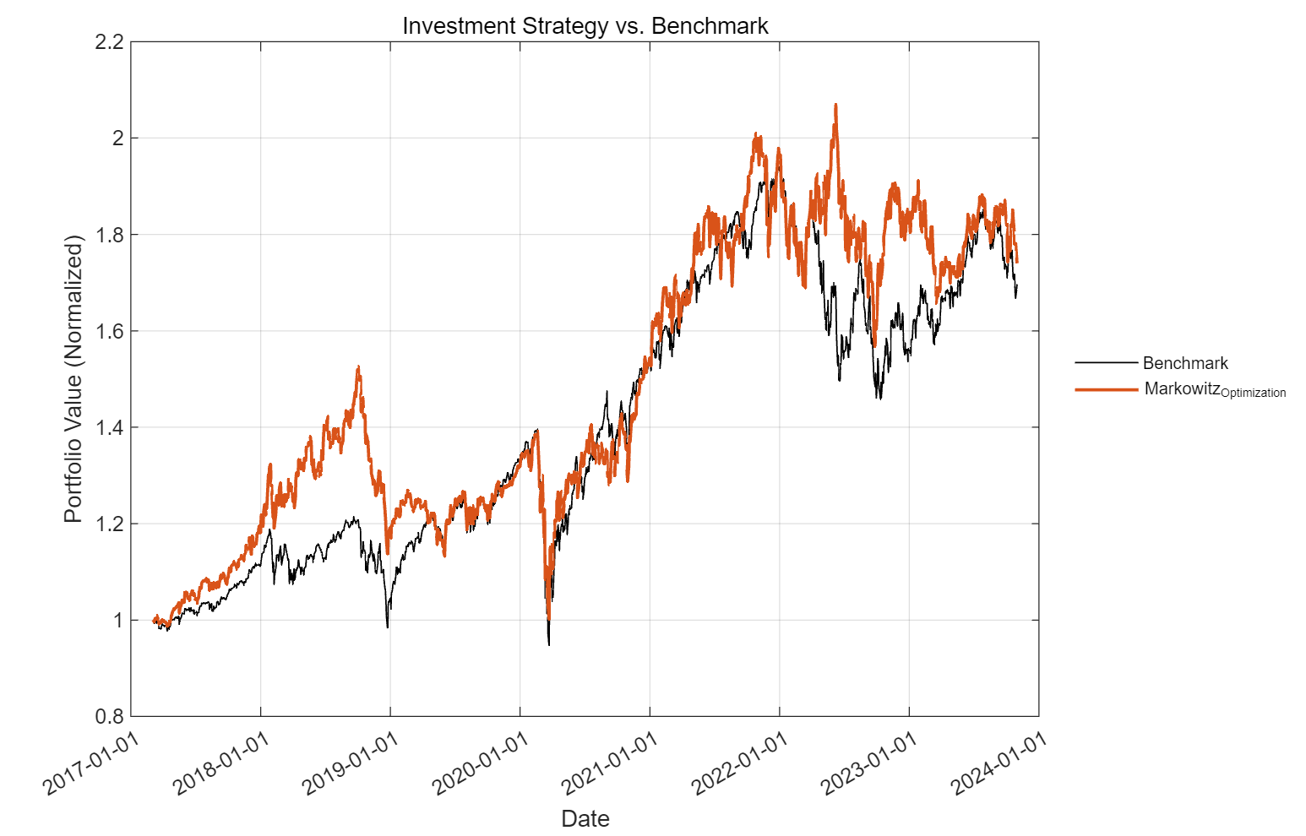
Asset Allocation Model
Backtesting Results
Benchmark =
60% SPY +
40% GOVT
(U.S. Treasury Bond)

Slide 16
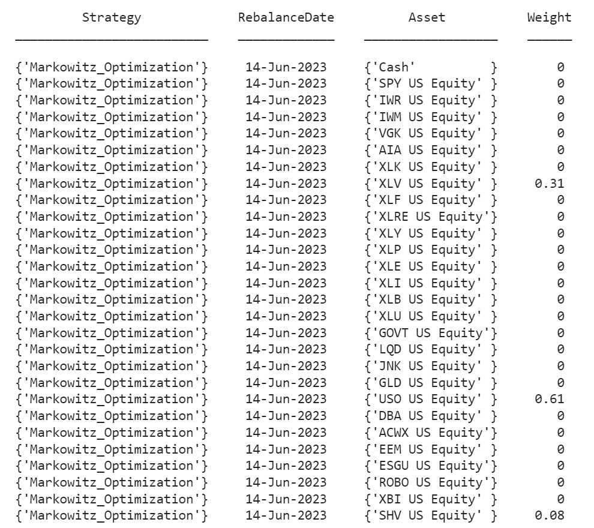
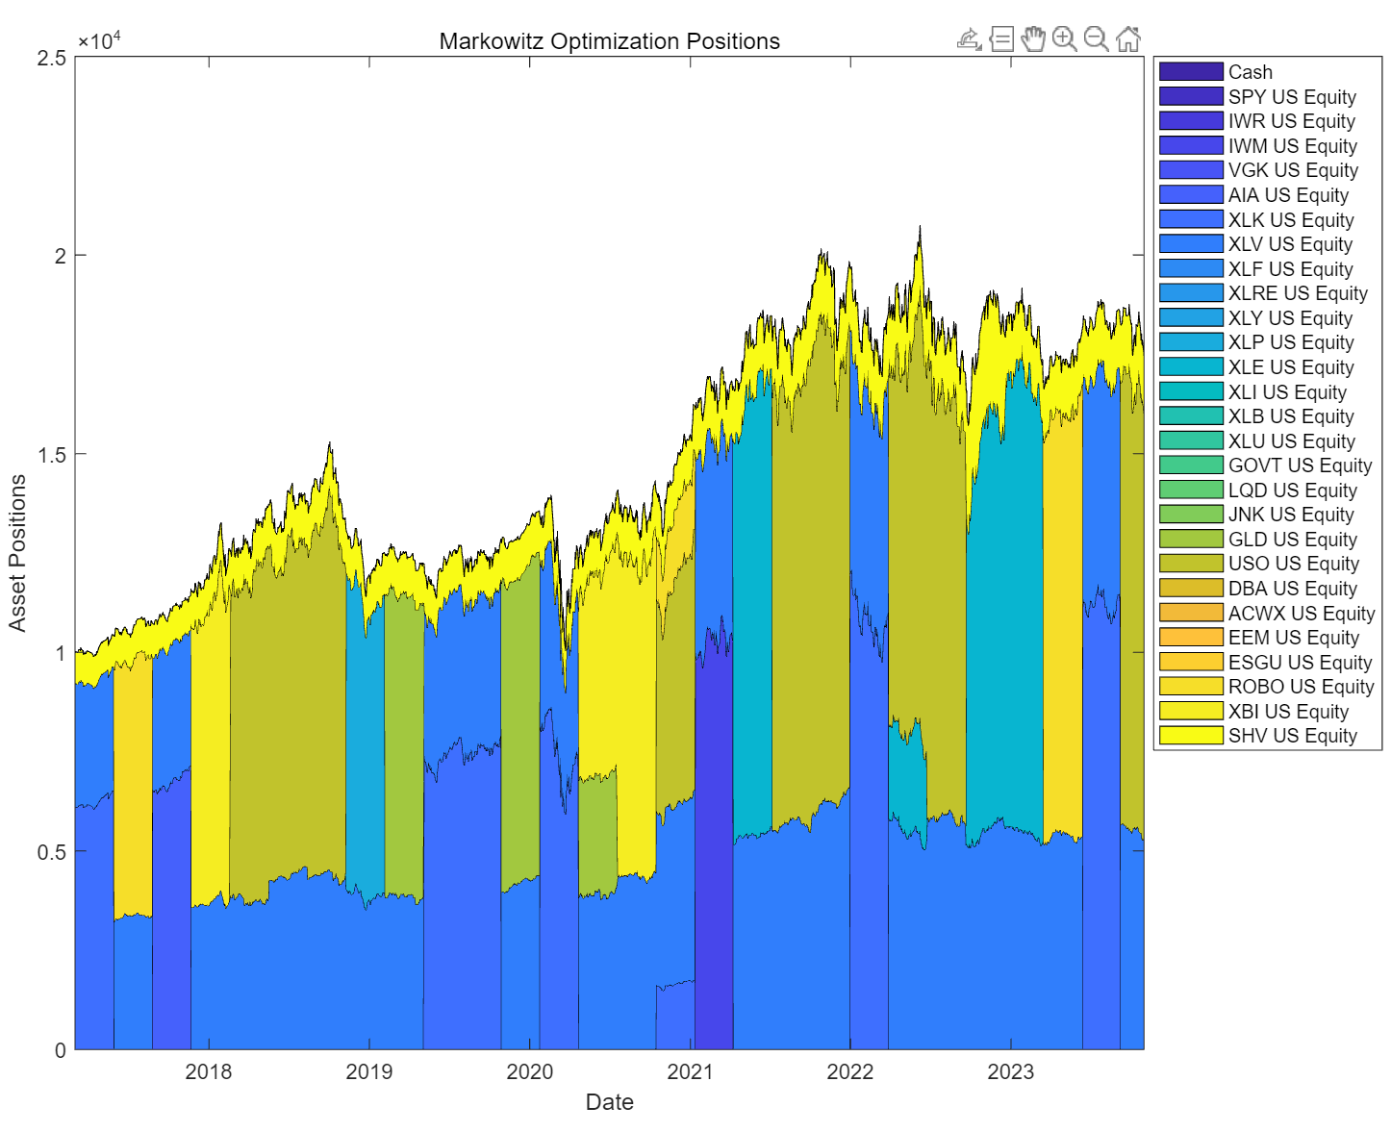
Asset Allocation Model
Backtesting Results

Slide 17
Demo

Slide 18
Investment Manager Robot Based on LLM
Thank you!

