Slide 1
Generating simple geometric shapes using gan
Presented by:
Jasmin Jeba.X
au962821104038
jasminjeba30@gmail.com
B.E. Computer Science & Engineering
University College of Engineering Nagercoil

Slide 2
Outline
Problem statement
Proposed system/solution
System development approach
Algorithm and deployment
Result
Conclusion
References

Slide 3
Problem statement
Develop a Generative Adversarial Network (GAN) to generate synthetic images of simple geometric shapes such as squares, circles, and triangles. The objective is to create a model that can produce realistic-looking shapes resembling those found in the training dataset. The synthetic images should exhibit diverse variations in shapes and positions.

Slide 4
Proposed solution
Generate Simple Geometric Shapes Dataset: The generate_shapes function creates a dataset consisting of images containing circles, squares, and triangles. Each shape is randomly positioned on a blank canvas of a fixed size.
Define Generator Model: The build_generator function defines the generator neural network model, which takes random noise as input and generates synthetic images resembling the simple geometric shapes found in the dataset.
Define Discriminator Model: The build_discriminator function defines the discriminator neural network model, which learns to distinguish between real images from the dataset and fake images generated by the generator.
Build and Compile Models: The generator and discriminator models are built and compiled using the Adam optimizer and binary cross-entropy loss.
Training GAN: The train_gan function trains the GAN model by alternating between training the discriminator and the generator. The discriminator is trained to distinguish between real and fake images, while the generator is trained to generate realistic-looking images to fool the discriminator.

Slide 5
Plot Generated Images: The plot_generated_images function generates and plots synthetic images produced by the generator at regular intervals during training.
Training Loop: The GAN is trained for a specified number of epochs, and the loss values for both the discriminator and the generator are printed during training. Additionally, synthetic images are plotted periodically to visualize the training progress
Testing: Finally, the trained GAN can be used to generate new synthetic images of simple geometric shapes for testing purposes.

Slide 6
System development approach
Hardware Requirements:
CPU or GPU for training the neural network models.
Adequate RAM for handling the dataset and model parameters.
Sufficient storage space for storing datasets, model checkpoints, and generated images.
Software Requirements:
Python programming language for coding the GAN model and associated scripts.
Deep learning frameworks such as TensorFlow or PyTorch for building and training neural network models.
Libraries for data manipulation and visualization, such as NumPy, OpenCV, and Matplotlib.
Development environment like Jupyter Notebook or IDEs like PyCharm for coding and experimentation.
Optional: Image editing software for preprocessing dataset images if needed

Slide 7
Algorithm and deployment
Algorithm:
Data Generation:
Generate a dataset of simple geometric shapes such as circles, squares, and triangles. Each shape can be represented as an image with a white background and the shape drawn with a distinct color.
Randomize the position, size, and color of each shape to create diverse samples.
Generator Model:
Define a generator neural network model that takes random noise as input and generates images of simple shapes.The generator typically consists of several layers of dense and convolutional layers followed by activation functions like ReLU or tanh to map the input noise to the desired image shape and color.
Discriminator Model:
Define a discriminator neural network model that evaluates whether an input image is real (from the dataset) or fake (generated by the generator).The discriminator is trained to distinguish between real and fake images and provides feedback to the generator to improve its performance.
Training Process:
Train the generator and discriminator alternately in a min-max game framework.
During each training iteration, the discriminator is first trained on a batch of real and fake images to improve its ability to differentiate between them.
Then, the generator is trained to generate more realistic images that can fool the discriminator.
This process continues iteratively until the generator generates images that closely resemble the real shapes in the dataset.

Slide 8
Deployment:
Model Deployment:
Once the GAN model is trained and evaluated, it can be deployed in a production environment for generating simple shapes on-demand.
The trained generator model can be saved and loaded into a production system for generating shapes as needed.
API Integration:
Create an API endpoint or service that exposes the trained generator model and accepts requests for generating shapes.
Clients can send requests with parameters such as the type of shape, size, and color preferences, and receive the corresponding generated image in response.
Web or Mobile Application:
Develop a web or mobile application that leverages the GAN model to generate simple shapes interactively.
Users can interact with the application to specify their preferences and receive customized shape images generated in real-time.
Scaling and Maintenance:
Monitor the deployed system for performance, scalability, and reliability.
Scale the infrastructure as needed to handle increased demand or workload.
Regularly update and maintain the model to ensure optimal performance and compatibility with new software updates or requirements.

Slide 9
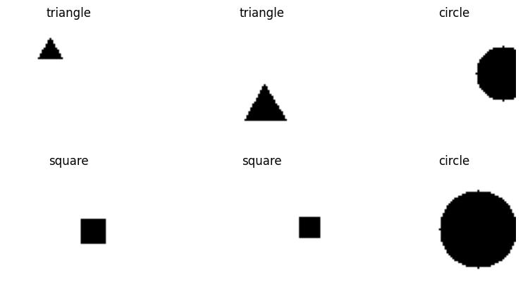
Result

Slide 10
Conclusion
In conclusion, the use of Generative Adversarial Networks (GANs) for generating simple geometric shapes presents a fascinating application of deep learning techniques. By employing a GAN architecture consisting of a generator and discriminator, we can effectively learn the underlying distribution of shape images and generate new samples that closely resemble the shapes in the dataset.
Through the systematic approach outlined above, we can develop and deploy a GAN-based system for generating simple geometric shapes.

