Slide 1
Digital Portfolio
STUDENT NAME: Jasmin mol J
REGISTER NO AND NMID: 2422J1182
DEPARTMENT: BCA
COLLEGE/ UNIVERSITY: JCT College of Arts and Science Bharathiar Unversity

Slide 2
SIMPLE PORTFOLIO WEBSITE

Slide 3


AGENDA
Problem Statement
Project Overview
End Users
Tools and Technologies
Portfolio design and Layout
Features and Functionality
Results and Screenshots
Conclusion
Github Link
3/21/2024 Annual Review

Slide 4

PROBLEM STATEMENT
Design and develop a responsive personal portfolio website for a web developer named Jasmin. The website should serve as a digital resume and project showcase, providing essential information to visitors such as:
A brief introduction about the developer.
A section to highlight selected projects with interactive elements.
Contact details for potential clients or collaborators.
Consistent and aesthetically pleasing design using HTML, CSS, and basic JavaScript.

Slide 5

PROJECT OVERVIEW
The Jasmin Portfolio is a clean, responsive personal website built with HTML, CSS, and JavaScript.
It showcases Jasmin’s web development skills through an "About Me" section, featured projects with interactive
buttons, and contact details.
Key Features:
Responsive layout
Project showcase with interactive buttons
Contact information
Simple and clean design
Tech Stack: HTML5, CSS3, JavaScript

Slide 6

WHO ARE THE END USERS?
The end users of Jasmin's portfolio website are:
🎯 Potential clients looking to hire Jasmin for web development projects
💼 Employers or recruiters evaluating her skills and experience
🧑‍💻 Collaborators or peers interested in networking or teaming up
📚 Visitors or learners exploring her work for inspiration or reference

Slide 7

TOOLS AND TECHNIQUES
🛠️ Tools
HTML – for structuring the content
CSS – for styling and layout
JavaScript – for interactivity (e.g., alert buttons)
Text Editor – like VS Code or Sublime Text
Web Browser – for testing and previewing the site
🧪 Techniques
Semantic HTML – using meaningful tags like <header>, <section>, and <footer>
Responsive Design – layout adapts to different screen sizes
CSS Styling – custom fonts, colors, spacing, and hover effects
Box Model & Flexbox/Grid (optional) – for clean layout control
Event Handling – JavaScript onclick for button actions

Slide 8
PORTFOLIO DESIGN AND LAYOUT
🎨 Design Principles
Clean & Minimalist: Neutral colors, lots of whitespace, clear typography
Consistent Styling: Unified fonts, button styles, and spacing
Responsive Layout: Adapts smoothly to mobile, tablet, and desktop screens
Layout
Section | Purpose
Header | Site title and welcome message
Navigation | Links to About, Projects, and Contact
About | Brief intro and personal bio
Projects | Cards or blocks showcasing key work
Contact | Email, phone, or contact form
Footer | Copyright and closing note
8

Slide 9
FEATURES AND FUNCTIONALITY
✨ Features
Header & Navigation Bar: Clear site title and easy links to sections
About Section: Personal introduction and bio
Projects Section: Highlighted projects with descriptions and buttons
Contact Section: Email and phone details for direct communication
Footer: Copyright notice and site closure
⚙️ Functionality
Smooth Navigation: Anchor links scroll to sections
Interactive Buttons: JavaScript alerts for project details
Responsive Layout (basic): Centralized content with clean spacing
Hover Effects: Visual feedback on buttons and links

Slide 10
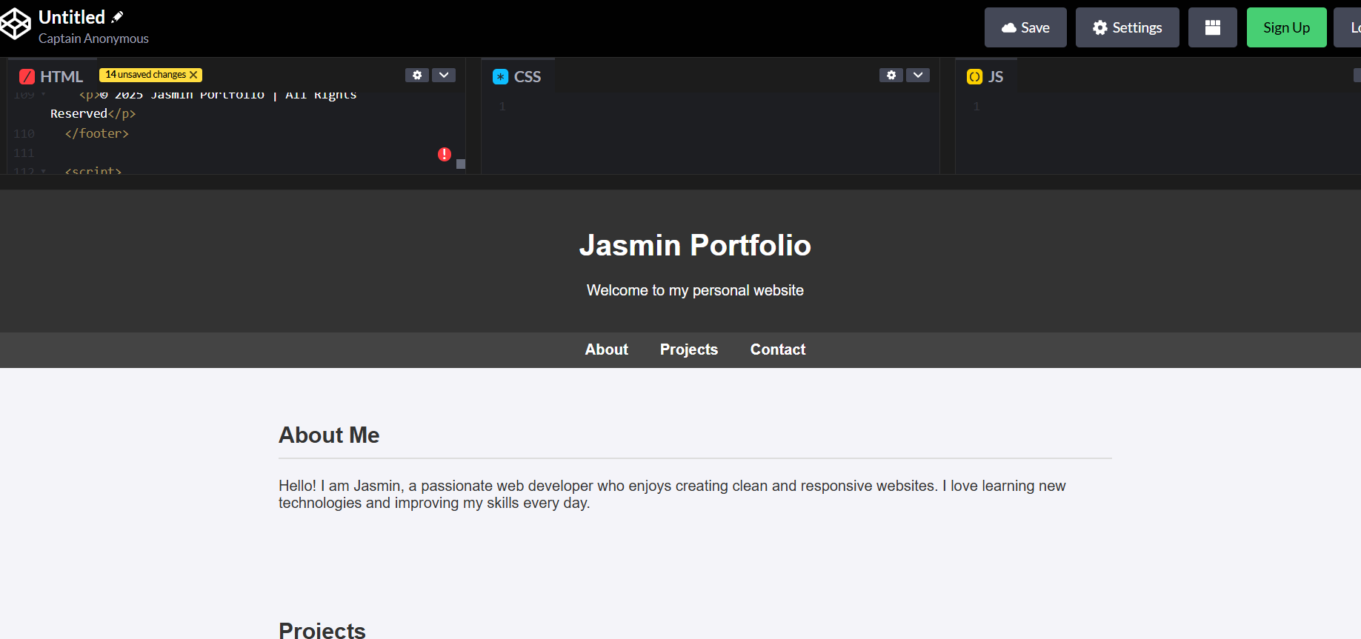

RESULTS AND SCREENSHOTS
3/21/2024 Annual Review
10

Slide 11
CONCLUSION
Jasmin’s portfolio website effectively showcases her skills, projects, and contact information in a clean, responsive layout. With simple navigation and interactive elements, it serves as a professional digital presence for attracting clients, collaborators, and employers. Enhancing it with more features like a contact form or project links can further boost its impact.
11

